Slide 1
AI RESUME STUDIO
Bachelor In Computer Applications (BCA)
Project Title : AI RESUME STUDIO
Student Name : Vansh Khandekar
Class : Bachelor In Computer Applications (BCA)
Guide Name : Prof. R.K. Sharma
College : JANAPRABHA COLLEGE, RAMTEK
Date : April 2026
1/15

Slide 2
Table of Contents
1) Introduction
7) Functional Modules
2) Problem Definition
8) Database Design & Data Modeling
3) Objectives & Design Goals
9) Implementation Strategy
4) Scope & Constraints
10) Outputs
5) System Architecture
11) Future Enhancements
6) Technology Stack
12) References
2/15

Slide 3
1. Introduction
Modernizing the job application process with AI
AI Resume Studio is a next-generation platform designed to help job seekers create highly competitive, ATS-optimized resumes. By integrating Large Language Models, the system provides intelligent content suggestions, real-time scoring, and high-fidelity PDF exports. It bridges the gap between raw professional experience and the sophisticated requirements of modern Applicant Tracking Systems.
✦ Modular Design
✦ Real-time Scoring
✦ AI-Powered Writing
✦ Cloud-Native Flow
3/15

Slide 4
2. Problem Definition
Why traditional resume building is broken
⚠️
🚫
😶
⏳
Formatting Chaos
ATS Rejection
Writer's Block
Time Consuming
Word layouts break across devices & ATS parsers
80% of resumes are rejected by ATS before human review
Candidates struggle to articulate achievements professionally
Manual formatting takes 3–5 hours per resume version
4/15

Slide 5
3. Objectives
Designing a user-centric AI career assistant
🎯
🤖
🎨
📥
ATS Optimization
AI Integration
UI/UX Excellence
Seamless Export
100% compliance with modern ranking algorithms
Leveraging LLMs for smart content auditing
Premium, interactive resume builder interface
Watermark-free, professional PDF delivery in seconds
5/15

Slide 6
4. Scope & Constraints
Defining project boundaries and limits
🛠️ Project Scope
⚠️ Constraints
▸ Multi-template Support
▸ Internet Dependency
▸ Multi-section Builder
▸ API Token Limits
▸ AI Summary Generator
▸ Single Page Export
▸ Keyword Optimization
▸ English Language focus
▸ Cloud Persistence
▸ Static Assets only
6/15

Slide 7
5. System Architecture
Cloud-native, three-tier scalable infrastructure
👤
⚙️
🗄️
───▶
───▶
React UI
API Gateway
Supabase DB
Optimistic state Client-side logic
Deno Edge Functions Claude-3 Integration
PostgreSQL JSONB Row Level Security
7/15

Slide 8
6. Technology Stack
Built with modern, production-grade tools
⚛️ FRONTEND
⚙️ BACKEND
🛠️ DEPLOYMENT
▸ React 18
▸ Supabase (Postgres)
▸ Git & GitHub
▸ TypeScript
▸ Edge Functions
▸ Vercel CI/CD
▸ Vite 5
▸ Claude-3 API
▸ ESLint + Prettier
▸ Tailwind CSS 3
▸ JWT Auth
▸ React Query
▸ Shadcn UI
▸ PostgreSQL JSONB
▸ jsPDF Export
▸ Lucide Icons
8/15

Slide 9
7. Functional Modules
Core system capabilities and key features
🤖
📊
AI Content Engine
ATS Scoring
LLM-driven rewriting and professional auditing
Real-time ranking heuristics and keyword analysis
⚡
📥
Modular Builder
PDF Generator
Dynamic form builder with document state persistence
One-click, high-fidelity export with typography
9/15

Slide 10
8. Database & Data Modeling
Schema integrity and JSONB data persistence
• Profiles
▸ User authentication and baseline metadata
• Resumes
▸ The core entity storing resume JSONB structures
• Sections
▸ Dynamic section configurations and visibility flags
• Audit Logs
▸ Tracking AI credit usage and history
10/15

Slide 11
9. Implementation Strategy
Iterative development and deployment flow
1
2
3
4
Phase 1
Phase 2
Phase 3
Phase 4
Database schema setup & Authentication layer init
Core Builder UI & State Management with React Context
AI Edge Functions & Gemini API Integration
PDF Export Engine & Final UAT Deployment
11/15

Slide 12
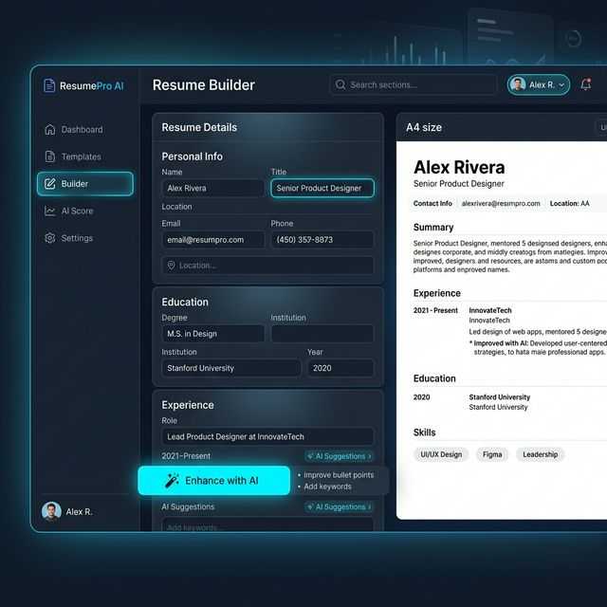
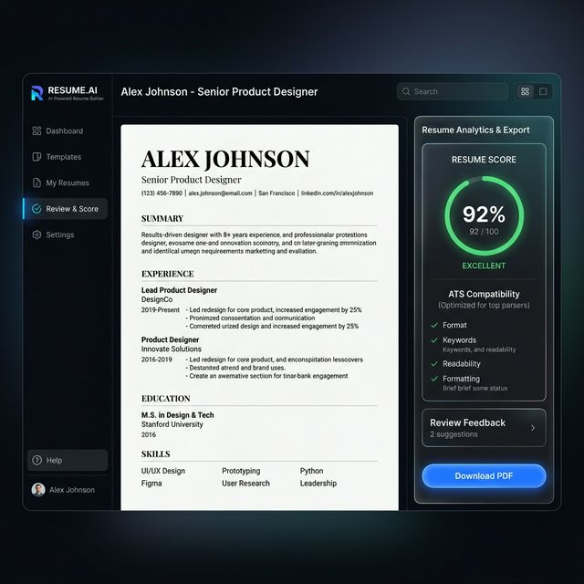
10. Product Outputs
Glimpse of the final application interface
12/15

Slide 13
11. Future Enhancements
Expanding the horizons of AI career tools
🔗
✉️
🎨
🌐
LinkedIn Import
Cover Letters
Custom Themes
Job Submission
One-click data Sync
Auto-Gen per Job
CSS-level control
Direct ATS upload
13/15

Slide 14
References
• React Documentation (react.dev) — Component architecture
• Supabase Auth & DB (supabase.com) — Backend infrastructure
• Anthropic Claude 3 Opus API — AI content generation logic
• Tailwind CSS — Utility-first styling framework
• 'Building Resumes with AI' (Medium 2024) — ATS Heuristics
• GitHub: AI Resume Studio Open Source Repository
14/15

Slide 15
Thank You!
Questions & Discussion
Vansh Khandekar • Bachelor In Computer Applications (BCA) • 2025–26
Built with React • TypeScript • Gemini AI • Supabase
15/15

