Slide 1

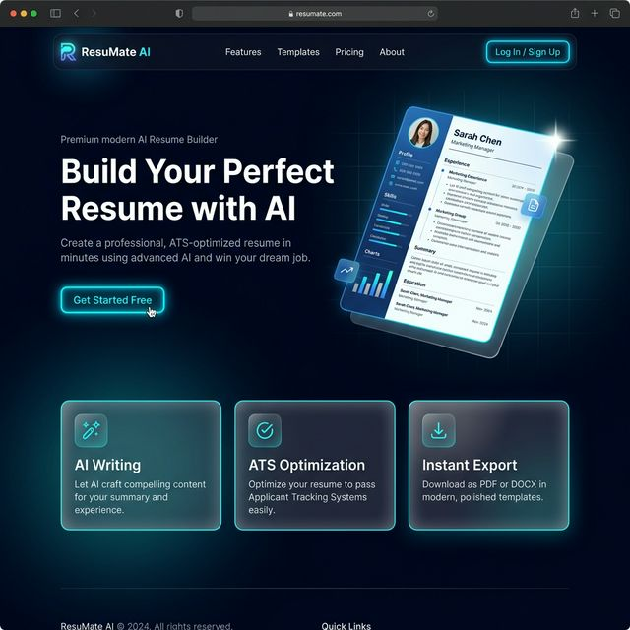
Antigravity Resume Studio
AI-Powered Resume Builder • Final Year Project
👤 Vansh Khandekar
🎓 Final Year • B.Tech / BCA / MCA
🏛️ [Your College Name]
📅 Academic Year 2025–26
1/9

Slide 2
The Problem
Why traditional resume building is broken
⚠️
🚫
😶
⏳
Formatting Chaos
ATS Rejection
Writer's Block
Time Consuming
Word/Docs layouts break across devices & ATS parsers
80% of resumes are rejected by ATS before a human ever sees them
Candidates struggle to articulate achievements professionally
Average resume takes 3–5 hours to format and write properly
75%
3.5 hrs
62%
89%
resumes rejected by ATS systems
average time to build a resume
candidates lack writing confidence
prefer AI-assisted resume tools
2/9

Slide 3
Our Solution
An intelligent, AI-first approach to resume creation
👤
🤖
📄
───▶
───▶
User Input
AI Engine
Smart Resume
Enter basic info, education & notes
Gemini processes & enhances content
ATS-optimized, beautifully formatted
✨ Result: Professional, ATS-friendly resumes generated in under 2 minutes
No design skills needed • No subscription required • 100% free & open source
3/9

Slide 4
Key Features
Everything you need for the perfect resume
🤖
📊
⚡
AI Content Generation
ATS Score Optimizer
Instant Formatting
Google Gemini rewrites your notes into polished, action-oriented bullets
Real-time scoring engine ensures your resume passes every ATS
Auto-adjusting layouts with professional typography & spacing
👁️
📥
🎨
Live Preview
One-Click PDF Export
Premium Templates
See every change instantly rendered on a live resume canvas
High-resolution, watermark-free PDF in a single click
Multiple ATS-friendly templates designed by UI/UX professionals
4/9

Slide 5
Technology Stack
Built with modern, production-grade tools
⚛️ FRONTEND
⚙️ BACKEND & DATA
🛠️ TOOLS & DEPLOY
▸ React 18
▸ Supabase (PostgreSQL)
▸ Git & GitHub
▸ TypeScript
▸ Row Level Security
▸ Vercel (CI/CD)
▸ Vite 5
▸ Edge Functions
▸ ESLint + Prettier
▸ Tailwind CSS 3
▸ Google Gemini API
▸ Vitest (Testing)
▸ Shadcn UI + Radix
▸ React Query
▸ React Hook Form
▸ Lucide React Icons
▸ Zod Validation
▸ jsPDF Export
5/9

Slide 6
How It Works
From raw input to polished resume in 4 simple steps
1
2
3
4
User Input
▶
AI Enhancement
▶
Live Preview
▶
Score & Export
Fill in personal details, education, work experience via guided multi-step form
Gemini AI rewrites raw notes into professional, action-driven bullet points
Instant rendering of formatted resume with chosen ATS template
Get ATS compatibility score, then one-click export to PDF
⚡ End-to-end flow completes in under 2 minutes — no design skills required
The multi-step guided form ensures completeness • AI suggestions are editable before export • Resume score gives actionable improvement tips • PDF output is printer-ready at 300 DPI
6/9

Slide 7
Product Interface
Landing Page & Onboarding
Navigation
Hero CTA
Feature Cards
7/9

Slide 8
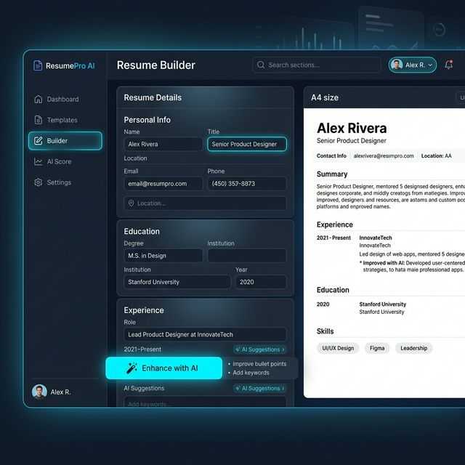
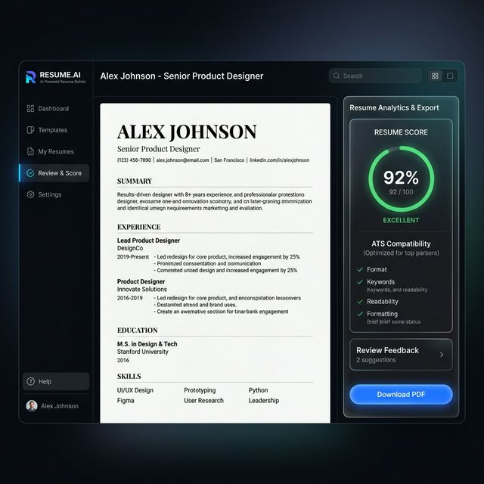
Product Interface
Resume Builder & AI Score Dashboard
Resume Builder (Form + Live Preview)
AI Score & Export Dashboard
8/9

Slide 9
Advantages & USP
Why this stands out from alternatives
✅ Antigravity Resume Studio
❌ Traditional Resume Builders
▸ 100% Free & Open Source — no paywalls, ever
▸ Expensive subscriptions ($8–30/month)
▸ Deep AI integration via Google Gemini NLP
▸ Basic formatting with no AI writing help
▸ Instant live preview with zero page reloads
▸ Slow, server-rendered preview cycles
▸ Client-side first — your data stays with you
▸ User data sold to third-party advertisers
▸ ATS scoring engine with actionable feedback
▸ No real ATS analysis — false confidence
▸ Modern React UI — feels like a premium SaaS
▸ Generic templates used by millions
▸ One-click PDF export (watermark-free)
▸ Watermarks on free-tier PDF exports
9/9

Slide 10
Conclusion & Future Scope
📌 Project Summary
Antigravity Resume Studio successfully demonstrates a scalable, AI-first approach to resume building. By combining Google Gemini's NLP capabilities with a modern React frontend and Supabase backend, the platform delivers a seamless experience that rivals paid SaaS products — completely free.
🔮 Future Scope
🔗
✉️
🎨
🌐
LinkedIn Import
Cover Letter AI
Custom CSS Editor
Job Matching
One-click profile import for instant resume creation
Auto-generate tailored cover letters per job
Let power users design their own templates
Direct ATS submission to partner employers
10/9

Slide 11
Thank You!
Questions & Discussion
Vansh Khandekar • Final Year Project • 2025–26
Built with React • TypeScript • Gemini AI • Supabase

