Slide 1
Encryptor Decryptor cum Messaging app
Project by :
Vansh Pundir (2110993856)
Advitiya Bharti Gupta (2110993858)

Slide 2
What is Encryptor and Decryptor ?
Encryptor is basically an algorithm designed to convert simple text to cipher text.
Decryptor is an algorithm basically to convert cipher text into simple text.

Slide 3
Why Encryptor Decryptor ?
Secures data
Securing privacy
Cyber attacks
Prevents data leakage/breaches

Slide 4
Messaging Application
This application can be used to send or receive a text from the other server.
The user can send an encrypted text which can be received by the other server and can be decoded using the same pin used by the user to encrypt the same or vice versa.

Slide 5
Base64 module:
It is a type of conversion of bytes to ASCII characters. the list of available Base64 characters are mentioned below:
26 uppercase letters
26 lowercase letters
10 numbers
+ and / for new lines
Base64 encoding is a process of converting binary data to an ASCII string format by converting that binary data into a 6-bit character representation. The Base64 method of encoding is used when binary data, such as images or video, is transmitted over systems that are designed to transmit data in a plain-text (ASCII) format.

Slide 6
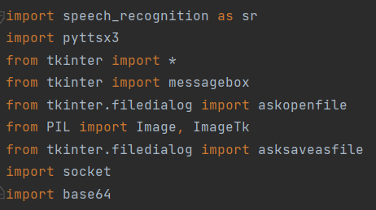
Modules used:
Tkinter
Pillow
Base64
pyttsx3
Socket
Speech_recognition

Slide 7
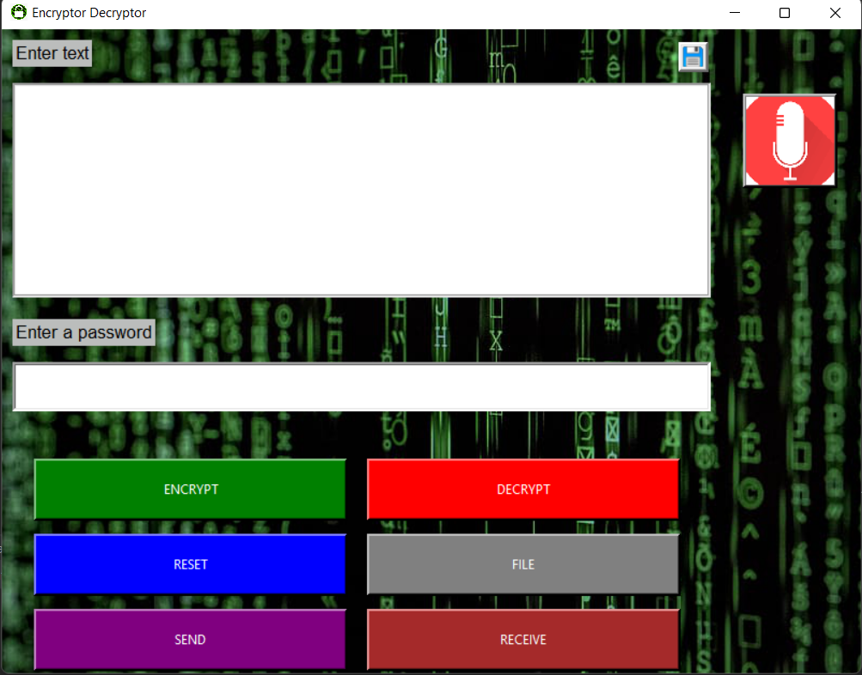
Frontend
7 - Buttons
1 - Entry box
2 – Labels
1 – textbox
1 – Mic Button

Slide 8
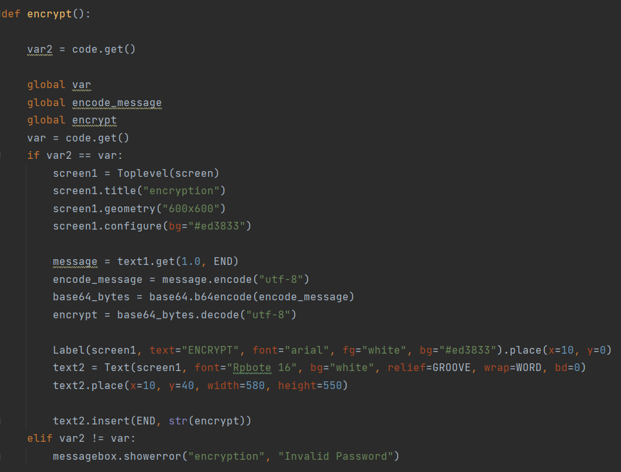
Screenshots of the functions defined:
Encrypt:

Slide 9
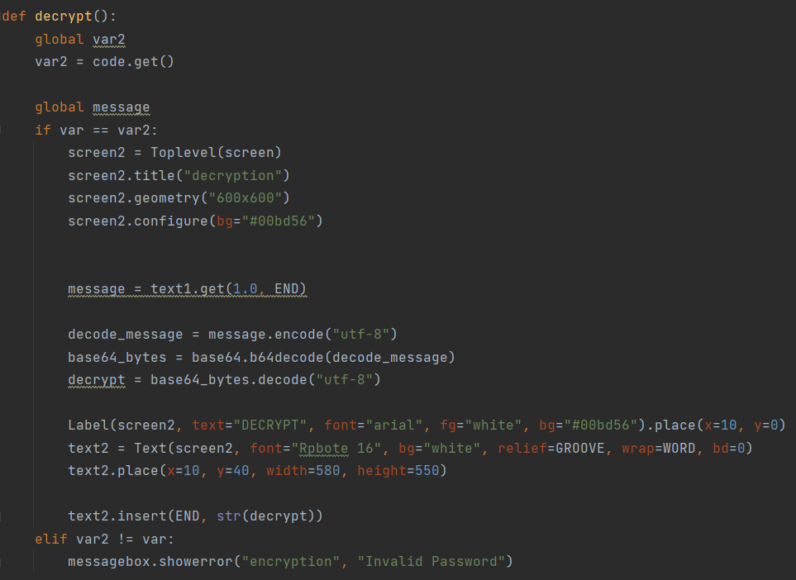
Decrypt:

Slide 10
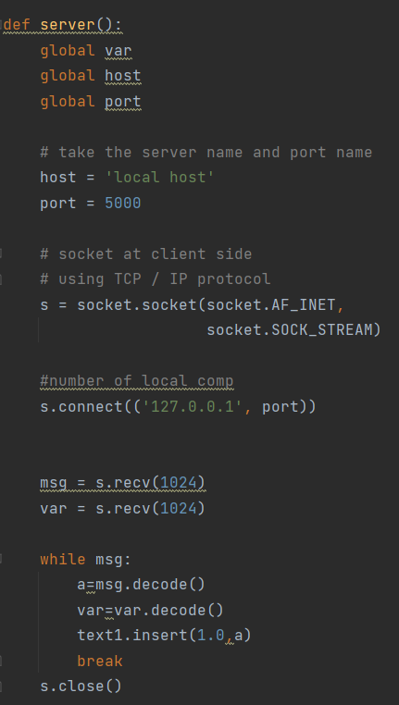
Server:

Slide 11
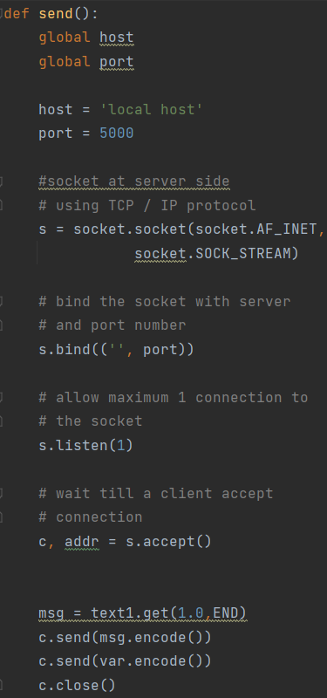
send:

Slide 12
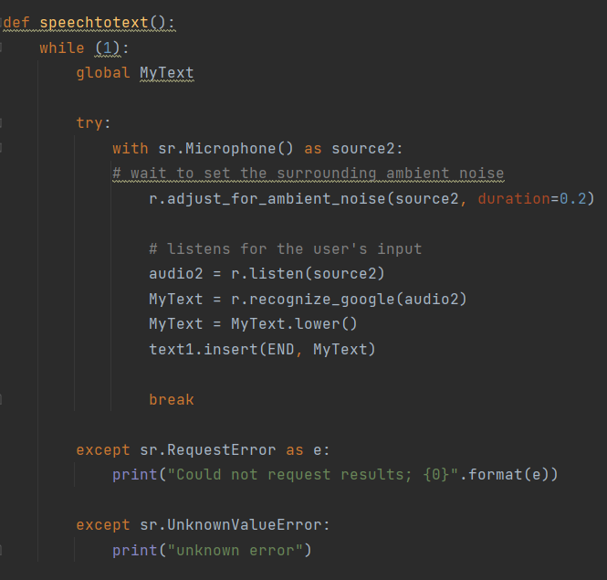
Speechtotext

Slide 13
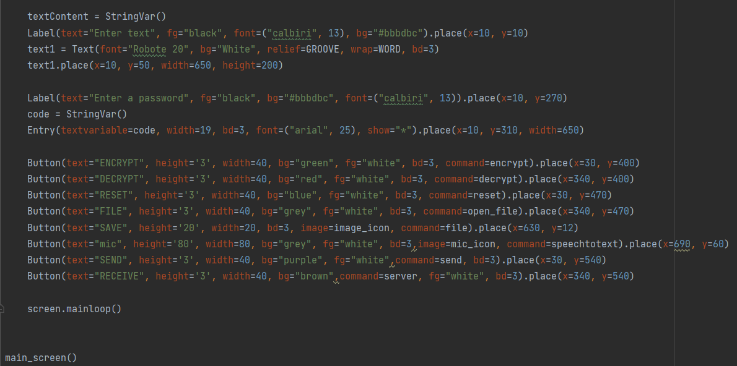
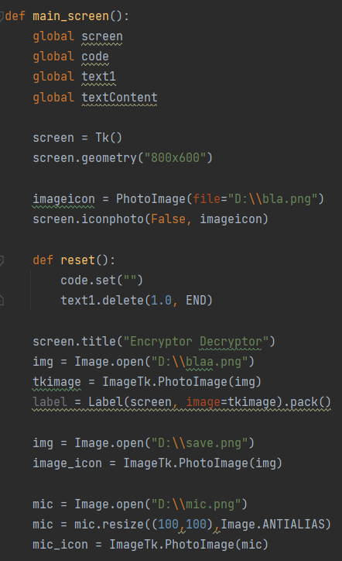
main_screen:

Slide 14
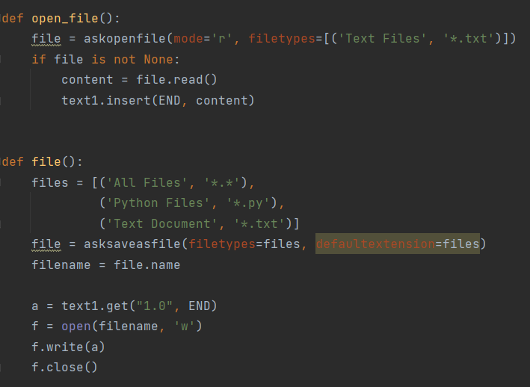
file and open_file:

Slide 15


