Slide 1
Smart Rental Tracker
SRT
AI-Powered Equipment Rental Management System
"Revolutionizing Equipment Rental Management with ML-Powered Intelligence"
Real-time tracking, demand forecasting, and anomaly detection for construction & mining industries
Team Synergy

Slide 2




Problem Statement
SRT
The Challenge:
Equipment rental industry worth $82.6 billion by 2025, faces critical inefficiencies
30% idle time rate of construction equipment, causing massive revenue loss
Equipment theft costs industry $300M-$1B annually
No real-time visibility into equipment performance and demand patterns
Why It Matters:
Construction delays cost $1.5M per day on large projects
Environmental impact of underutilized heavy machinery
Safety risks from unmaintained or improperly tracked equipment
Predictive maintenance can reduce downtime by 40%
Real-World Impact:
A construction company lost $500K due to 3 excavators sitting idle for 2 months
Mining operation delayed by 3 weeks waiting for available equipment

Slide 3
Our Solution
SRT
Smart Rental Tracker - An ML-powered platform that provides real-time equipment monitoring, predictive demand forecasting, and intelligent anomaly detection to maximize equipment utilization and minimize operational costs.
What Makes Us Unique:
ML-Powered Demand Forecasting
Predicts equipment needs 30 days in advance, allowing optimal resource planning
Real-time Anomaly Detection
Identifies misuse, underutilization, and operational issues
instantly
Smart Utilization Analytics
Optimizes equipment allocation across multiple sites for maximum efficiency
Predictive Maintenance Insights
Reduces downtime by 40% and extends equipment lifespan
Notes:
Innovation Factor:
Machine Learning models trained on real construction data
Real-time telemetry simulation for comprehensive testing
Integration of IoT concepts for future scalability
Predictive analytics for proactive decision-making

Slide 4
















Tech Stack
SRT
Frontend
Next.js 14 - Modern React framework with SSR Tailwind CSS - Utility-first CSS framework Chart.js - Interactive data visualization TypeScript - Type-safe development
Backend
FastAPI - High-performance Python framework SQLAlchemy - Python ORM for database operations PostgreSQL/SQLite - Flexible database options Pydantic - Data validation and serialization
Machine Learning
Scikit-learn - Anomaly detection & forecasting Pandas & NumPy - Data manipulation and analysis Isolation Forest - Anomaly detection algorithm
Random Forest - Demand prediction model
DevOps & Tools
Python 3.12 - Backend and ML development
Node.js 18+ - Frontend development
Git - Version control
Virtual Environments - Dependency management

Slide 5
System Architecture & Workflow
SRT
Frontend
(Next.js)
Backend
(FastAPI)
ML System
(Python)
User Interface
Data Storage (SQL Alchemy)
ML Models Storage
Interactive Charts
User Controls
Usage Data
Telemetry
Predictions
Analytics
Data Flow:
Data Input
CSV files with equipment data
ML Processing
Analysis & forecasting
API Layer
Request handling
Frontend
Dashboard updates
User Actions
Equipment management
1
2
3
4
5

Slide 6






Prototype Highlights
SRT
Key Features Demonstrated:
Real-time Dashboard: Live equipment count, status, utilization metrics, alerts
Equipment Management: Add/edit assets, track status, monitor usage patterns
ML-Powered Insights: Anomaly detection, demand forecasting, performance analytics
User Experience: Responsive design, intuitive controls, real-time updates
AI Insights:
Anomaly Detection: Identifies high idle time, low utilization, unused equipment
Demand Forecasting: Predicts equipment needs 30 days ahead
Performance Analytics: Equipment efficiency scores and recommendations
Cost Optimization: Rental duration and allocation insights

Slide 7
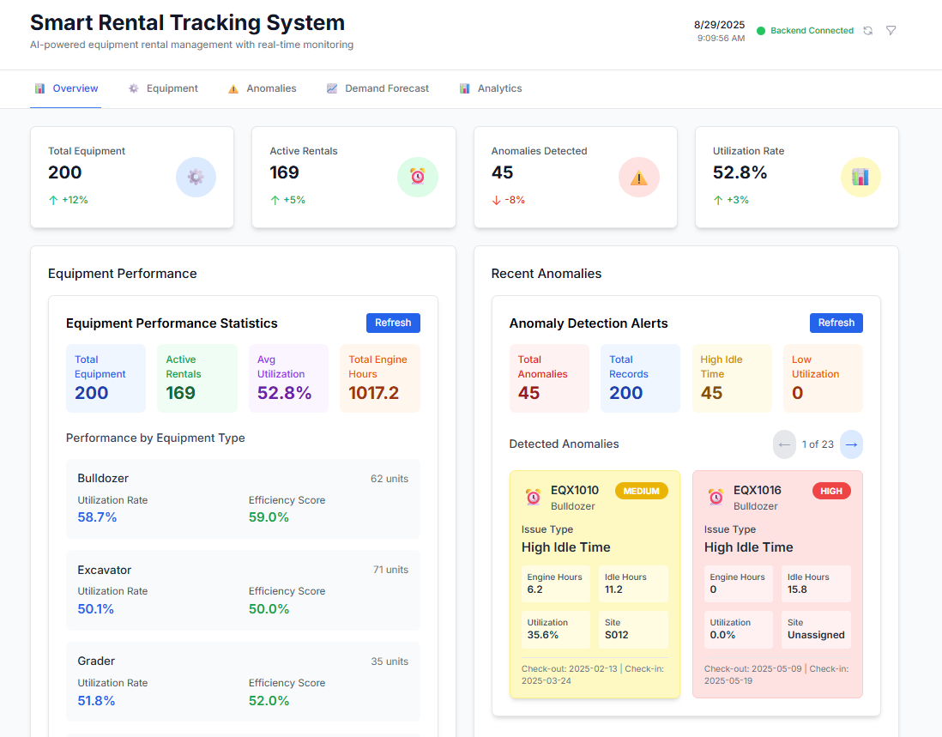
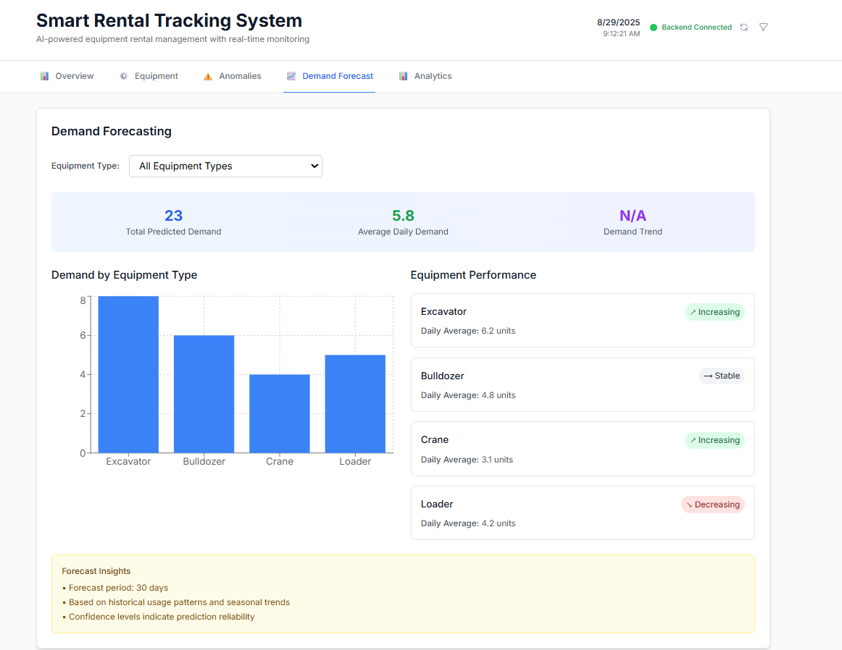
Dashboard Highlights
SRT

Slide 8













Impact & Benefits
SRT
Construction Companies
15-25% increase in equipment utilization
20-30% reduction in rental costs
Faster project completion with optimized equipment allocation
Real-time visibility into equipment performance
Mining Operations
Predictive maintenance reduces downtime by 40% Demand forecasting prevents equipment shortages Cost optimization through better resource planning Safety improvements with proper equipment tracking
Environmental Impact
Reduced carbon footprint through better utilization Less equipment waste and over-purchasing Sustainable resource management practices Efficient logistics and transportation
Economic Benefits
$50K - $500K annual savings for mid-size companies
ROI of 300-500% within first year
Reduced insurance costs with better tracking
Improved compliance and regulatory adherence

Slide 9


Challenges Faced
SRT
Technical Challenges
ML Model Integration: Connecting scikit-learn models with FastAPI backend in limited time
Real-time Data Processing: Handling large datasets and live updates efficiently
Frontend-Backend Sync: Maintaining real-time connection status and data consistency
Responsive Design: Creating mobile-friendly interface for field workers
Solutions Implemented
Created modular ML system with dedicated REST API endpoints
Implemented data streaming and caching
mechanisms
Added polling mechanisms and connection state management
Used Tailwind CSS with mobile-first approach
Key Lessons Learned
API-first design is critical for ML integration
Robust error handling improves client satisfaction
Performance optimization is crucial for user experience
UX requirements vary significantly across devices

Slide 10












Future Scope
SRT
6-Month Roadmap - Phase 2 Enhancements
IoT Integration
Real-time GPS tracking and geofencing
Sensor data integration (fuel, temperature, vibration) Automated check-in/check-out with RFID/NFC
Mobile Applications
Native iOS and Android apps Offline capability for remote sites Push notifications for critical alerts
Advanced AI Features
Deep learning models for better predictions Computer vision for equipment damage detection Natural language processing for report generation
Enterprise & Integrations
Multi-tenant architecture & advanced role-based access
ERP systems, accounting software & project management tool integration
Weather API for demand forecasting & equipment manufacturer APIs

Slide 11

Conclusion & Call to Action
SRT
Project Summary:
Problem: Equipment rental industry loses billions due to poor utilization and manual tracking Solution: AI-powered platform with real-time monitoring, demand forecasting, and anomaly detection Impact: 15-25% increase in utilization, 20-30% cost reduction, improved project efficiency
Key Achievements:
Complete full-stack application
ML-powered anomaly detection & forecasting Real-time interactive dashboard
Responsive design for all devices
Next Steps:
Visit our live demo platform
Schedule a personalized consultation Explore technical documentation
Join our early adopter program
Thank You!
https://github.com/Kshitij83/smart-rental-tracker

