Slide 1
SQL Concepts & Queries- Lab
SQL COMMANDS

Slide 2
SQL COMMANDS
SQL commands are instructions.
It is used to communicate with the database.
It is also used to perform specific tasks, functions, and queries of data.
SQL can perform various tasks like create a table, add data to tables, drop the table, modify the table, set permission for users.

Slide 3
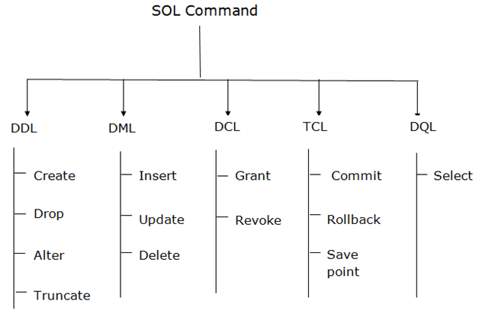
Types of SQL Commands
Call
Lock

Slide 4
DDL (Data Definition Language)
Data Definition Language is used to define the database structure or schema.
DDL is also used to specify additional properties of the data.

Slide 5
DDL (Data Definition Language)
CREATE - To create a database and its objects like (table, index, views, store procedure, function, and triggers)
ALTER - Alters the structure of the existing database
DROP - Delete objects from the database
TRUNCATE - The TRUNCATE statement in MySQL removes the complete data without removing its structure.
COMMENT - Add comments to the data dictionary
RENAME - Rename an object

Slide 6
Alter Command
ADD Column:
DROP Column:
Syntax:
ALTER TABLE table_name ADD column_name datatype;
Syntax:
ALTER TABLE table_name DROP column column_name;

Slide 7
Alter Command
MODIFY Column:
Syntax:
ALTER TABLE table_name MODIFY COLUMN column_name datatype;

Slide 8
TRUNCATE Command
TRUNCATE table:
Syntax:
TRUNCATE [TABLE] table_name;

Slide 9
Lock Command
LOCK [ TABLE ] [ ONLY ]
table_name
[ IN lock_mode MODE ] [ NOWAIT ];
The parameters used in the above-mentioned syntax are as follows:
table_name: Name of the table on which you want to apply LOCK.
lock_mode: The kind of lock you want to place on the table. You may choose one from {access share. row share, share update exclusive, share, exclusive, access exclusive, row exclusive, share row exclusive}. Each mode serves a different purpose.

Slide 10
COMMENT
Single Line Comments:
Multi-line Comments:
-- Select all: SELECT * FROM Customers;
/*Select all the columns of all the records in the Customers table:*/ SELECT * FROM Customers;

Slide 11
RENAME table
Syntax:
ALTER TABLE table_name RENAME TO new_table_name;

