Slide 1
Basic Concepts of RDBMS
RDBMS stands for Relational Database Management System.
RDBMS concepts are a basic requirement to understand SQL and all other modern database examples: MS Access, SQL, MS SQL Server, etc.
A Relational database management system (RDBMS) is a database management system (DBMS) that is based on the relational model as introduced by E. F. Codd in 1970.

Slide 2
RDBMS COMPONENTS
TABLE
COLUMN
(ATTRIBUTE)
TUPLE
(A RECORD)
RDBMS
SCHEMA
DOMAIN
CONSTRAINTS

Slide 3
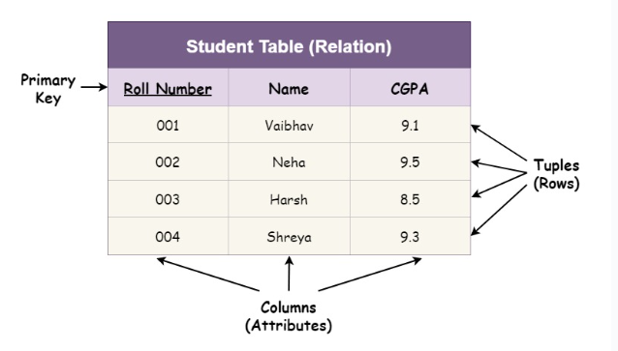
Example:-

Slide 4
Relational Model Concept
Relational model can represent as a table with columns and rows. Each row is known as a tuple. Each table of the column has a name or attribute.
Domain: It contains a set of atomic values that an attribute can take.
Attribute: It contains the name of a column in a particular table. Each attribute Ai must have a domain, dom(Ai)
Relational instance: In the relational database system, the relational instance is represented by a finite set of tuples. Relation instances do not have duplicate tuples.
Relational schema: A relational schema contains the name of the relation and name of all columns or attributes.
Relational key: In the relational key, each row has one or more attributes. It can identify the row in the relation uniquely.

Slide 5
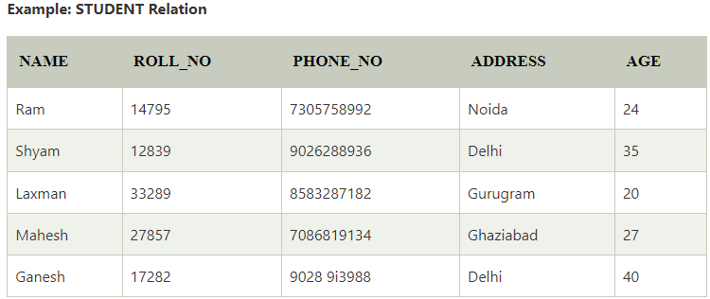
In the given table, NAME, ROLL_NO, PHONE_NO, ADDRESS, and AGE are the attributes.
The instance of schema STUDENT has 5 tuples.

Slide 6
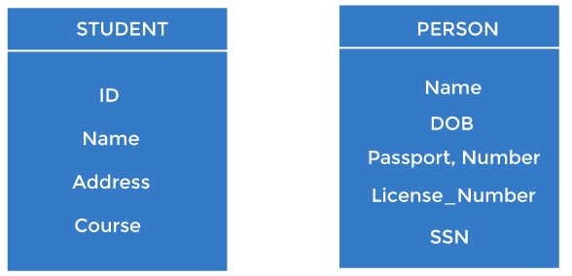
Keys
Keys play an important role in the relational database.
It is used to uniquely identify any record or row of data from the table. It is also used to establish and identify relationships between tables.
For example, ID is used as a key in the Student table because it is unique for each student. In the PERSON table, passport, number, license, number, SSN are keys since they are unique for each person.

Slide 7
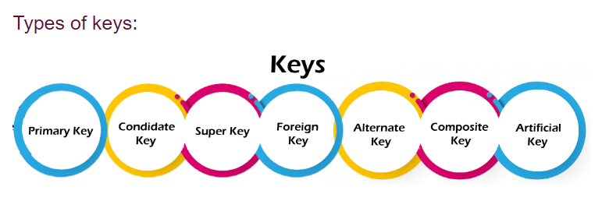

Slide 8
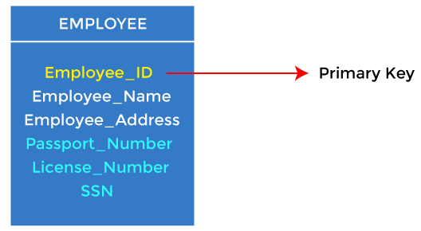
1. Primary key
It is the first key used to identify one and only one instance of an entity uniquely. An entity can contain multiple keys.
In the EMPLOYEE table, ID can be the primary key since it is unique for each employee. In the EMPLOYEE table, we can even select License_Number and Passport_Number as primary keys since they are also unique.

Slide 9
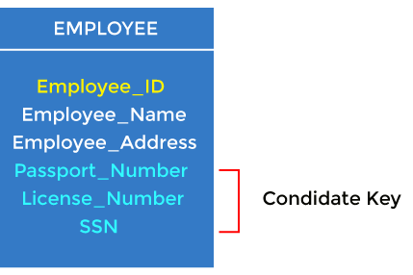
2. Candidate key
A candidate key is an attribute or set of attributes that can uniquely identify a tuple.
Except for the primary key, the remaining attributes are considered a candidate key. The candidate keys are as strong as the primary key.
For example: In the EMPLOYEE table, id is best suited for the primary key. The rest of the attributes, like SSN, Passport_Number, License_Number, etc., are considered a candidate key.

Slide 10
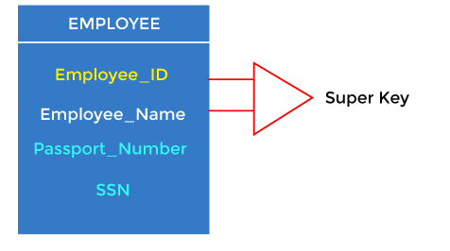
3. Super Key
Super key is an attribute set that can uniquely identify a tuple. A super key is a superset of a candidate key.
For example: In the above EMPLOYEE table, for(EMPLOEE_ID, EMPLOYEE_NAME), the name of two employees can be the same, but their EMPLYEE_ID can't be the same. Hence, this combination can also be a key. The super key would be EMPLOYEE-ID (EMPLOYEE_ID, EMPLOYEE-NAME), etc.

Slide 11
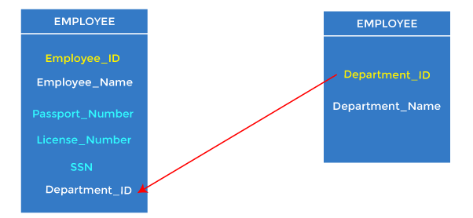
4. Foreign key
Foreign keys are the column of the table used to point to the primary key of another table.
Example :- Every employee works in a specific department in a company, and employee and department are two different entities. So we can't store the department's information in the employee table. That's why we link these two tables through the primary key of one table.
In the EMPLOYEE table, Department_Id is the foreign key, and both the tables are related.

Slide 12
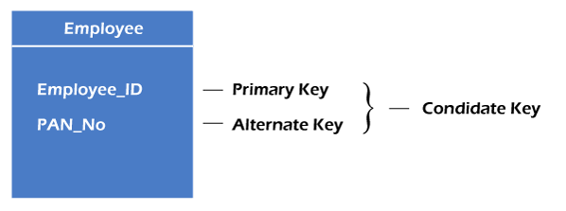
5. Alternate key
There may be one or more attributes or a combination of attributes that uniquely identify each tuple in a relation. These attributes or combinations of the attributes are called the candidate keys. One key is chosen as the primary key from these candidate keys, and the remaining candidate key, if it exists, is termed the alternate key.
For example- employee relation has two attributes, Employee_Id and PAN_No, that act as candidate keys. In this relation, Employee_Id is chosen as the primary key, so the other candidate key, PAN_No, acts as the Alternate key.

Slide 13

6. Composite key
Whenever a primary key consists of more than one attribute, it is known as a composite key. This key is also known as Concatenated Key.
For example, in employee relations, we assume that an employee may be assigned multiple roles, and an employee may work on multiple projects simultaneously. So the primary key will be composed of all three attributes, namely Emp_ID, Emp_role, and Proj_ID in combination. So these attributes act as a composite key since the primary key comprises more than one attribute.

Slide 14
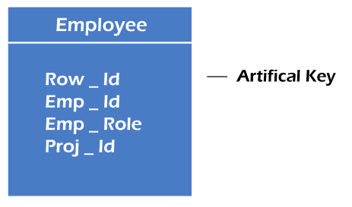
7. Artificial key
The key created using arbitrarily assigned data are known as artificial keys. These keys are created when a primary key is large and complex and has no relationship with many other relations. The data values of the artificial keys are usually numbered in a serial order.
For example, the primary key, which is composed of Emp_ID, Emp_role, and Proj_ID, is large in employee relations. So it would be better to add a new virtual attribute to identify each tuple in the relation uniquely.

Slide 15
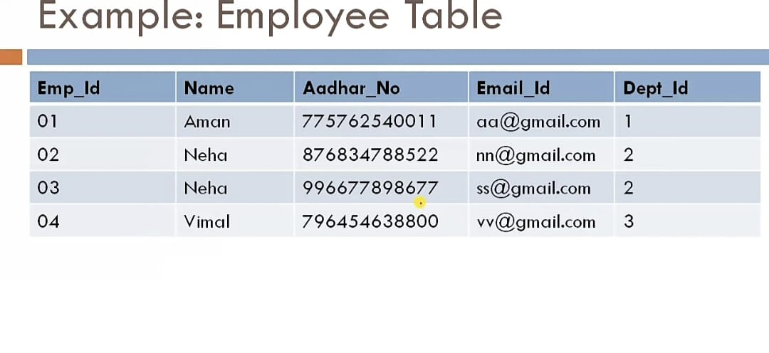

Slide 16
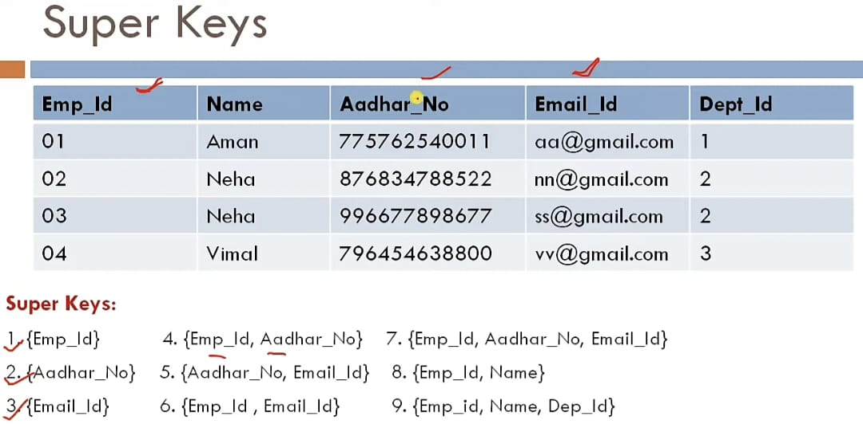

Slide 17
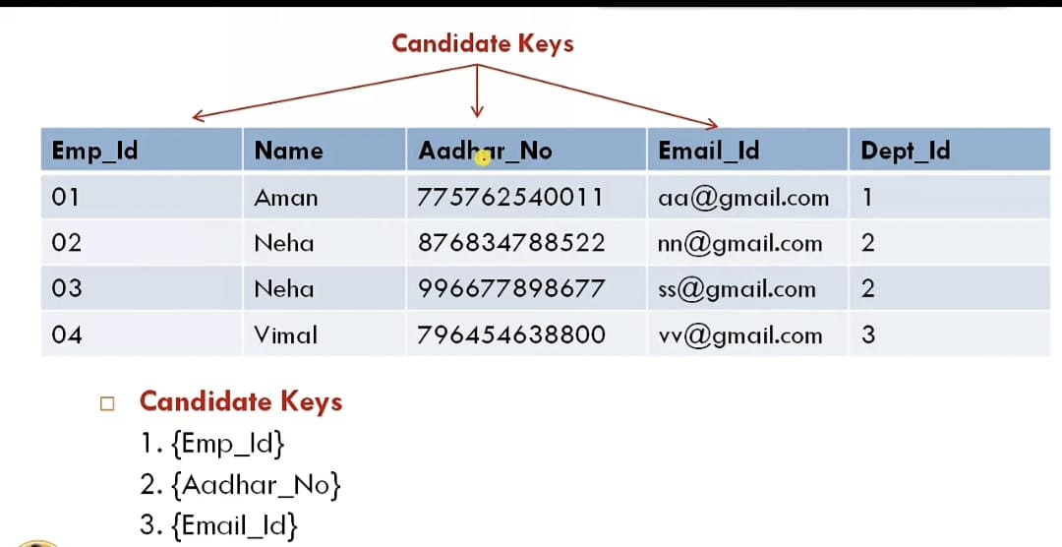

Slide 18
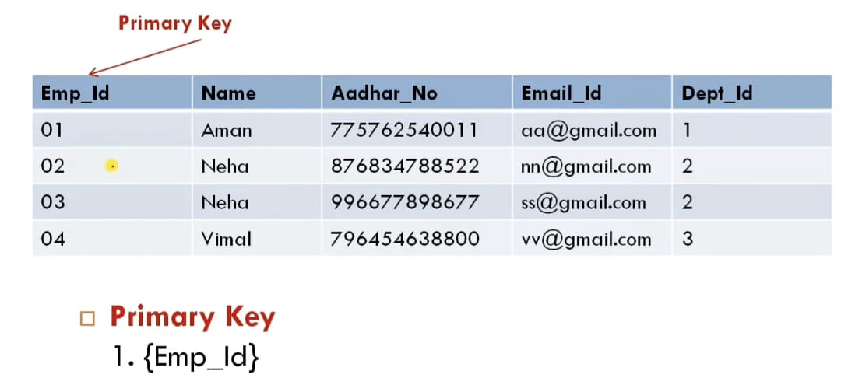

Slide 19
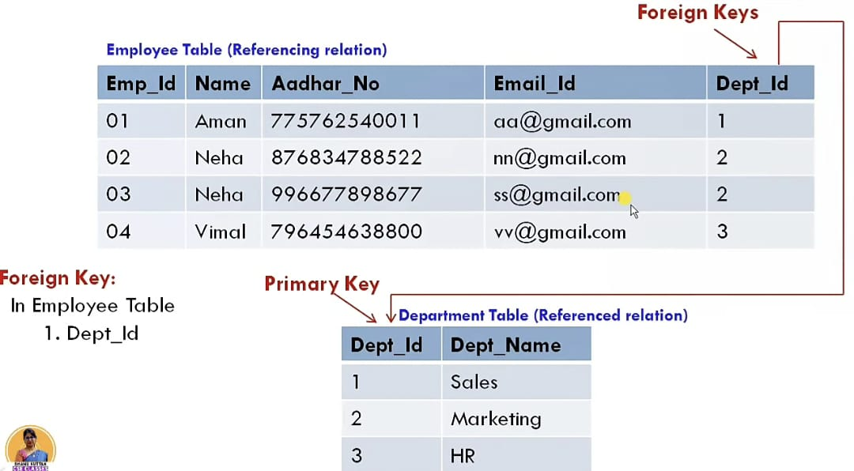

Slide 20
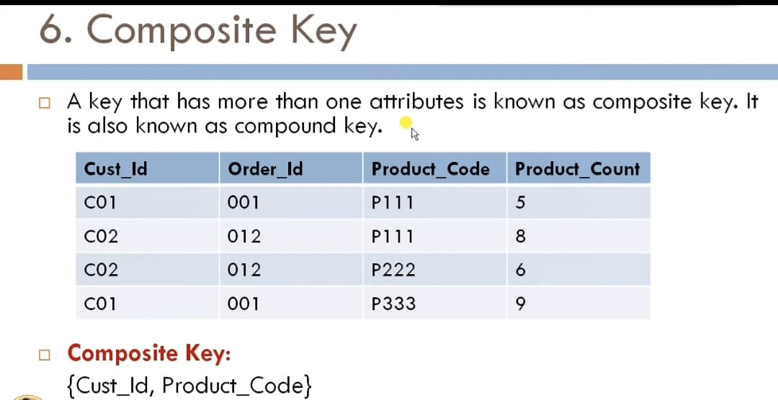

Slide 21
