Slide 1
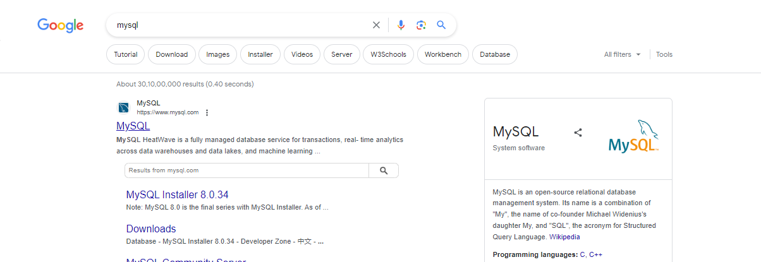
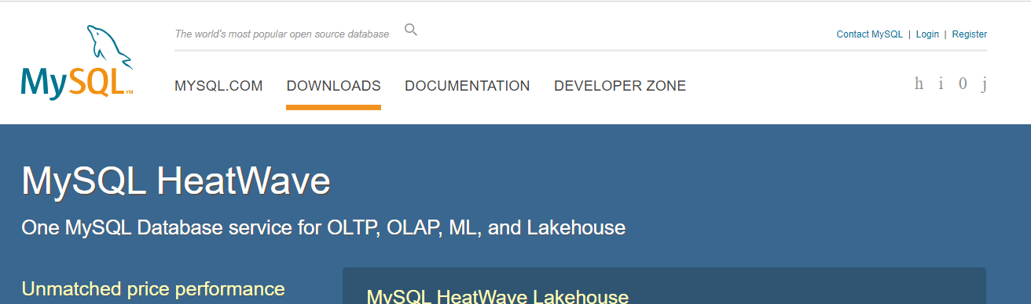
SQL –Workbench –installation process (STEPS related to path setup or other Mysql related issues)
Step 1 – Search On Google Mysql, Click on first link- and click on download

Slide 2
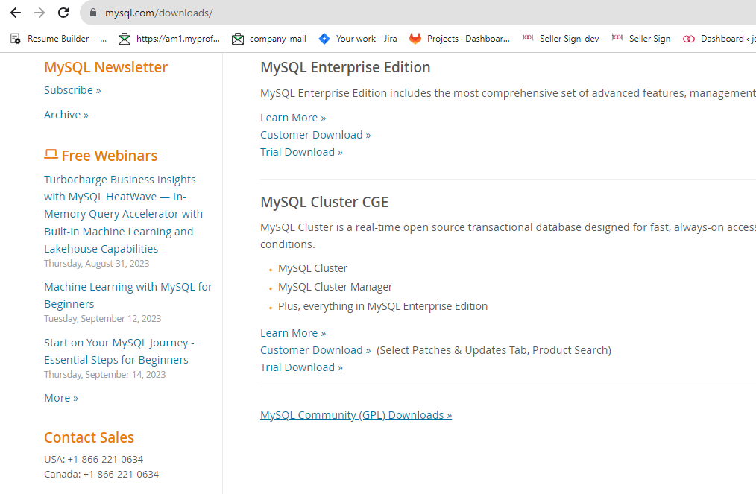
Select community server

Slide 3
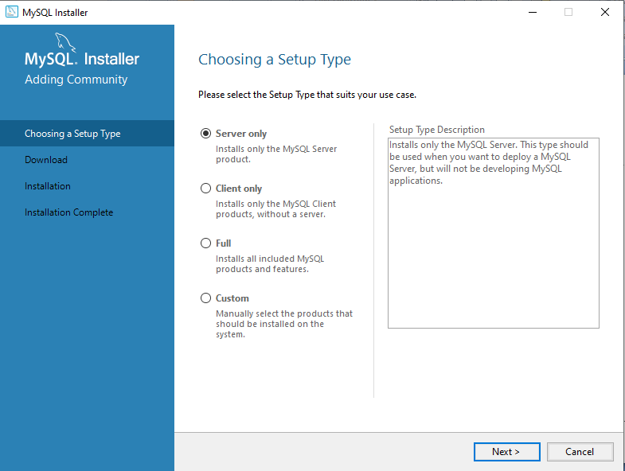
Install Mysql as per your need Please follow the steps to install that you run in your BA classes

Slide 4
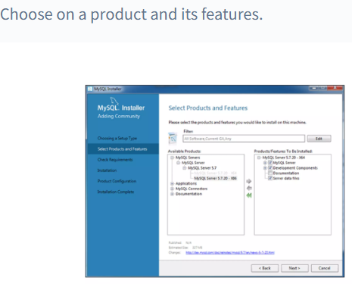

Slide 5
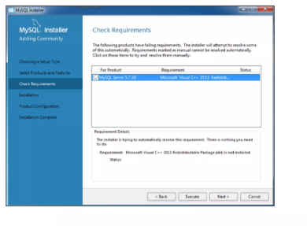

Slide 6
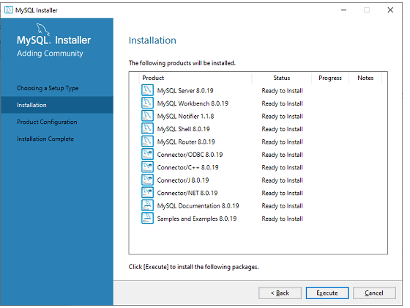
Please install and check 4 file should be there if not please install it by custom- server, router, shell and workbench

Slide 7
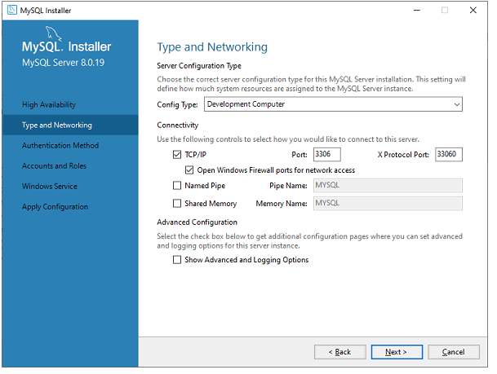
No need to change anything here direct click on NEXT button

Slide 8
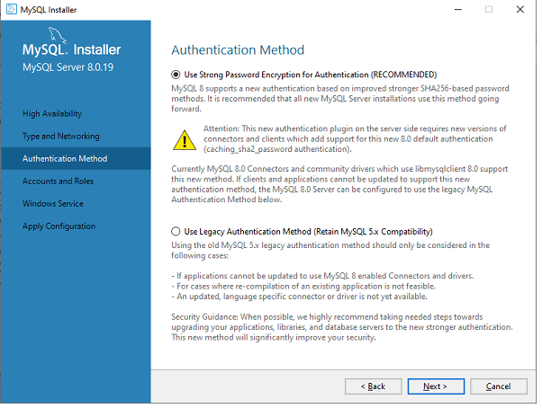

Slide 9
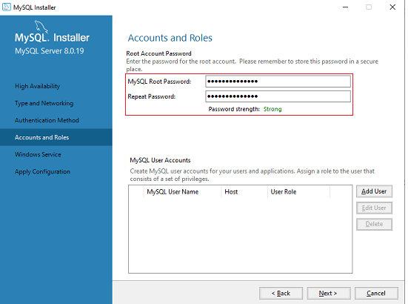
Insert password and please save it –user id and password is necessary to connect with Pyhton

Slide 10
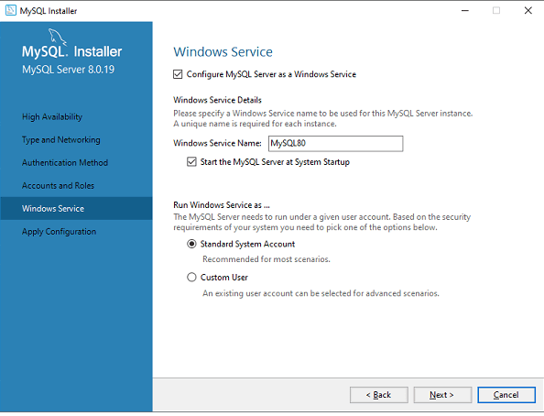

Slide 11
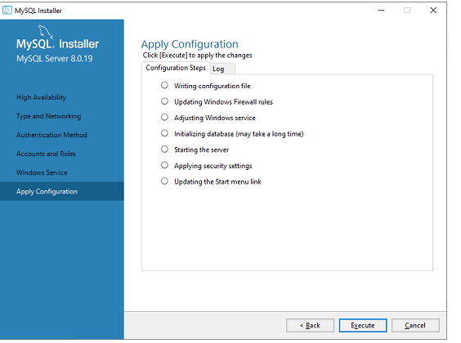

Slide 12
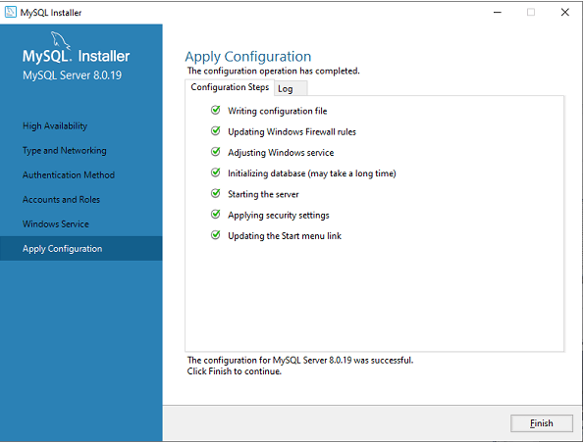
Now run workbench if you are getting any connectivity issue please follow the further steps

Slide 13
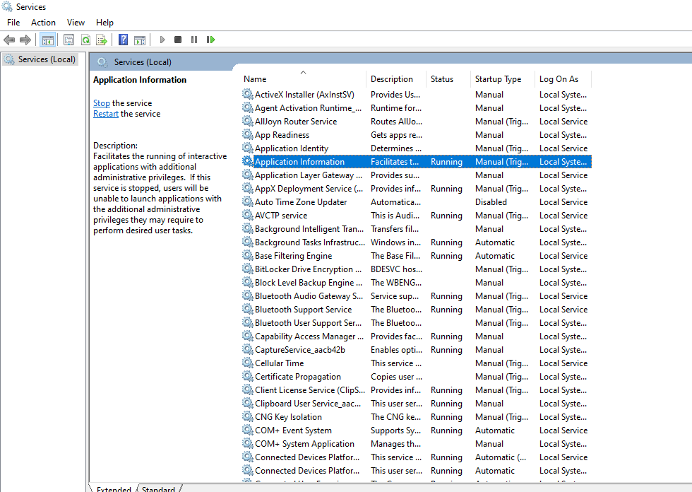
If you are facing any issue to run workbench or mysql server
Please go to windows service and select –Application information and just press ‘M’ key and check its running or not if your workbench not running then right click on Mysql inside service and click on run option

Slide 14
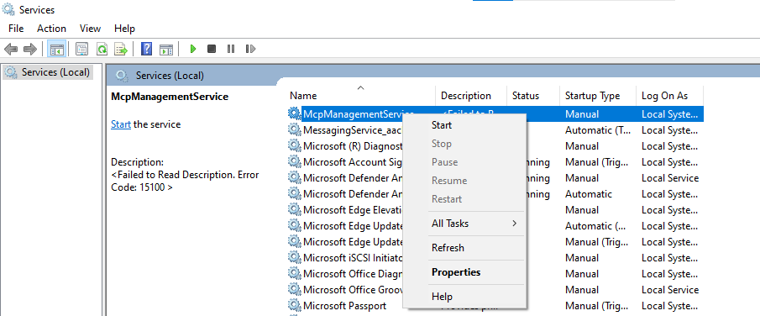
Application information and just press ‘M’ key and check its running or not if your workbench not running then right click on Mysql inside service and click on start option shown in below image. You can also restart or stop and then again start. After this process please refresh or restart your window.

Slide 15
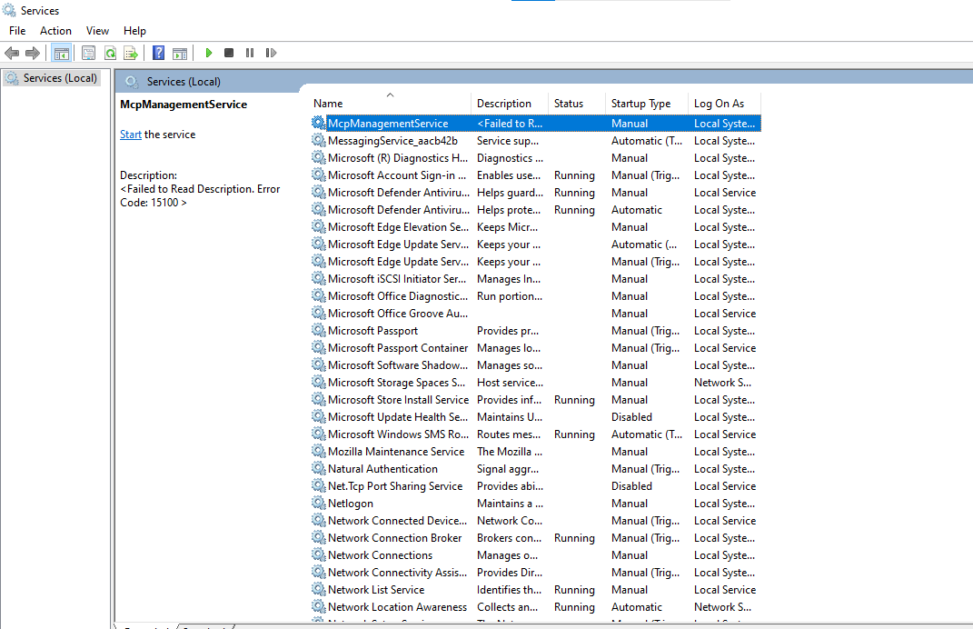
When you type M you will get all the list related to m Here you will get MySQL (PLEASE CHECK IT’S RUNNING OR NOT), if you are not getting mysql then follow the steps to add path of server in environment file in next slide

Slide 16
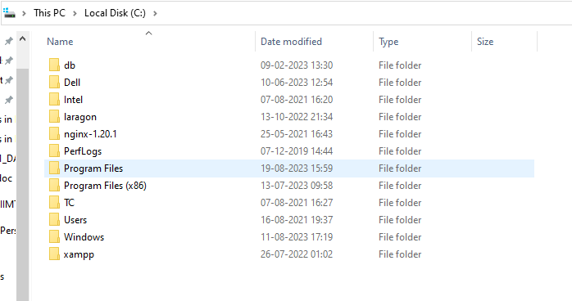
Add Mysql path in ENV. file
Steps
Go to folder name Program files inside C-Drive

Slide 17
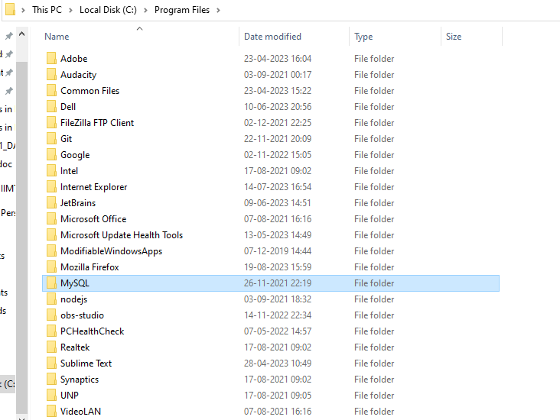
2. Go to MySQL folder

Slide 18
Inside this MySQL Folder please check 4 file should be listed there –SERVER, ROUTE,SHELL, WORKBENCH (if it’s not there please go to installation part again and install all these file by selecting custom option
Now please go to MySQL file and click on server folder/file here you will get Bin file now please click on path and copy the bin path of Mysql server only
And after copy the path open environment

Slide 19
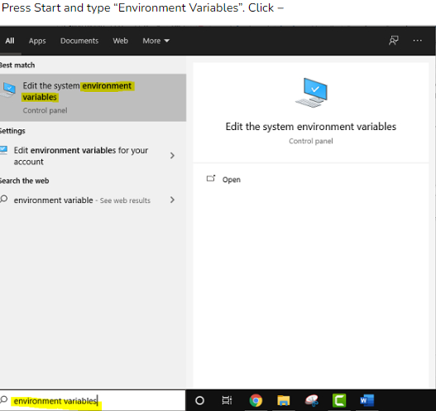

Slide 20
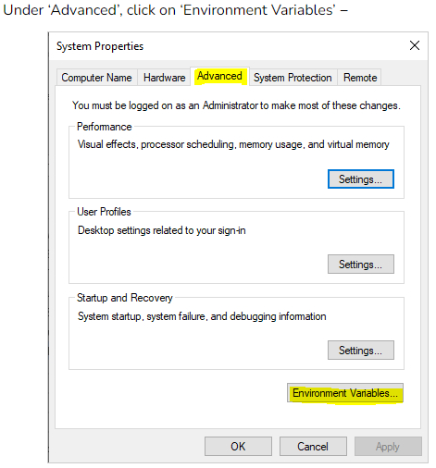

Slide 21
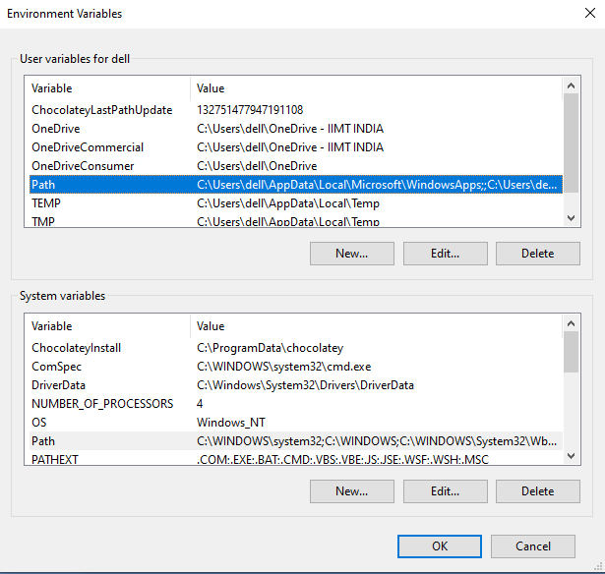
Goto user variable and select PATH and click on edit

Slide 22
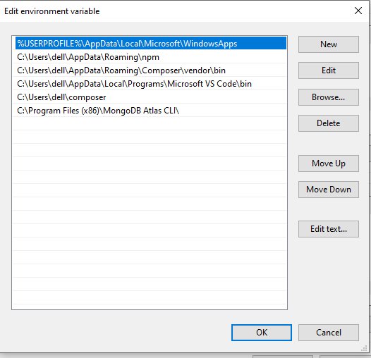

Slide 23
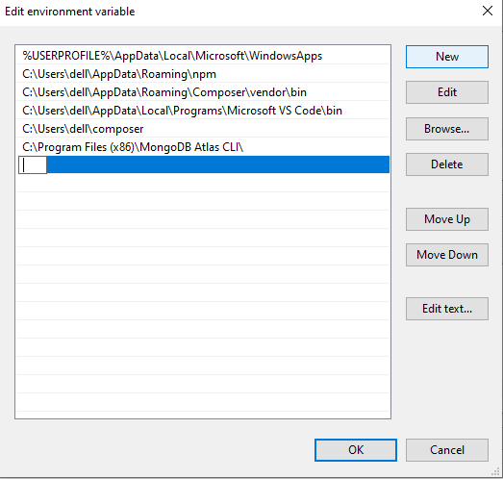
Now please click on New option and add the copied Mysql server bin path here and click on OK (if path is already there please delete it and add new)

Slide 24
After that please refresh or restart your window and again run workbench.
If you face any issue please follow these steps specially installation part
Server, shell, router and workbench is necessary to run Mysql

