Slide 1
Database Schema
A database schema is the skeleton structure that represents the logical view of the entire database.
It defines how the data is organized and how the relations among them are associated.
It’s the database designers who design the schema to help programmers understand the database and make it useful.

Slide 2
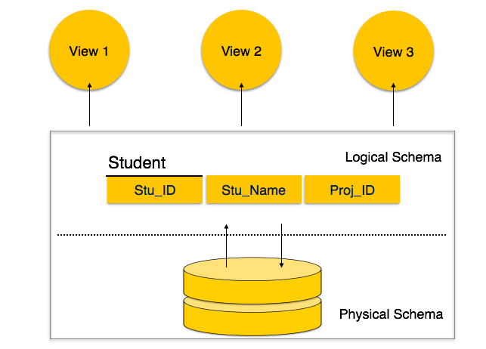

Slide 3
Schema Categories in two types
Physical Database Schema − This schema pertains to the actual storage of data and its form of storage like files, indices, etc. It defines how the data will be stored in a secondary storage.
Logical Database Schema − This schema defines all the logical constraints that need to be applied on the data stored. It defines tables, views, and integrity constraints.

Slide 4
Generalization
It works using bottom-up approach.
The size of schema is reduced.
It is generally applied to a group of entities.
Inheritance is not used in generalization.
It can be defined as a process where grouping are created from multiple entity sets.
It takes the union of two or more lower-level entity sets, and produces a higher-level entity set.
Some of the common features are obtained in the resultant higher-level entity set.
The differences and similarities between the entities that need to be in union operation are ignored.

Slide 5
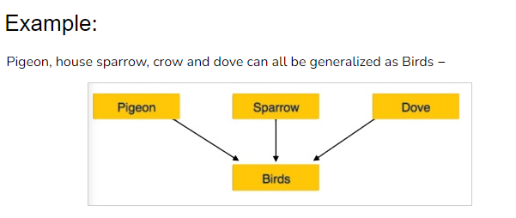

Slide 6
Specialization
It uses a top-down approach.
The size of schema is increased.
It can be applied to a single entity.
It can be defined as process of creation of subgroups within an entity set.
It is the reverse of generalization.
It takes a subset of higher level entity, and forms a lower-level entity set.
A higher entity is split to form one or more low entity.
Inheritance can be used in this approach.

Slide 7
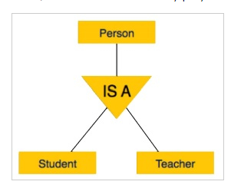
Example
A person has name, date of birth, gender, etc. These properties are common in all persons, human beings. But in a company, persons can be identified as employee, employer, customer, or vendor, based on what role they play in the company.

Slide 8
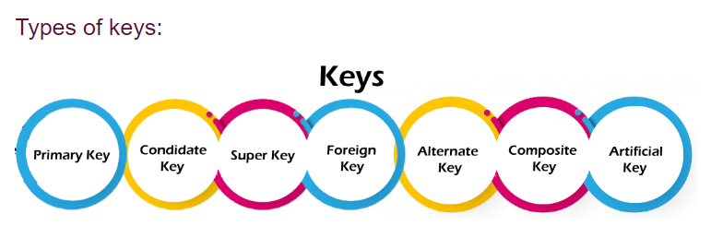
Keys
Keys play an important role in the relational database.
It is used to uniquely identify any record or row of data from the table. It is also used to establish and identify relationships between tables.
For example, ID is used as a key in the Student table because it is unique for each student. In the PERSON table, passport, number, license, number, SSN are keys since they are unique for each person.

