Slide 1
Business Analytics
Introduction to Database Management System
&
Basic SQL
Block-1
Session 1

Slide 2
Roadmap
Responsibilities
Pre-requisites
Job Profiles
Skills
Placement Level
Resume
Jobs Platform
Salary-package
Soft Skills

Slide 3
Role & Responsibilities
The role of a Business analyst typically involves understanding and analyzing business processes and identifying areas for improvement or optimization.
They may also be involved in project management, requirements gathering, and stakeholder communication.

Slide 4
Analyze Data
Classify
Assembler
Clean
Interpret

Slide 5
Pre-requisites
Mathematics & Statistics
Bachelor’s Degree
Formulas

Slide 6
Job Profiles
Data Analyst
Data scientist
Business analyst
Data Engineer/ Specialist
Data Architect
Marketing Business
Research Risk
Operations Analyst
Analysts / Specialist
Project manager
Associate Analyst / manager
Management Executive
Analytics Manager
Report/Research/Quality Specialist/Analyst

Slide 7
Skills
MS EXCEL
Advance MS-Excel ( Function, VLOOKUP, Macros & VBA, Charts, Pivot Table)
SQL
Aggregate Function, Joins, Views, Query Optimizations, Triggers, Transactions
Data Visualization
Tableau, Power BI, LOOKER
Programming Language
Python, R, SAS
Soft skills

Slide 8
Placement Level
Logical & Aptitude
Technical
HR

Slide 9
Resume
Overleaf.com
Novoresume.com
resume.io
zety.com
canva.com
Note- JD & Keywords, Projects, Certificate, work-experience

Slide 10
Jobs Platform & Salary-package
Job –Platform
Shine
NCS
LinkedIn
Naukari
Future Ready Talent
Optime Hire
Canva
Indeed
Jobseekers
Glassdoor
placementindia.com
Salary-Package - 3 LPA – 12 LPA

Slide 11
Soft Skills
Listening
Communication
Problem Solving
Strategic Thinking
Presentation
Decision making
Body Language
Approach

Slide 12
Session 2 - Overview of DBMS |Database Environment | The evolution of data models
What is Data?
In simple words data can be facts related to any object in consideration. For example your name, age, height, weight, etc are some data related to you. A picture , image , file , pdf etc can also be considered data.
What is a Database?
Database is a systematic collection of data. Databases support storage and manipulation of data. Databases make data management easy.
Let's discuss few examples.
An online telephone directory would definitely use database to store data pertaining to people, phone numbers, other contact details, etc.
Your electricity service provider is obviously using a database to manage billing , client related issues, to handle fault data, etc. Let's also consider the facebook.
It needs to store, manipulate and present data related to members, their friends, member activities, messages, advertisements and lot more.

Slide 13
DBMS ROADMAP
Basic Introduction
E-R Model
Basic of Keys
Normalization
Transaction Control & Concurrency
SQL & Relational algebra.
Indexing

Slide 14
What is Database System?
Database System in short refers to the technology of storing and retrieving users’ data with utmost efficiency along with appropriate security measures.
Why Database?
A database is an organized collection of various forms of data. It is also known as a structured set of data that is accessible in many ways through your computer.

Slide 15
Characteristics of Database
Real-world entity
Relation-based tables
Isolation of data and application
Less redundancy
Consistency
Query Language
ACID Properties
Multiuser and Concurrent Access
Multiple views
Security

Slide 16
The various reasons for which we require databases are:
To manage large chunks of data
For instance
Accuracy
Ease of updating data
Security of data
Data integrity

Slide 17
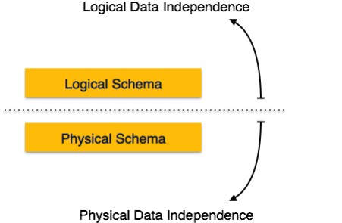
Data Independence

Slide 18
Logical Data Independence
Logical data independence refers characteristic of being able to change the conceptual schema without having to change the external schema.
Logical data independence is used to separate the external level from the conceptual view.
If we do any changes in the conceptual view of the data, then the user view of the data would not be affected.
Logical data independence occurs at the user interface level.

Slide 19
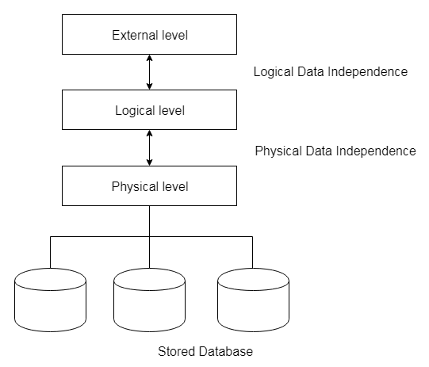
Physical Data Independence
Physical data independence can be defined as the capacity to change the internal schema without having to change the conceptual schema.
If we do any changes in the storage size of the database system server, then the Conceptual structure of the database will not be affected.
Physical data independence is used to separate conceptual levels from the internal levels.
Physical data independence occurs at the logical interface level.

Slide 20
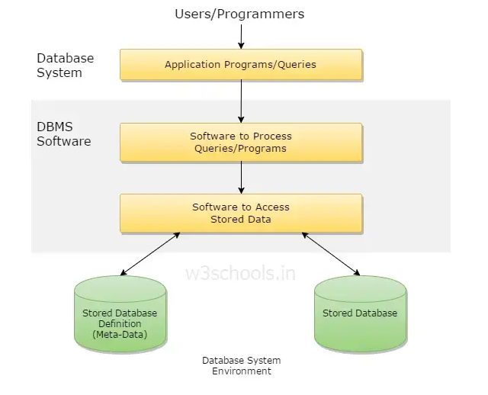
Database Environment

Slide 21
What is Database Environment ?
One of the primary aims of a database is to supply users with an abstract view of data, hiding a certain element of how data is stored and manipulated. Therefore, the starting point for the design of a database should be an abstract and general description of the information needs of the organization that is to be represented in the database. And hence you will require an environment to store data and make it work as a database.

Slide 22
A database environment is a collective system of components that comprise and regulates the group of data, management, and use of data, which consist of software, hardware, people, techniques of handling database, and the data also.
The hardware in a database environment means the computers and computer peripherals that are being used to manage a database.
The software means the whole thing right from the operating system (OS) to the application programs that include database management software like M.S. Access or SQL Server.
Again the people in a database environment include those people who administrate and use the system

Slide 23
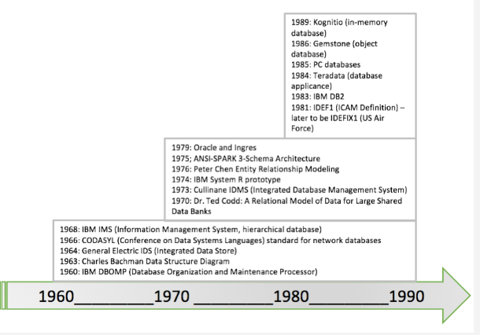
Evolution of Database

Slide 24
Codd. Edgar Frank "Ted" Codd (19 August 1923 – 18 April 2003) was an English computer scientist who, while working for IBM, invented the relational model for database management, the theoretical basis for relational databases and relational database management systems.

Slide 25
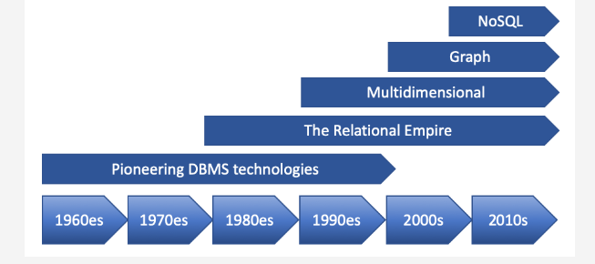
Data modeling and databases evolved together, and their history dates back to the 1960’s. The database evolution happened in five “waves”:

