Slide 1
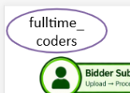


SMART INDIA HACKATHON 2026
GeM-Compliflix
AI-Powered Assistant for Smarter Compliance, Faster Verification, Better Decisions
Core Idea: Transform manual, fragmented bid verification into an AI-assisted, evidence-driven workflow.
🏛️ PROBLEM STATEMENT DETAILS
Problem Statement ID: SIH26100
Problem Statement Title: AI-Powered Integrated Bid Compliance Verification Platform for GeM Procurement
Theme: Smart Automation
PS Category: Software
Team ID: T089
Team Name: fulltime_coders
⚡ CAPABILITIES & STAKEHOLDERS
End-to-End Workflow:
Bid Docs ➔ AI/ML Verification ➔ Compliance Analysis ➔ Risk Detection ➔ AI Summary ➔ Decision Support
Key User Personas:
👤 Bidders: Submit documents, get automated compliance checks & instant deficiency feedback.
👨‍💼 Government Officers: Review compliance findings, interrogate bids with AI RAG, make informed awards.
Core Technology Stack:
AI/ML • OCR • NLP • RAG • Google Gemini LLM • Java Spring Boot • PostgreSQL + pgvector • Cloud Services

Slide 2
PROBLEM & PROPOSED SOLUTION
Transforming manual, fragmented bid verification into an intelligent, evidence-driven workflow
🔴 THE PROBLEM: Manual Bid Verification Bottlenecks
🟢 OUR SOLUTION: GeM-Compliflix AI Assistant
1. Manual Document Review
Officers spend exhaustive hours sifting through multi-page PDFs, technical annexures, and financial declarations.
1. Automated Document Intelligence
Multi-engine OCR & layout parsers extract structured entities from complex bids in seconds.
2. Fragmented Information
Critical bidder data is scattered across diverse formats, MCA21 portals, GST records, and bank guarantees.
2. Automated AI/ML Verification
Cross-checks bidder identities, GSTN, financial criteria, and technical specs automatically.
3. Difficult Cross-Verification
Tedious manual comparison between tender clauses and bidder claims with high cognitive fatigue.
3. Rules & Compliance Engine
Identifies missing documents, clause violations, and eligibility mismatches instantaneously.
4. Overlooked Discrepancies
High risk of missing forged certificates, expired licenses, or non-compliant technical deviations.
4. Risk Scoring & Summary
Generates structured compliance scores, deficiency matrices, and highlighted risk indicators.
5. Delayed Procurement Cycles
Repetitive clarification queries stall tender awards, creating severe administrative backlogs.
5. Evidence-Based RAG Copilot
Allows officers to interrogate tender requirements and bid submissions with direct source citations.
🔴 PROBLEM FLOW:
Upload ➔ Manual Review ➔ Cross-Verification ➔ Overlooked Gaps ➔ Delays
🟢 SOLUTION FLOW:
Upload ➔ AI/ML Verification ➔ Compliance Analysis ➔ Risk Summary ➔ AI Decision Support
⚖️ Bottom Line: From Manual Verification ➔ Intelligent Compliance Assistance (Human-in-the-Loop Decision Authority)

Slide 3
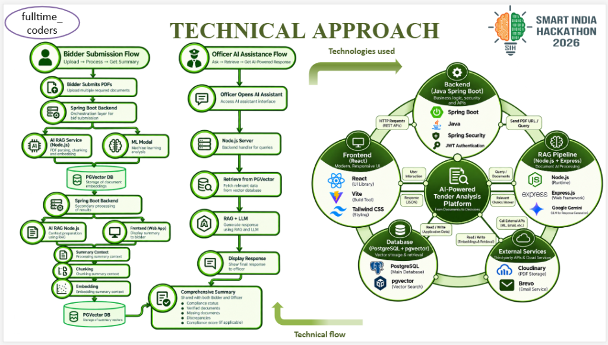

Slide 4
FEASIBILITY, POTENTIAL CHALLENGES & MITIGATION
Comprehensive evaluation of technical viability, operational risks, and robust engineering mitigations
🟢 TECHNICAL FEASIBILITY
⚠️ POTENTIAL CHALLENGES
🛡️ MITIGATION STRATEGIES
✓ Existing & Proven Stack
Built on enterprise-tested technologies: Java Spring Boot, PostgreSQL with pgvector, Node.js, and Google Gemini LLMs.
⚠ Document Format Variability
Scanned PDFs, skewed orientations, low-DPI scans, and complex multi-column tables.
🛡 Hybrid Preprocessing Pipeline
Multi-stage OCR with contrast normalization, deskewing, and fallback layout-aware extractors.
✓ Modular Microservices
Decoupled backend, AI/ML, and RAG services communicate via clean REST APIs for independent deployment.
⚠ AI Accuracy & Hallucination
Risk of LLMs producing inaccurate conclusions on critical legal or financial compliance clauses.
🛡 Strict Evidence-Grounded RAG
Answers anchored exclusively in retrieved vector chunks with exact document and page citations.
✓ Cloud-Ready & Elastic
Containerized with Docker; effortlessly handles traffic spikes during high-volume tender deadlines.
⚠ Procurement Data Security
Confidentiality of commercial pricing, earnest money deposits (EMD), and bidder credentials.
🛡 Zero-Trust Security & RBAC
Encrypted document storage (AES-256), JWT token authorization, and strict role access controls.
✓ Human-in-the-Loop Design
AI never takes autonomous tender disqualification decisions; acts purely as an evidence-driven copilot.
⚠ Changing Procurement Rules
GeM guidelines, General Financial Rules (GFR), and department criteria evolve over time.
🛡 Dynamic Knowledge Base
Hot-swappable compliance rules and regulatory vectors updatable without changing core codebase.

Slide 5
IMPACT, STAKEHOLDER BENEFITS & VALUE CREATION
Quantifiable outcomes across government officers, participating bidders, and procurement bodies
👨‍💼 Government Officers
• Slashes manual document reading time by up to 80%.
• Instant highlighting of compliance gaps & missing annexures.
• Interactive RAG copilot to query 500+ page tenders in seconds.
👤 Participating Bidders
• Pre-submission compliance check minimizes accidental rejections.
• Instant deficiency feedback to rectify missing attachments.
• Transparent, level-playing field for MSMEs & startups.
🏛️ Government Departments
• Standardized, objective evaluation across all ministries.
• Eliminates procurement disputes and post-award litigation.
• Significant administrative cost savings & faster project rollouts.
⏱️ 80%+ Faster Verification
Automates repetitive document reading, certificate checks, and compliance verification in seconds.
🎯 Elimination of Human Error
Rigorous automated cross-checking prevents overlooked non-compliance or fraudulent documents.
🔍 100% Audit Transparency
Every compliance flag is backed by exact document passages and immutable verification logs.
📊 Objective Risk Scoring
Visual risk heatmaps and deficiency matrices empower officers to make swift, confident awards.
🤖 Evidence-Grounded AI Copilot
RAG assistant answers complex tender questions with zero hallucination and source citations.
📈 Scalable to Lakhs of Bids
Cloud-native microservices architecture effortlessly scales across state and central portals.
🌱 Transformation: Reduced Administrative Effort ➔ Faster Verification ➔ Better Compliance ➔ Smarter Public Decisions

Slide 6
RESEARCH FOUNDATION & FUTURE SCOPE
Academic grounding in document intelligence paired with a high-impact product roadmap
📚 RESEARCH & REFERENCES
🔮 FUTURE SCOPE & ROADMAP
📖 Government Procurement Workflows
In-depth study of GeM guidelines, General Financial Rules (GFR 2017), and CVC public procurement manuals.
🚀 Multilingual Indian Language Support
Extend OCR and NLP document intelligence to Hindi and 12+ scheduled regional Indian languages.
🚀 AI Bid-Rigging & Cartel Detection
Graph neural networks to detect collusion patterns, shared metadata, and bidding syndicates.
📖 Document Intelligence & OCR
State-of-the-art layout-aware document understanding and table extraction algorithms for complex government annexures.
🚀 Direct Government API Integrations
Live automated verification pipelines with MCA21, GSTN, PAN, and DigiLocker APIs.
📖 Retrieval-Augmented Generation (RAG)
Dense vector embeddings with pgvector, document chunking strategies, and strict prompt grounding heuristics.
🚀 Continuous Compliance Rule Sync
Automated ingestion of new procurement notifications, amendments, and gazette circulars.
📖 Compliance Automation Frameworks
Hybrid architecture combining deterministic rule verification with probabilistic LLM reasoning.
🚀 Executive Procurement Analytics
Department dashboards tracking vendor compliance trends, cycle times, and anomaly statistics.
📖 Human-in-the-Loop AI Ethics
UX design patterns ensuring AI empowers authorized officers while avoiding automation complacency.
🚀 Pan-India Multi-Tenant Scaling
Enterprise cloud deployment across central ministries, state procurement portals, and PSUs.

Slide 7
SMART INDIA HACKATHON 2026
AI-Powered Integrated Bid Compliance Verification Platform for GeM Procurement
GeM-Compliflix
AI-Powered Assistant for Smarter Compliance, Faster Verification, Better Decisions
Bridging cutting-edge Document Intelligence, Vector RAG, and automated compliance engines with human governance to deliver faster, error-free, and transparent public procurement.
👥 TEAM DETAILS
Team Name: fulltime_coders
Team ID: T089
Problem Statement ID: SIH26100
Theme: Smart Automation
Category: Software Edition
Platform: Smart India Hackathon 2026
🎯 THANK YOU!
Questions & Demonstration
We welcome your queries, feedback, and discussion.
💻 Working Prototype & AI Engine Ready for Live Evaluation

