Slide 1

IBM SKILLSBUILD PROJECT
ResumeIQ
AI-Powered Secure Cloud Resume Management System
Presented by Vansh Singhal
REACT
NODE.JS
EXPRESS
MONGODB ATLAS
AWS S3
DOCKER
GROQ AI

Slide 2

The Problem With Resume Screening Today
Slow & Manual Process
Manual resume screening is time-consuming and prone to human error, creating bottlenecks in hiring pipelines.
ATS Black Box
Candidates have no visibility into how Applicant Tracking Systems evaluate and rank their resumes.
Insecure Storage
Resume documents are often scattered across unsecured local drives or unencrypted cloud folders.
No Centralized Solution
No unified, AI-powered cloud platform exists that combines secure storage with intelligent resume analysis.

Slide 3

Project Objectives
1
Secure Cloud Platform
Build a cloud-based resume management system with AWS S3 storage and encrypted data handling.
2
AI-Powered ATS Analysis
Use Groq AI to score resumes, extract skills, and generate actionable improvement suggestions.
3
Robust Authentication
Protect user data with JWT tokens, OTP verification, and bcrypt password hashing.
4
Containerized Deployment
Package the full application using Docker for consistent, scalable deployment across environments.

Slide 4

System Architecture
ResumeIQ follows a clean three-tier architecture with dedicated services for storage and AI analysis,
ensuring scalability and separation of concerns.
React Frontend
User interface and interactions
Express Backend API
Groq AI
Four-layer Architecture
ATS scoring and suggestions
Request routing and processing
AWS S3
MongoDB Atlas
Resume storage and retrieval
User metadata and profiles
React handles the UI, Express processes all API requests, MongoDB stores user metadata, AWS S3 securely hosts
resume files, and Groq AI delivers instant ATS scores and recommendations.

Slide 5
Technology Stack
Every layer of ResumeIQ is built with modern, industry-standard tools chosen for reliability, performance, and scalability.
Layer
Technology
Frontend
React, Tailwind CSS
Backend
Node.js, Express.js
Database
MongoDB Atlas
Cloud Storage
AWS S3
Authentication
JWT, OTP
AI Engine
Groq API
Containerization
Docker
Version Control
Git & GitHub

Slide 6
Key Features
🔐 Authentication
📄 Resume Management
🤖 AI Analysis
Signup & Login with validation
Email OTP verification
Forgot password flow
JWT session management
Upload & download resumes
Secure AWS S3 storage
Signed URL access
Delete & manage documents
ATS compatibility score
Skills extraction
Missing keyword detection
Personalized suggestions

Slide 7
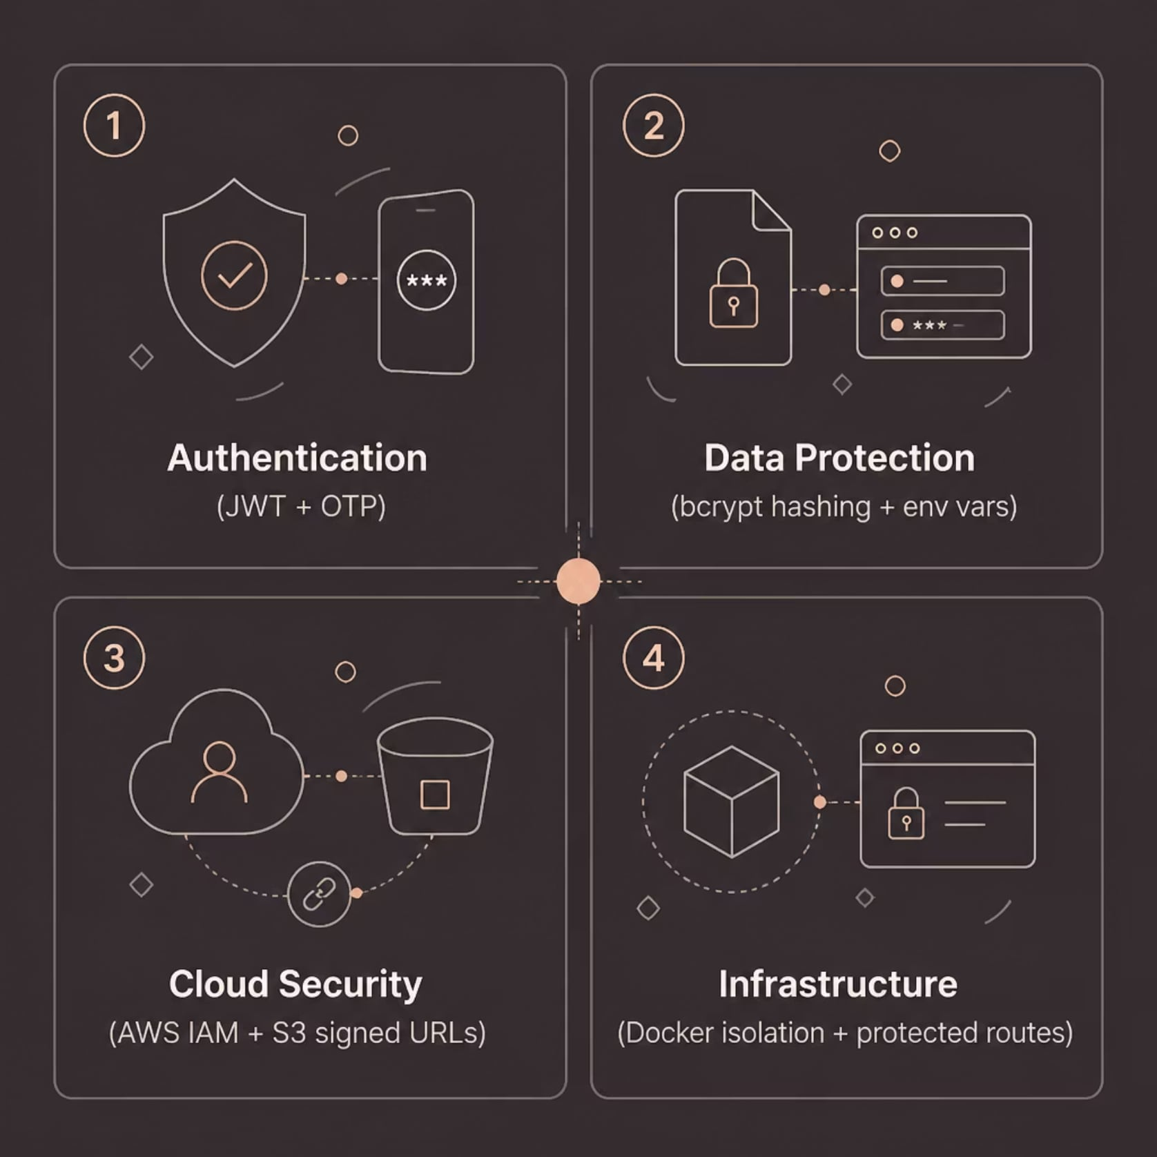
Security & Cloud Implementation
AWS S3
Resumes are stored in private S3 buckets with signed URLs for secure, time-limited download access. No public exposure of user documents.
AWS IAM
Least-privilege IAM policies restrict API access to only the S3 resources required, minimizing the blast radius of any credential compromise.
Application Security
JWT authentication with refresh tokens
bcrypt password hashing
Email OTP verification
Protected API routes
Environment variable secrets
Docker container isolation

Slide 8
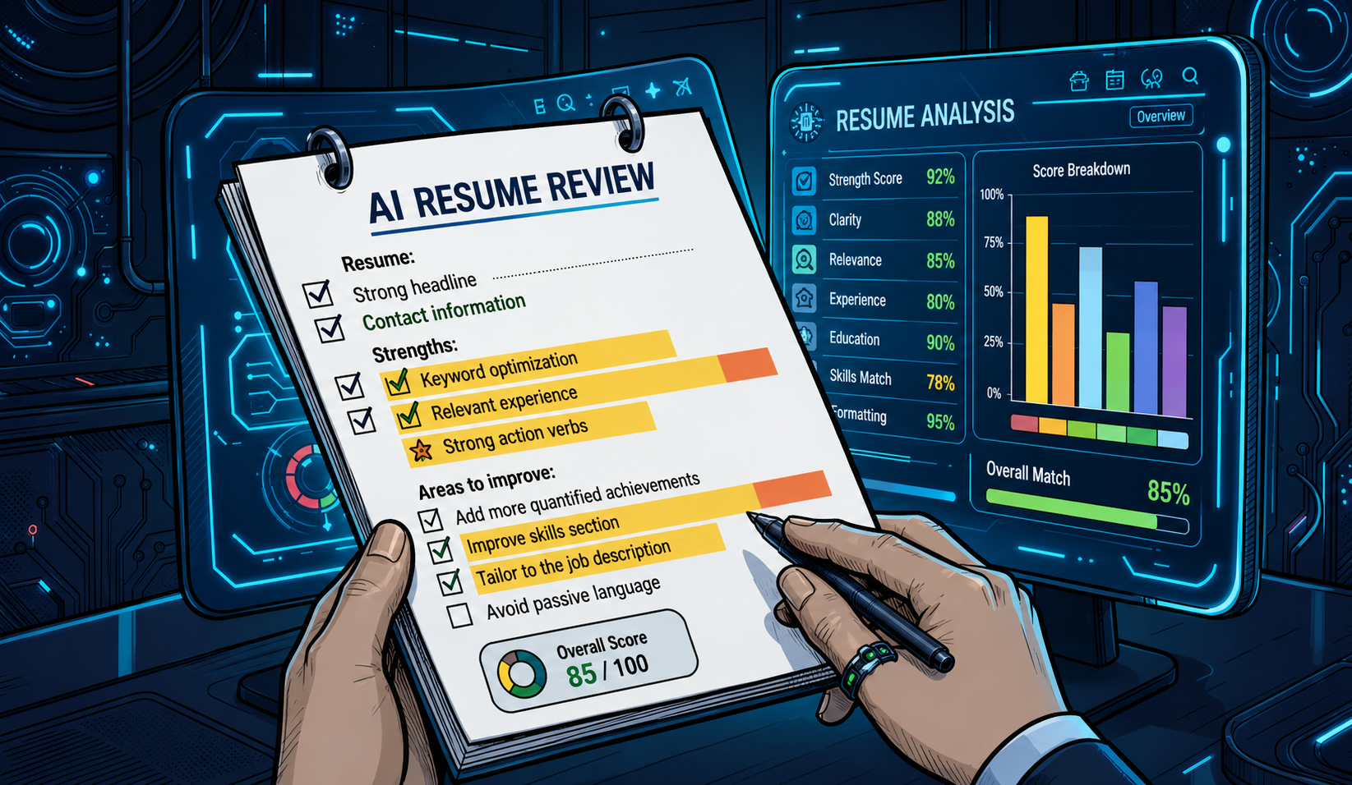
AI Analysis & ATS Scoring
How It Works
ResumeIQ leverages Groq AI to parse uploaded resumes and generate instant, actionable feedback — giving candidates the insight they need to stand out.
ATS Compatibility Score
Skills & Keyword Extraction
Personalized Suggestions
Evaluates formatting, structure, and keyword density against ATS standards.
Identifies existing skills and flags missing keywords for target roles.
Generates tailored recommendations to improve resume impact and readability.

Slide 9
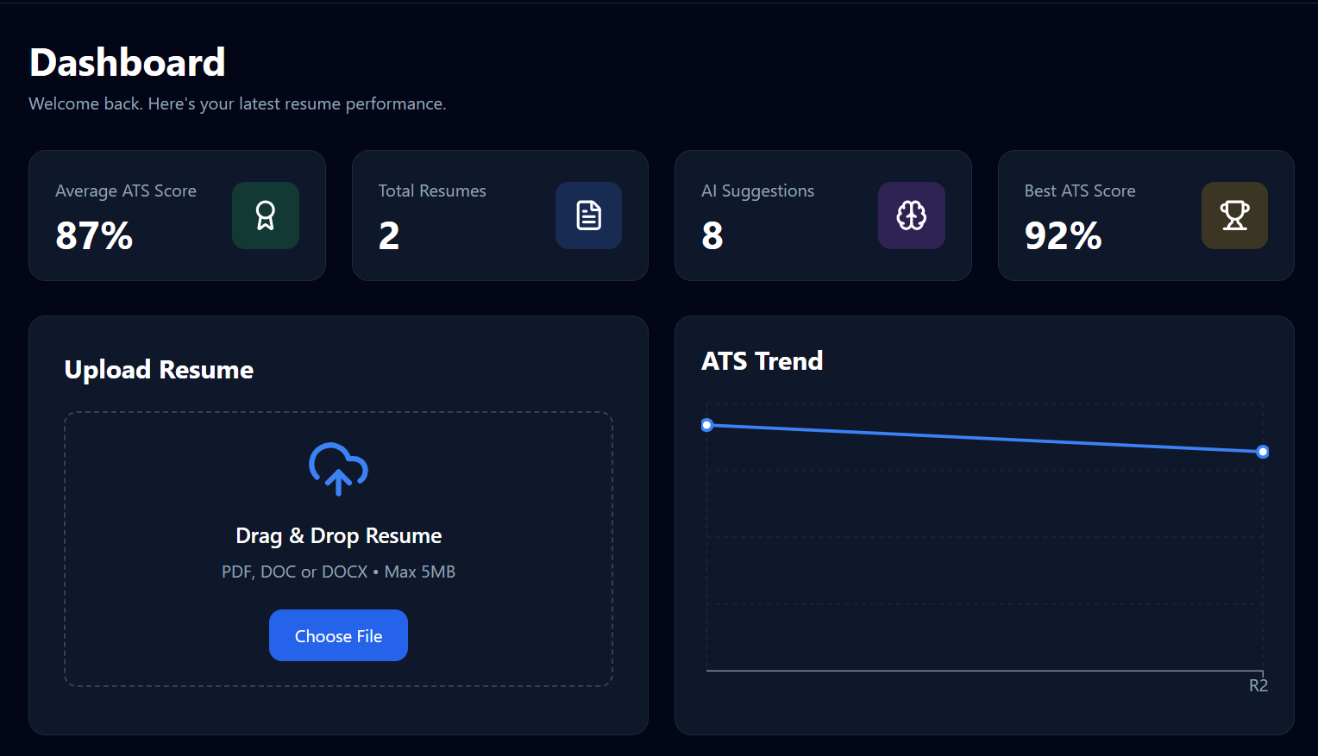
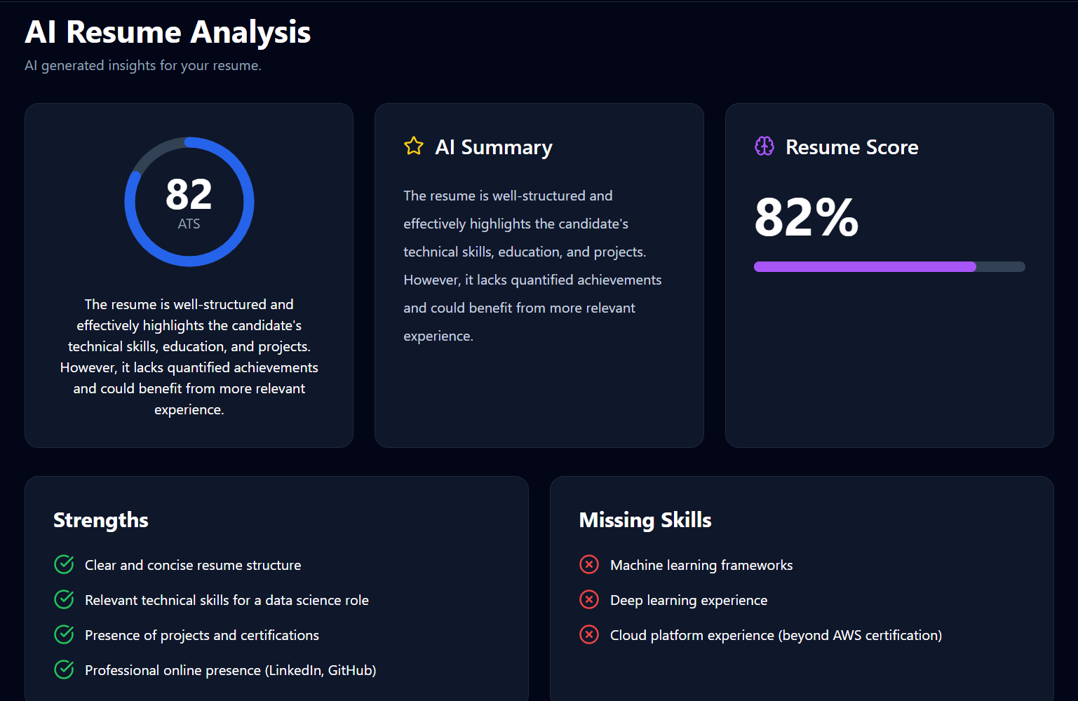
Results & Demonstration
Successfully Implemented
✅ User Authentication (JWT + OTP)
✅ Resume Upload to AWS S3
✅ AI Resume Analysis using Groq
✅ ATS Score Generation
✅ Dockerized Deployment
✅ Responsive Dashboard

Slide 10

Future Scope
Resume Analytics Dashboard
Visualize trends in ATS scores and improvement over time
Job Alerts
Notify users of matching opportunities based on their resume profile
Resume Templates
Provide ATS-friendly templates to help users build stronger resumes
Multi-Cloud Support
Extend storage capabilities beyond AWS to additional cloud providers
ResumeIQ — AI-Powered Secure Cloud Resume Management System ·
IBM SkillsBuild Project · Vansh Singhal

