Slide 1


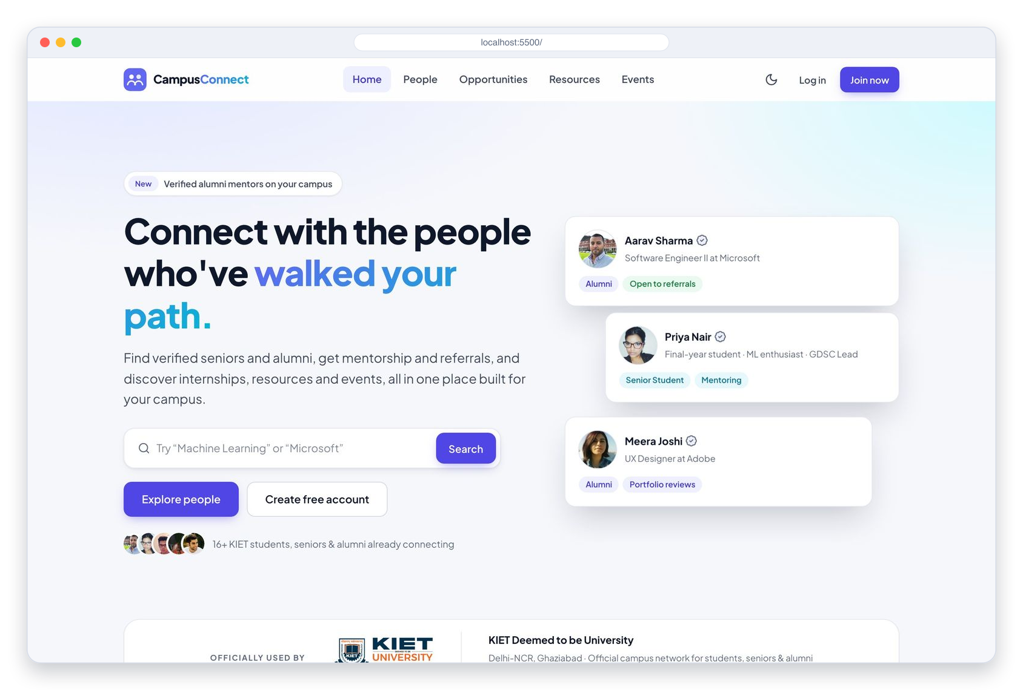

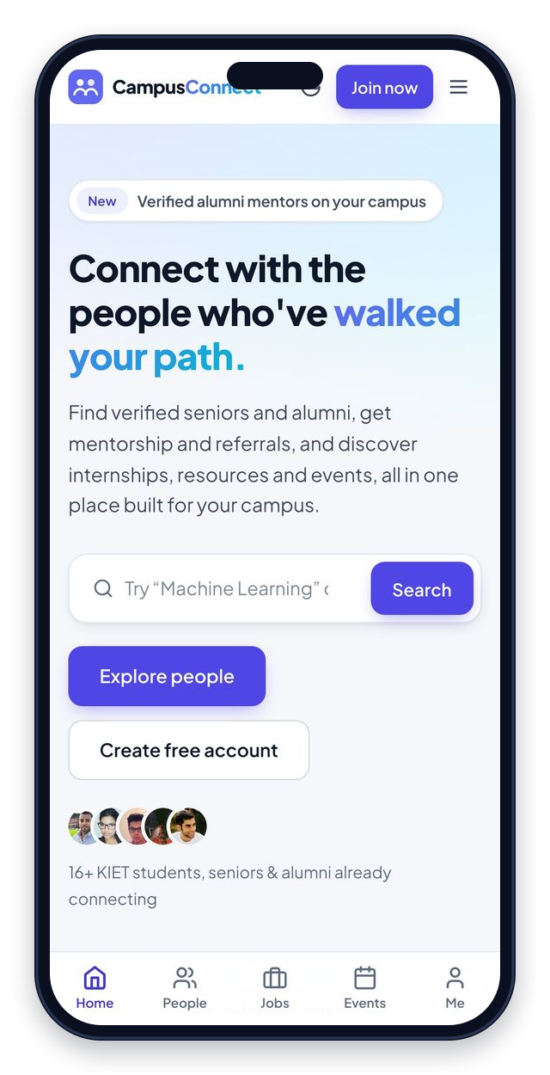
Campus Connect
A social-academic networking platform connecting KIET students, seniors & alumni.
Synopsis Project · Front End Web Development (26CA205PCB) · MCA
SUBMITTED BY
SUBMITTED TO
Shruti 2628MCA0248
Vikas Jain 2628MCA0311
Vansh Singh Solanki 2628MCA0112
Dr. Shashank Bhardwaj
Department of Computer Applications
KIET Deemed to be University, Ghaziabad
August 2026
Notes:
Introduce the team and the project. Campus Connect is a social-academic networking web app for KIET: students can find seniors and alumni, and discover opportunities, resources and events. This semester (Phase 1) is a complete front-end prototype.

Slide 2






THE PROBLEM
Campus networking today is scattered
Students rely on informal channels to find seniors, mentors and opportunities.
Scattered channels
Impossible to search
Unequal access
WhatsApp groups, notice boards and word-of-mouth referrals.
Useful information gets buried deep inside long chat histories.
Guidance depends on already knowing the right people.
Result: finding the right senior, mentor or opportunity is left to chance.
Campus Connect · KIET Deemed to be University
2
Notes:
From our own experience: finding the right senior or alumnus for guidance depends on chance. Information lives in WhatsApp groups and word of mouth, is impossible to search, and only reaches students who already know the right people.

Slide 3
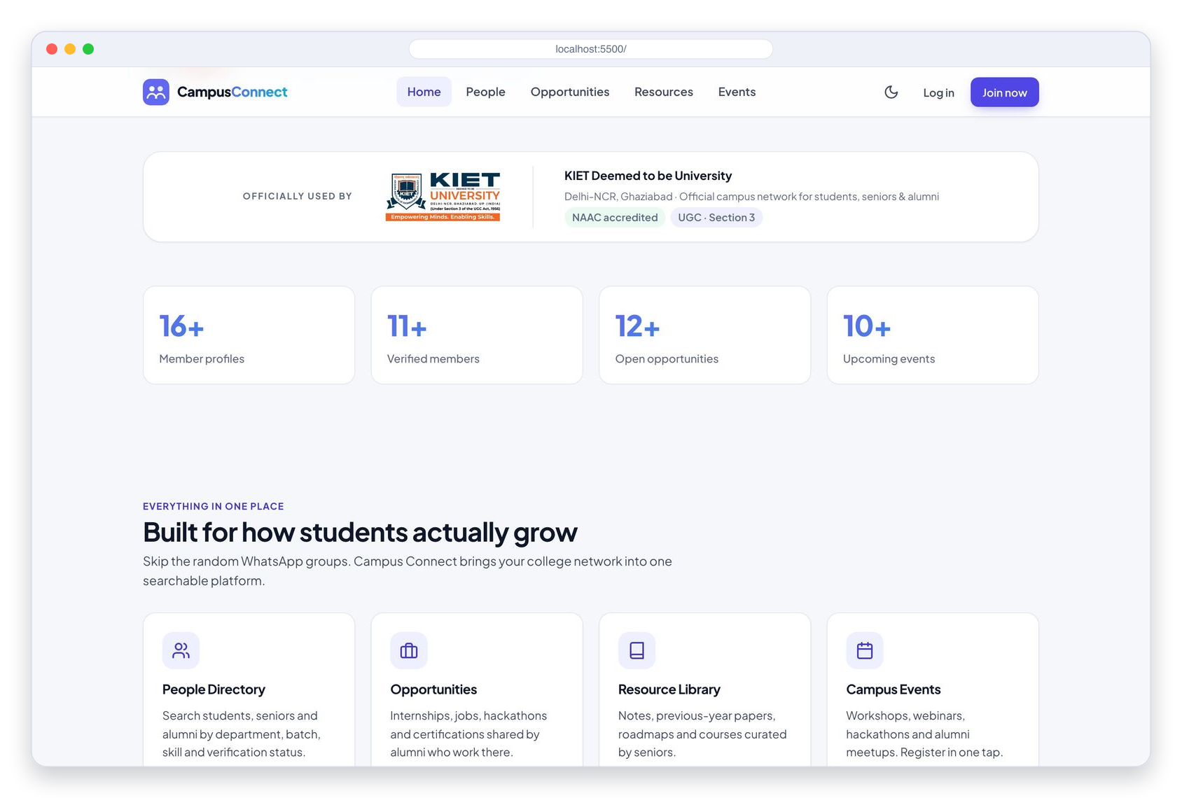




OUR SOLUTION
Campus Connect: one trusted campus network
A single, searchable web platform where students discover seniors and alumni, and find opportunities, resources and events.
Discover people
Directory of verified seniors & alumni
Search & filter
By year, department, skill, verification
Everything in one place
Opportunities, resources & campus events
Trust built in
Registration & verification workflows (UI demo)
Campus Connect · KIET Deemed to be University
3
Notes:
Our answer is one searchable platform. The home page shows the value immediately: the KIET strip, live stats, and the four pillars: people, opportunities, resources and events.

Slide 4




TARGET USERS
Built for every stage of campus life
PHASE 2
Student / Junior
Senior Student
Alumni
Admin
Find mentors, discover opportunities and resources, join campus events.
Mentor juniors and share notes, projects and internship leads.
Give back through mentorship, referrals and industry insight.
Verifies profiles and moderates content.
WHAT THEY DO
WHAT THEY DO
WHAT THEY DO
WHAT THEY DO
Search
Connect
Apply
Mentor
Share notes
Refer
Post jobs
Verify
Moderate
Campus Connect · KIET Deemed to be University
4
Notes:
Three actors use the platform in Phase 1: juniors seeking guidance, seniors who mentor, and alumni who give back. The Admin role (verifying profiles, moderating content) is planned for Phase 2.

Slide 5



WHAT WE BUILT · PHASE 1
All 9 use cases, delivered as a front end
People Directory
Profile Detail
Opportunities
Browse & search profiles; filter by year, department, skill and verification.
Rich profiles with Connect, Message and Request-a-call (demo).
Internships, jobs, hackathons & certifications, with Apply (demo).
Resource Library
Campus Events
Register · Verify · Login
Notes, question papers, roadmaps & courses: open or download.
Filter by type & date; register and add to your calendar.
Multi-step sign-up, verification workflow and login UI.
Campus Connect · KIET Deemed to be University
5
Notes:
Walk through the six feature areas. Everything runs in the browser on sample data (data.js). Login, registration, verification, connect and messaging are UI-level demos, exactly as scoped for Phase 1.

Slide 6
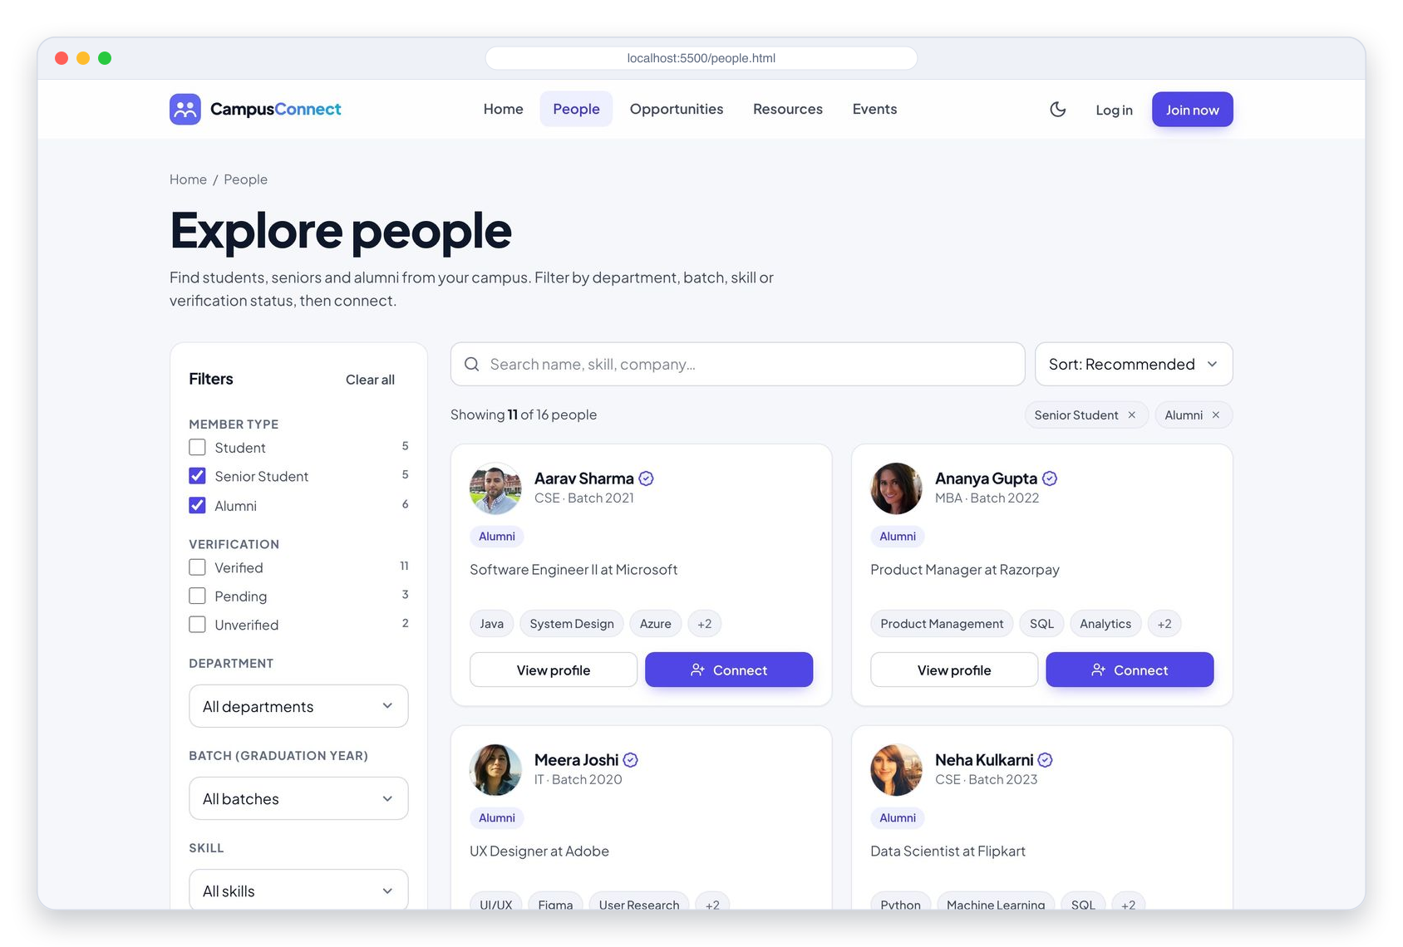
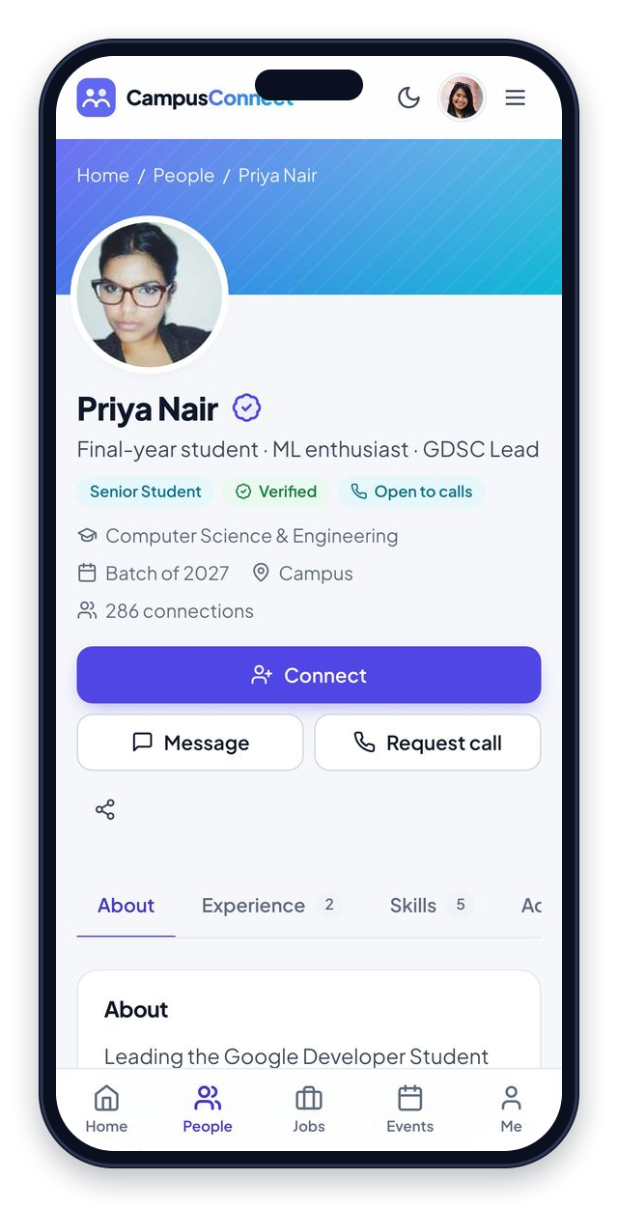



APP WALKTHROUGH
Explore people & view profiles
Keyword search
Name, skill, company or headline
5 filters + sort
Type, verification, department, batch, skill
Reach out
Connect, message or request a call
Campus Connect · KIET Deemed to be University
6
Notes:
People page: keyword search plus filters for member type, verification, department, batch and skill. Filters stay in the URL, so a filtered view can be shared. Opening a profile shows About, Experience, Skills and Activity tabs, with Connect, Message and Request-a-call actions.

Slide 7
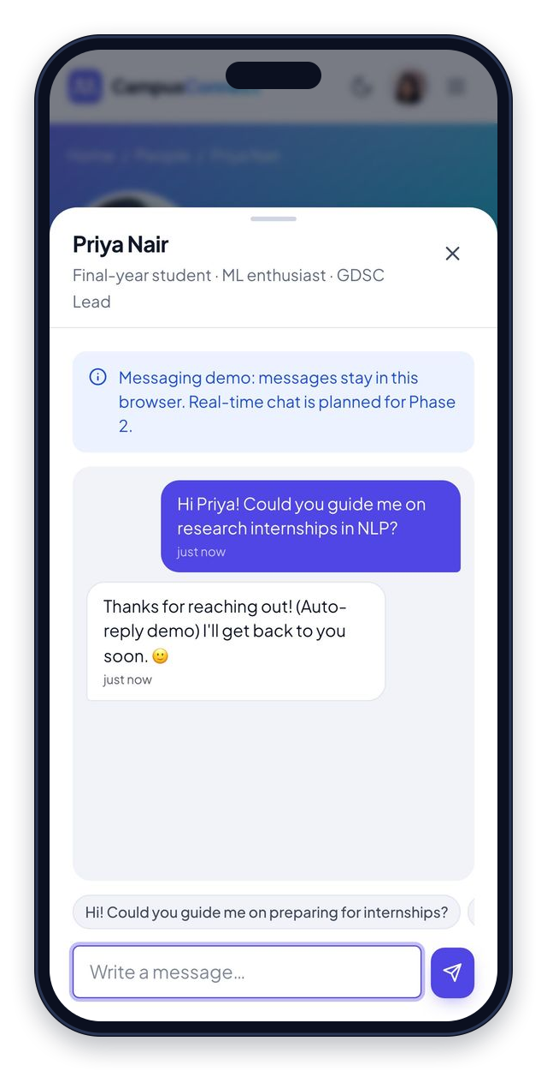
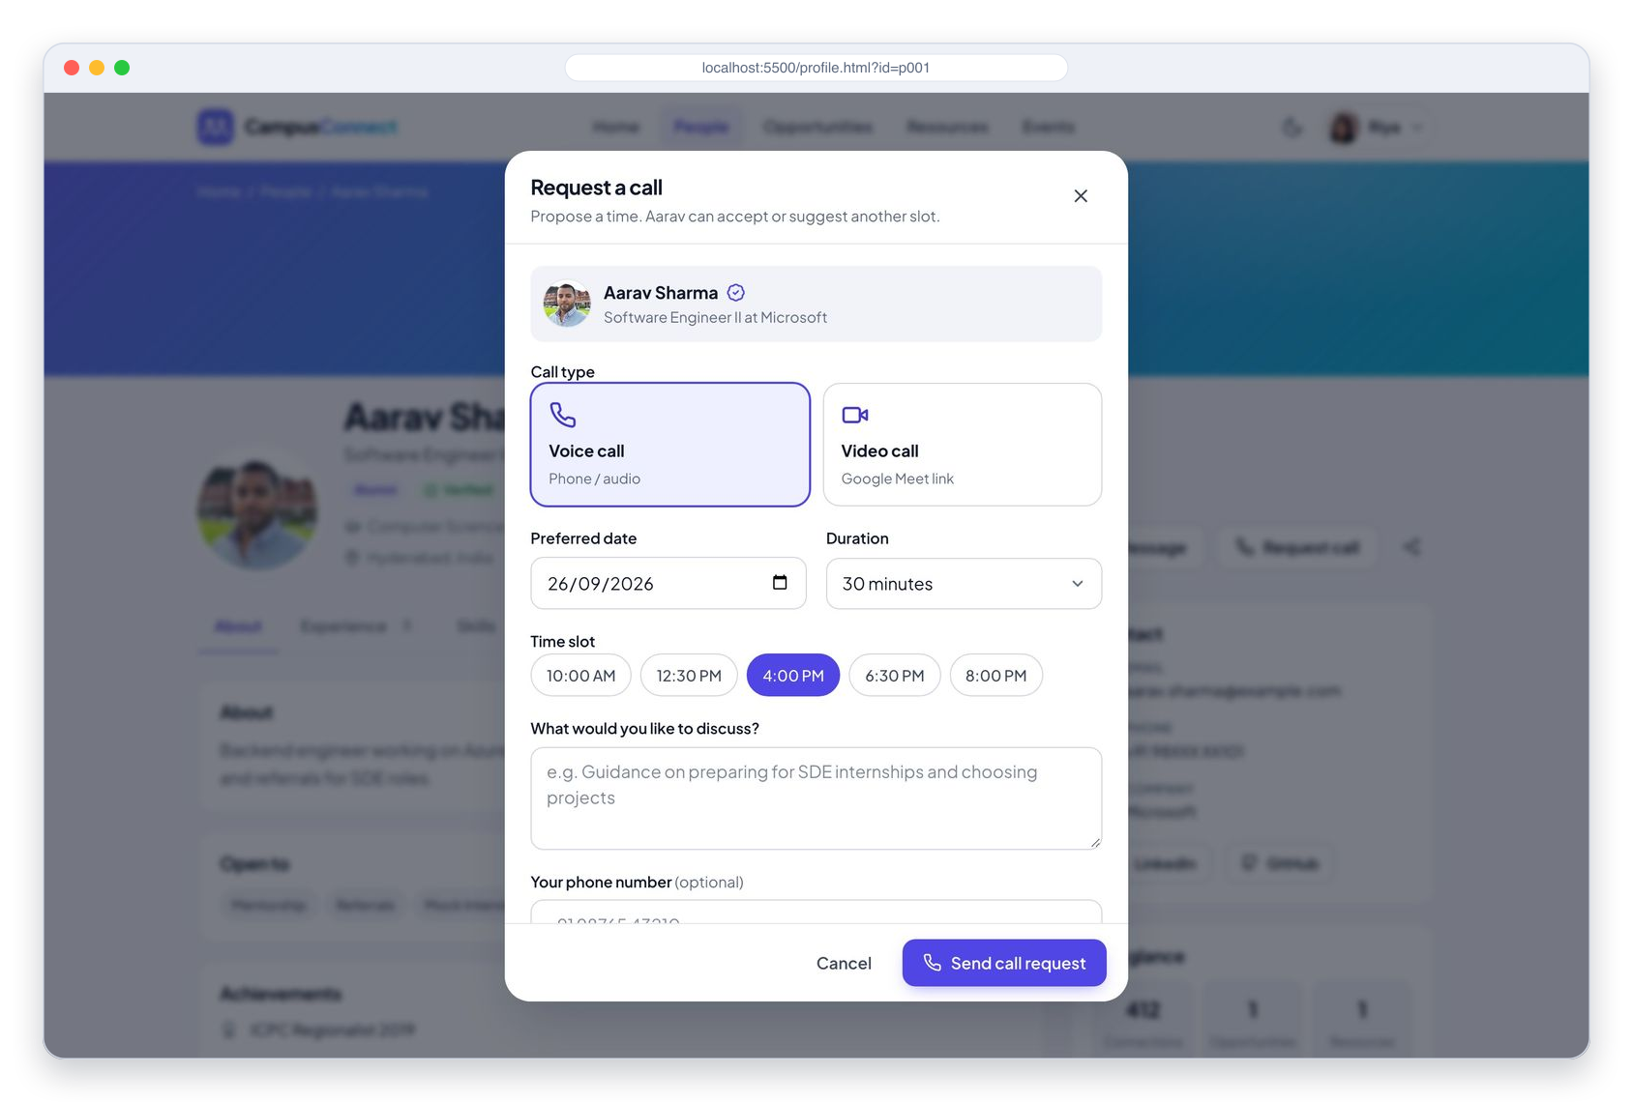
APP WALKTHROUGH
Connect, message & request a call
1
Connect
Send a request with a reason and a personal note
2
Message
Demo chat with quick replies and auto-reply
3
Request a call
Voice or video: pick date, time slot & topic
UI demo, saved in the browser. Real-time messaging arrives in Phase 2.
Campus Connect · KIET Deemed to be University
7
Notes:
Three ways to reach a mentor: a connection request with a reason and note, a demo chat with quick replies, and a call request with voice or video, date, time slot and topic. All of it is saved in the browser for the demo; real messaging comes in Phase 2.

Slide 8
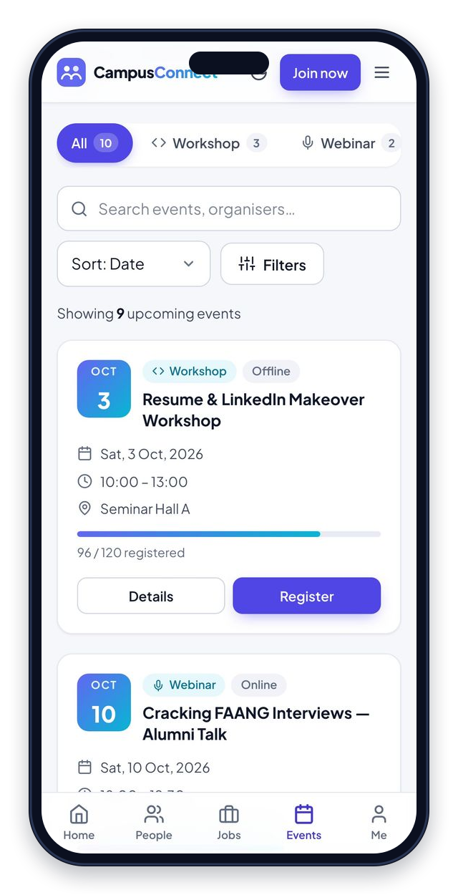
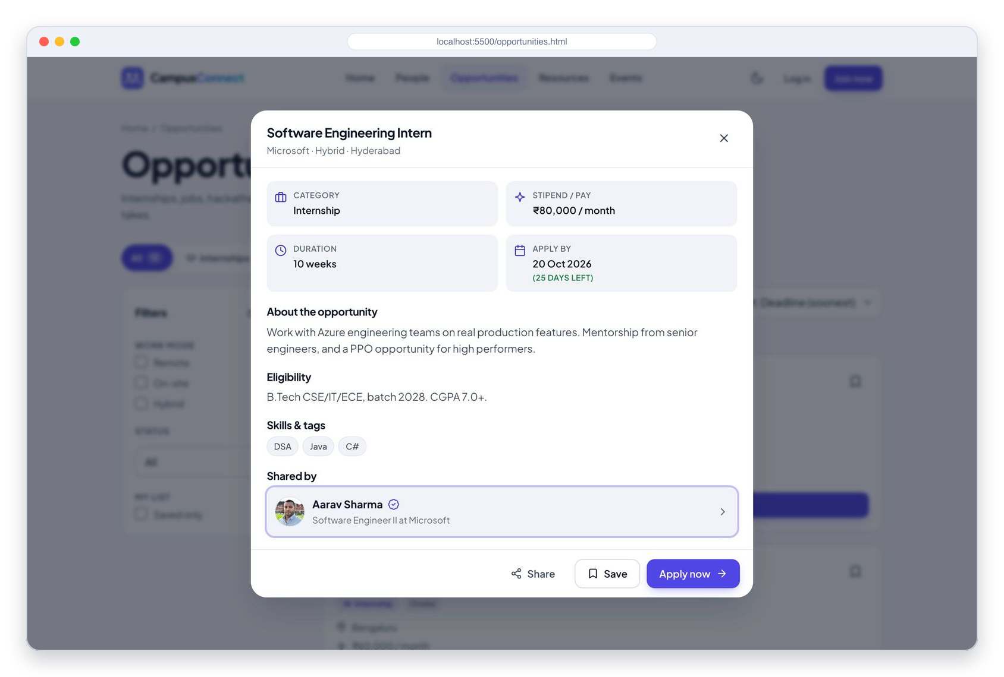



APP WALKTHROUGH
Opportunities, resources & events
Opportunities
Category tabs, deadlines, save & apply
Resources
Type & subject filters; open or download
Events
Register & add to calendar (.ics)
Campus Connect · KIET Deemed to be University
8
Notes:
Opportunities have category tabs with live counts, deadline countdowns, save and a demo Apply that leads to the Thank-you page. Resources open the real source or download a summary. Events show seats, let you register (demo) and add the event to your calendar as an .ics file.

Slide 9
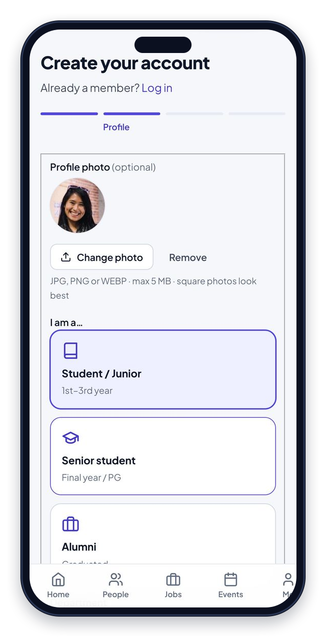
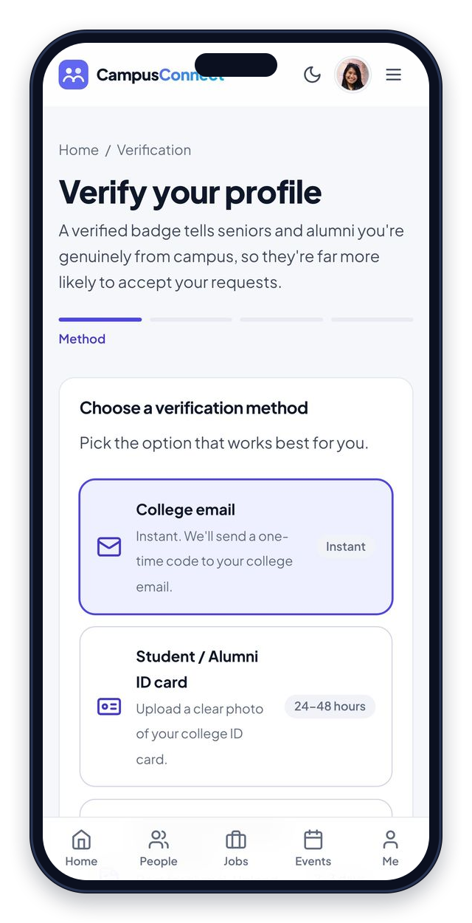
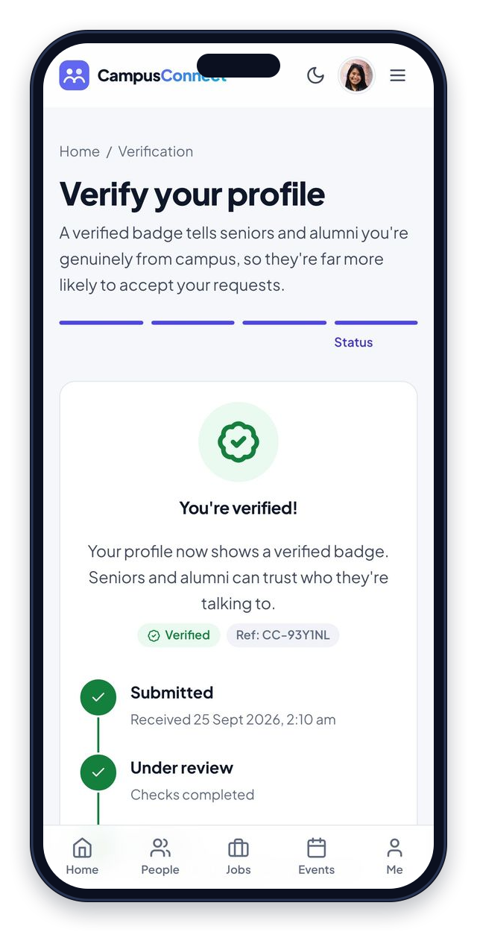

REGISTRATION & VERIFICATION
From sign-up to a verified badge
1 · Register
2 · Choose a method
3 · Status result
4-step wizard with photo upload
Email OTP, ID card or certificate
Tracker ending in a verified badge
Campus Connect · KIET Deemed to be University
9
Notes:
Registration is a 4-step wizard (account, profile with photo upload, preferences, review) with validation and draft autosave. Verification offers college-email OTP, ID card or certificate upload, then a status tracker. Admin approval is simulated in Phase 1.

Slide 10
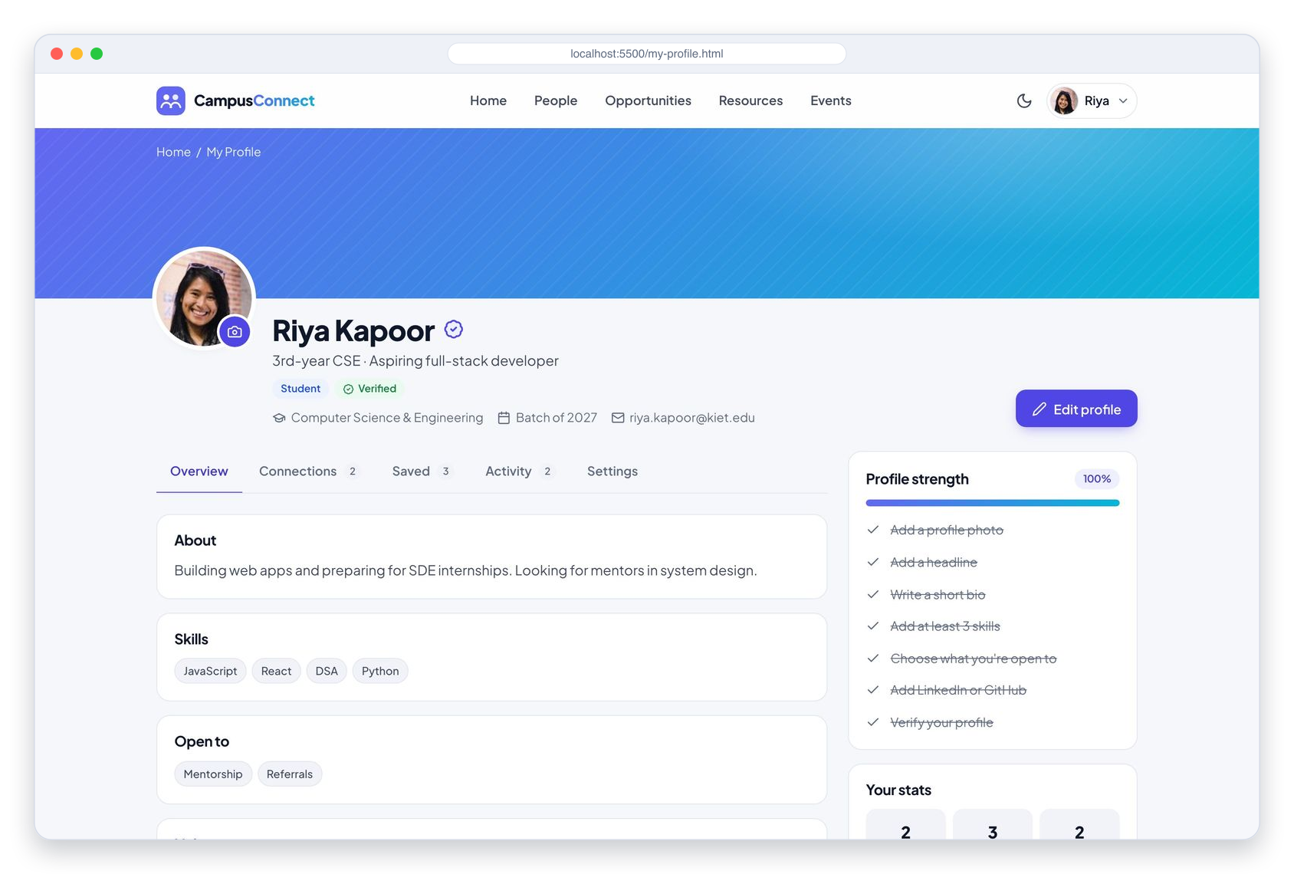
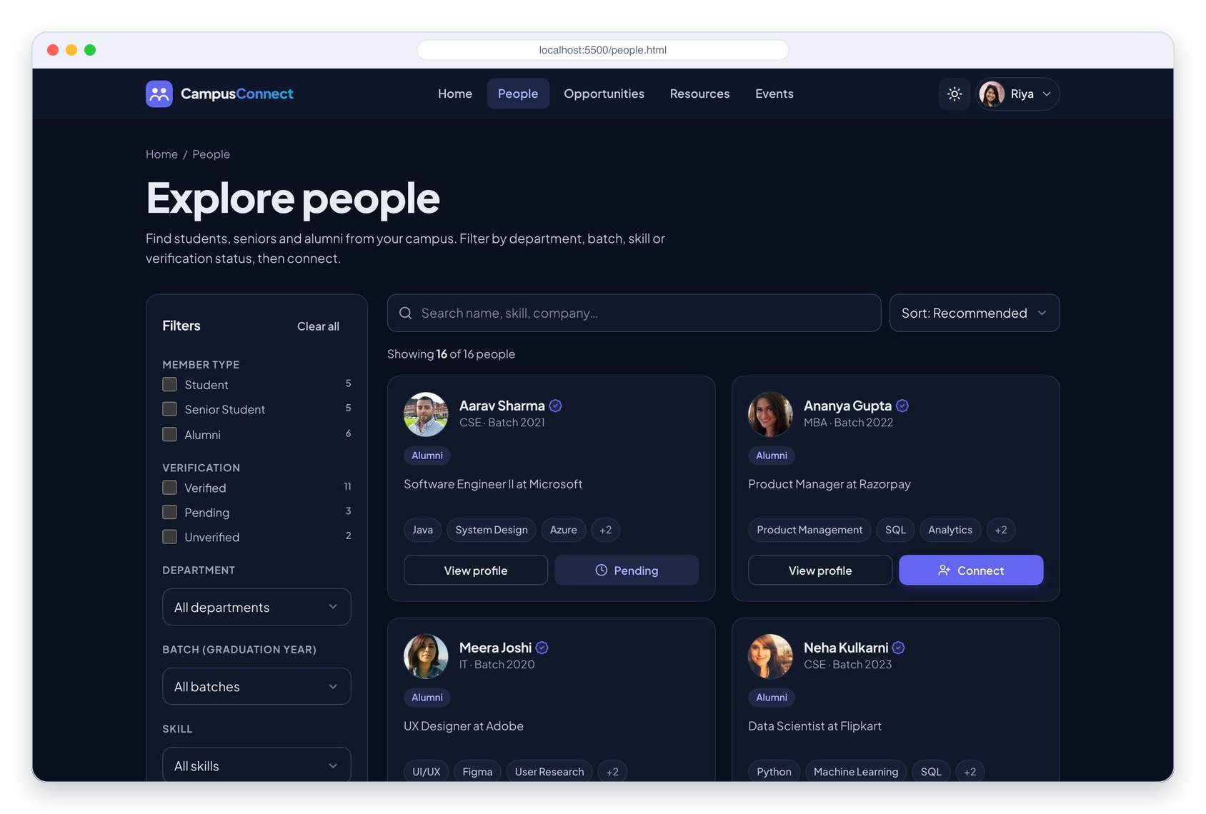

EXPERIENCE
Personal dashboard, responsive & dark mode
My Profile dashboard
Light & dark · fully responsive
Photo upload, completion meter, connections, saved & activity
Mobile, tablet & desktop; keyboard & screen-reader friendly
Campus Connect · KIET Deemed to be University
10
Notes:
My Profile is the user's own page: photo upload, completion meter, sent requests, saved items and activity. The whole app is mobile-first with a bottom tab bar, works on phones, tablets and desktops, and supports light and dark themes with accessibility built in.

Slide 11
SYSTEM FLOW
How users move through the app
People
Home
Explore / Sign up
Registration
Profile info
Explore people
Search / Filter
View profile
Connect (demo)
Opportunities
Opportunities
Category filter
View opportunity
Apply (demo)
Resources
Resources
Type filter
View resource
Download / Open
Events
Events
Type filter
View event
Register (demo)
Verification
Sign up
Choose method
Upload / Enter info
Submit
Demo status result
Campus Connect · KIET Deemed to be University
11
Notes:
These are the five flows from our synopsis, all implemented. Steps marked demo are UI-level actions on sample data.

Slide 12
ARCHITECTURE & TECH STACK
Built to scale into a full-stack app
Layered front-end architecture
Layer | Phase 1 (now) | Phase 2 (planned)
Frontend | HTML5, CSS3, JavaScript | React (optional)
Backend | Not implemented | Node.js + Express
Database | Sample data (data.js) | MongoDB / Firestore
Auth | UI demo only | Firebase Auth
Storage | Not implemented | Firebase Storage
Hosting | GitHub Pages | Vercel / Render
HTML5 pages (19) + style.css (design tokens, light/dark)
Page controllers: assets/js/pages/*.js
app.js · components.js: layout, UI kit, forms, listing engine
CC.api: Promise-based service layer
data.js: sample profiles, opportunities, resources, events
Also used: Figma · Google Fonts · Git & GitHub · VS Code
Phase 2 swaps only CC.api for fetch() calls to a Node.js / Express API. Pages stay unchanged.
Campus Connect · KIET Deemed to be University
12
Notes:
Data is separated from display logic. Pages never read data.js directly; they call the CC.api service layer. In Phase 2 only that layer changes to call a Node.js/Express API, and the pages stay the same. The table shows the Phase 1 stack against the planned Phase 2 stack.

Slide 13
OUTCOMES
What Phase 1 delivers
19
9 / 9
3
2
pages, incl. 404, Thank-you & legal
Phase 1 use cases delivered
breakpoints: mobile, tablet & desktop
themes, light & dark, accessible
Key findings
✓
✓
✓
Structured discovery makes networking purposeful. No more searching through chat histories.
Filtering by skill, year and department finds the right profile in seconds.
Separating data, logic and presentation gives a clean path to a real backend.
Campus Connect · KIET Deemed to be University
13
Notes:
Phase 1 in numbers: 19 pages, all 9 Phase 1 use cases, three responsive breakpoints and two themes. Our key findings match the synopsis: structured discovery beats chat groups, filtering finds people fast, and separating data from logic prepares the app for a backend.

Slide 14





PHASE 2 · NEXT SEMESTER
Roadmap to a full-stack platform
Firebase Authentication
Node.js + Express
MongoDB / Firestore
Real connections
Real sign-up & login
REST APIs for every module
Persistent profiles & data
Persisted connection requests
Real-time messaging
Admin dashboard
Notifications
User-posted content
Chat between connections
Verify profiles, moderate content
Requests, messages, new posts
Opportunities & resources
Campus Connect · KIET Deemed to be University
14
Notes:
Next semester we add the backend: real accounts with Firebase Authentication, Node.js/Express APIs, a MongoDB or Firestore database, persisted connections, real-time messaging, an admin verification dashboard, notifications and user-posted content.

Slide 15
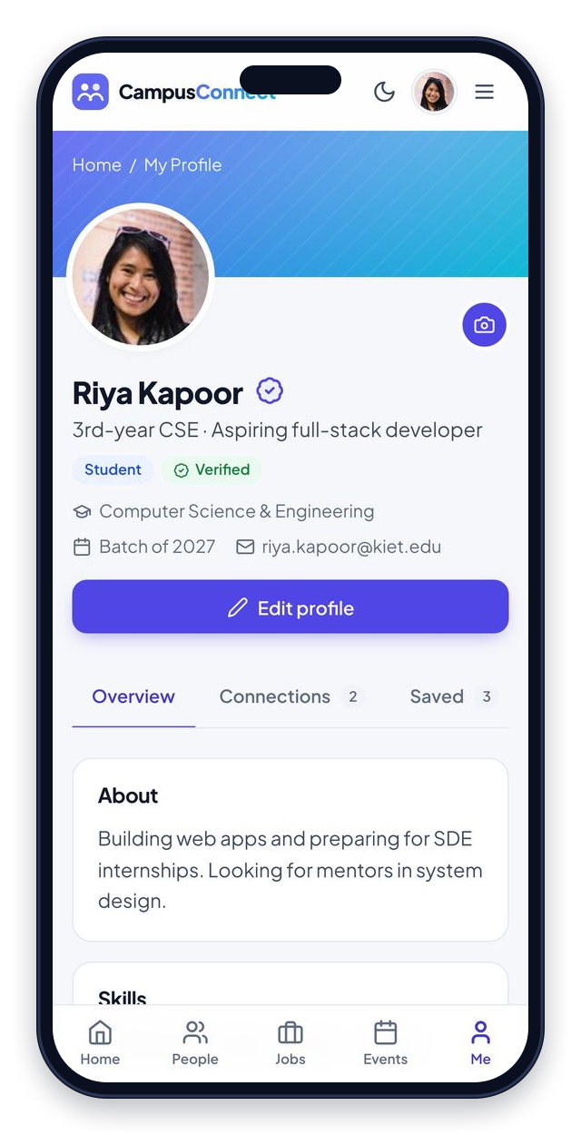
Thank you!
Questions? Let's open the live demo.
TEAM
TRY IT YOURSELF
Shruti
Vikas Jain
Vansh Singh Solanki
Open index.html (or localhost:5500)
Log in: click “Use demo account”
Verification code (OTP): 246810
GUIDE
Dr. Shashank Bhardwaj
Notes:
Thank the guide and audience. Switch to the live demo: home page, people search and filters, a profile with Connect/Message/Call, registration and verification (OTP 246810), then My Profile.

