Slide 1
LOGIC VERIFICATION

Slide 2
Logic Verification What is verification?
Verification is a process used to demonstrate the functional correctness of a design. It is the act of ensuring that the logic design conforms to the specifications.
Also called logic verification or simulation.
Transformation
Verification

Slide 3
Logic Verification Functional verification
Simulation
Directed tests
Constrained random tests
Formal methods
Model checking
Equivalence checking
HDL Design
Spec
RTL
Functional
Verification
Testbench
Synthesis
RTL
Gates
Formal
Verification
Equivalence Checking

Slide 4
Logic Verification Verification VS. Test
Two often confused
Purpose of test is to verify that the design was manufactured properly
Verification is to ensure that the design meets the functionality intent
HW Design
Fabrication
Specification
Net list
Silicon
Verification
Test

Slide 5
Logic Verification Why do Verification?
Cost of bugs over time
Bugs found at the block level have little cost
Bugs found at the system level may effect the time-to-market
Bugs found after fabrication require an expensive re-spin
Bugs found by customers can cost hundreds of millions and worst of all – Reputation
In design 60% - 80% time spent in verification

Slide 6
Logic Verification Who does Verification?
Designers may begin the process
Verification engineers manage and complete the process
Verification engineers may outnumber designers 2-1

Slide 7
Logic Verification Why is Verification hard?
How do you know when you are done?
How do you know that your specification is complete?
How do you verify the verifier?

Slide 8
Functional Verification Approaches Overview
Function verification is primarily done via simulation
Black-Box Approach
White-Box Approach
Gray-Box Approach

Slide 9
Functional Verification Approaches Black-Box
The verifier has access to input, output and device function
Given a set of inputs the verifier checks for correct outputs
To fully verify a black-box you must show that function is correct for all combinations of inputs
Full verification via black-box testing is impractical for any real design

Slide 10
Functional Verification Approaches while-Box
The verifier has access (and uses) internal signals during verification
This is common during block-level verification
Input vector
Output vector

Slide 11
Functional Verification Approaches Gray-Box
The verifier has access (and uses) a limited number of internal signals during verification
This is the reality for most verification
Knowing the architecture of the DUT enables you to write better test

Slide 12
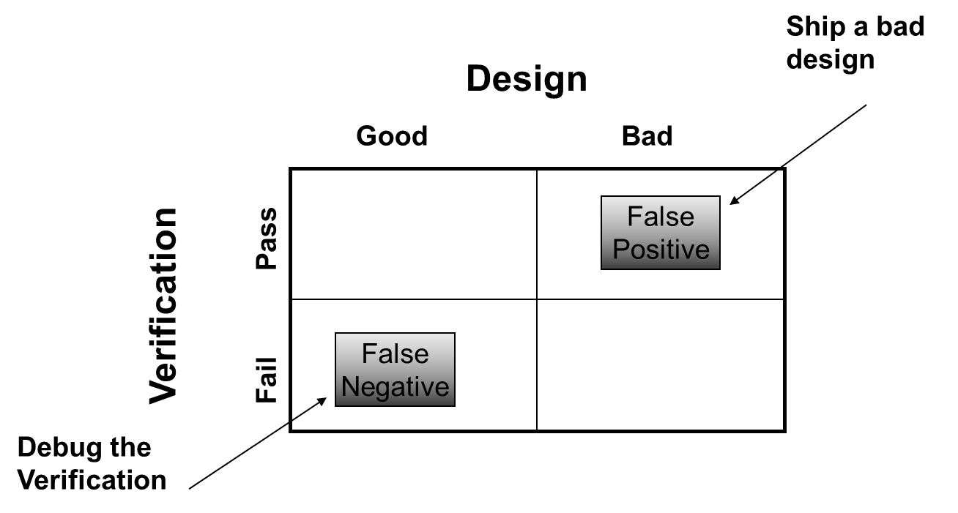
Verification Flow Goals
Ensure conformance with specification
But avoid false positives

Slide 13
Verification Flow Key
The verification engineer should not participate in the logic design of the DUT
Designers may not think of all failing scenarios
Verification engineer have a different perspective on the design
Verification engineers must understand the function, but not the implementation

Slide 14
Verification Flow Do
Talk to the designer to understand the function of the design
Think of situations the designer neglected
Focus on the corner case or exotic scenarios
Focus on concurrent event
Think about the all the pieces of the design you need to verify

Slide 15
Verification Flow A typical flow
Devise a potential bug
Write a test-case to expose the bug
Run the simulator with the test-case
Check the simulation result
If the test has uncovered a bug
Verify the bug
Work with designer to fix the bug

Slide 16
Verification Flow High level flow
ASIC Spec
Verification
Plan
Testbench
development
RTL
Handoff
Identify
approach
Create
enviroment
Coverage
Goals satisfied
Level of
Verification
Create
Test cases
Stop
Level of
abstraction
Run and
Debug tests
Strategy for
correctness

Slide 17
Conclusion
Verification is on critical path
Want to minimize verification time
Using new tools
methodologies

