Slide 1
TESTBENCH ORGANIZATION

Slide 2
TESTBENCH Overview
A testbench is HDL code to verify a module
The main purpose of a testbench is to supply input waveform to the design and to monitor its response
Testbench Module
Module Instance: Device Under Verification (DUV)

Slide 3
TESTBENCH Major Component of a Testbench
Testbench Environment
Testbench
Input Stimulus
Response Assessment
Verification Utility
Clock
Generation
Interface
Design Under Verification

Slide 4
TESTBENCH Approach: visual inspection
Testbench File
Stimulus
Generator
Device under Verification (DUV)
Waveform Viewer
OR
Text Output

Slide 5
TESTBENCH Approach: output comparison
Testbench File
“Gold”
Vectors
Reference
Model
Output
Comparator
Stimulus Generator
Error/Status Messages
Device under Verification (DUV)

Slide 6
TESTBENCH Approach: self checking
Testbench File
Input Signals
Stimulus
Generator
Device under Verification (DUV)
Output
Signals
Output
Checker
Error/Status
Messages

Slide 7
TESTBENCH Coding
Coding testbench:
initial block
Task and function
System tasks
General approach:
Use initial block to apply input vector
Use # delay operator to sequence input changes in time
Use @ operator to synchronize with clock
Use $display to show output, print messages
Common variations:
Write a task (procedure) to do common checking
Use a separate always block to generate the clock

Slide 8
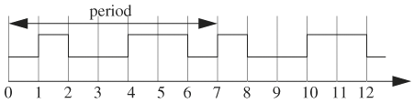
CLOCK GENERATION Explicit Method
One period of a clock is generated
Putting this period inside a loop and initializing the clock produces the complete waveform
#1 clock = 1'b1;
#1 clock = 1'b0;
#2 clock = 1'b1;
#2 clock = 1'b0;
initial clock = 1'b0;
always begin
#1 clock = 1'b1;
#1 clock = 1'b0;
#2 clock = 1'b1;
#2 clock = 1'b0;
end

Slide 9
CLOCK GENERATION Toggle Method
The same clock waveform can also be generated using the toggle method
initial clock = 1'b0;
always
begin
#1 clock = ~clock; // rising
#1 clock = ~clock; // falling
#2 clock = ~clock; // rising
#2 clock = ~clock; // falling
end

Slide 10
CLOCK GENERATION Time Unit
The unit for delay (for example: #2) is specified using timescale
The clock period may change by using parameters to represent the delays, instead of hard coding them
'timescale unit/resolution
define PERIOD 4
initial begin
clock = 1'b0;
forever begin
#('PERIOD/2)
clock = ~ clock;
end
end

Slide 11
STIMULUS GENERATION Overview
In addition to clock, the testbench has to produce various other signals that are used as input to the DUT.
These signals, also called stimulus, have to be applied with specific values at specific times
Stimulus are usually generated in an initial procedural block in the testbench. Many ways exist to apply input vector to DUT

Slide 12
STIMULUS GENERATION Using Synchronous Method(1)
Stimuli Memory
input vector
10111011
I/O
10111100
memory
00001110
I | D
Control Data
00101101
00001111
11011011
00110010
10101010
Stimulus Clock
Design
Testbench

Slide 13
STIMULUS GENERATION Using Synchronous Method(2)
reg [M:0] input_vectors [N:0] // stimulus memory
reg [M:0] vector; // input vector
initial
begin
$load_memory (input_vectors, "stimuli_file");
i = 0;
end
always @(posedge stimulus_clock)
begin
if(apply_input == TRUE)
begin
vector = input_vectors[i];
design.address <= vector[31:0];
...
design.data <= vector [M:M-31];
i = i + 1;
end
end

Slide 14
STIMULUS GENERATION Using Task Statement
// task applying an input to cpu's PIs
task cpu_apply_input;
input [N:0] vector;
begin
cpu.address = vector[0];
...
cpu.data = vector[j];
...
cpu.interrupt = vector[k];
...
end
endtask
initial // use the cpu task to apply inputs
begin #10;
cpu_apply_input(64'b0); // reset
...
#50;
cpu_apply_input(v1); // now start input vector sequence #60;
cpu_apply_input(v2);
...
end

Slide 15
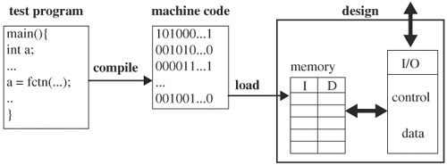
STIMULUS GENERATION Using Instruction Code

Slide 16
RESPONSE ASSESSMENT Overview
The general principle in accessing simulation result consists of 2 parts
The first part monitors the design’s nodes during simulation
The second part compares the node values with expected value
Comparison method
Offline(post processing)
Node value are dumped out to file during simulation
The the file is processed after the simulation is finished
On the fly
Node value are gathered during simulation and are compared with expected value

Slide 17
RESPONSE ASSESSMENT Offline
Design state dumping in text or VPD to be viewer by a waveform viewer
initial begin
$vcdpluson;
$vcdplusdeltacycleon;
$vcdplusmemon(
simulation_top.dut.core.NVM_0.model.data_memory);
$vcdplusmemon(
simulation_top.dut.core.NVM_1.model.data_memory);
end

Slide 18
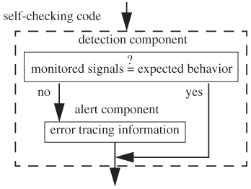
RESPONSE ASSESSMENT On the Fly

Slide 19
VERIFICATION UTILITY Overview
Every testbench use s utility routines common to other testbench
These utility can take on the form of a module, a task or a function
Some commonly used verification utility routines are a random error generator and an injector, error and warning display routines, and memory loading

Slide 20
VERIFICATION UTILITY Display Routines(1)
task test_pass;
begin
$display("\n=====> PASS\n\n");
begin
$display ("||||||||||| |||| ||||||| ||||||| ");
$display ("|| || || || || || || ||");
$display ("|| || || || || ||");
$display ("|| || || || || ||");
$display ("||||||||||| |||||||||| |||||| |||||| ");
$display ("|| || || || ||");
$display ("|| || || || ||");
$display ("|| || || || || || ||");
$display ("|| || || ||||||| |||||| ");
$display ("==========================");
end
$finish;
end
endtask

Slide 21
VERIFICATION UTILITY Display Routines(2)
task test_fail;
begin
$display("\n=====> FAIL\n\n");
begin
$display ("||||||||||||| |||| |||||||||| || ");
$display ("|| || || || ||");
$display ("|| || || || ||");
$display ("|| || || || ||");
$display ("|||||||||||| |||||||||| || || ");
$display ("|| || || || || ");
$display ("|| || || || || ");
$display ("|| || || || ||");
$display ("|| || || |||||||||| |||||||||| ");
$display ("==========================");
end
$finish;
end
endtask

Slide 22
VERIFICATION UTILITY Memory Loading
// declaration of a 1K 32-bit wide memory
reg [31:0] mem [1023:0];
// transfer data in file image to memory mem
$readmemh ("image", mem, START_ADDR, END_ADDR);

