Slide 1
Basic Functional Verification Fundamental
FSOFT - LSI-Verification team
Nguyen Tien Anh – v1.1

Slide 2
Outline
Introduction
Verification in the Chip Design Process
Missions and Goals of Verification
The Verification challenge
Functional Verification: Definition and Category
The Functional Verification cycle
Simulation-based Verification

Slide 3
Introduction

Slide 4
Introduction
This document is created to helps readers have a basic overview about Functional Verification via below subjects:
Verification’s position, roles in chip design flow
Important missions and goals of verification and verification engineers
Important terminologies in verification
Main stages in functional verification cycle (verification flow)
Basic fundamentals of a common functional verification – simulation-based verification
Almost the document’s contents are recapitulations from Comprehensive Functional Verification: The Complete Industry Cycle document. So you can refer the document for more very detail.

Slide 5
Verification in the Chip Design Process

Slide 6
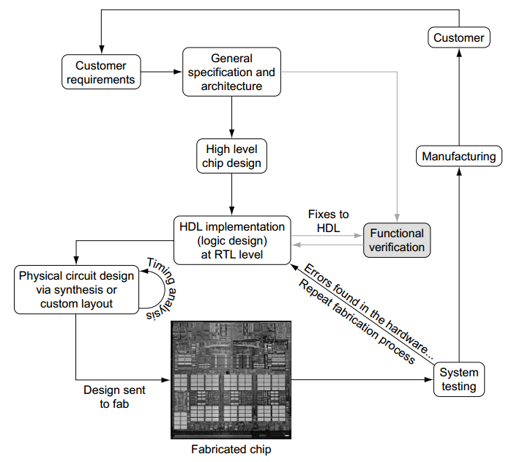
Verification in the Chip Design Process
All silicon design starts with the customer’s requirements, which drive the general specification and architecture.
The chip components then take shape during the high-level design stage.
Next is RTL implementation in a hardware description language (HDL; usually Verilog or VHDL).
Circuit design and timing analysis are based on the HDL, whereas functional verification explores the state space of the logic design to compare the implementation against the specification and design intent.
The chip design process
HDL: Hardware-Description Language

Slide 7
Missions and Goals of Verification

Slide 8
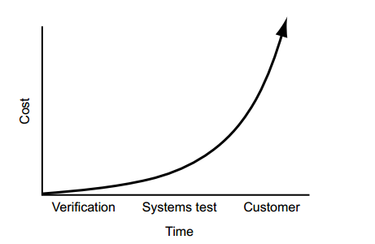
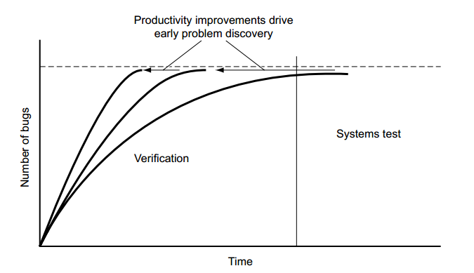
Missions and Goals of Verification
The mission of the verification is to remove all of the functional design problems (bugs) as quickly as possible
The design team measures verification productivity by two factors: schedule time and quality of bugs found.
Cost of undetected bug grows overtime.
There is little cost in finding and fixing a problem in verification, but there is a huge cost if the customer finds the problem.
The bug curve: Increasing verification productivity reduces schedule and costs

Slide 9
Missions and Goals of Verification
Goal of verification is clear all bugs from designs with prudently balancing three factors of Schedule-Cost-Quality in chip design process. Verification is the single biggest lever that affects all three of the triple constraints.
Schedule: Semiconductor product success depends heavily on hitting the marketplace at the right time. Delays in getting products to market can be deadly for a company or more.
Cost: To maximize the profit or minimize the price, the manufacturing and development expense for a product must be kept at a minimum.
Quality: Beside short time to market (TTM) and low development cost, quality of the product should be met quality standard.
Schedule
Cost
Quality

Slide 10
Missions and Goals of Verification
Verification engineer’s missions:
Must understand the design under test (DUV).
Must be able to work closely and cordially with designers. Should be able to proposal the solution to fix the bug to designers.
Must understand the strengths and weaknesses of the variety of verification tools/methods at their disposal.
Must be able to use these tools/methods efficiently to uncover the bugs in the design.
=> Must be able to create the verification environment and test scenarios based on verification tool/methods, DUV specifications. Ensuring that the required functional test scenarios occur and the checking is complete.

Slide 11
The Verification challenge

Slide 12
The Verification challenge
The number of functions in the chip grow quickly over time. Verification engineer faces below major challenges:
Dealing with enormous chip’s states to verify. Exhaustive verification is impossible.
Detecting incorrect behavior: The verification engineer must be able to identify whether or not the design acted correctly based on the current state and inputs.
Comprehend up-to-date verification methodologies. The higher requirements of verification the more advance verification methodologies need to be comprehended.

Slide 13
Functional Verification: Definition and Category

Slide 14
Functional Verification: Definition and Category
Functional Verification is the task of verifying that the functions of logic design conform to specification.
This is a complex task, and takes the majority of time and effort in most large chip design projects.
Functional verification is a part of more encompassing design verification, which, besides functional verification, considers non-functional aspects like timing, layout and power *.
* Reference source: https://en.wikipedia.org/wiki/Functional_verification

Slide 15
Functional Verification: Definition and Category
Based on the scope, functional Verification has basic below categories:
Unit verification
Combined verification
Based on the design’s status:
Black box verification
White box verification
Grey box verification
Based on the verification methodologies:
Simulation-based verification
Directed verification
Random verification
Formal verification

Slide 16
Functional Verification cycle

Slide 17
Functional Verification cycle
Because the verification team enhances their environment based on previous experiences, the verification process is called the verification cycle.
The cycle proceeds in a clockwise direction, starting from the functional specification, a key delivery to both the design and verification teams. As the team starts development of the verification environment, they reach the first checkpoint.
Specifications
Design data
Create verification plan
Develop verification environment
Debug Design and Environment
Run regression test
Validate coverage of verification
Do lessons learned
Functional verification cycle

Slide 18
Functional Verification cycle
CREATE VERIFICATION PLAN: A verification plan is crucial because it presents a detailed description of the verification effort. It answers the questions “what am I verifying?” and “how am I going to verify it?”. It is usually created by verification leader.
Necessary inputs of verification plan:
Functional specification.
Customer/Design requirements.
Resource information (people, time, tools, …).
Outcomes of verification plan:
Specific tests and methods: which verification methodologies are used.
List of EDA tools, VIPs necessary to support verification.
Completion criteria - define the measurements that indicate that verification is complete and coverage requirement.
Resource allocation and schedule detail.
Functions to be verified - list the functions that will be verified at this level of verification (verification checklist).
Functions not covered - describe any functions that must be verified at a different level of the hierarchy (out of scope of functional verification).
After completing the verification plan based on the specifications, the entire engineering team reviews the plan to ensure all team member comprehend all points in verification plan.

Slide 19
Functional Verification cycle
DEVELOP VERIFICATION ENVIRONMENT:
Once the verification plan is in place, construction of the verification environment begins. Verification engineers spend the majority of their time on this stage of the cycle
The verification environment is the set of software code and tools that enable the verification engineer to identify flaws in the design.
There are many different types of environments, including directed based, random based, formal based, and test case generators.
The environment is continually refined throughout the verification cycle. Refinements include fixes and additions to the testcase code.

Slide 20
Functional Verification cycle
DEBUG DESIGN AND ENVIRONMENT:
It is time that verification engineers begin to debug the design by running tests
With tests run, verification engineers find abnormal points and examine them to reveals the failure source. It will be either in the verification environment or in the HDL design.
If the error is in the verification environment, the verification engineer updates the software to correct the predicted behavior. Otherwise, the HDL has a bug that the design team must correct.
Once fixed, the verification engineer reruns the exact same test. This ensures that the update corrects the original bug and does not introduce new ones. The team applies this iterative approach until all tests pass.

Slide 21
Functional Verification cycle
RUN REGRESSION:
Regression is the continuous running of the tests defined in the verification plan (checklists).
Two reasons for doing regression:
Verification environments often have elements of randomization, which drive different input scenarios each time the team runs the test. Running regression ensures all tests are executed in same verification conditions.
The team must repeat all tests after fixes have been applied to the design.

Slide 22
Functional Verification cycle
VALIDATE COVERAGE of VERIFICATION:
Coverage is the collection of information about the scenarios run against a DUV.
The verification environment provides “quality control” on the DUV; coverage provides quality control on the verification environment. Coverage results show the effectiveness of verification automation by highlighting unexercised areas of the design.
If the coverage results are satisfied, functional verification is completed basically. Otherwise, verification team must detect which part in verification plan effecting to coverage result. The verification plan might be refined and new verification cycle starts.

Slide 23
Functional Verification cycle
DO LESSONS LEARNED
The final checkpoint in the cycle, lessons learned, uses escape analysis and the entire verification cycle experience to compile a list of items to improve on as they start the cycle again.

Slide 24
Simulation-based Verification

Slide 25
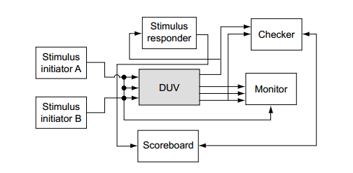
Simulation-based Verification
This chapter introduces a simple simulation-based verification environment, explores the individual elements (also known as verification components) that comprise the verification environment
BASIC VERIFICATION ENVIRONMENT - A TEST BENCH:
The basic environment consists of the DUV, stimulus components (verification model), monitor components, checking components, and scoreboard components (optional).
In general, a test bench is all the code (almost in HDL) used to create, observe, and check a pre-determined input sequence to the design.

Slide 26
Simulation-based Verification
BASIC VERIFICATION ENVIRONMENT - A TEST BENCH:
Stimulus Component: The stimulus component manipulates inputs to the DUV. Stimulus models are known as model, drivers, verification model, agitators, irritators, or generators. Typically, the stimulus component code mimics the behavior of a neighboring design entity or entities.
Monitor: A monitor is a model that observes different aspects of the environment. Monitors are self-contained components that observe
Outputs of the DUV for protocol checking
Inputs to the DUV for functional coverage analysis and scoreboard updates
Internals of the DUV for events of interest to the environment
Checker: A checker is a special type of monitor. However, it validates that the design is working as intended from a functional standpoint, not just from a protocol standpoint.
Without checker verification engineers perform the functional checking by reviewing the test case traces by hand and looking for specific results on waveforms.
The checker may need knowledge from a monitor or scoreboard to monitor for various types of errors (refer to the next slide)

Slide 27
Simulation-based Verification
BASIC VERIFICATION ENVIRONMENT - A TEST BENCH:
Checker:
The checker may need knowledge from a monitor or scoreboard to monitor for various types of errors: All requests receive responses (no lost data, commands, packets, etc.); all outputs match predicted values (response codes, data, packets, etc.); no superfluous output activity (outputs that do not correspond to any stimulus)
Scoreboard: The scoreboard is the reference model and does the expected result calculation based on the input stimulus it observes. When the checker observes DUV output events, it then queries the scoreboard for the expected data and performs the compare
Design under verification (DUV): The last component, the DUV, is the center of the verification environment and is also known as the unit under test (UUT) or the design under test (DUT). Most of the other components interact with the DUV. If there are bugs in the DUV, the verification team must find them. The DUV source is the HDL itself *.
* DUV might be not considered as a part of verification environment in many other verification aspects.

Slide 28
Simulation-based Verification
VERIFICATION CHECKLIST: Describes the detail functions of DUV which must be verified. Creating checklists is essential and time-consuming tasks of each verification engineers.
A adequate and accurate verification checklist is a decisive factor for success in engineer verification task. It effects directly to the coverage of verification.
Verification checklist with result is also a tool for managing verification tasks and progress.

Slide 29
Simulation-based Verification
TEST-CASE: Simulation-based verification environment is refined almost by addition to the test-cases. Test-cases create required scenarios to verify all checked items listed in the checklist
Test-cases are code stimulating DUV or an aggregate constrains for random simulation. They are in one of below languages or combined in many languages:
HDL: Verilog or VHDL, System Verilog
General-purpose programming language: C, C++ or assembly
Test-cases are also know as test-vectors, test modules (TMs) or test scenarios

Slide 30
Recommended references

Slide 31
Recommended references
For more detailed and deep knowledge, please be recommended to reading below parts in COMPREHENSIVE FUNCTIONAL VERIFICATION book:
Chapter 1,2 , 3.1, 4.1, 4.2, 4.3, 6
For other viewpoints about functional verification, pleased read below references:
Wikipedia: https://en.wikipedia.org/wiki/Functional_verification
Principles of Functional Verification by Andreas Meyer

Slide 32
THE END

