Slide 1
SYSTEMVERILOG LANGUAGE BASIC

Slide 2
DATA TYPE Integer
Type | State | Signed/unsigned | Num of bits
bit | 2 | Unsigned | Vector
byte | 2 | Signed | 8
int | 2 | Signed | 32
shortint | 2 | Signed | 16
longint | 2 | Signed | 64
reg | 4 | Unsigned | Vector
logic | 4 | Unsigned | Vector
integer | 4 | Signed | 32
2 state (0, 1) -> default = 0
4 state (0, 1, x, z) -> default = x

Slide 3
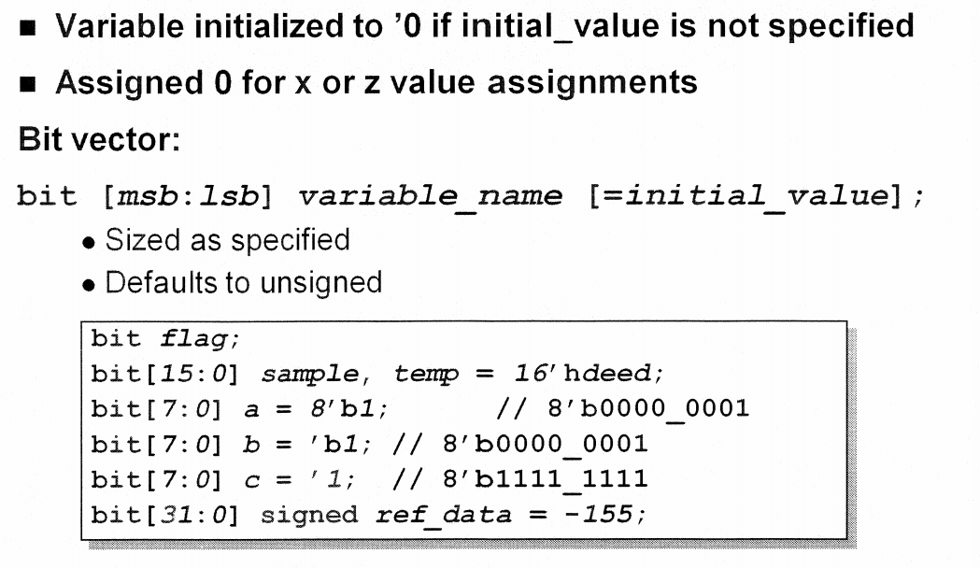
DATA TYPE Integer: example 2 state

Slide 4
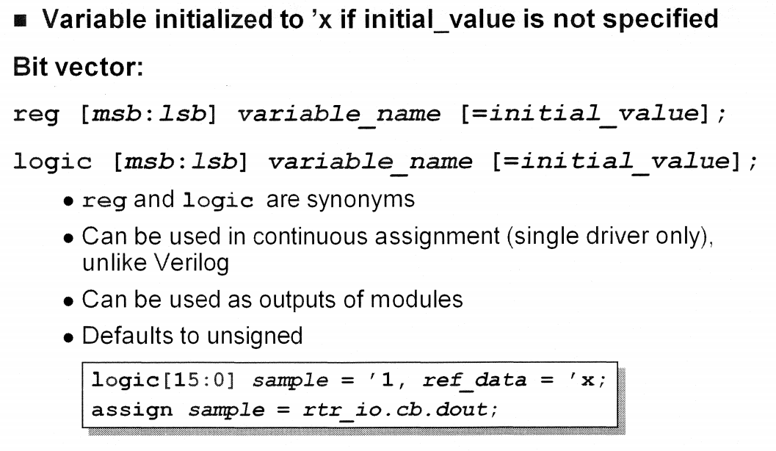
DATA TYPE Integer: example 4 state

Slide 5
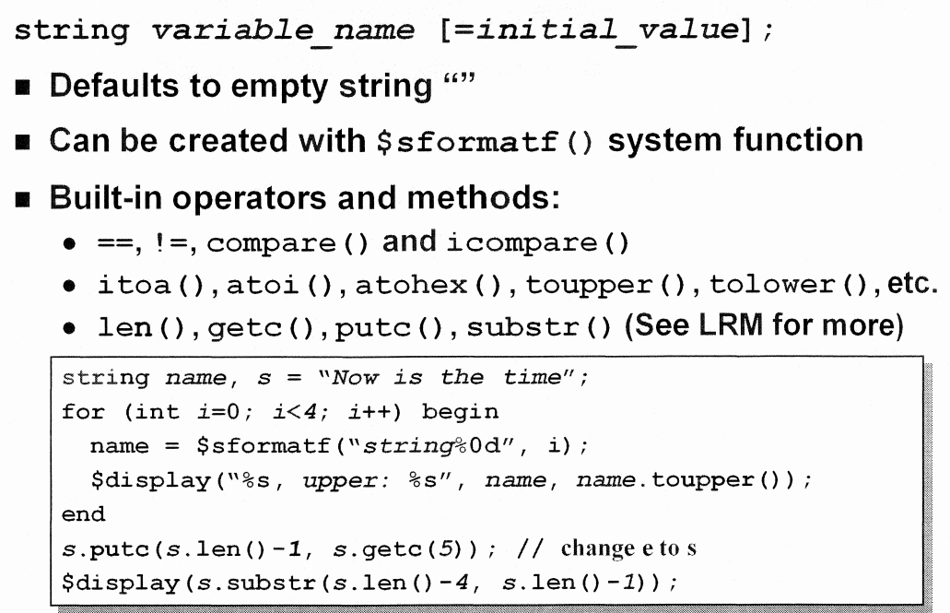
DATA TYPE String

Slide 6
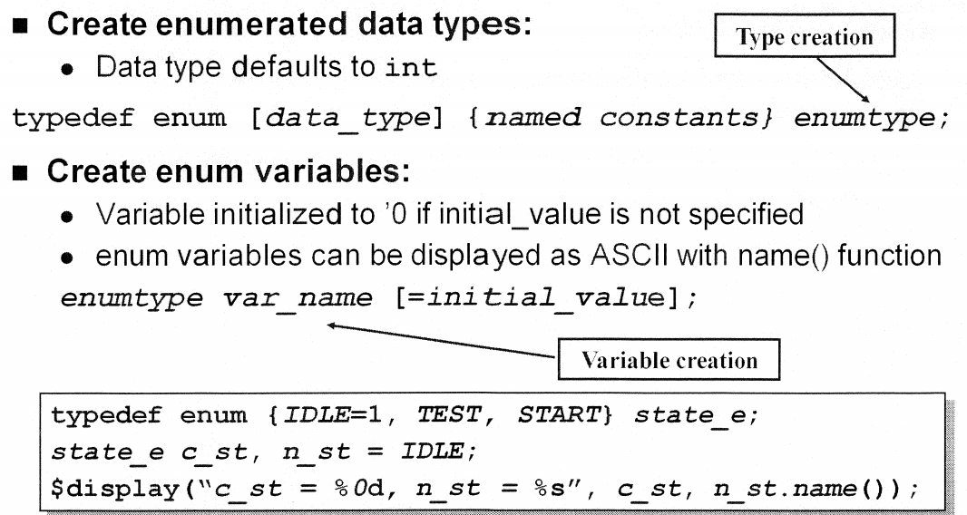
DATA TYPE Enum

Slide 7
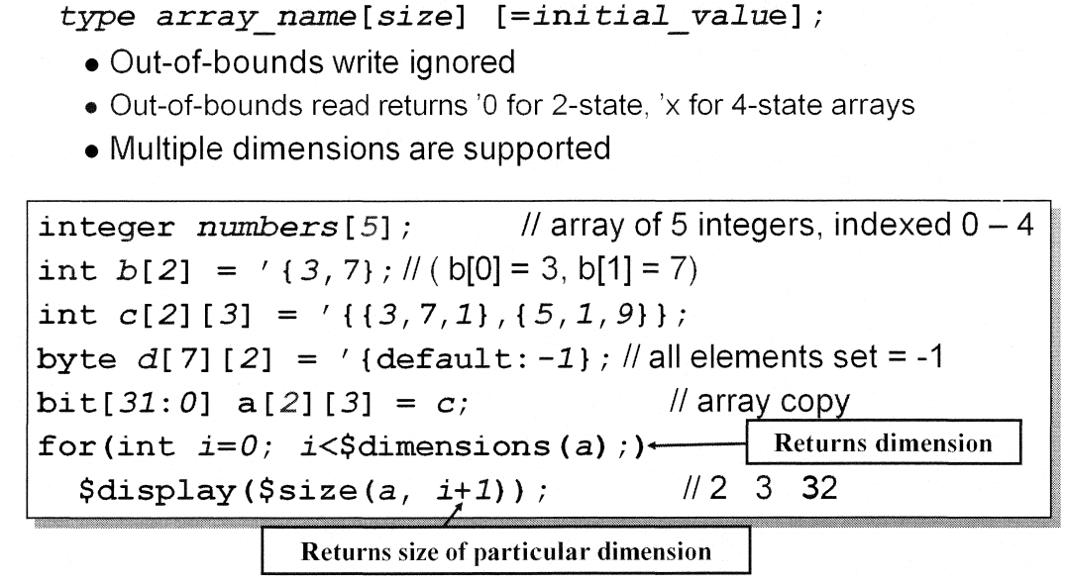
DATA TYPE Fixed arrays

Slide 8
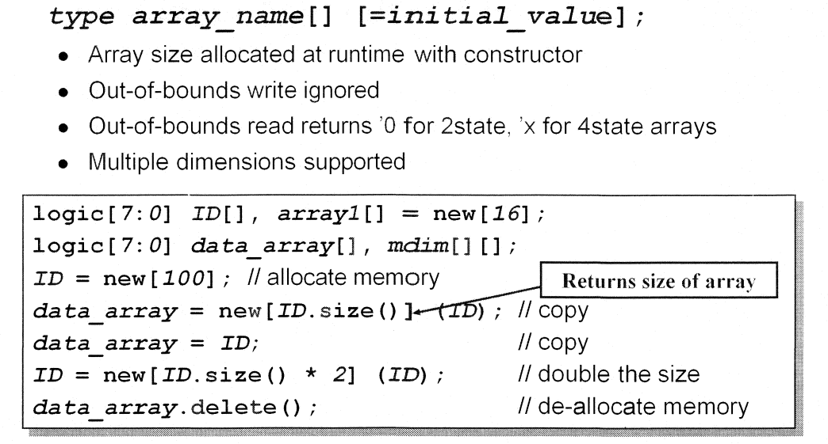
DATA TYPE Dynamic array

Slide 9
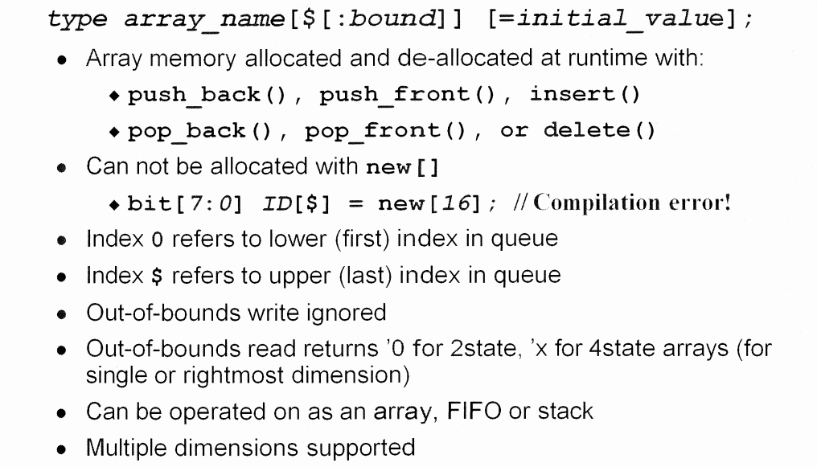
DATA TYPE Queues(1)

Slide 10
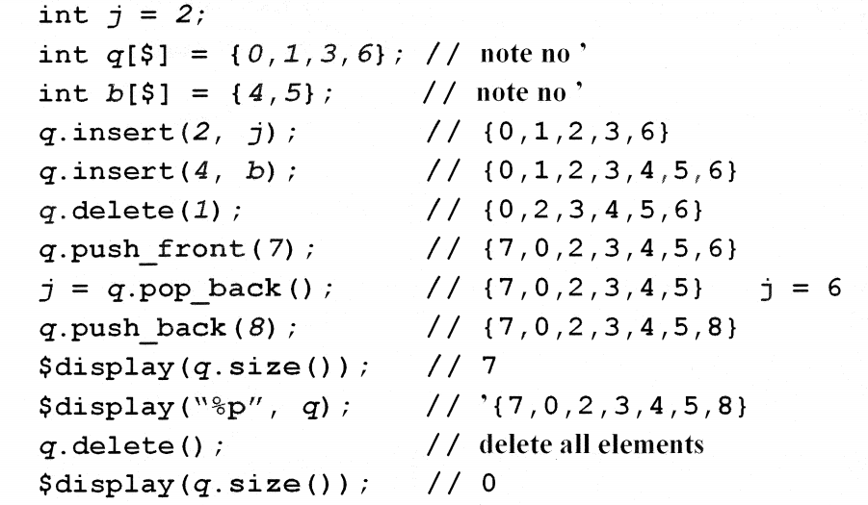
DATA TYPE Queues(2)

Slide 11
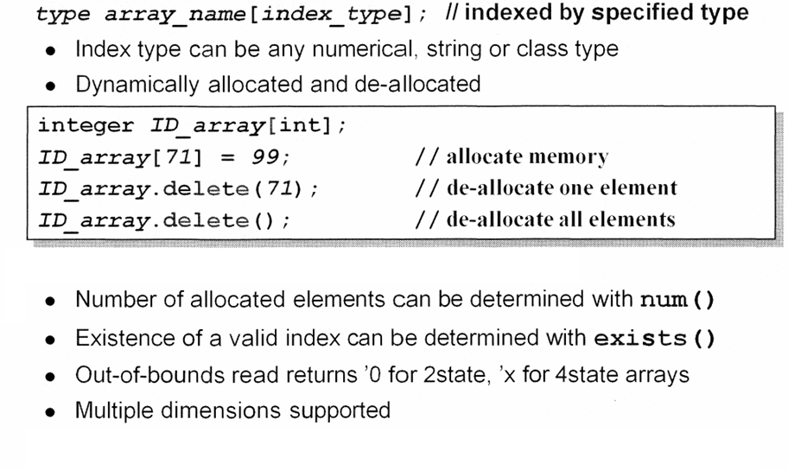
DATA TYPE Associative array(1)

Slide 12
DATA TYPE Associative array(2)
Array can be traversed with:
Syntax:
function int first (ref index)
function int last (ref index)
function int next (ref index)
function int prev (ref index)
The above functions assigns the index value by modifying their argument
The function return value is only a status value of 0 or 1

Slide 13
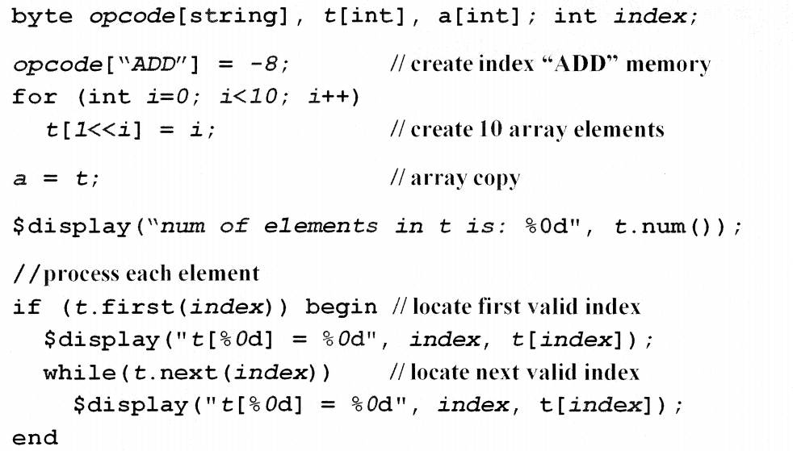
DATA TYPE Associative array(3)

Slide 14
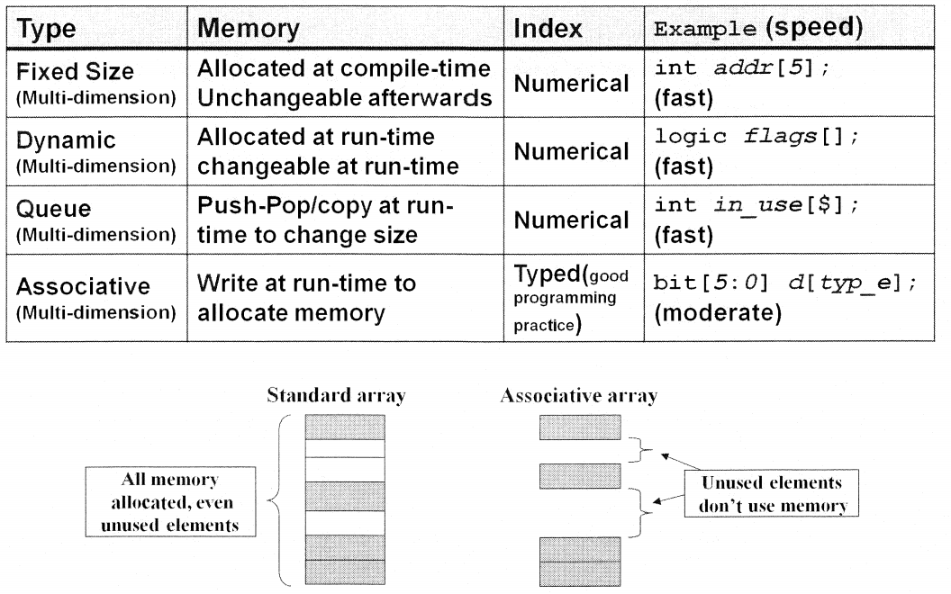
DATA TYPE Summary array

Slide 15
PROCEDURAL PROGRAMMING STATEMENT Overview
Procedural programming statements shall be contained within any of the following constructs
Always
Initial
Subroutine (task, function)
Procedural programming statements include the following:
Condition statements (if…else, case)
Jump statements (break, continue, return)
Loop statement (forever, for, repeat, while, foreach)
Sequential & parallel blocks (begin…end, fork-join)
Timing control (#, @, wait)
Subroutine calls

Slide 16
PROCEDURAL PROGRAMMING STATEMENT Timing control
Delay controls
# <time> statement;
# 10 y = 1;
Edge sensitive event control
@(<posedge> | <negedge> signal) statement;
@(posedge clock) q= d;
Level sensitive event control
@(signal) statement;
@(clock) q = d;
wait(expression) statement;
wait(count_enable) #20 count = count + 1;

Slide 17
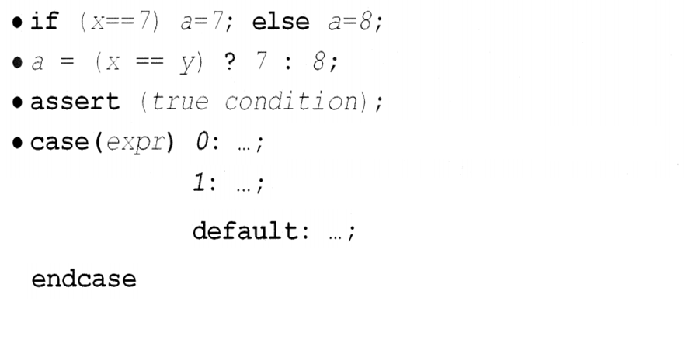
PROCEDURAL PROGRAMMING STATEMENT Condition statements
The condition statements is used to make a decision about whether a statement is executed

Slide 18
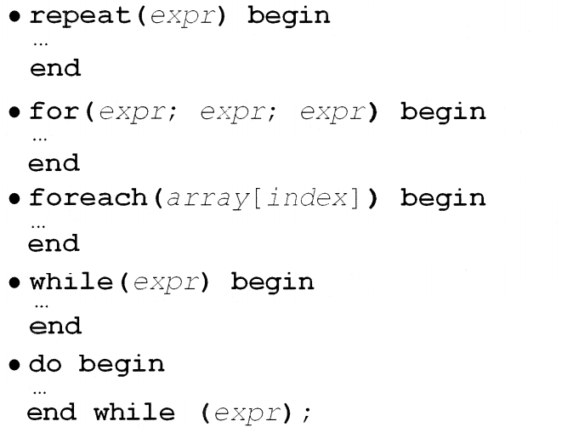
PROCEDURAL PROGRAMMING STATEMENT Loop statements

Slide 19
PROCEDURAL PROGRAMMING STATEMENT Jump statements
SV provides the C – like jump statements
Break
Continue
Return
The continue & break statements can only be used in a loop
The return statement can only used in a subroutine

Slide 20
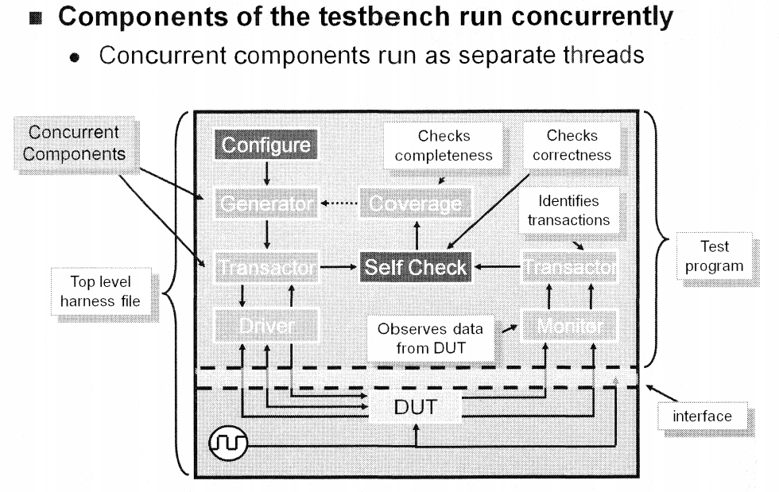
PROCEDURAL PROGRAMMING STATEMENT Parallel block: overview

Slide 21
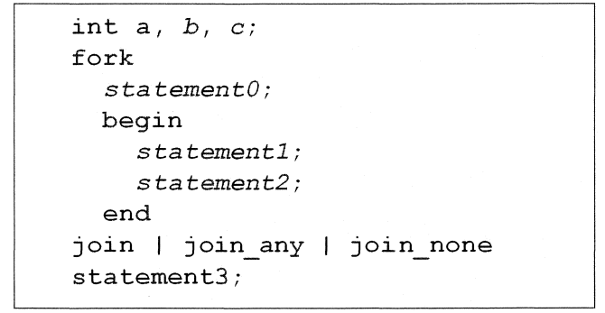
PROCEDURAL PROGRAMMING STATEMENT Parallel block: creating
The parallel block are created in a fork-join block
A parallel block shall have the following characteristics
The procedural statements shall be executed concurrently
No pre-determined execution order for concurrent threads
All child threads share the parent variables

Slide 22
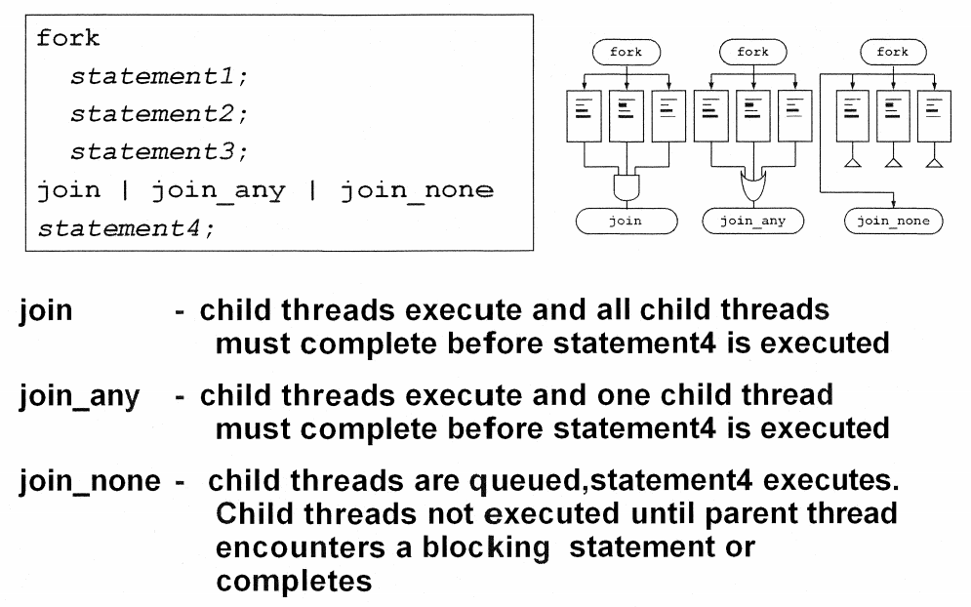
PROCEDURAL PROGRAMMING STATEMENT Parallel block: join option

Slide 23
PROCEDURAL PROGRAMMING STATEMENT Parallel block: wait fork
To prevent improper early termination of simulation, one can use wait fork
The wait fork statement is used to ensure that all child processes have completed execution
begin
fork
task1();
task2();
join_any
fork
task3();
task4();
join_none
wait fork
end

Slide 24
PROCEDURAL PROGRAMMING STATEMENT Parallel block: disable fork
The disable fork statement terminates all active child processes on the processes where it is called
task watch_dog_timer;
fork
run_test();
time_out(1000);
join_any
disable fork; //kills the slower task
endtask

Slide 25
SUBROUTINES overview
Task and function are called subroutines
A function can not enable a task; a task can enable other tasks and functions
A function shall not contain any time controlled statement; a task may contain time controlled statements (#, @, wait, fork-join, fork-join_any)
The statements in the body of the function shall execute in one simulation time unit
A non void function shall return a single value; a task or void function shall not return a value

Slide 26
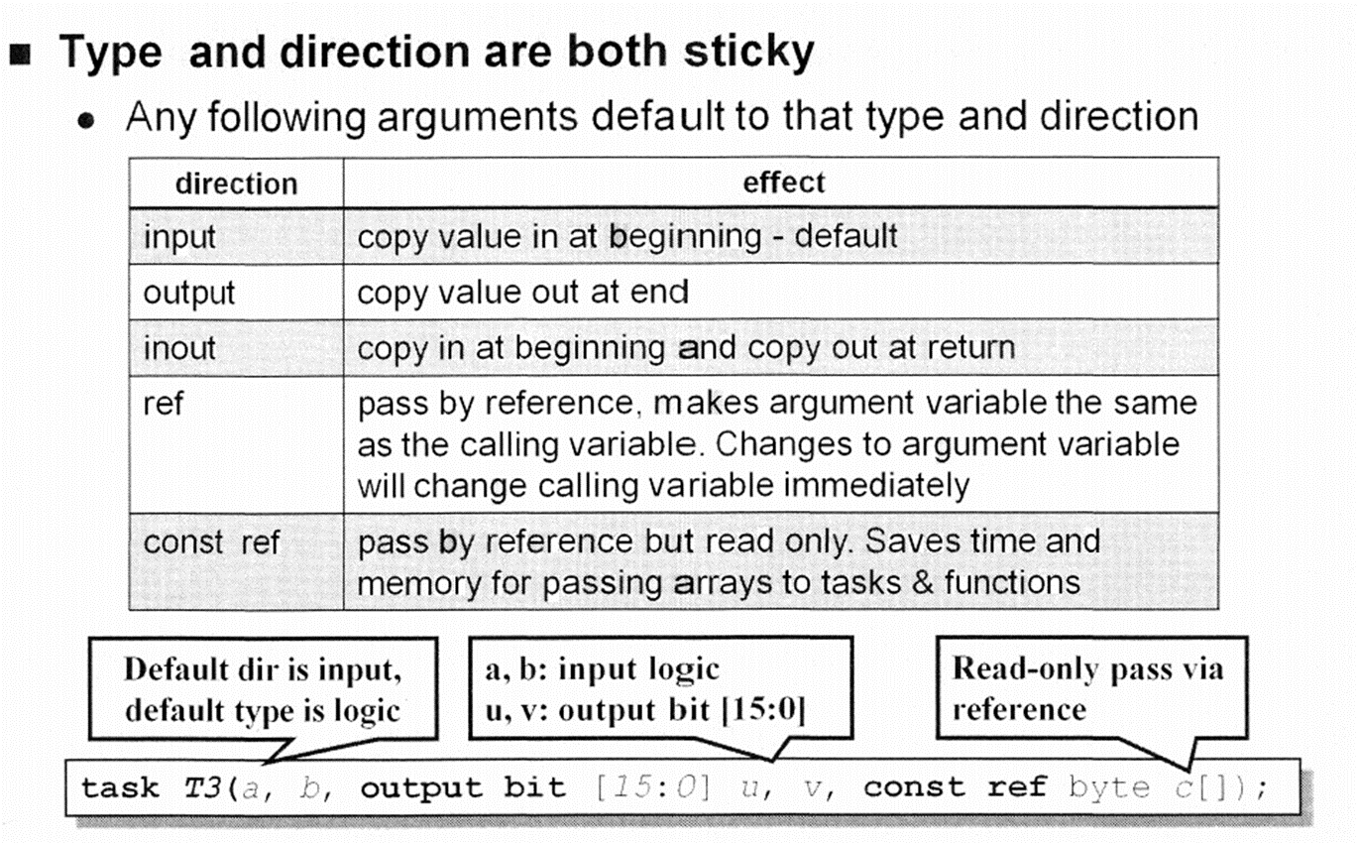
SUBROUTINES Argument

Slide 27
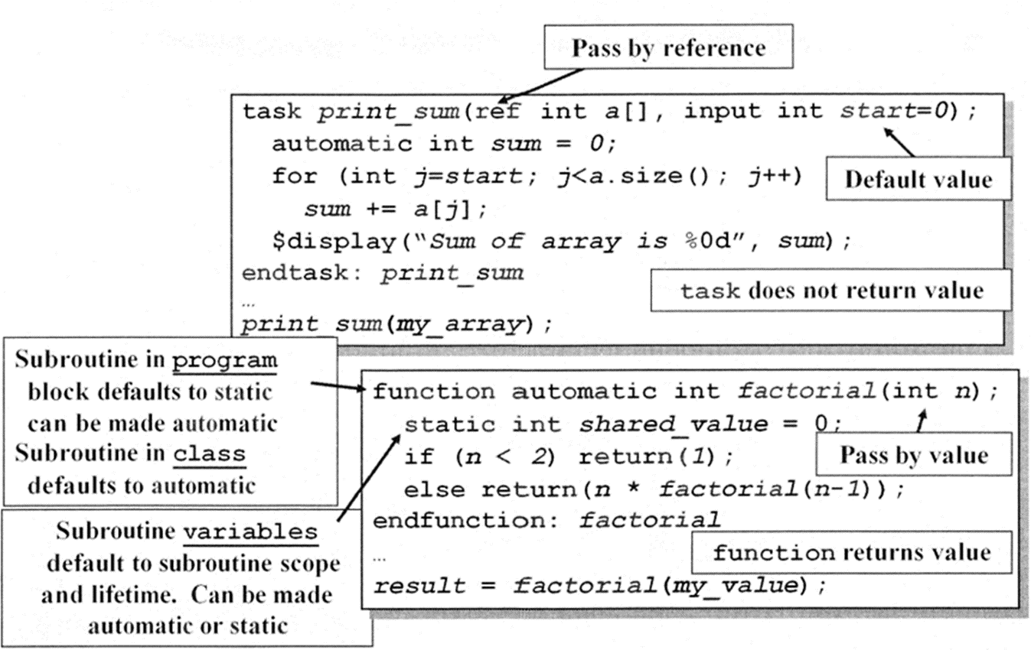
SUBROUTINES examples

Slide 28
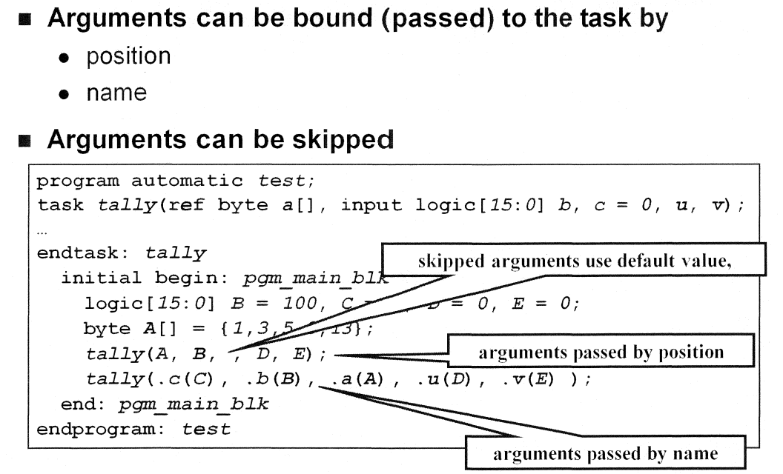
SUBROUTINES Pass argument

Slide 29
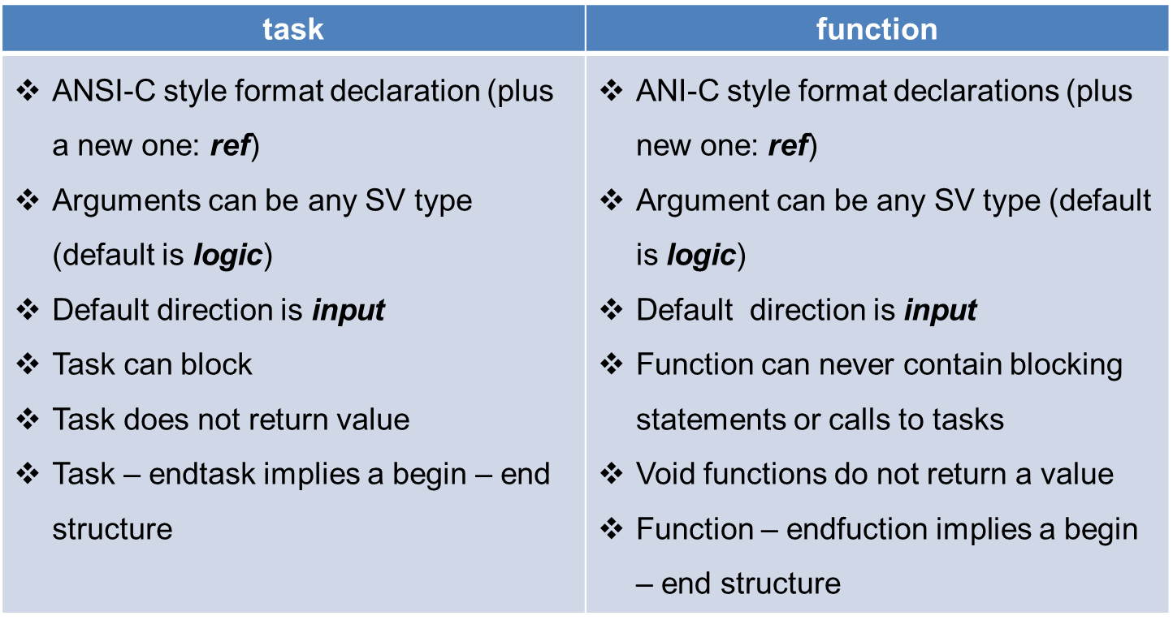
SUBROUTINES Summary

Slide 30
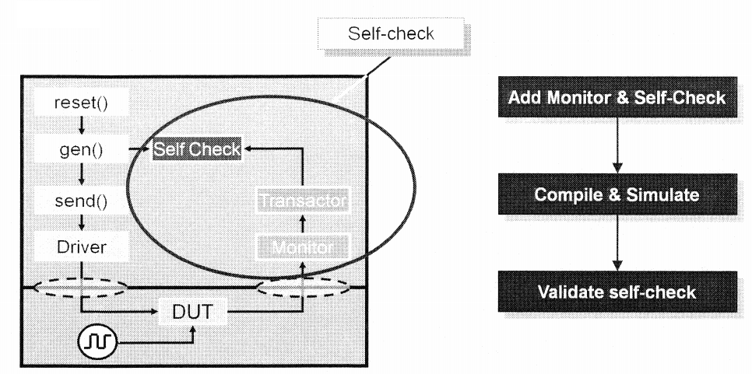
LAB INTRODUCTION
Lab 3: add concurrent monitor and self-check

