Slide 1
OBJECT ORIENTED PROGRAMMING

Slide 2
OVERVIEW
Object oriented design is a common programming paradigm
Data and the means to manipulate is described together in a formal structure called a class
An instance of a class is referred to as an object. Objects are dynamically created and destroyed
Memory allocation and de-allocation is handled automatically
Code minimization and reuse is facilitated through inheritance and polymorphism

Slide 3
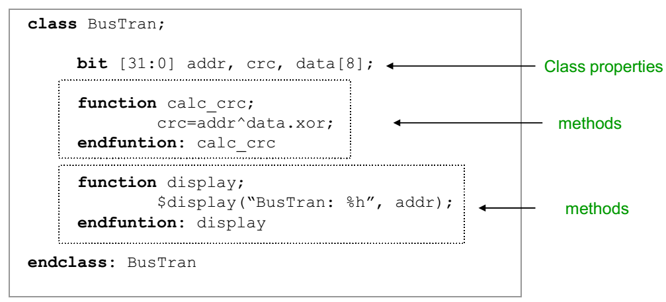
CLASS introduction
A class is a data type
Contains data referred to as class properties
Contains subroutines (task/function) referred to as class methods
Both properties and methods are members of class

Slide 4
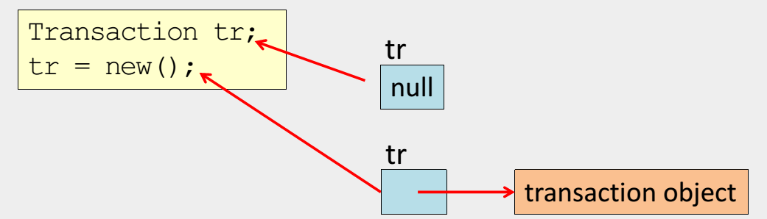
CLASS object creation
An object is an instance of a class. To create a class object:
1. Declare a handle (class variable)
When a handle is declared it is initialized to null
2. Create the object by invoking the new() method
When you call new() you are allocating a new block of memory to store variable for that object. Initialized the variables to their default value (0 for 2 state, x for 4 state)

Slide 5
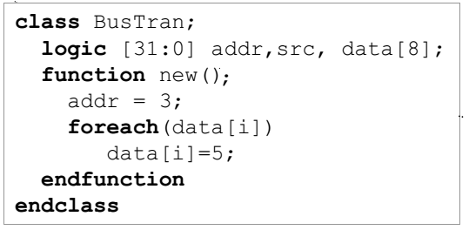
CLASS constructor(1)
Every class has a build-in method new() called the constructor
Memory space is allocated
All variables initialized to their default value
Used for initialization of the instance (overloads new())

Slide 6
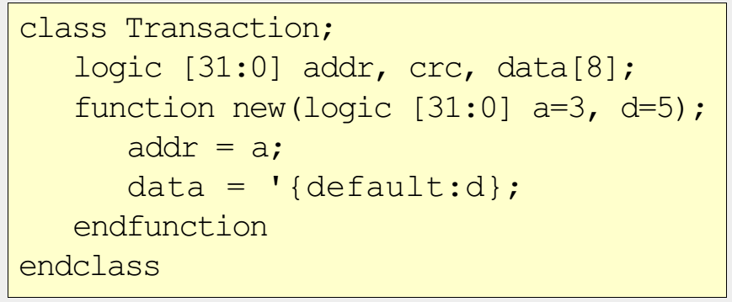
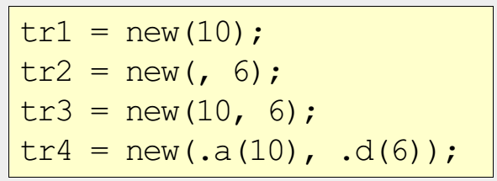
CLASS constructor(2)
Make the constructor more flexible by passing in values

Slide 7
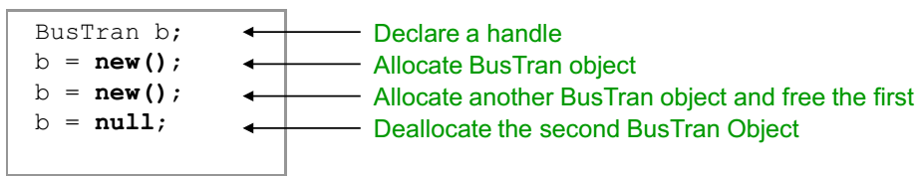
CLASS object destruction
Objects destruction (de-allocation) done automatically when an object is no longer being referenced
Need to manually clear all handle by setting them to null

Slide 8
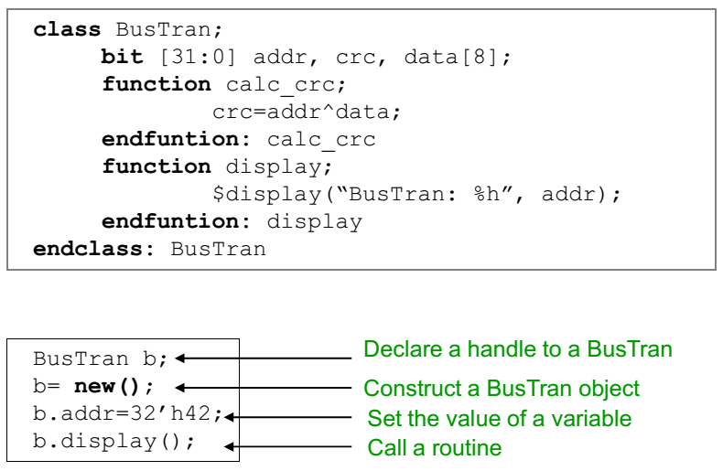
CLASS accessing object member
Refer to members using the . notation

Slide 9
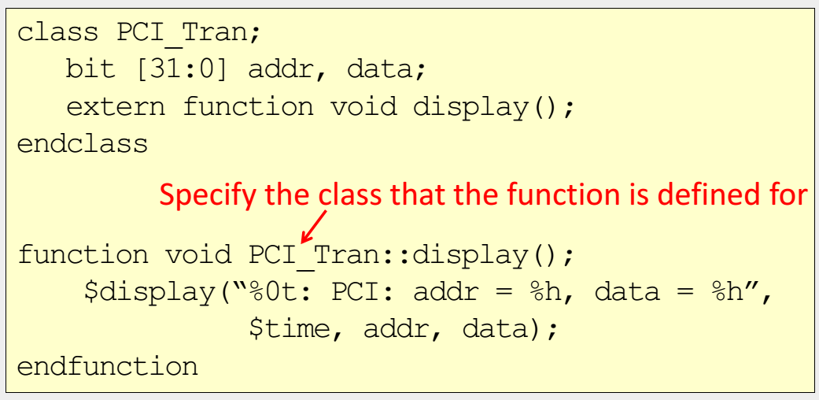
CLASS out-of-block declarations
Done to keep the class definition readable
Define a prototype of the method in the class
Use the extern keyword to indicate the full definition is external

Slide 10
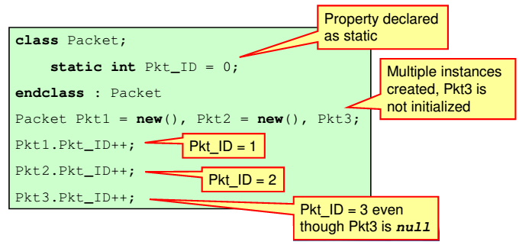
CLASS static properties
Unless declared static, each class object has its own copy of the class properties
Static properties shared between all instances of class
Static properties can be used with out creating object

Slide 11
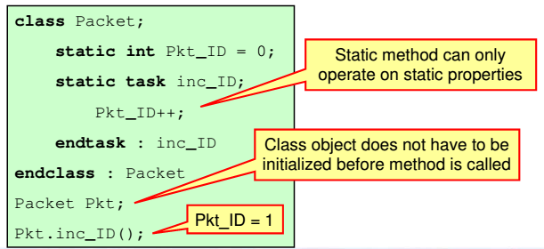
CLASS static method
Static class methods can be called from outside class. Can be used without creating object
Can not access non-static members (properties or methods)

Slide 12
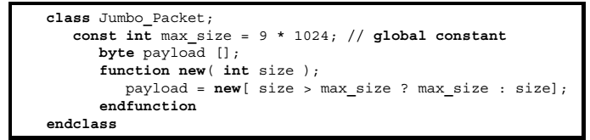
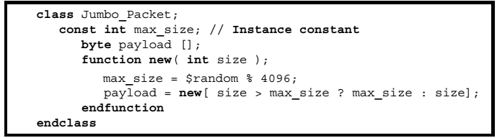
CLASS const properties
Global constant have an initial value as a part of their declaration. They can not be assigned a value anywhere other than in the declaration
Instance constant are assigned value in their constructors

Slide 13
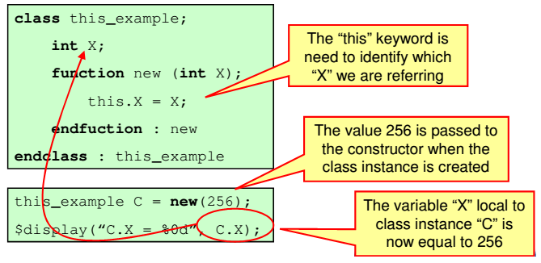
CLASS this
The this keyword is used to unambiguously refer to (non-static) members of the current instance
Commonly used in constructor where argument to constructor matches a class variable

Slide 14
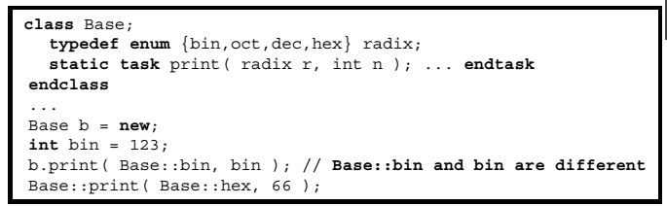
CLASS scope operator(::)
:: refers to the member of the class
Applies to all static elements of a class
Static properties and static method
Typedef
enumeration

Slide 15
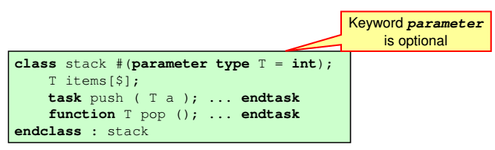
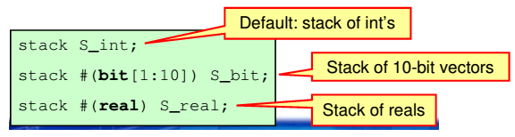
CLASS Parameterized Class(1)
Allows Generic Class to be instantiated as objects of different types or size
A generic class and actual parameter values is called a specialization

Slide 16
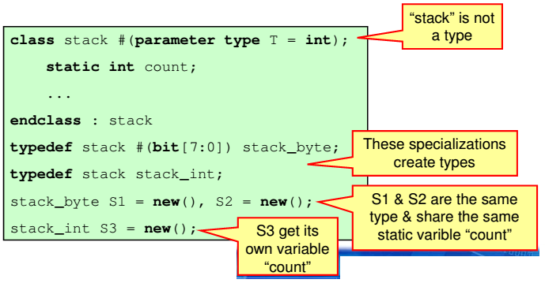
CLASS Parameterized Class(2)
A generic class declaration is not a type
Only its concrete specialization is a type
Each specialization has its own unique copy of static variable
If parameter types and sizes are the same, those specialization share static variables

Slide 17
OOP INHERITANCE

Slide 18
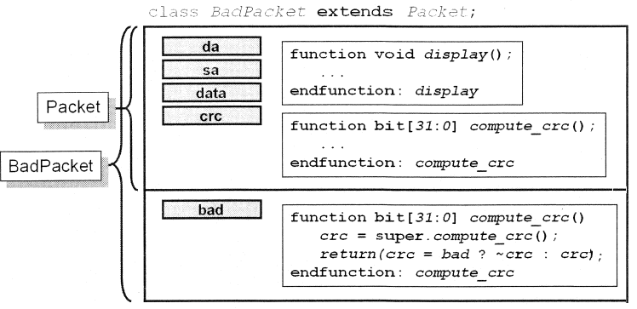
INHERITANCE introduction
Object-oriented programming
New classes derived from original (base) class. This class is called a derived class
Inherits all contains of base class

Slide 19
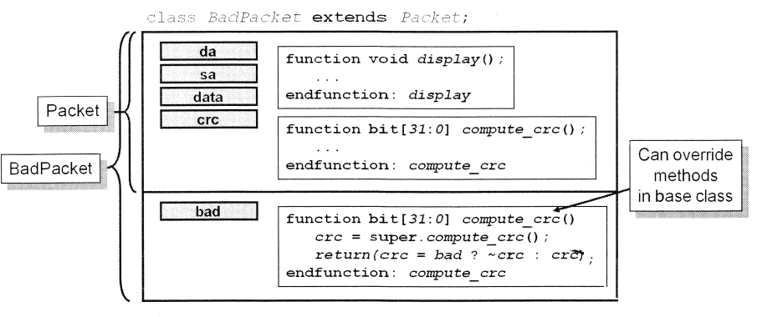
INHERITANCE overriding
Derived classes may “override” the definition of a member inherited from the base class
“hides” the overridden property or method
To override a method the child method’s signature must match the parent’s exactly

Slide 20
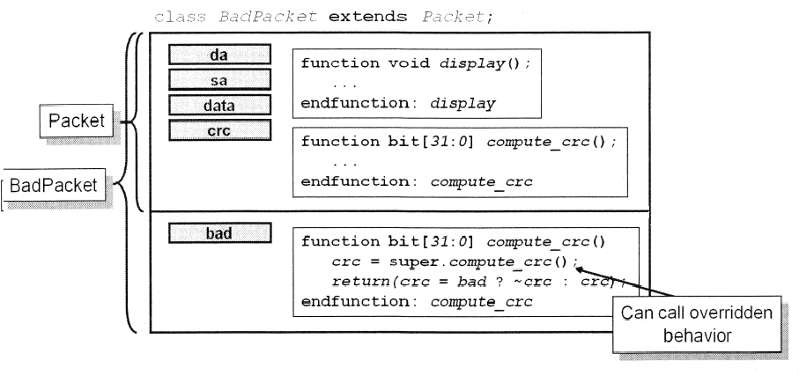
INHERITANCE super
The super keyword is used to refer to members of the base class
Required to access members of the parent class when the members are overridden in the child class
Only legal from within the derived class

Slide 21
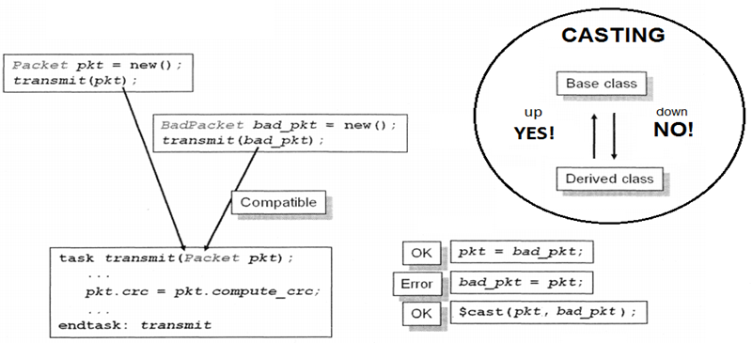
INHERITANCE $cast
Derived classes compatible with base class
$cast() can also be used as a function that check if the type of the arguments match. It returns a true if they match and a false if they do not

Slide 22
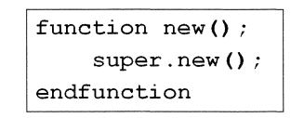
INHERITANCE constructor
When constructing an object of a derived class
If the derived class does not have a constructor defined VCS inserts one
If the derived class defines a constructor, SV expects its first procedural statement to be super.new()
If called anywhere except as the first statement, a syntax error will result
User provides the correct argument set

Slide 23
ENCAPSULATION introduction
By default, all members are visible in the scope in which the object is visible or we can say it be accessed outside the class directly using the dot operator
This is not always desirable. To prevent accidental and incorrect manipulation of class properties and invocation of methods, they can be declared as local or protected
Hiding the properties from being accessed outside the class is called encapsulation

Slide 24
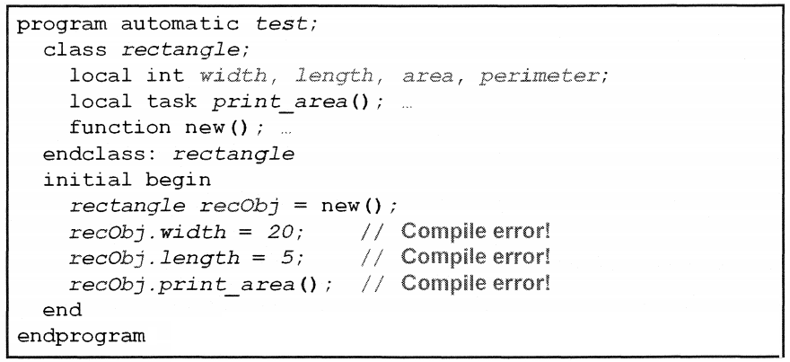
ENCAPSULATION local member(1)
Properties and methods can be protected via “local”

Slide 25
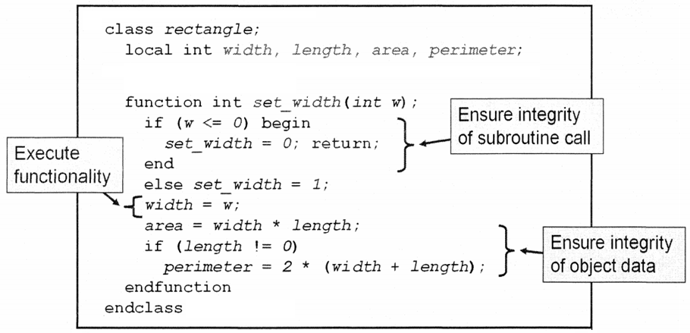
ENCAPSULATION local member(2)
Local members are only available to methods inside the class

Slide 26
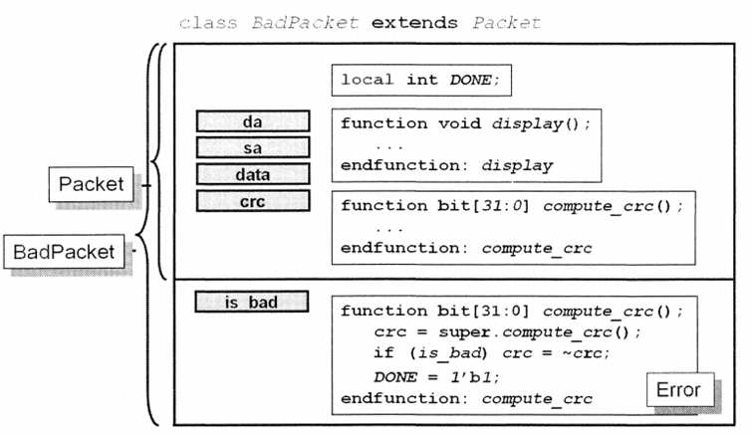
ENCAPSULATION local member(3)
Local members not visible in the derived class

Slide 27
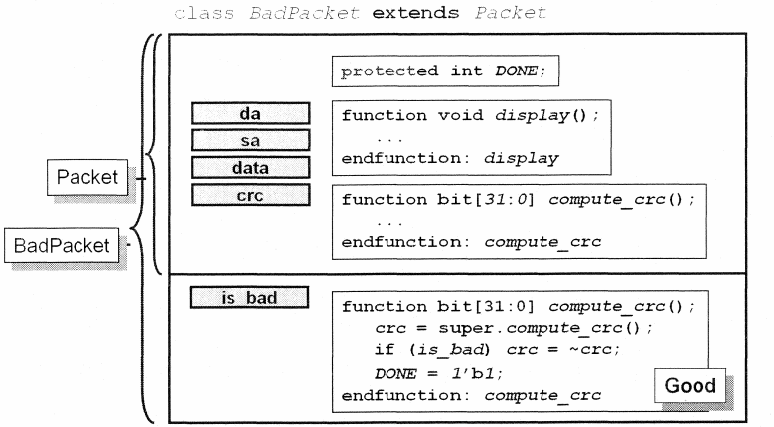
ENCAPSULATION protected member
A protected member has all of the characteristics of a local member, except that it can be inherited; it is visible to derived class

Slide 28
OOP POLYMORPHISM

Slide 29
POLYMORPHISM introduction
Consider a base class that is multiply derived into subclasses, each of which overrides a common base method
Polymorphism allows the use of variable in the base class to hold subclasses object and to reference the methods of those subclasses directly from the base class variable
To achieve polymorphism the virtual identifier must be used when defining the methods within that class

Slide 30
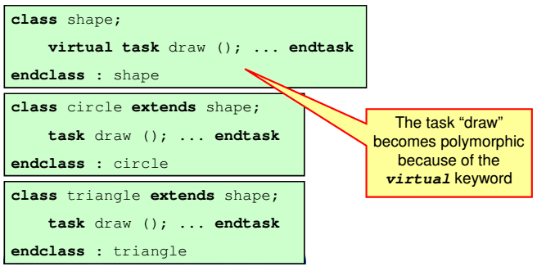
POLYMORPHISM example(1)

Slide 31
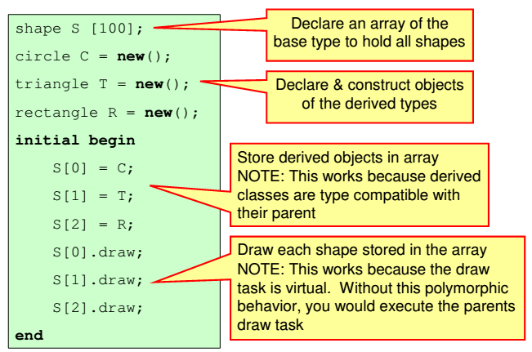
POLYMORPHISM example(2)

Slide 32
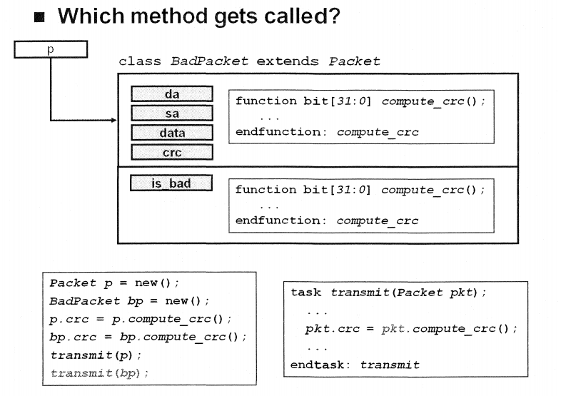
POLYMORPHISM virtual method

Slide 33
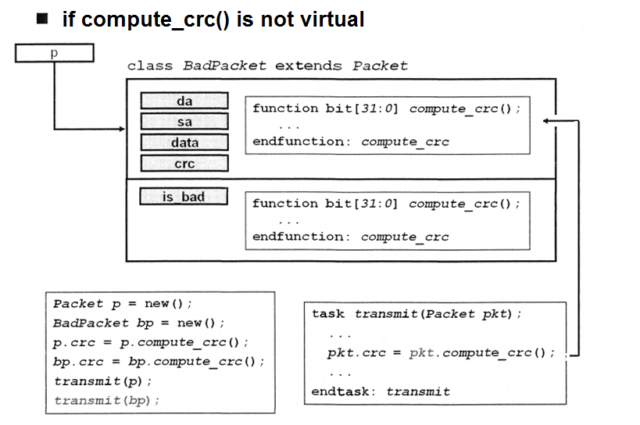
POLYMORPHISM without virtual

Slide 34
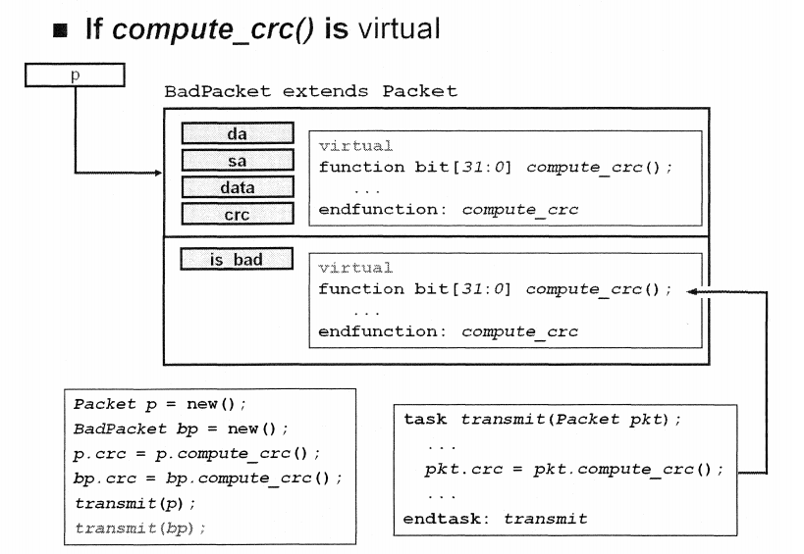
POLYMORPHISM virtual

