Slide 1
RANDOMIZATION AND CONSTRAINT

Slide 2
RANDOMIZATION overview
In SV, randomization is achieved via class
randomize() function built into class
Two types of random properties are supported
rand: same value may come before all the possible value
have been returned
randc: same value does not get returned until all possible
value have been returned
When the class function randomize() is called
Randomizes each rand and randc property value to full range of its data type

Slide 3
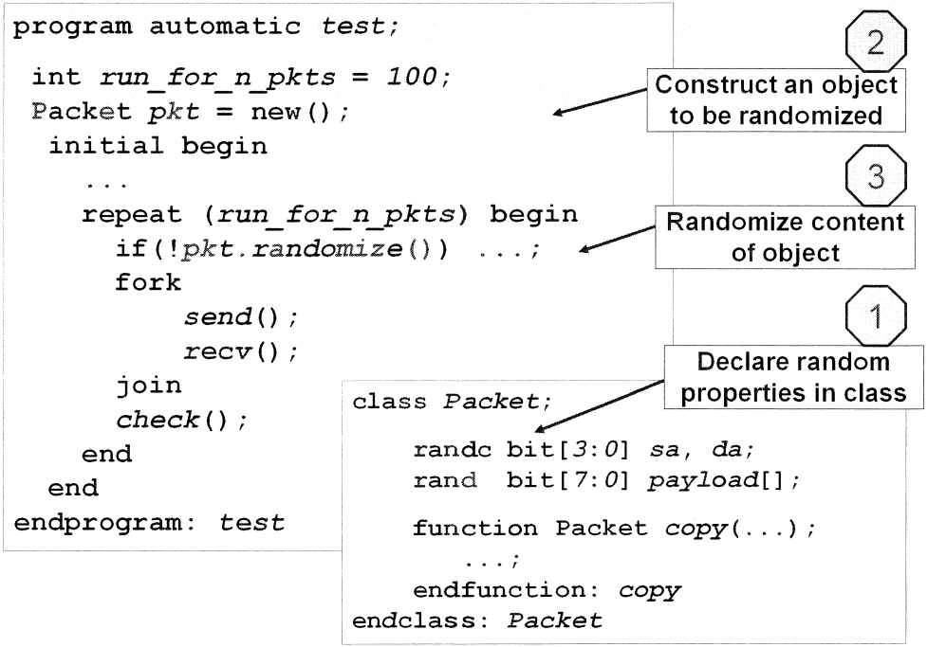
RANDOMIZATION example

Slide 4
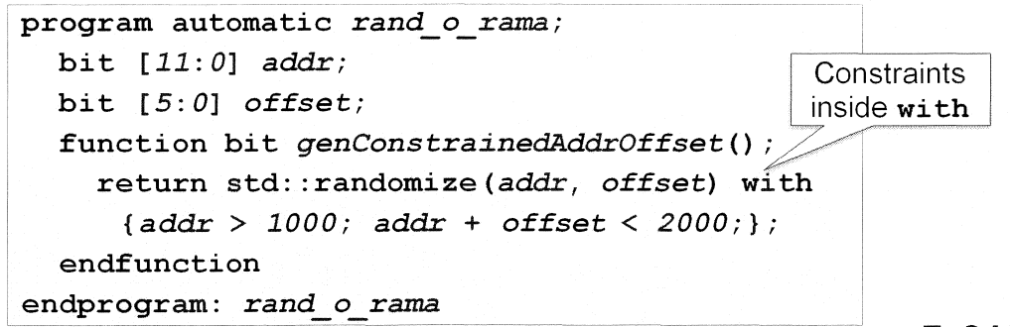
RANDOMIZATION std::randomize()
Std::randomize() randomizes variables without creating class
Available in modules, functions, tasks, and classes

Slide 5
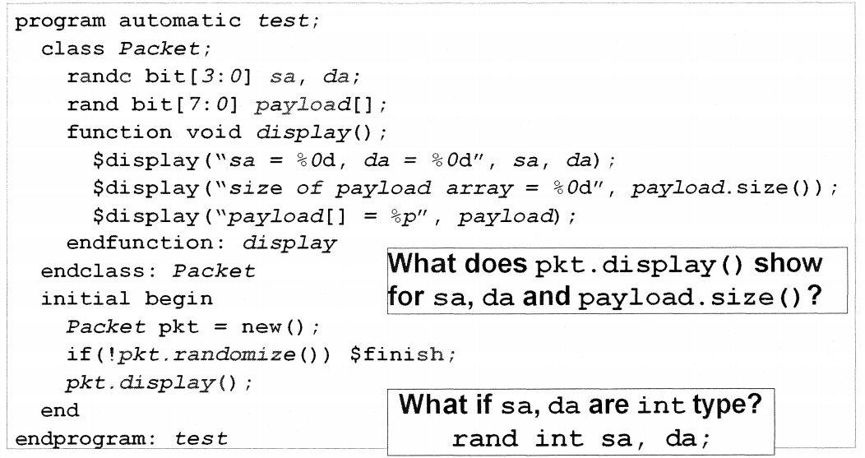
RANDOMIZATION controlling random variables(1)
How do you control the value range for sa and da?
How do you control the size of payload[]?

Slide 6
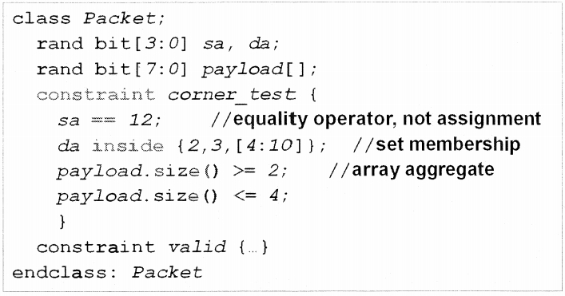
RANDOMIZATION controlling random variables(2)
Randomization controlled by constraint block
Note:
Constraint support only 2 state value
Multiple constraint blocks may be defined
Constraint expression must return true or false

Slide 7
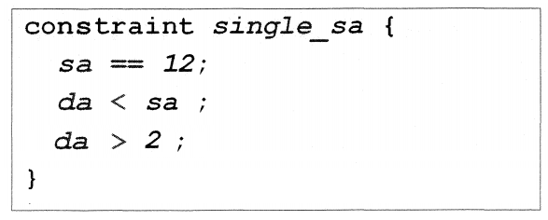
CONSTRAINT relational operator
There can be a maximum of only one relational operation (<, <=, ==, >, >=) in an expression

Slide 8
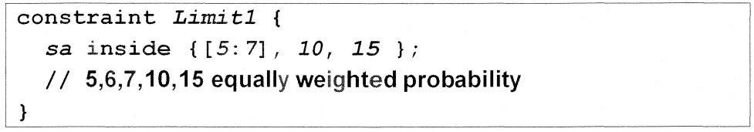
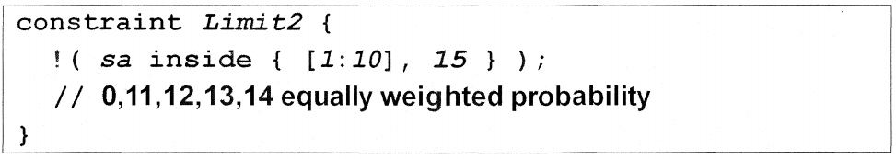
CONSTRAINT set membership
Select from a list or set with keyword inside
Excluded from a specified set with !

Slide 9
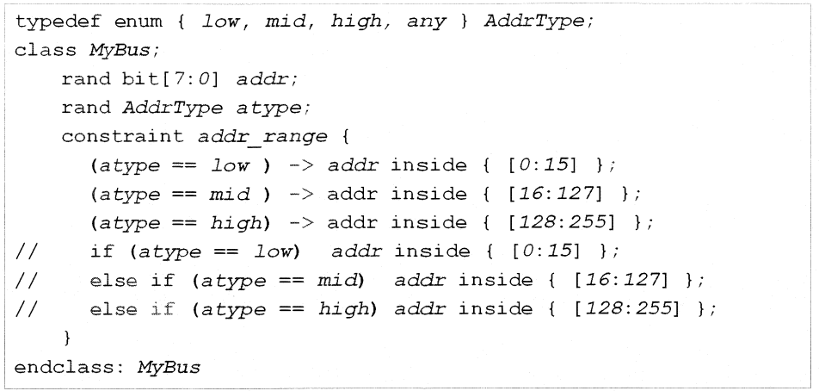
CONSTRAINT implication
Implication operator: ->
if (…) … [else ..]

Slide 10
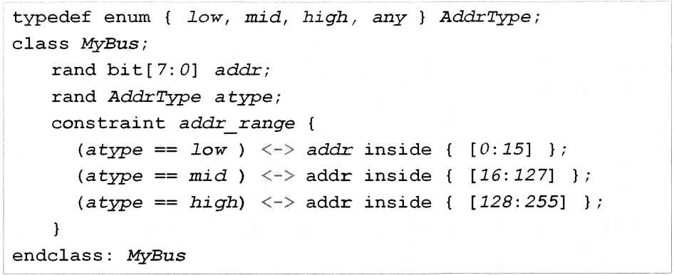
CONSTRAINT equivalence
Equivalence operator: <->
True bidirectional constraint
A <-> B means if A is true B must be true and if B is true A must be true

Slide 11
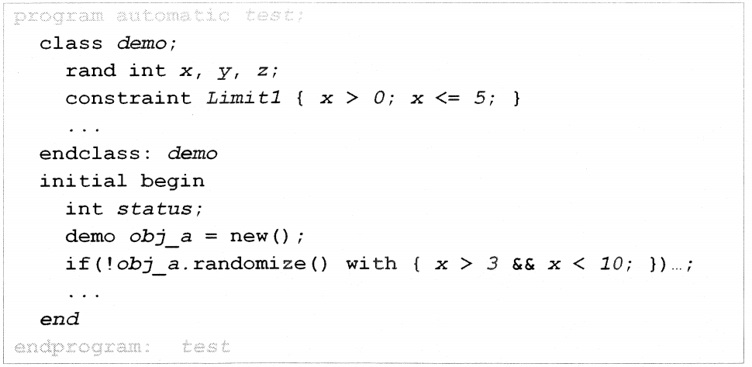
CONSTRAINT inline constraint
Syntax:
obj.randomize() with { <new constraints> }

Slide 12
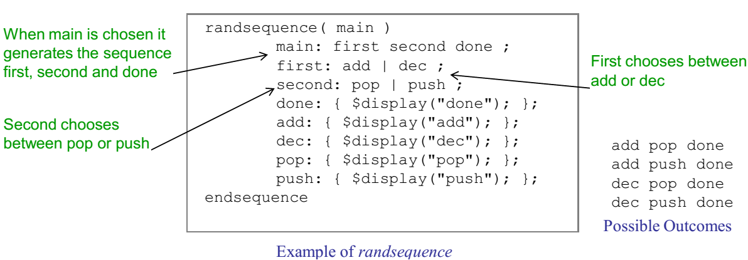
RANDSEQUENCE overview
Use randsequence SV constructs to generate a sequence of transaction

Slide 13
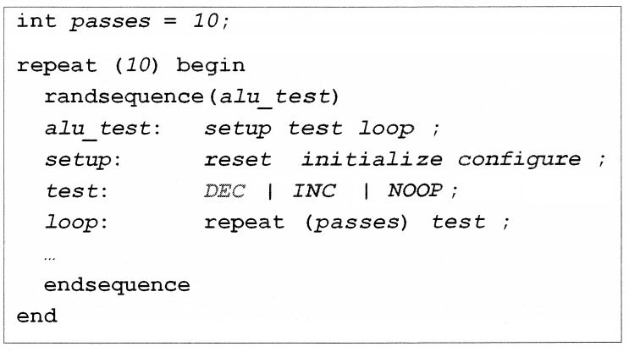
RANDSEQUENCE controlling execution sequence(1)
Can be inside a repeat, for, or while loop

Slide 14
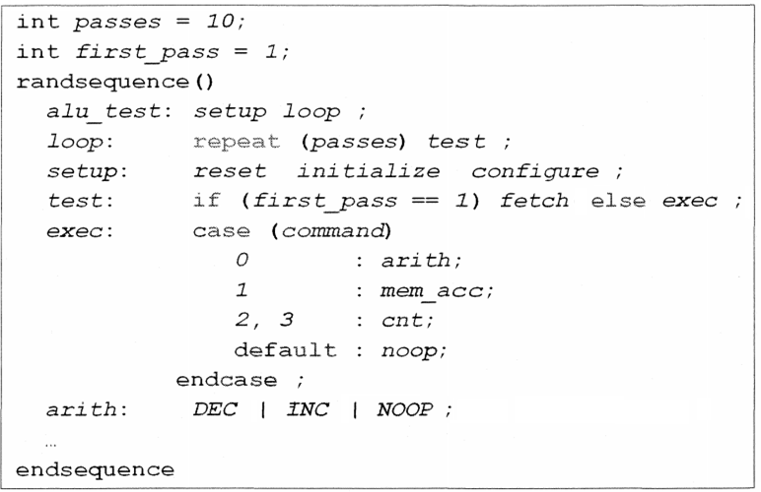
RANDSEQUENCE controlling execution sequence(2)
Randsequence supports if-else or case statement

Slide 15
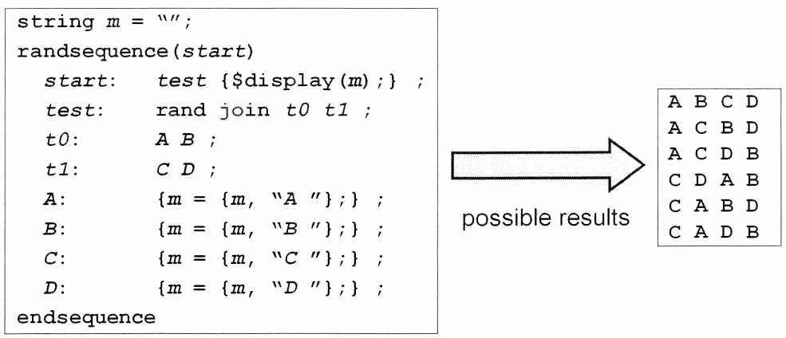
RANDSEQUENCE controlling execution sequence(3)
Productions can be interleaved with rand join:
Note: B always comes after A and D comes after C

Slide 16
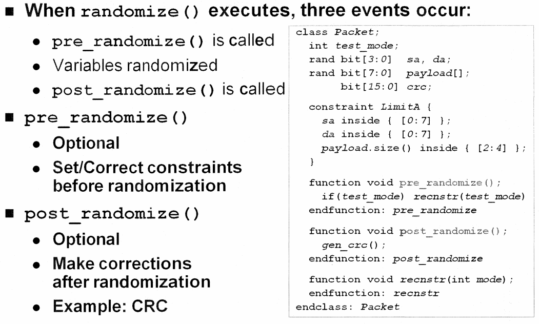
CONTROLLING RANDOMIZATION effects of calling randomize()

Slide 17
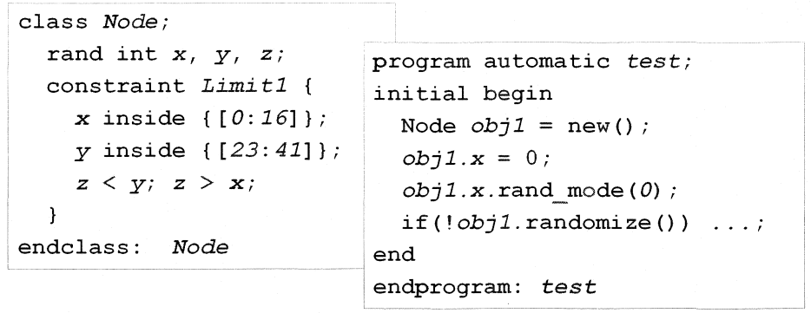
CONTROLLING RANDOMIZATION controlling randomization at runtime
Turn randomization for properties on or off with
task/function int object_name.properity.rand_mode(0|1);
1 – enable randomization (default)
0 – disable randomization

Slide 18
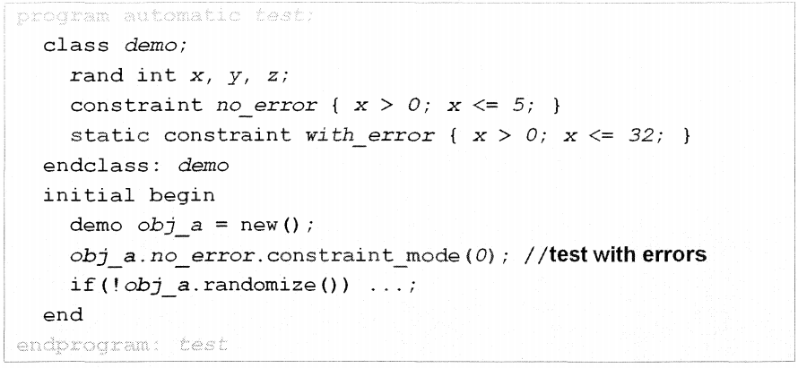
CONTROLLING RANDOMIZATION controlling constraint at runtime
Turns constraint block on or off with
task/function int object_name.constraint_block_name.constraint_mode(0|1);
1 – enable constraint (default)
0 – disable constraint

Slide 19
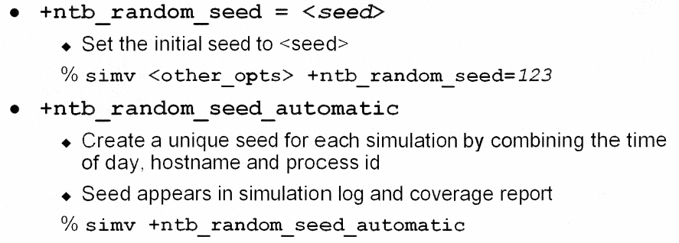
CONTROLLING RANDOMIZATION changing the random seed at simulation
VCS allows you to provide an initial seed during simulation with the following to simulator

Slide 20
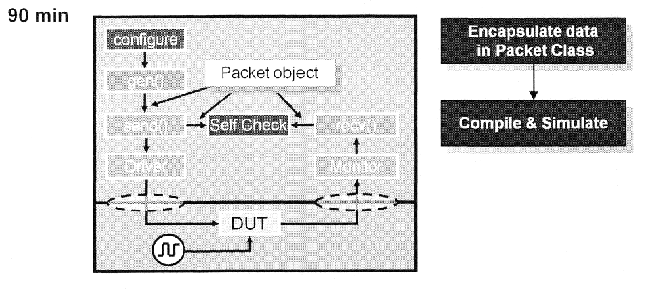
LAB 4 INTRODUCTION
Lab4: Encapsulate data in Packet Class

