Slide 1
INTER-PROCESS COMMUNICATION

Slide 2
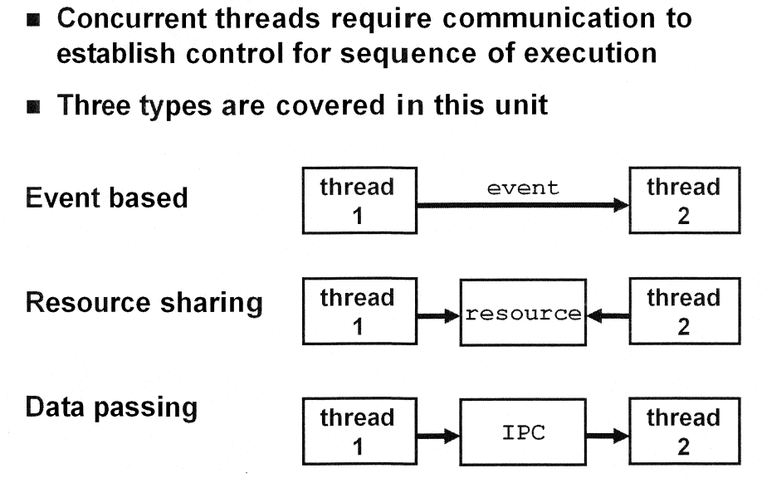
OVERVIEW

Slide 3
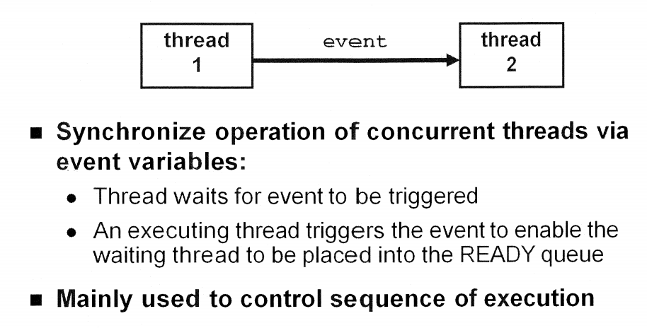
EVENT event base

Slide 4
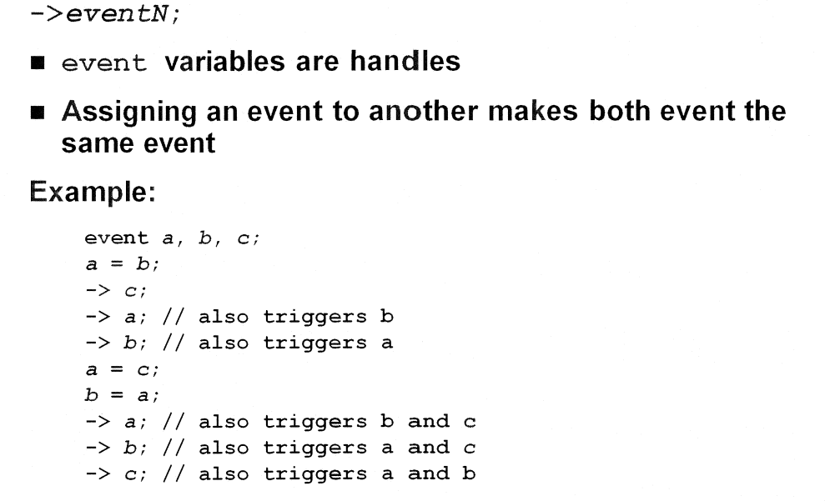
EVENT trigger syntax

Slide 5
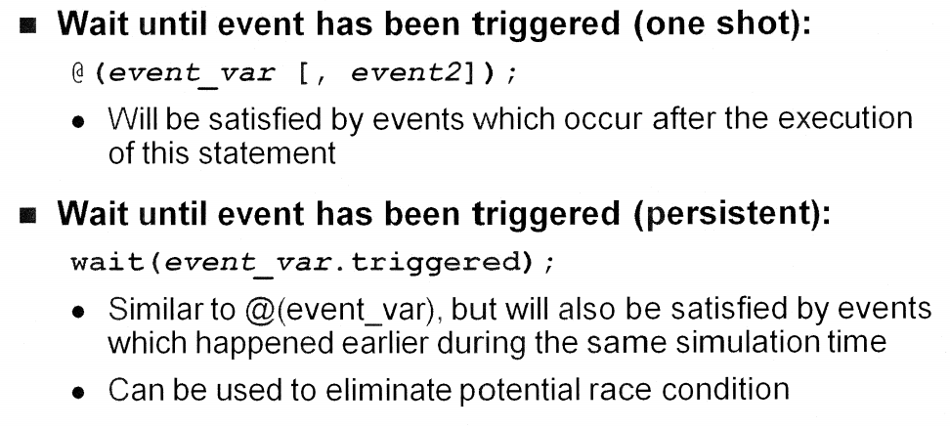
EVENT wait syntax

Slide 6
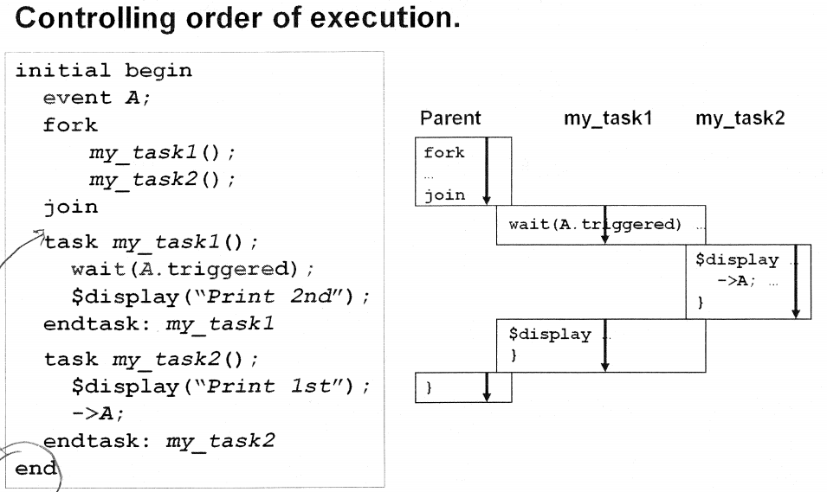
EVENT example: trigger

Slide 7
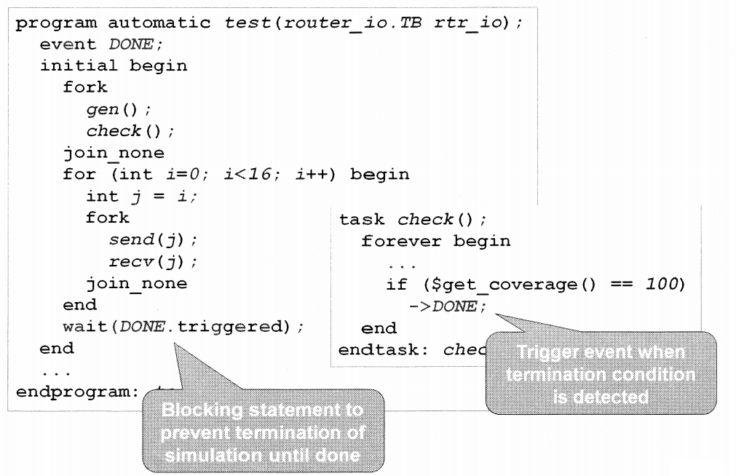
EVENT example: controlling terminal simulation

Slide 8
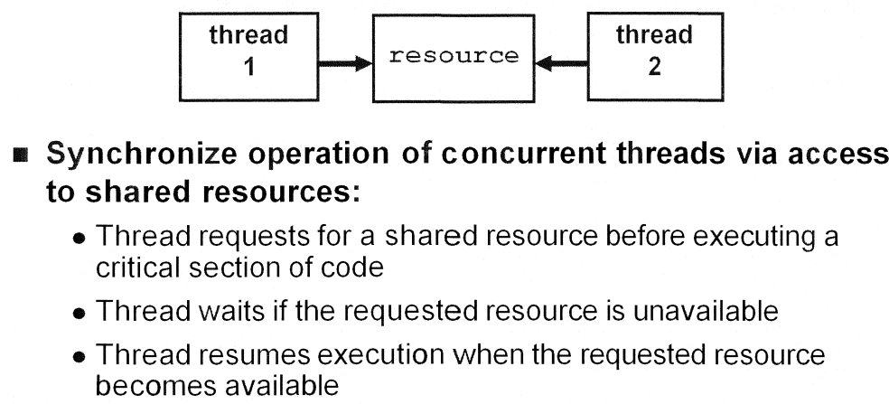
SEMAPHORE shared resources

Slide 9
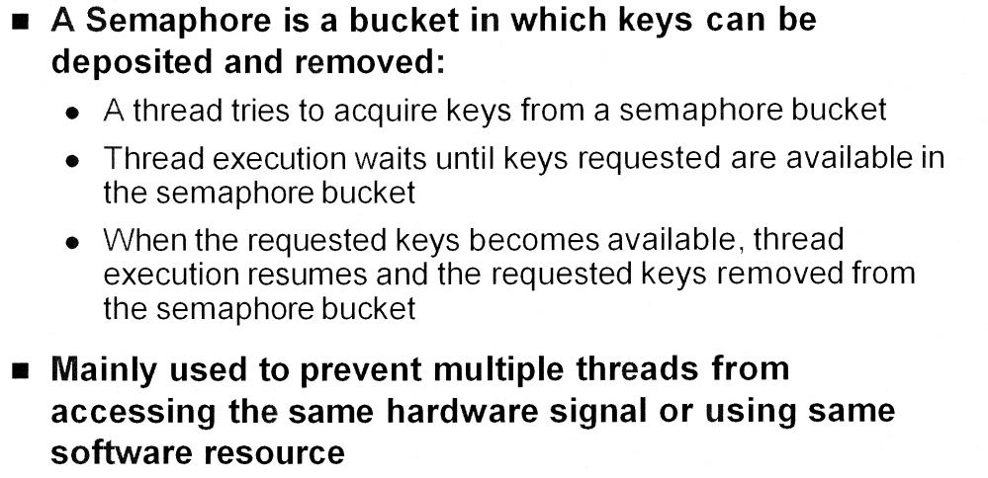
SEMAPHORE introduction

Slide 10
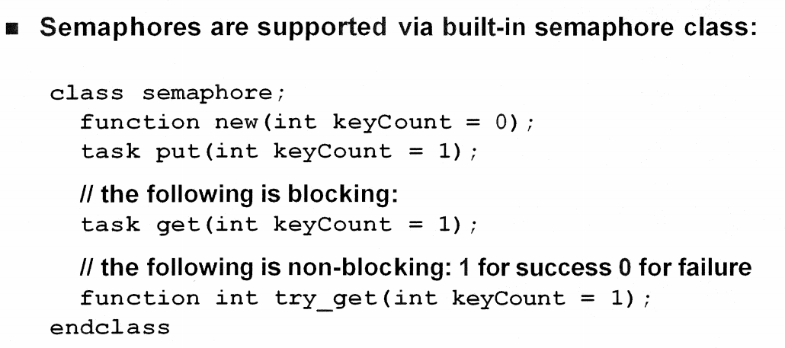
SEMAPHORE semaphore class

Slide 11
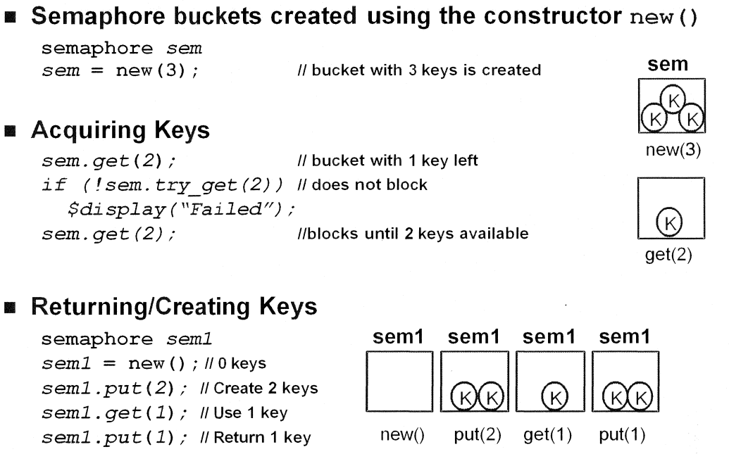
SEMAPHORE using semaphore(1)

Slide 12
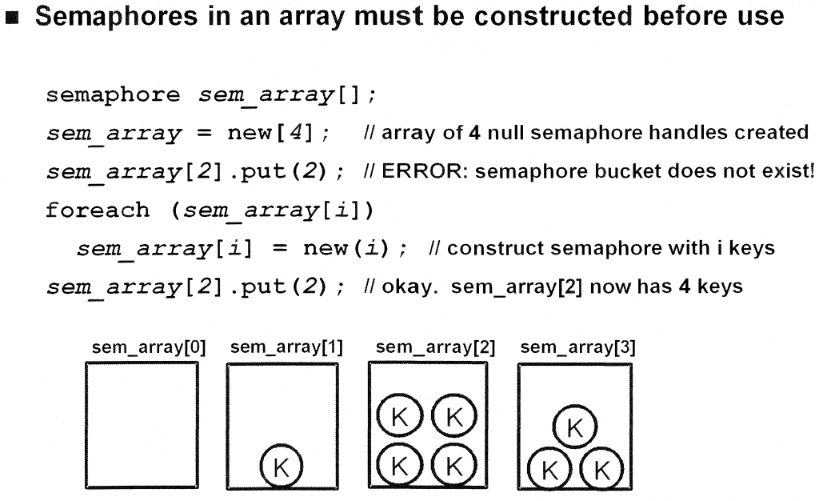
SEMAPHORE using semaphore(2)

Slide 13
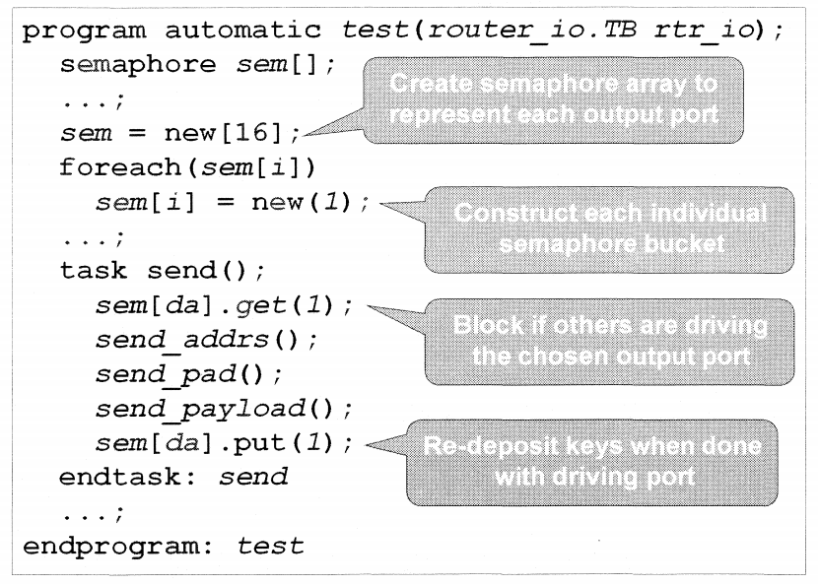
SEMAPHORE example

Slide 14
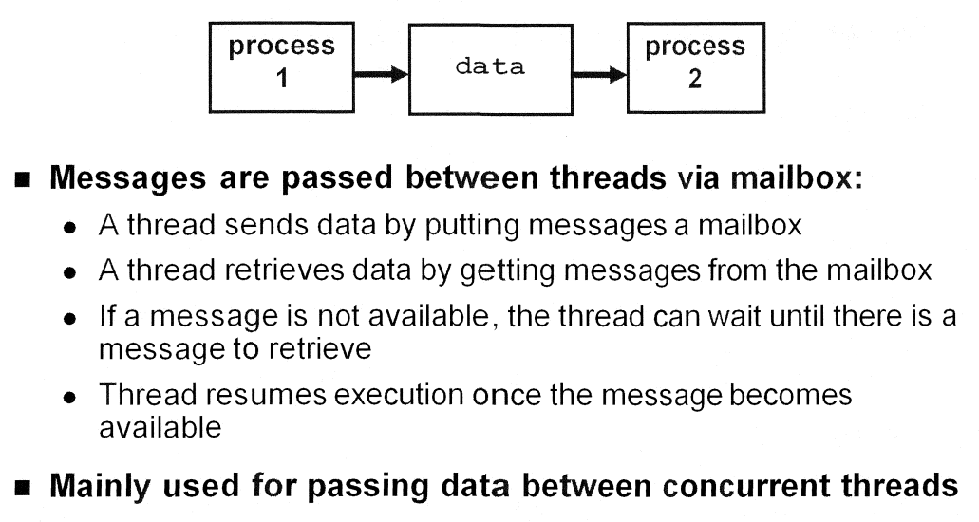
MAILBOX introduction

Slide 15
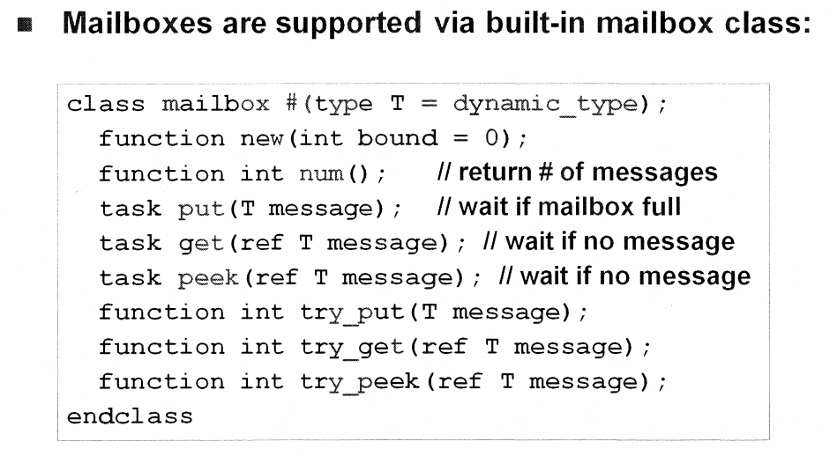
MAILBOX mailbox class

Slide 16
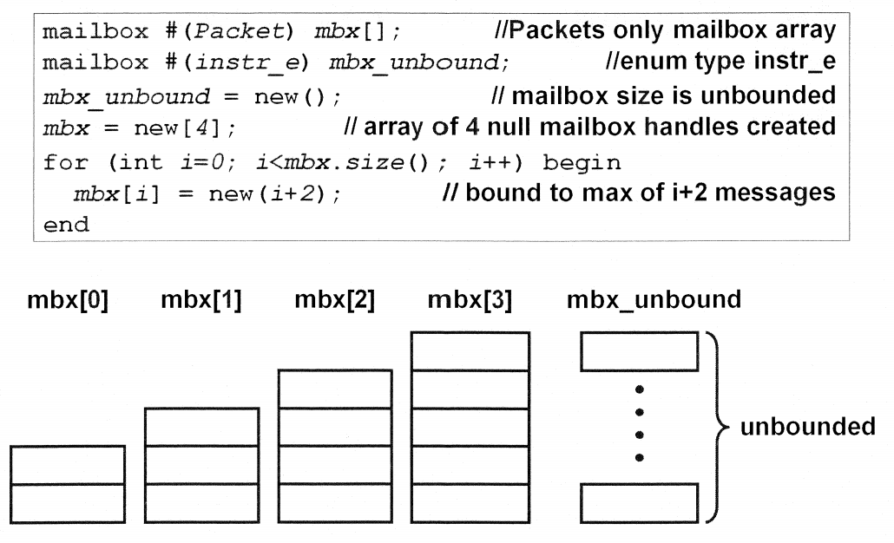
MAILBOX creating mailbox

Slide 17
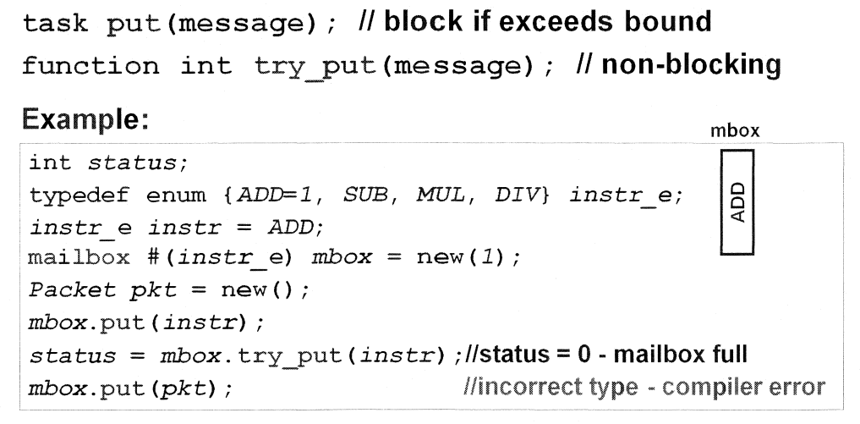
MAILBOX put messages into mailbox

Slide 18
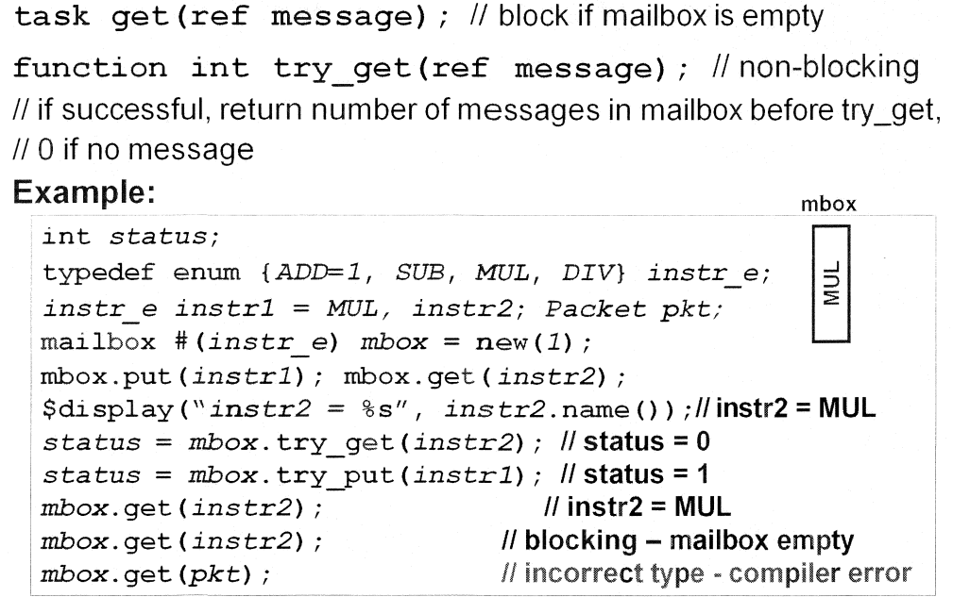
MAILBOX retrieving messages from mailbox(1)

Slide 19
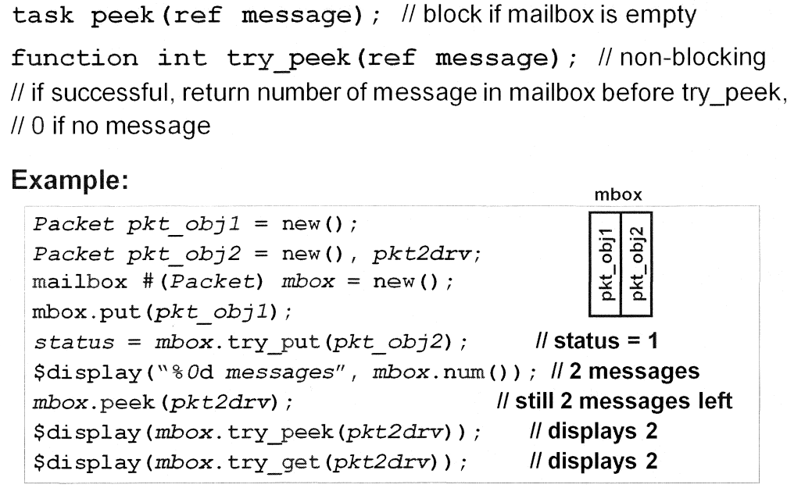
MAILBOX retrieving messages from mailbox(2)

Slide 20
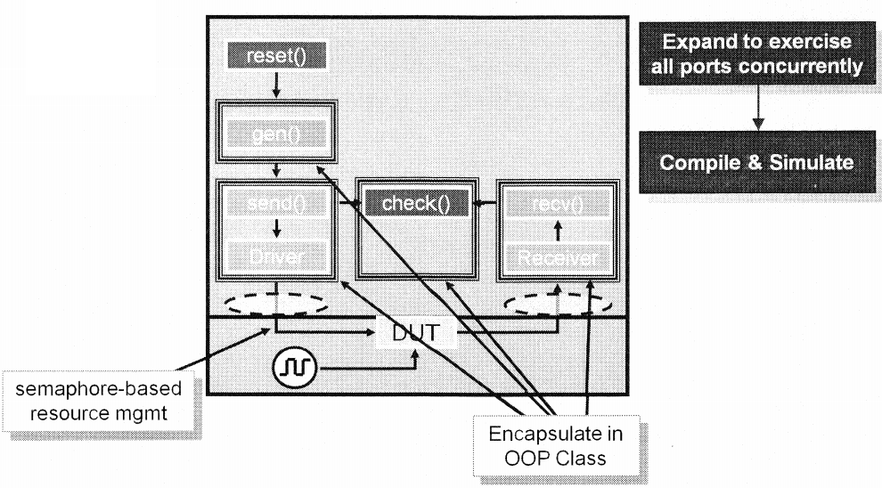
LAB 5 INTRODUCTION
Lab 5: Expand to broad-spectrum verification

