Slide 1
FUNCTIONAL COVERAGE

Slide 2
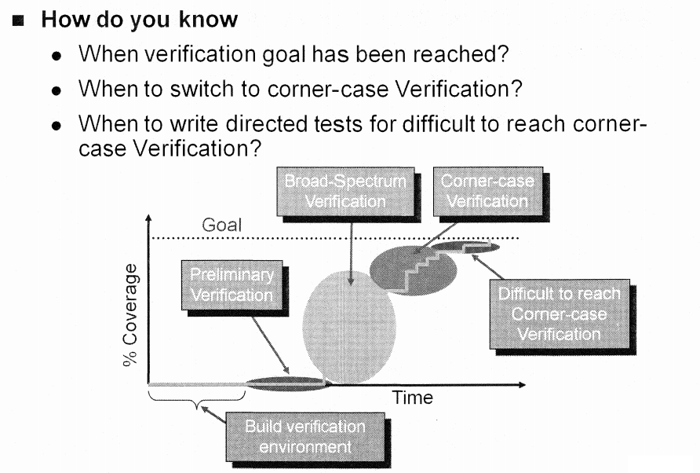
Phases of Verification

Slide 3
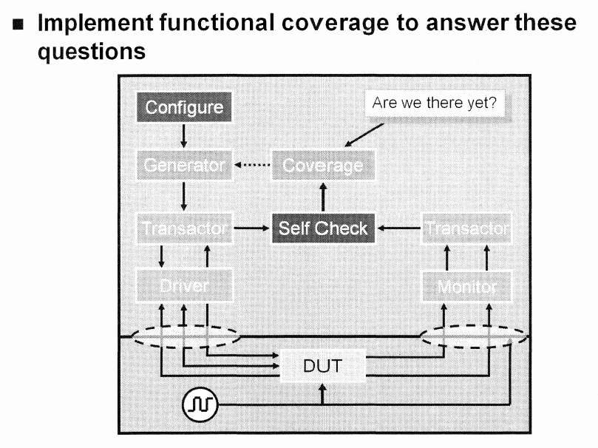
The Testbench Environment Architecture

Slide 4
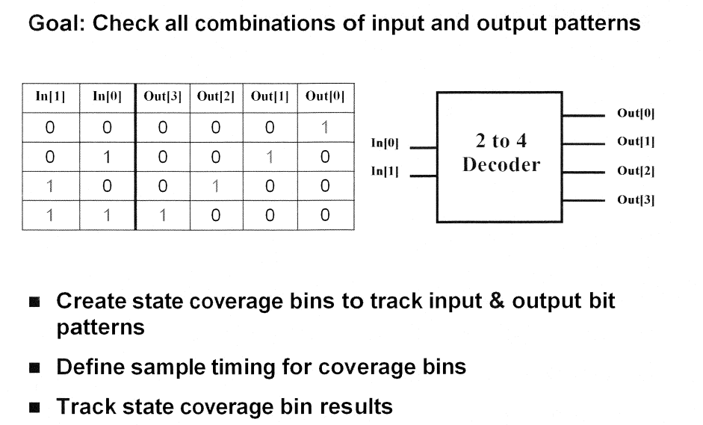
Example combinational logic

Slide 5
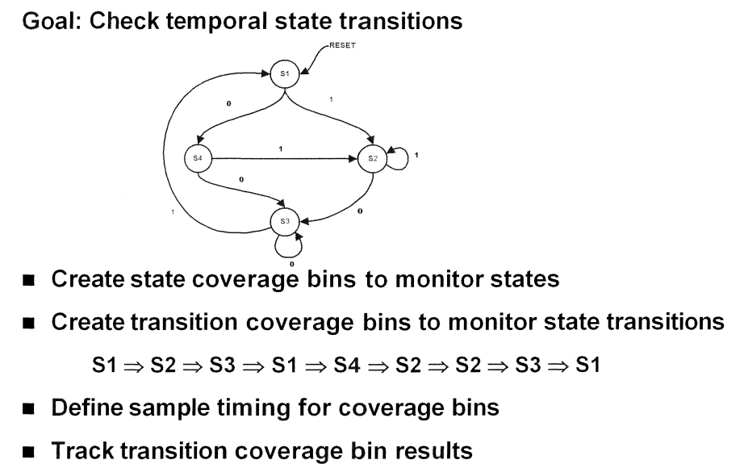
Example state transition

Slide 6
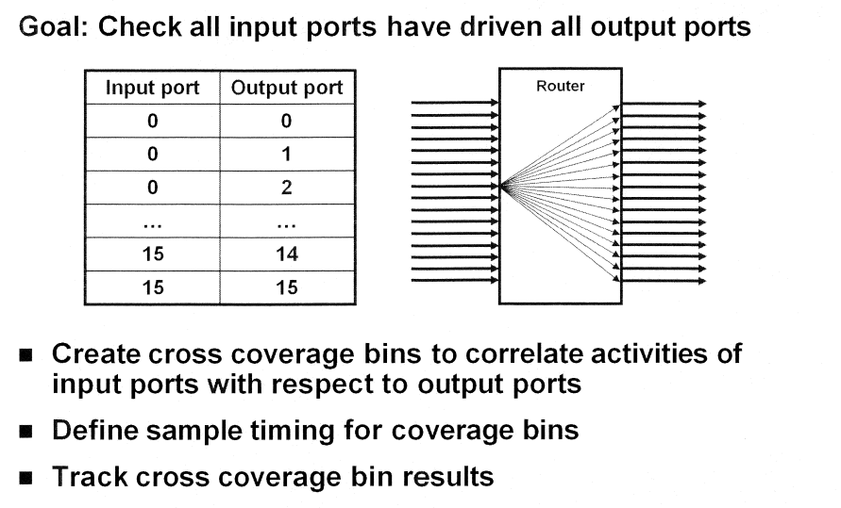
Example cross correlation

Slide 7
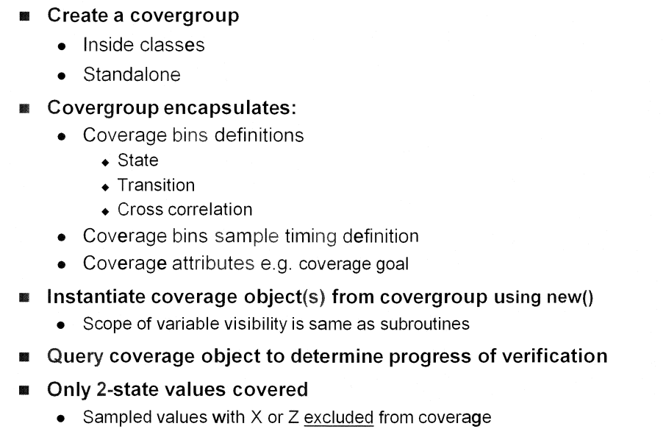
Functional Coverage in SV

Slide 8
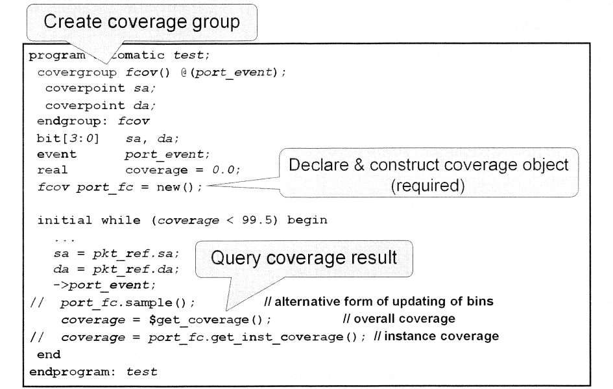
Functional Coverage example

Slide 9
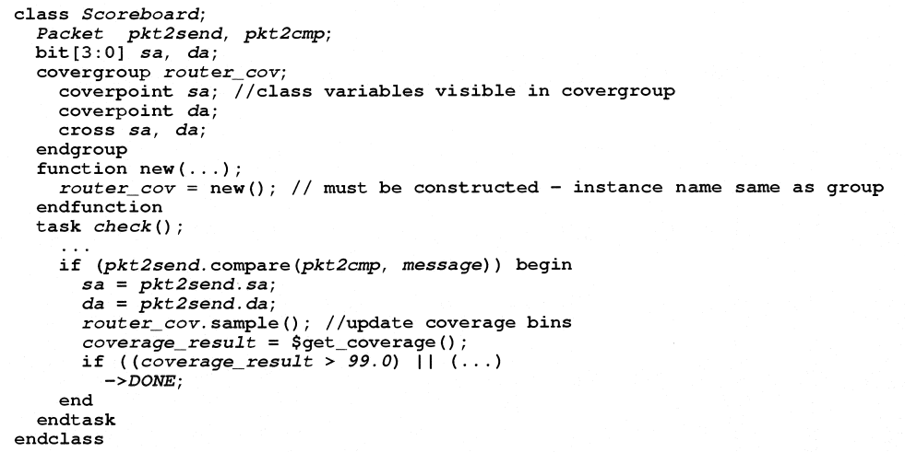
Functional coverage example
the covergroup can also be embedded inside a class

Slide 10
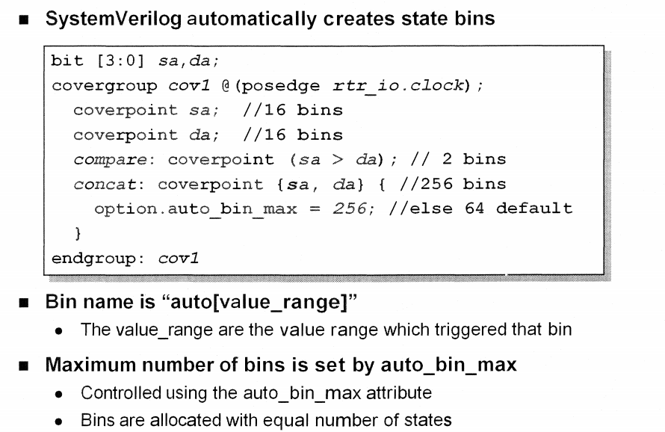
State Bin Creation automatic

Slide 11
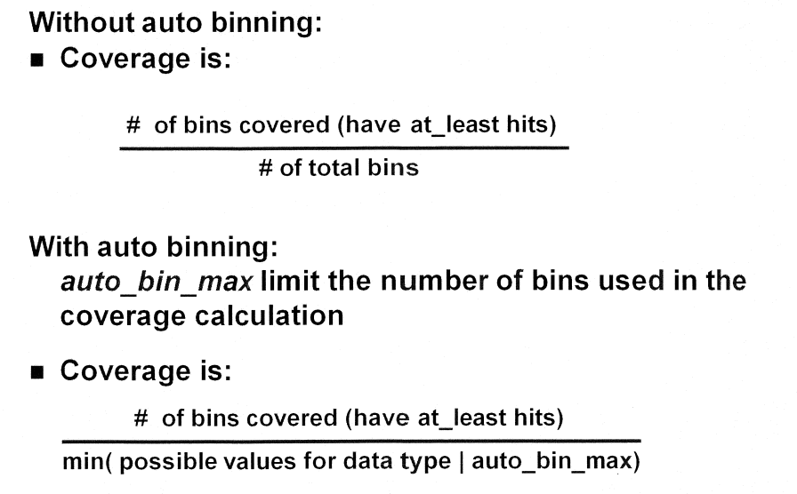
State Bin Creation measuring coverage

Slide 12
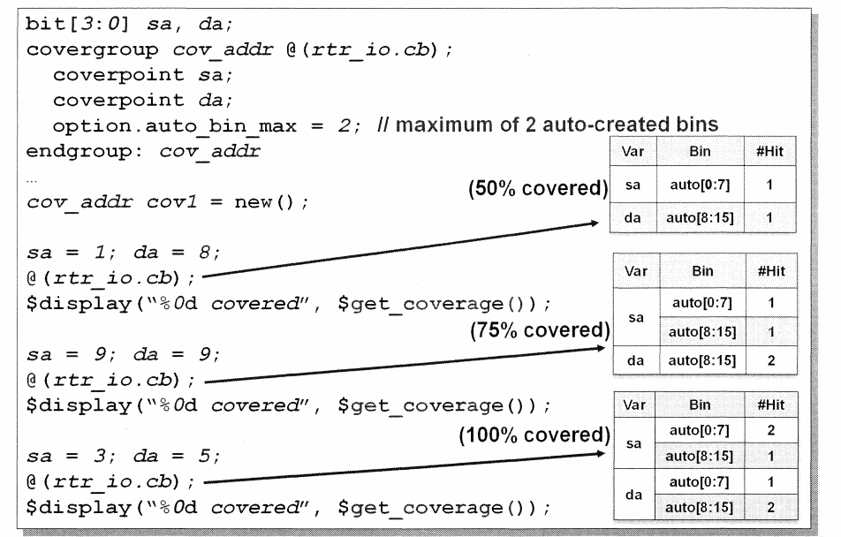
State Bin Creation automatic example

Slide 13
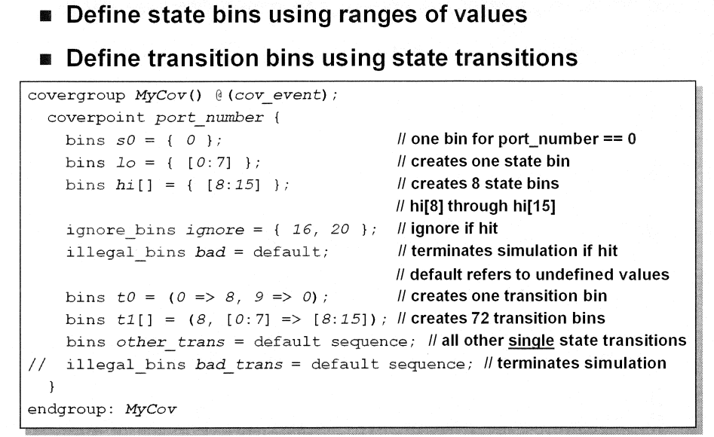
State & Transition Bin Creation user

Slide 14
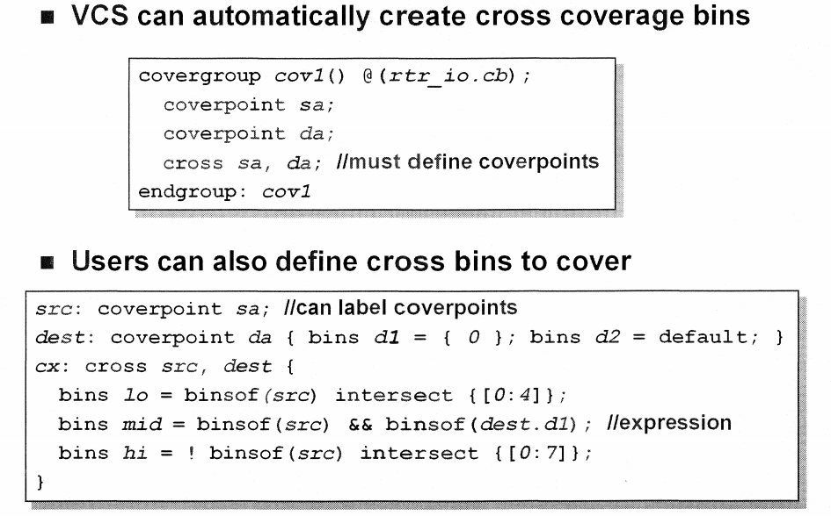
Cross Coverage Bin Creation

Slide 15
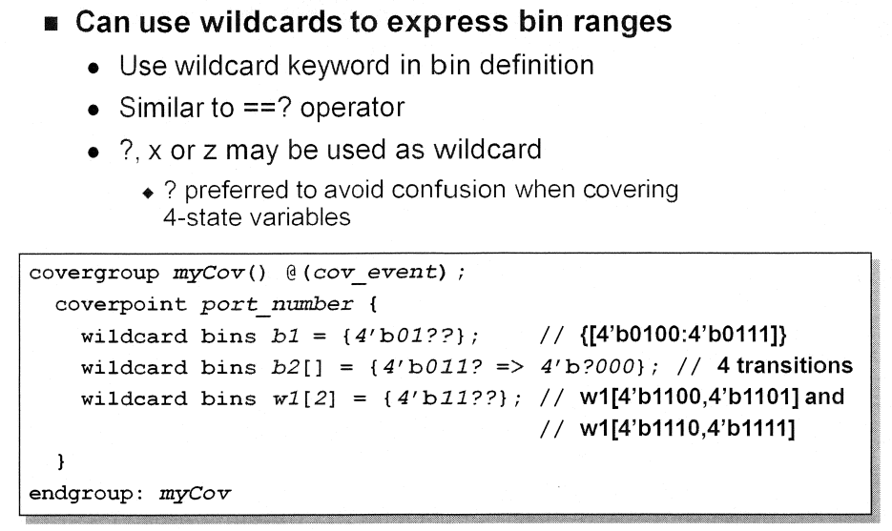
Wildcard Bins

Slide 16
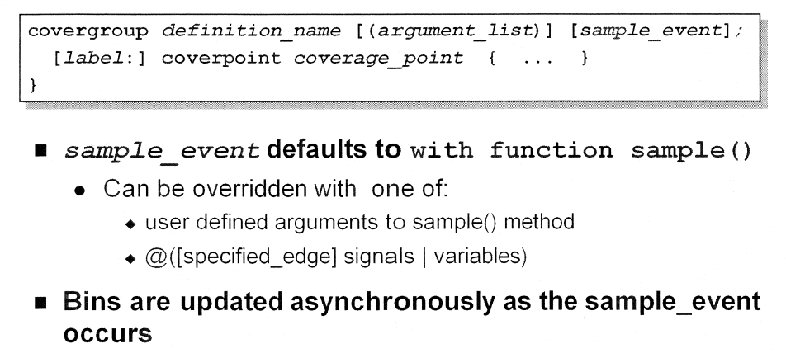
Specifying Sample Event Timing

Slide 17
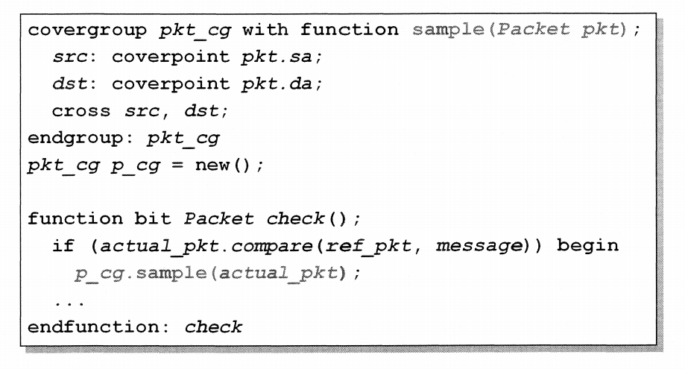
Sample Method example

Slide 18
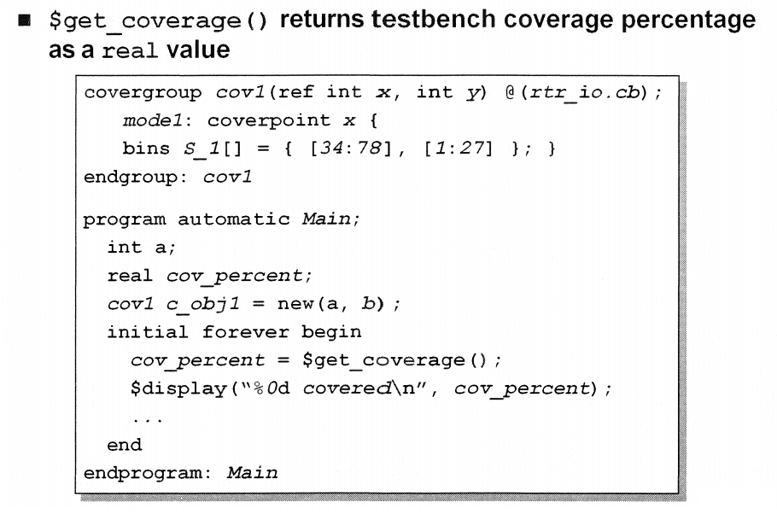
Determining Coverage Progress

Slide 19
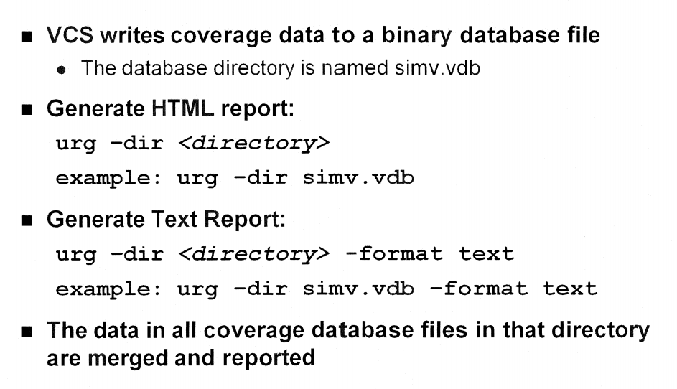
Coverage Result Reporting Utilities

