Slide 1
TRIP pipeline
Christ Leemans
Group meeting
25-05-'16

Slide 2
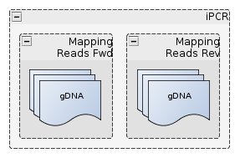
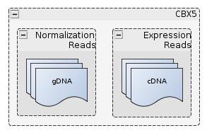





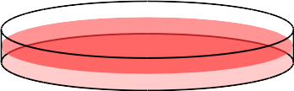
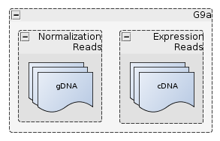
Raw Data
Spike-in

Slide 3














Trip.pl: input
map_pat2
map_pat1
map_pat_rev
pat1
pat2
Config.txt:
index_length = 10
barcode_length = 16
pat1 = map_pat1 = GTC...GAG (26bp)
pat2 = map_pat1 = TGATC ( 5bp)
map_pat_rev = GTA...TAA (36bp)
hd = 2
min_counts = 3
max_dist_for = 500
max_dist_rev = 20
cores = 8
bowtie_base = ~/bowtie2/hg19

Slide 4

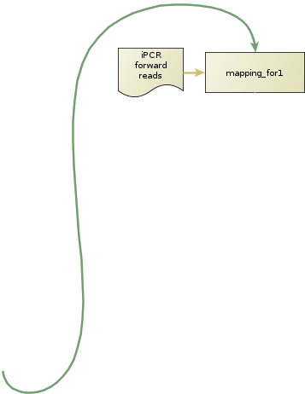
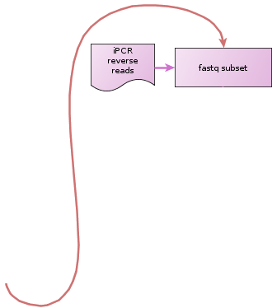













Trip.pl: pipeline

Slide 5







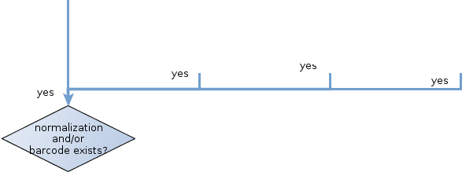



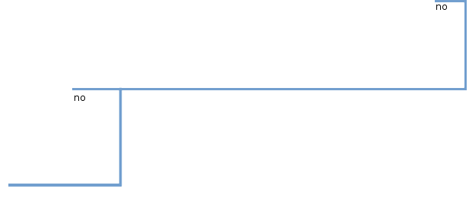



Regex = ^.{24,28}ACAACTCGAG(.{15,17})TGATC.+

Slide 6
Trip.pl: pipeline

Slide 7



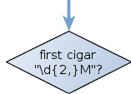








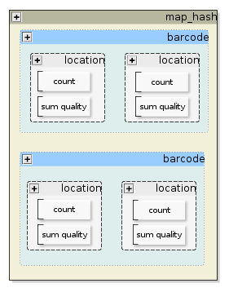

Match
Insertion
CIGAR: 12M1D4M2I4M7S
Soft-clip
Deletion
from ref

Slide 8
Raw Data
Spike-in

Slide 9
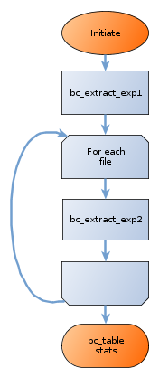
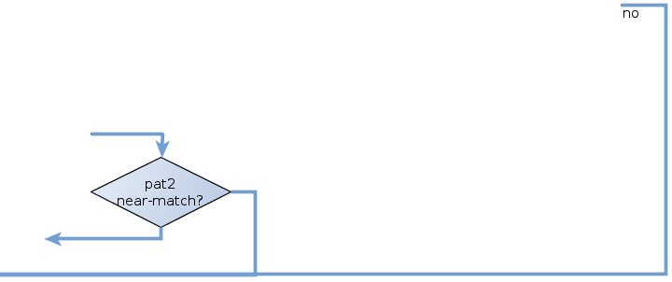
Barculator.pl

