Slide 1
V6 basics

Slide 2
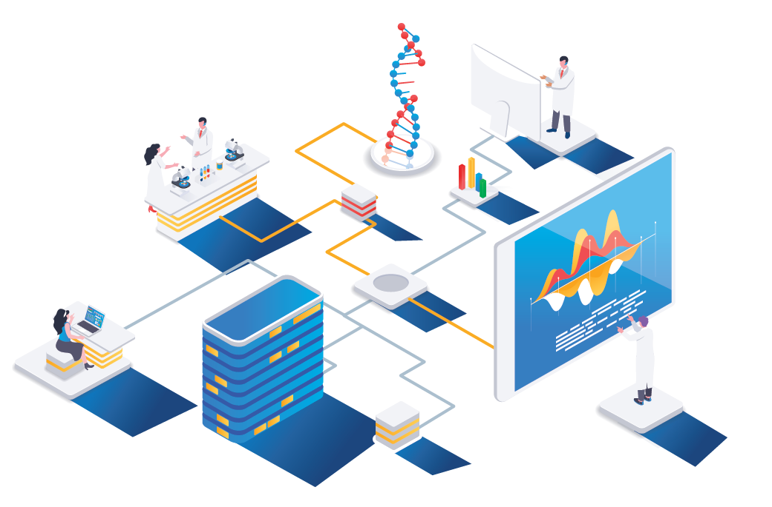
What is vantage6
Vantage6 is an open-source software framework for privacy enhancing analysis and decentralized data analysis

Slide 3




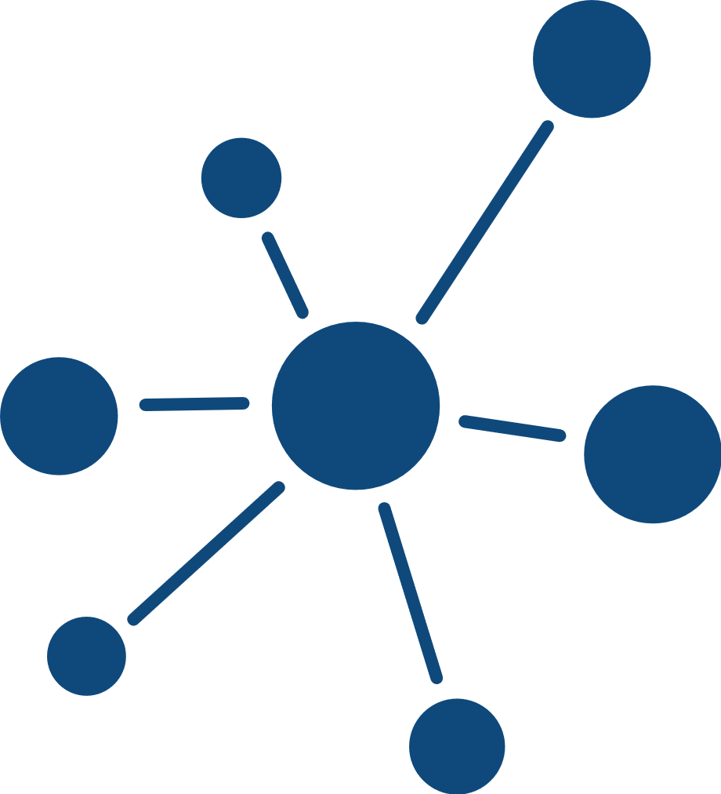

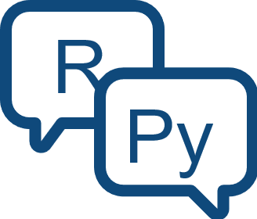




Why using vantage6
Open source with Apache-2.0 licence
Container orchestration for PETs
Extensible to different data source types
Algorithms in any language
Other applications can connect using the API
Graphical User Interface
Managing collaboration policies
Minimal network requirements

Slide 4
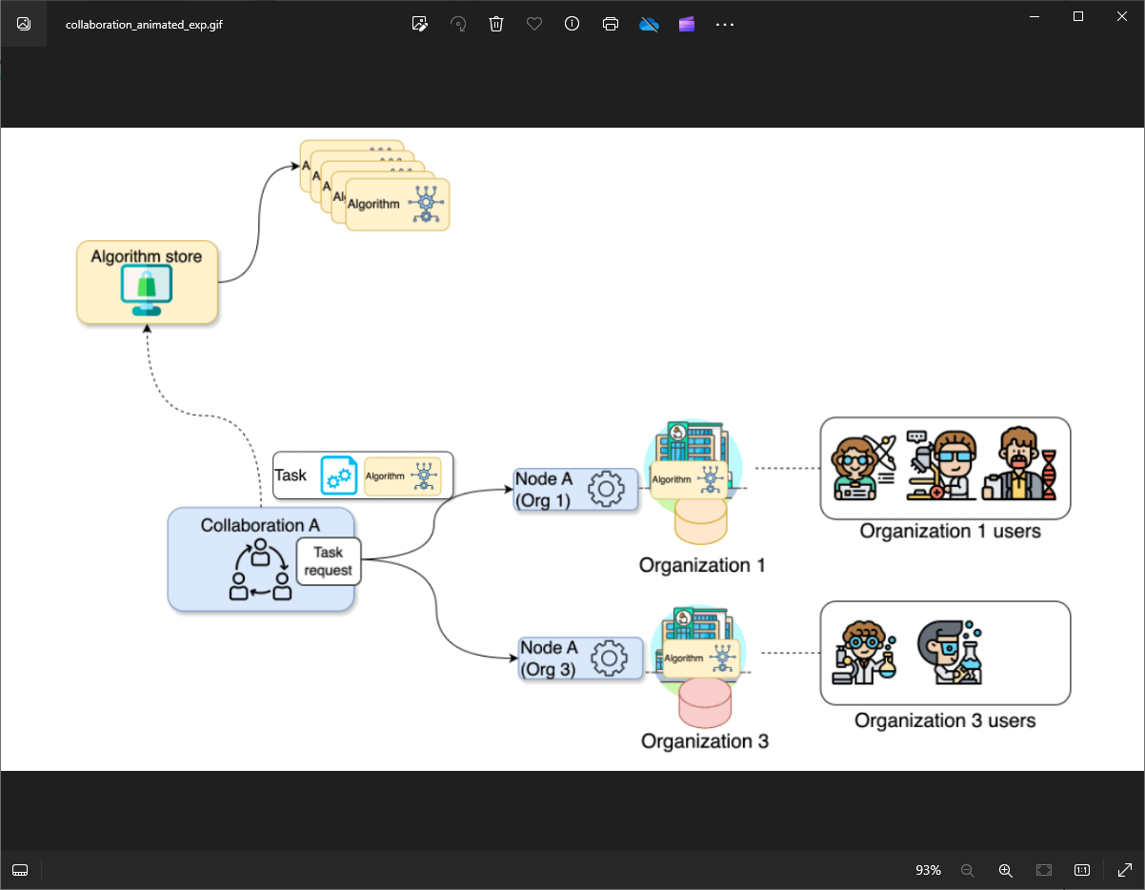
Federated analysis projects with vantage6
vantage6 encompasses a project administration system that allows the user to manage permissions and access to the resources, while assuring the protection of the data.

Slide 5
Federated analysis projects with vantage6
Organization
A group of users that share a common goal or interest (e.g., a consortium, an institute, etc.).

Slide 6
Federated analysis projects with vantage6
Collaboration
One or more organizations working together towards a shared objective.

Slide 7
Federated analysis projects with vantage6
Node
Component that accesses the organization data and executes algorithms on it.

Slide 8
Federated analysis projects with vantage6
Task
A request for the execution of an algorithm. It is handled by the corresponding organizations’ nodes.

Slide 9
Federated analysis projects with vantage6
User
A person that belongs to one organization who can create tasks for one or more organizations within a collaboration.

Slide 10
Federated analysis projects with vantage6
Algorithm
A computational model or process which can be securely distributed to nodes for execution.

Slide 11
Federated analysis projects with vantage6
Algorithm store
A repository for trusted algorithms within a certain project.

Slide 12
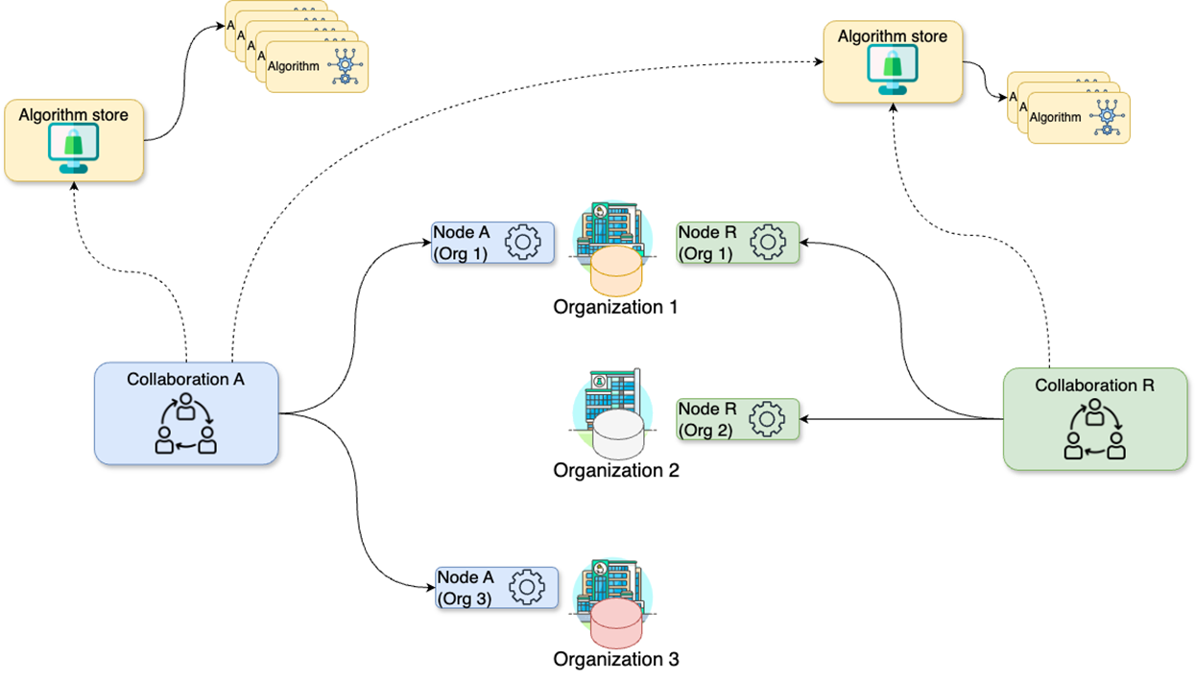
Federated analysis projects with vantage6
Expanding the scenario:
Organizations can take part to multiple collaborations

Slide 13
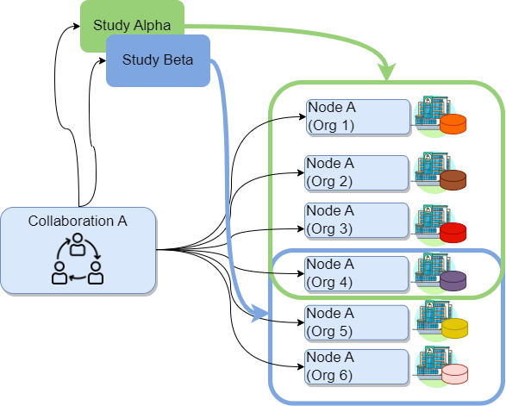
Federated analysis projects with vantage6
Study
A subset of organizations within a collaboration that are engaged in a specific research question.
Notes:
For example, consider the Collaboration W below, which includes six organizations. This collaboration might involve two distinct research questions: one that requires data from organizations 1, 2, 3, and 4, and another that focuses on data from organizations 4, 5, and 6. By establishing Study Alpha and Study Beta, you, as a researcher, can target your data analysis tasks in three different ways: you can address the entire Collaboration W (including nodes A to F), focus on Study Alpha (nodes A to D), or concentrate on Study Beta (nodes D to F).

Slide 14

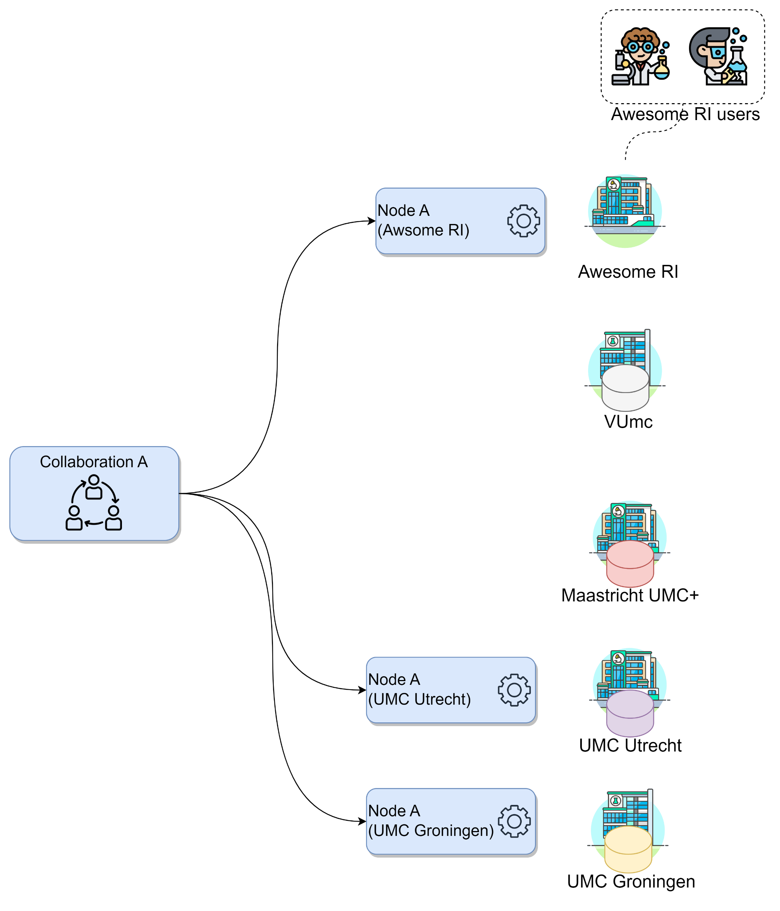
Design your own project structure
CHALLENGE
You, a researcher at the Awesome RI, want to conduct a study across three academic hospitals : VUmc in Amsterdam, Maastricht UMC+, and UMC Utrecht. Consider the following:
Your research institute has an existing collaboration with UMC Utrecht and UMC Groningen.
You will be conducting this study with a colleague from your institute. Both of you are already registered on the organization.
How would the concepts described above map to your potential use case?
Which organizations will you need to add to your collaboration?
How many new nodes would you need to set up and on which organizations?
How many users would be created?

Slide 15
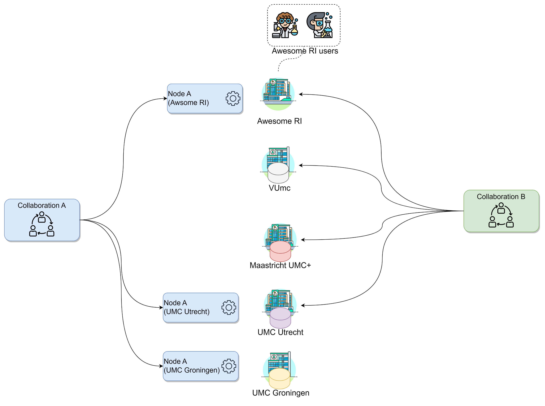
Solution
SOLUTION
Which organizations will you need to add to your collaboration?
All the academic hospitals as well as your own organization: VUmc, Maastricht UMC+, UMC Utrecht and your research institute.

Slide 16
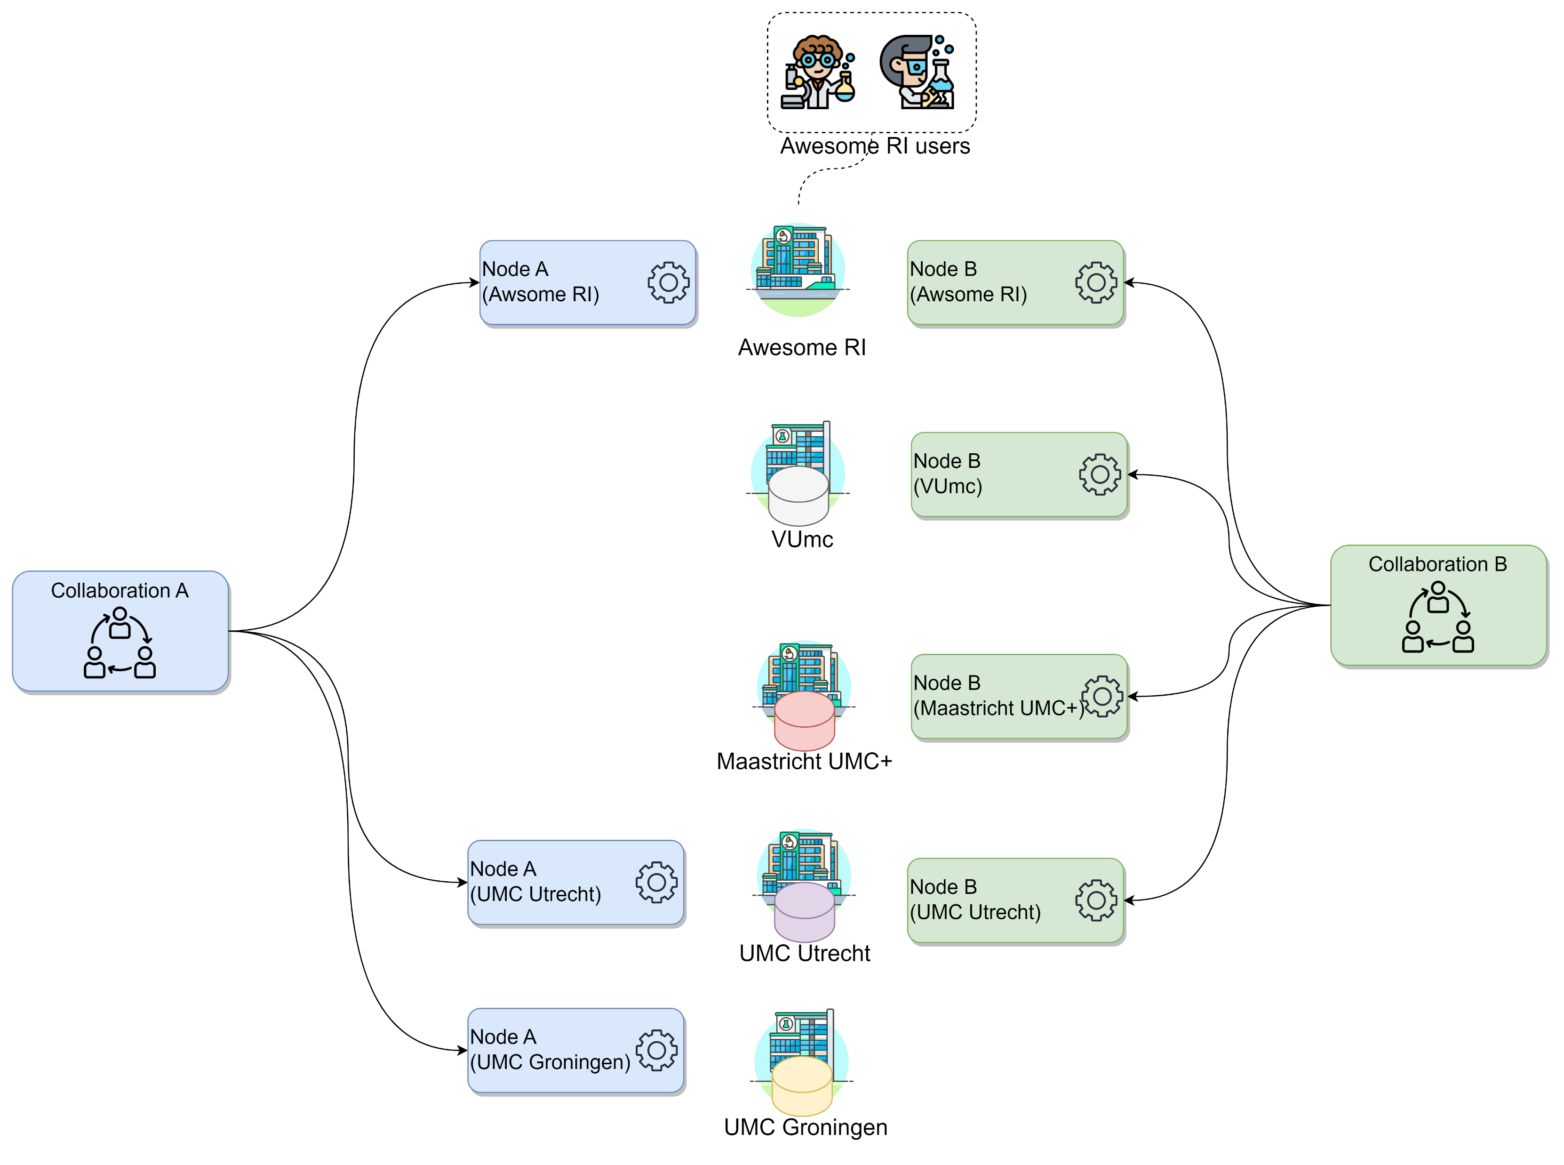
Solution
SOLUTION
Which organizations will you need to add to your collaboration?
All the academic hospitals as well as your own organization: VUmc, Maastricht UMC+, UMC Utrecht and your research institute.
How many new nodes would you need to set up and on which organizations?
One node for every academic organization in the collaboration, so 4.

Slide 17
Solution
SOLUTION
Which organizations will you need to add to your collaboration?
All the academic hospitals as well as your own organization: VUmc, Maastricht UMC+, UMC Utrecht and your research institute.
How many new nodes would you need to set up and on which organizations?
One node for every academic organization in the collaboration, so 4.
How many users would be created?
There is no need to create new users, as these are already registered on the organization.

Slide 18
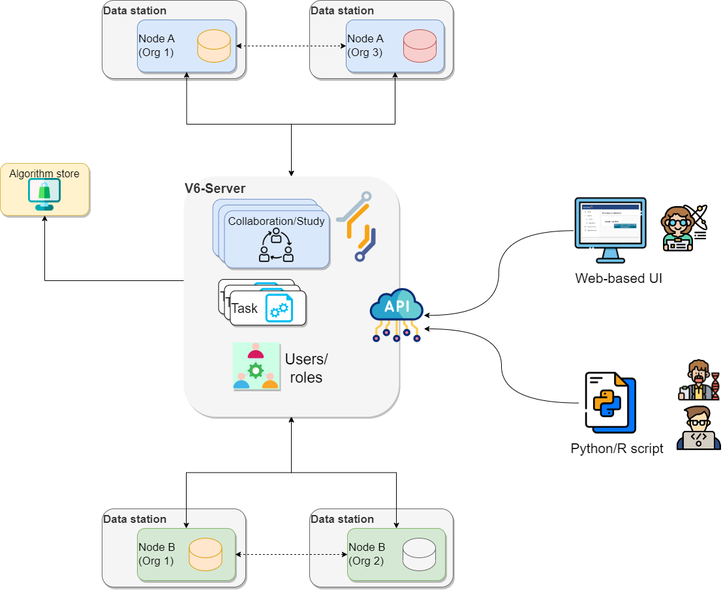
The vantage6 infrastructure
Notes:
Now that we have an overview of how vantage6 manages the project resources and how it can be used to setup the analysis framework, we can see how vantage6 works on a technical level and how the infrastructure maps the aforementioned concepts. In vantage6, a user can pose a question through a client to the vantage6 server. Each organization with sensitive data contributes one node to the network. The nodes collect the computation request from the server and fetches the algorithm from the algorithm store to answer it. When the algorithm completes, the node sends the aggregated results back to the server.

Slide 19
The vantage6 infrastructure
Server
Communication hub between clients and nodes. It also handles authentication and authorization to the system.
Notes:
The vantage6 server acts as communication hub between clients and nodes. The server tracks the status of the computation requests and handles administrative functions such as authentication and authorization.
Contains the users, organizations, collaborations, tasks and their results. It handles authentication and authorization to the system and acts as the communication hub for clients and nodes.

Slide 20
The vantage6 infrastructure
Data station
Hosts the data and the vantage6 node. The vantage6 node executes the allowed algorithms on the local data and sends the results back to the server.

Slide 21
The vantage6 infrastructure
Client
Entity that interacts with the vantage6 server via:
API
User interface
Python client
Notes:
A user or application who interacts with the vantage6-server. They create tasks, retrieve their results, or manage entities at the server (i.e. creating or editing users, organizations and collaborations).

Slide 22
The vantage6 infrastructure
Algorithm store
Repository for trusted algorithms. It allows researchers to explore which algorithms are available and how to run them.

Slide 23
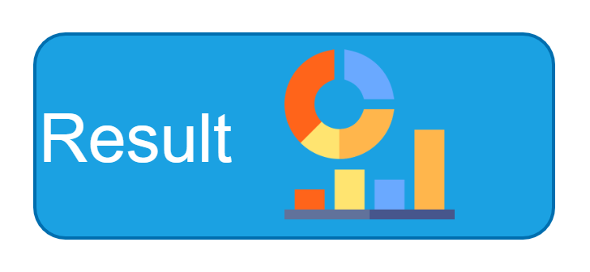
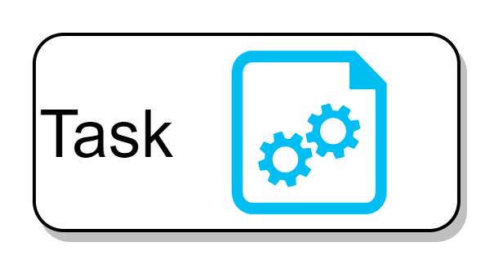
The vantage6 infrastructure
Request
Notes:
A user can request the execution of tasks within their collaboration. They request the execution of an algorithm (previously registered in an algorithm store trusted by the collaboration) across all participating organization nodes. In response, each node from the involved organizations executes the algorithm on its local data. The resulting (aggregated) data is then sent back to the server, where it can be accessed by the requesting user.

Slide 24






How algorithms run in vantage6
Let us consider the federated sum from chapter 1 again
Walter | 34 | 168
Giulia | 29 | 163
$$y_{1}$$
$$f\left(x_{1}\right)=y_{1}$$
$$y_{1}+y_{2}$$
Node 1
Node 3
$$y_{2}$$
Cunliang | 36 | 175
Giulia | 40 | 172
$$f\left(x_{2}\right)=y_{2}$$
Node 2
Vantage6 server
Data sources and the aggregation entity are mapped to nodes.
The vantage6 server is on the side, coordinating the analysis.

Slide 25
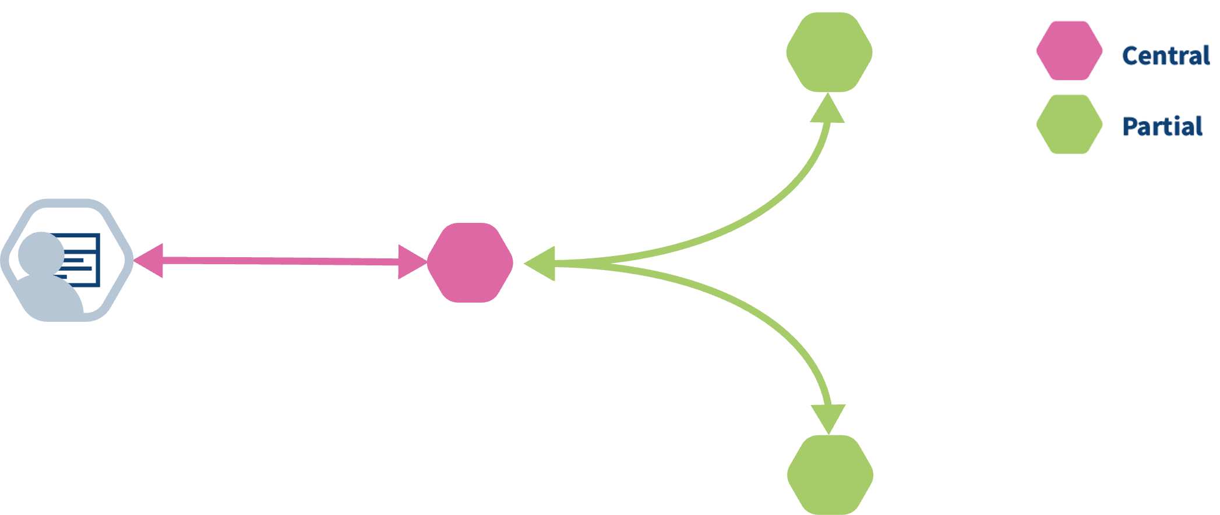
How algorithms run in vantage6
Federated algorithms can be split in a federated and a central part:
Central: The central part of the algorithm is responsible for orchestration and aggregation of the partial results.
Federated: The partial tasks are executing computations on the local privacy sensitive data.
Federated

Slide 26
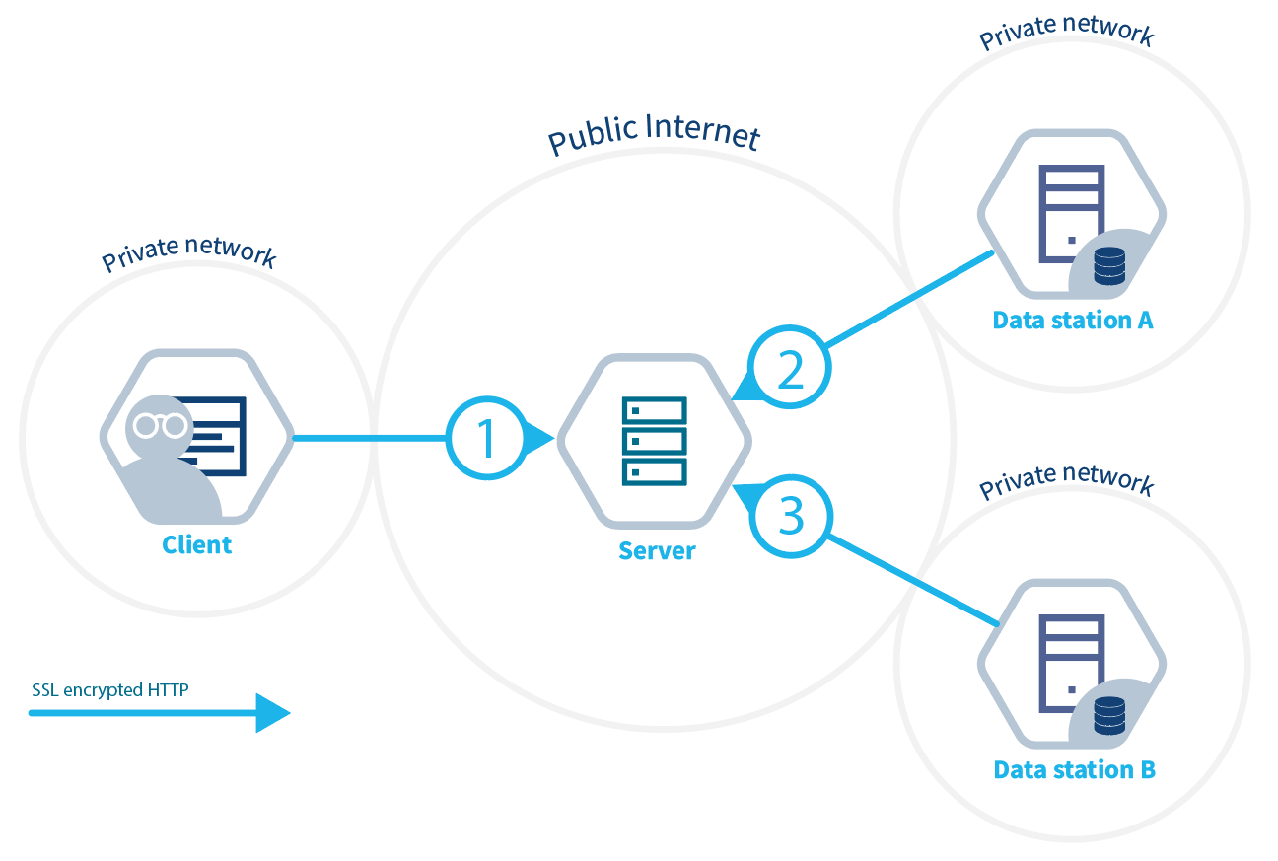
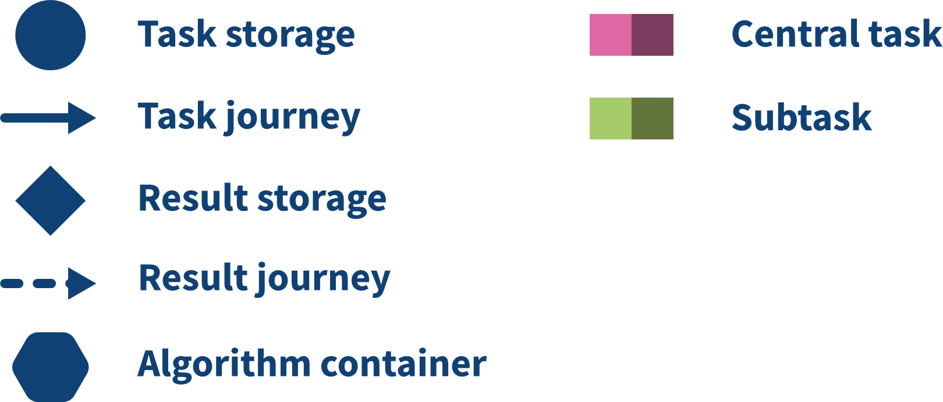

How algorithms run in vantage6
Partial task
Notes:
The user creates a task for the central part of the algorithm. This is registered at the server.
The task registration leads to the creation of a central algorithm container on one of the nodes

Slide 27
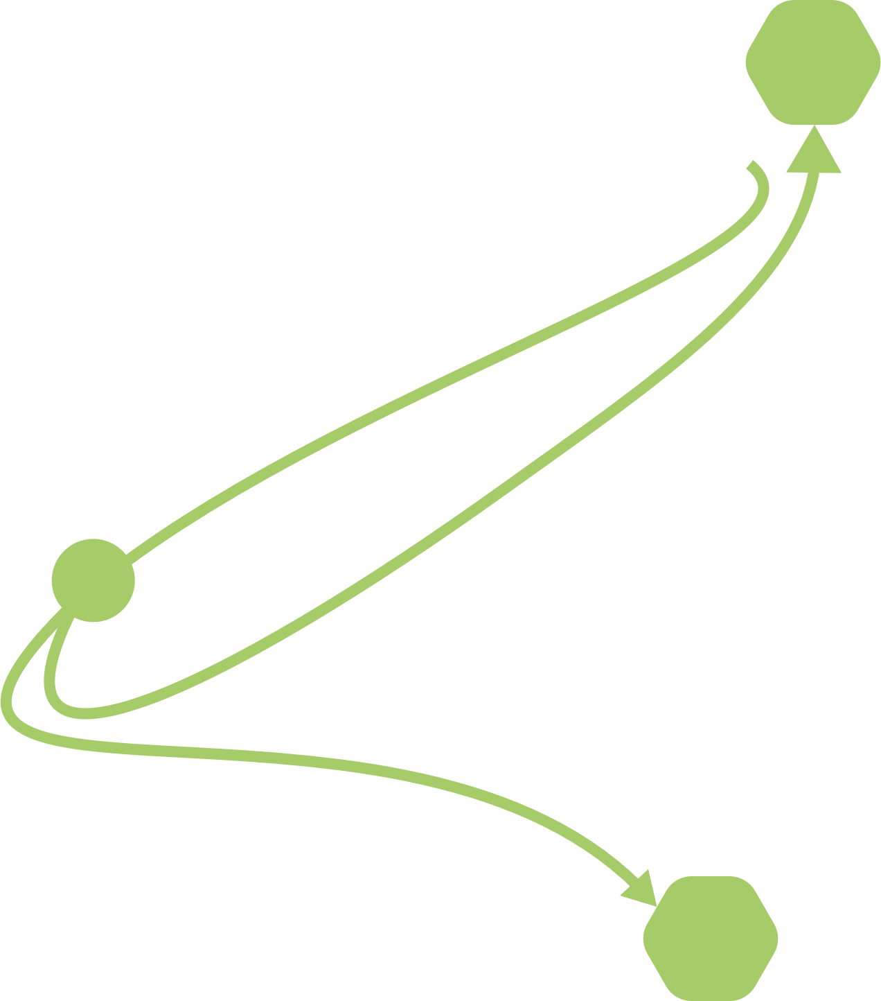
Algorithm projection on infrastructure
Partial task
Notes:
The central algorithm creates subtasks for the federated parts of the algorithm, which again are registered at the server.
All nodes for which the subtask is intended start their work by executing the federated part of the algorithm.

Slide 28
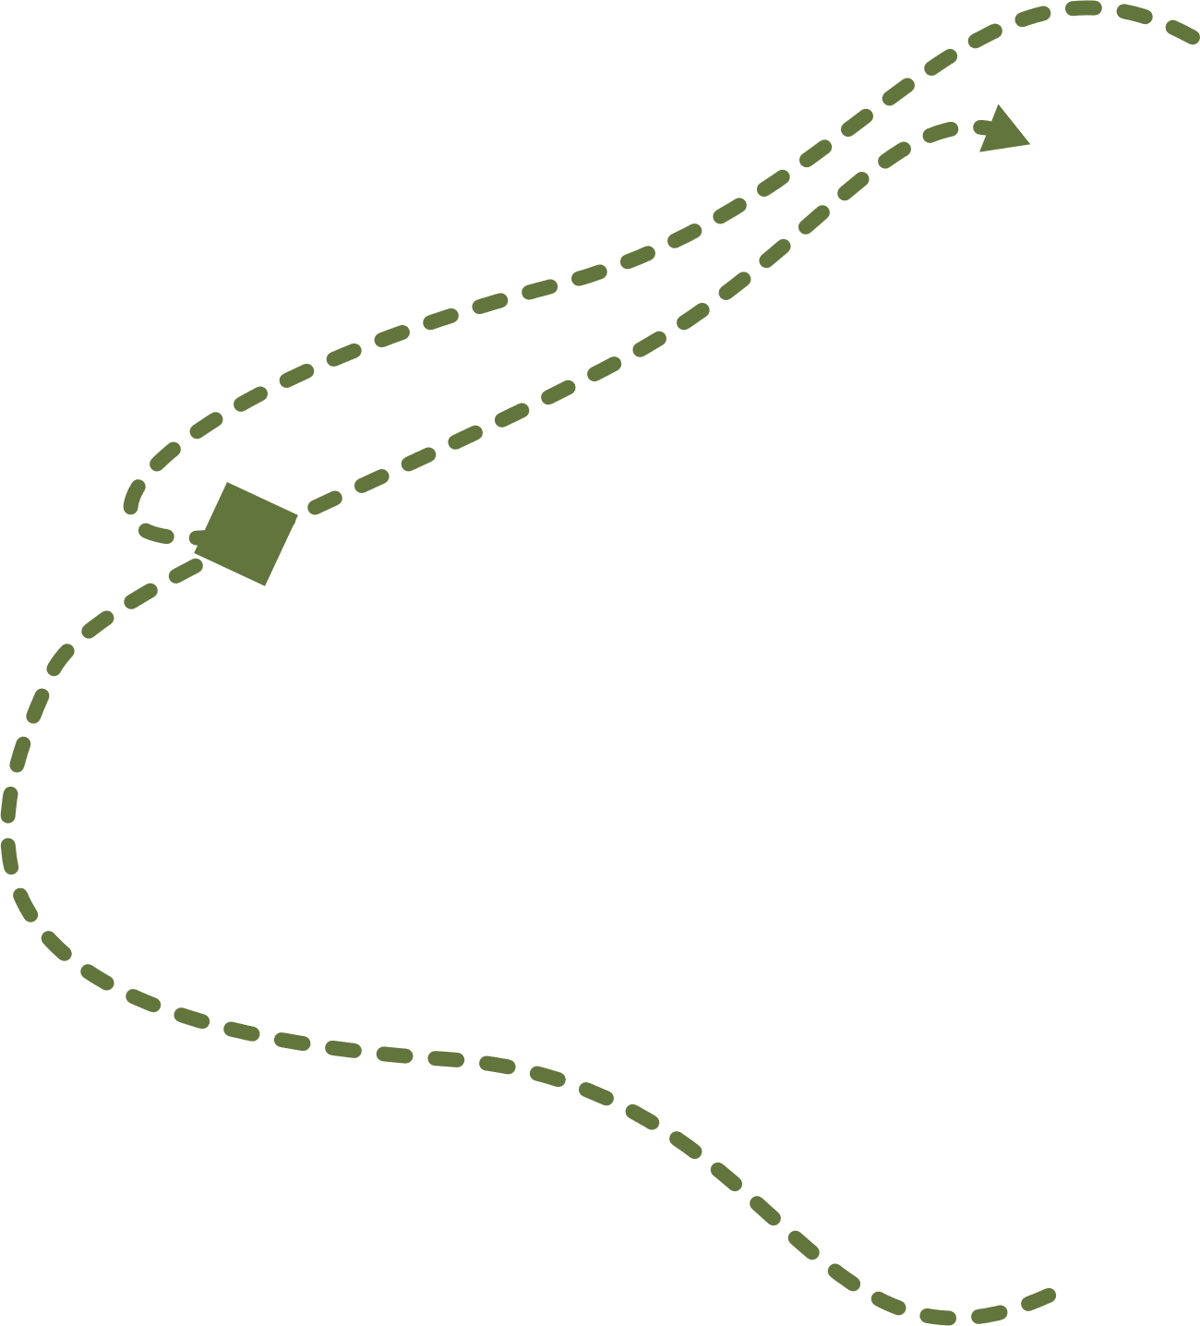
Algorithm projection on infrastructure
Partial task
Notes:
When finished, the nodes send the results back to the server.
Each node’s results are picked up by the central algorithm. The central algorithm then computes the final result and sends it to the server.

Slide 29
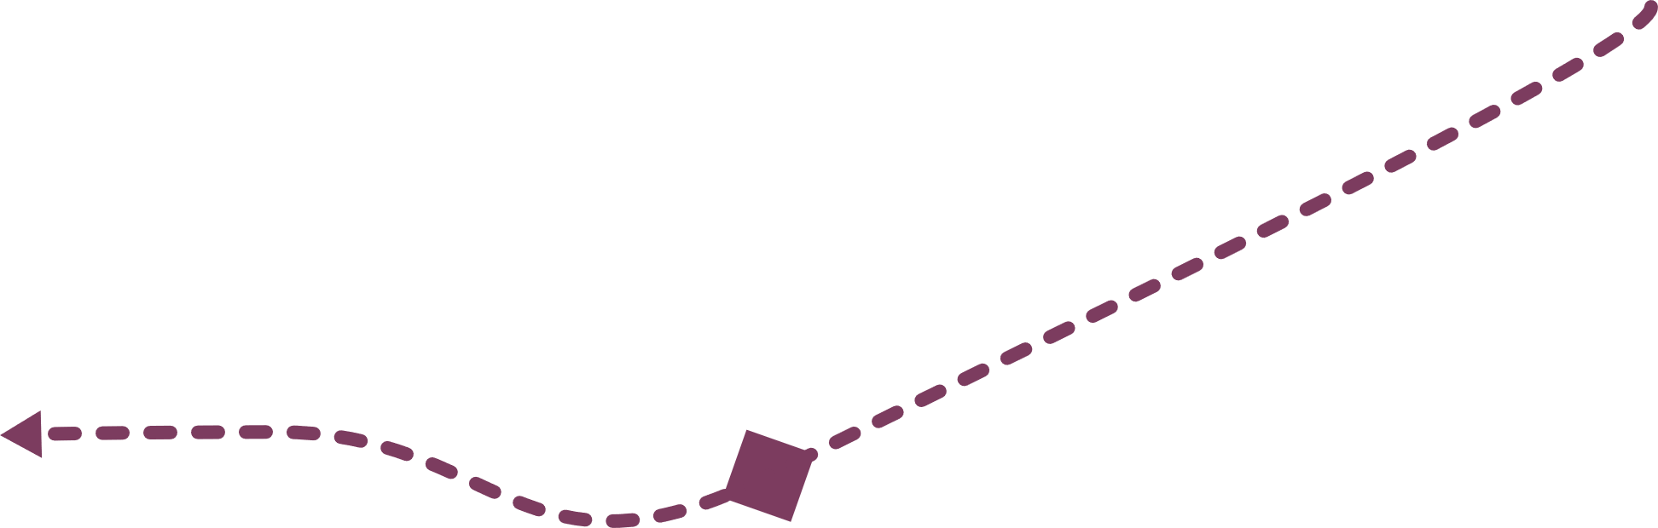
Algorithm projection on infrastructure
Partial task
Notes:
The user retrieves the result from the server.

Slide 30
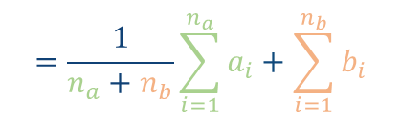

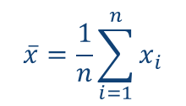
Exercise
CHALLENGE
Two centers A and B have data regarding the age of a set of patients
a=[34,42,28,49]
Which part of the infrastructure will execute each part of the computation?
Which is the result returned by the different parts?
b=[51,23,44]
They want to compute the average age:
$$\overline{x}=\frac{1}{n}\sum_{i=1}^{n}{x_{i}}$$
$$=\frac{34+42+28+49+51+23+44}{4+3}$$
$$=\frac{1}{n_{a}+n_{b}}\sum_{i=1}^{n_{a}}{a_{i}+\sum_{i=1}^{n_{b}}{b_{i}}}$$

Slide 31


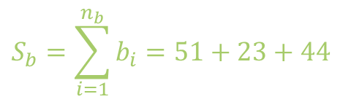
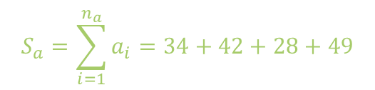
Exercise
SOLUTION
Partial task
$$S_{a}=\sum_{i=1}^{n_{a}}{a_{i}=34+42+28+49}$$
$$n_{a}=3$$
$$S_{b}=\sum_{i=1}^{n_{b}}{b_{i}=51+23+44}$$
$$n_{b}=3$$

Slide 32
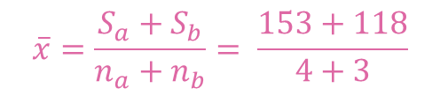
Exercise
SOLUTION
Partial task
$$\overline{x}=\frac{S_{a}+S_{b}}{n_{a}+n_{b}}= \frac{153+118}{4+3}$$

Slide 33

Exercise
SOLUTION
Partial task
$$\overline{x}=38,71$$

Slide 34
Future developments of vantage6
Policies: we want to extend the current available policies to a more generic policy framework in which any aspect of the vantage6 platform can be controlled by policies. This will maximize the flexibility of the platform and make it easier to adapt to new use cases.
Model repository: Currently, vantage6 is focused on privacy enhancing techniques. Some of these techniques result in a model that can be used to make predictions. We want to extend vantage6 with a model repository in which these models can be stored, shared and used. This will make it easier to reuse models and to compare the performance of different models.

