Slide 1
Algorithm development
Concepts and how to develop your own
🙋‍♀️🙋‍♂️
Please interrupt me if you have a question!

Slide 2
Overview
Objectives
Understand vantage6 algorithm tools
Create personalized boilerplate code
Create simple algorithm
Test algorithm
Build algorithm Docker image
Publish algorithm
Run algorithm

Slide 3

Algorithm tools
Algorithms need to communicate with the node and server
Input and output are handled in standard way
Algorithm tools provide this functionality – for Python algorithms

Slide 4
Algorithm client
Behaves similarly to the regular (user-centered) Python client
Functionality limited to what algorithm container is allowed to do
# create subtasks
client.task.create(…)
# wait for results of subtasks
client.wait_for_results(my_task_id)
# get organizations in collaboration
client.organization.list()

Slide 5
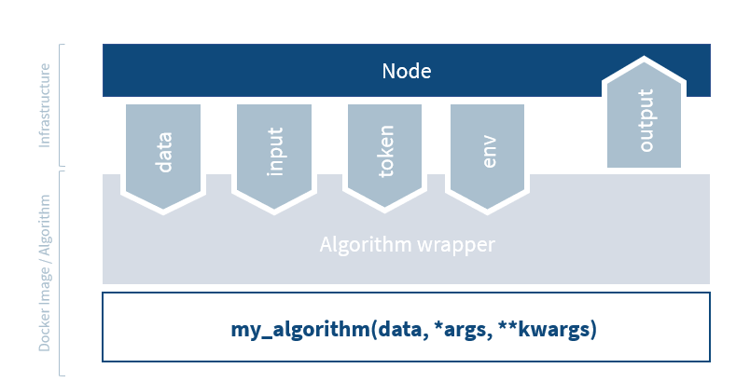
Node Algorithm Interface
Node
Responsible for collecting tasks
Start and provision the algorithm
Sending back the results to the server

Slide 6

Algorithm Layers
Algorithm Wrapper
Reads data from different database types (CSV, Parquet, SQL, …) and feeds to algorithm
Starts up the algorithm function
Reduces workload of the algorithm developer
NOTE Environment variables are also used in the wrapper to locate the database, input data, and the token

Slide 7
Algorithm Layers
My_algorithm
Contains code for the analysis
Returns JSON

Slide 8
Algorithm Layers
Algorithm client
Algorithm client is a special part of the wrapper – unlike the other components, it is flexible
Algorithm can call functions that the node forwards to the vantage6 server

Slide 9
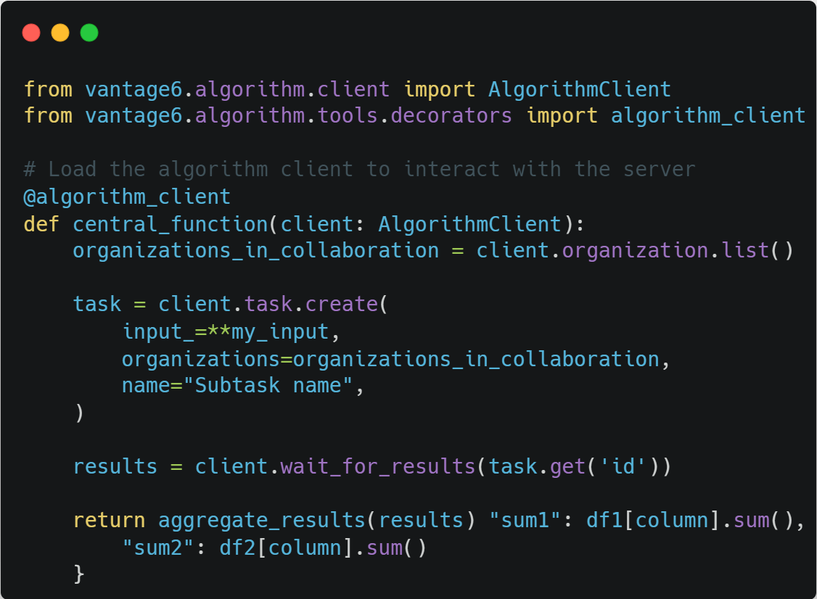
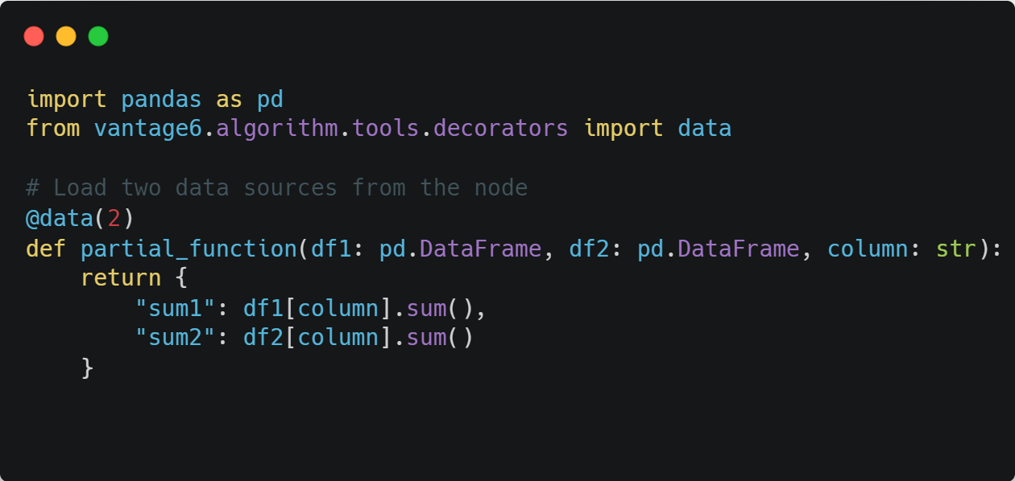
Client and data decorators

Slide 10
Creating non-Python algorithms
CHALLENGE
You want to create a vantage6 algorithm, but Python is not your favorite programming language.
What extra work would you need to do to make your algorithm communicate with the vantage6 node?

Slide 11
Creating non-Python algorithms
SOLUTION
You would need to implement parts of the wrapper and algorithm client yourself.
You should use the environment variables to load the token, input and data
You should create your own HTTP requests to replace the algorithm client
You should make sure the output is written to the correct place
Notes:
Create beautiful images of your code (ray.so)

Slide 12
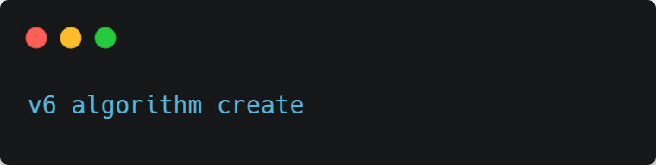
Creating an algorithm – how?
vantage6 infrastructure requires certain structure. For a Python algorithm:
It should be a valid Python package
Algorithm functions should be callable from the Docker image
Python code should correctly use the wrapper
…
To create a good starting point easily:

Slide 13
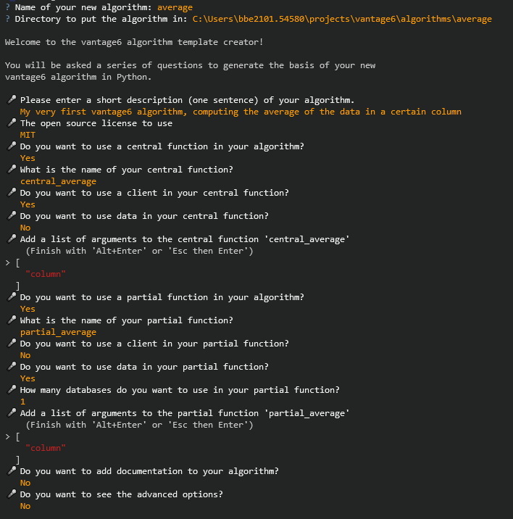
Time to start creating your algorithm!
TYPE ALONG

Slide 14
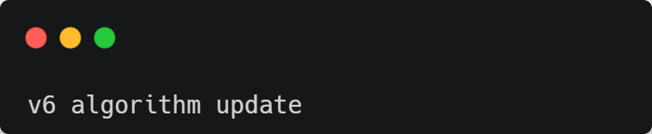
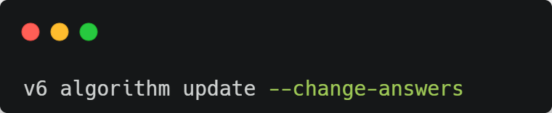
Updates to algorithm
On changes in the vantage6 infrastructure:
If you want to change the answers to the questions:

Slide 15
Boilerplate files
CHALLENGE
Inspect your personalized boilerplate code. What does it contain? Multiple answers possible.
Templates of your algorithm functions
Arguments of your algorithm functions
Scripts to test your algorithm functions
Checklist of what to do to complete your algorithm
A JSON file that helps to include the algorithm in an algorithm store

Slide 16
Boilerplate files
SOLUTION
The answers is that it contains all those things.
Any suggestions what would be useful to add? Let us know!
Notes:
Create beautiful images of your code (ray.so)

Slide 17
Implement your algorithm
CHALLENGE
Implement the partial function to compute sum and length of the requested column
Implement the central function to aggregate those and compute the final average
Install the algorithm with pip install –e .
Adjust test.py to compute the average of the Age column and run it with python test.py
What is the average age?
HINT Return the function’s results as a Python dictionary

Slide 18
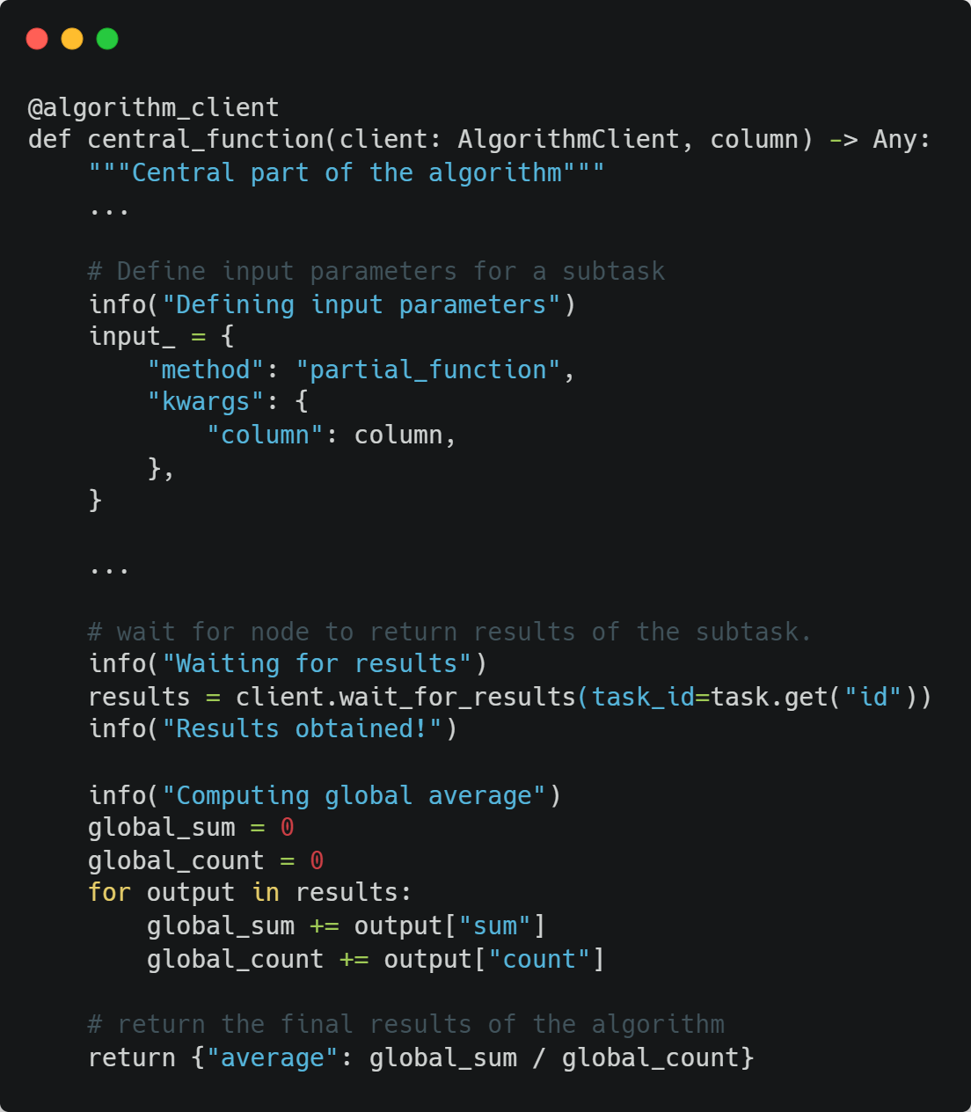
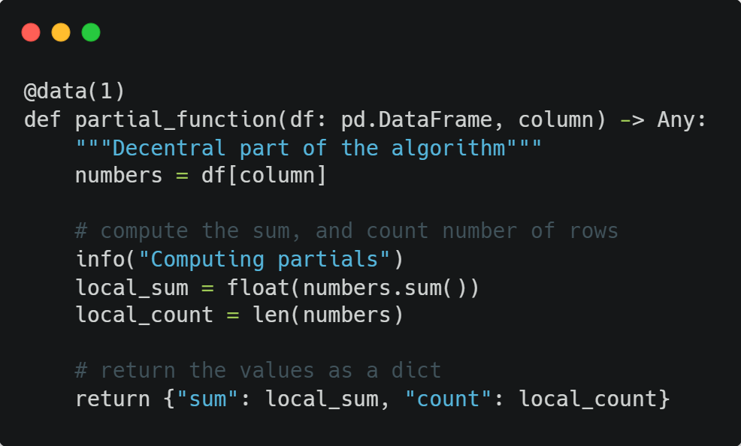
Implement your algorithm
SOLUTION
Full code: https://github.com/vantage6/workshop-average-boilerplate/tree/implemented-functions
Notes:
Create beautiful images of your code (ray.so)

Slide 19
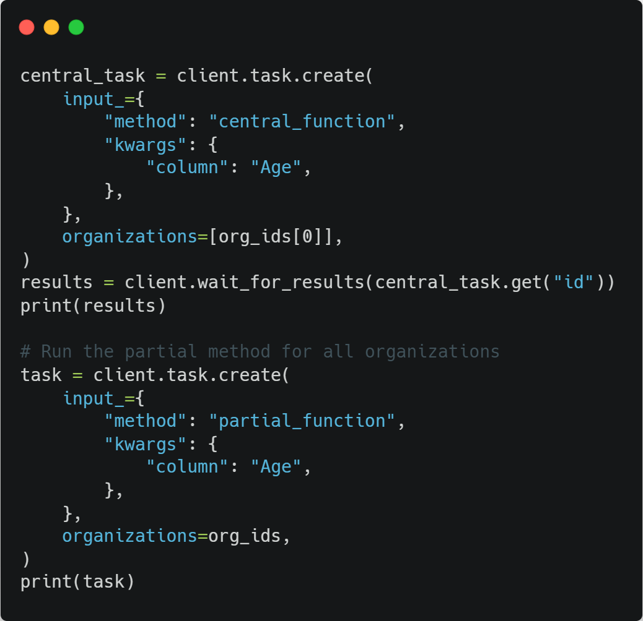
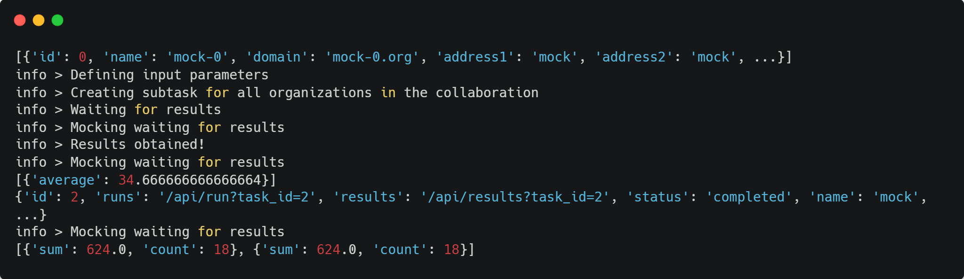
Implement your algorithm
SOLUTION
Average age is 34.67!
Full code: https://github.com/vantage6/workshop-average-boilerplate/tree/implemented-functions
Notes:
Create beautiful images of your code (ray.so)

Slide 20
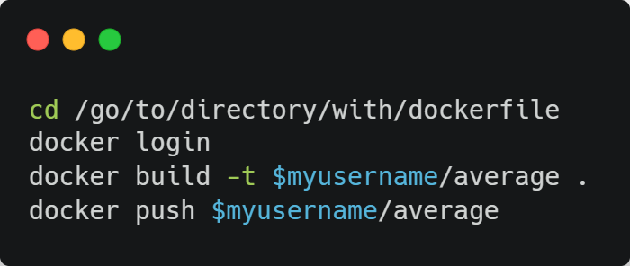
Building your algorithm
TYPE ALONG
To use the algorithm in vantage6, a Docker image is required
First, create an account on Dockerhub: https://app.docker.com/signup?
Then, replace your execute commands:
Creates docker image
Uploads image to registry

Slide 21
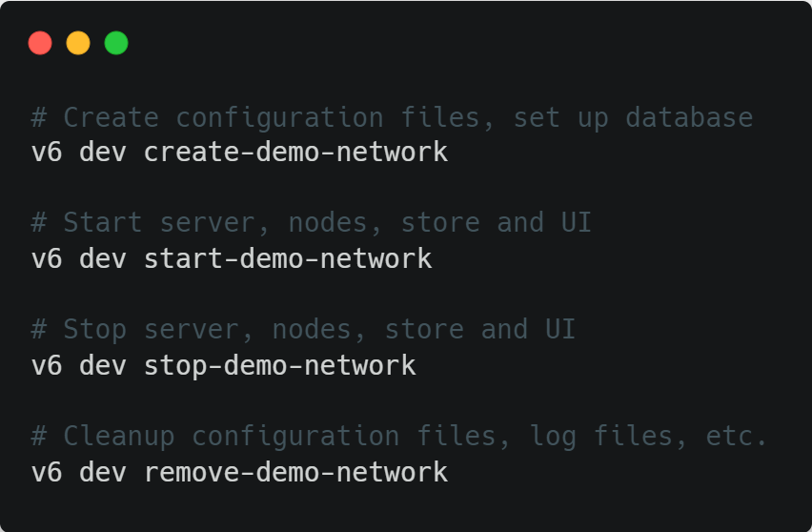
Run vantage6 locally to test algorithm
You can easily run vantage6 locally with these CLI commands:
A demo network consists of a server, three nodes, an algorithm store and a UI. It contains some test data on Olympic medal winners.

Slide 22
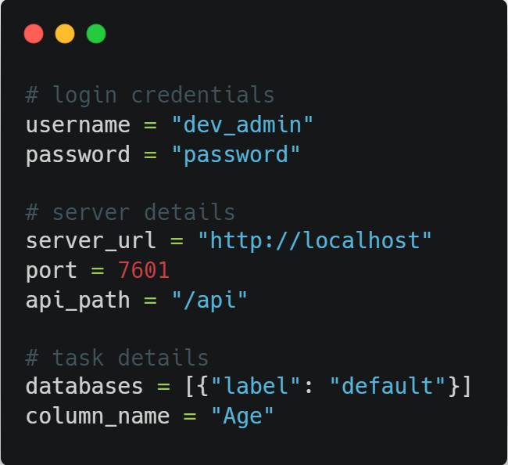
Run your Dockerized algorithm
CHALLENGE
Create and start a demo network with the v6 dev commands
Run the algorithm from the Python client using the details on the right
What is the average age for this dataset?
ALERT If you are using Linux without Docker desktop, you need to run:
v6 dev create-demo-network -–server-url http:172.17.0.1

Slide 23
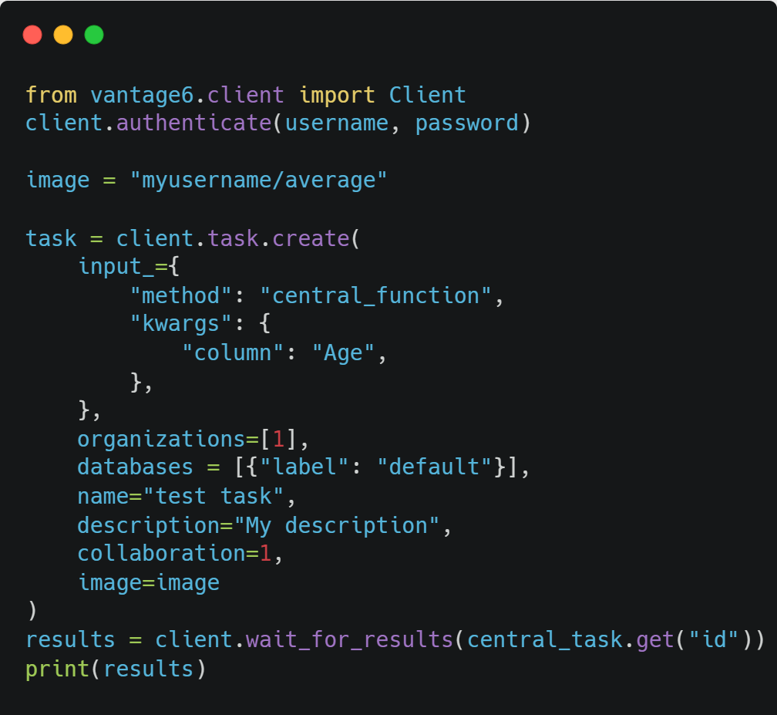
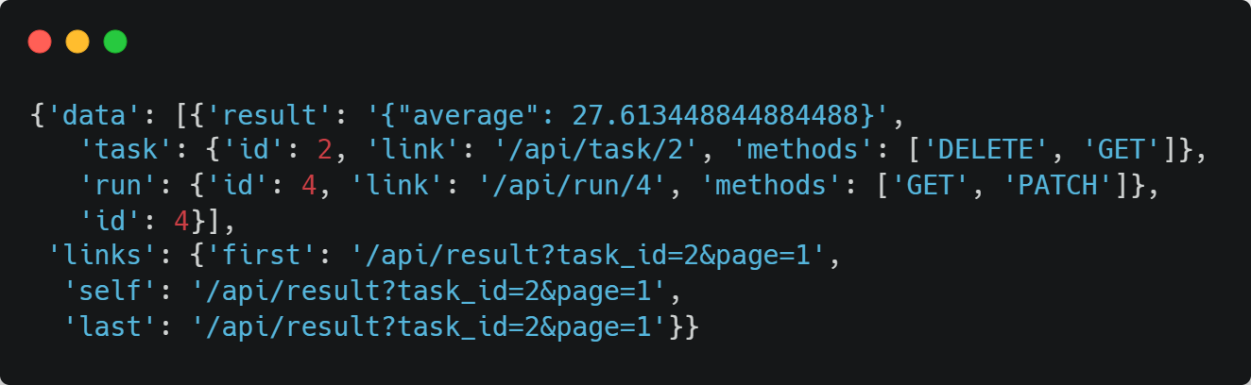
Run your Dockerized algorithm
SOLUTION
Average age is 27.61!
Notes:
Create beautiful images of your code (ray.so)

Slide 24
Run your algorithm in the UI - requirements
To run your algorithm in the UI, the UI needs to know its details such as which functions and parameters exist
The UI gets this data from the algorithm store
We need to upload our algorithm to the store
We can use the algorithm.json file from the boilerplate, which contains most of the required data

Slide 25
Uploading algorithm to the store
CHALLENGE
Login to the UI running at http://localhost:7600
Select the local algorithm store and add a new algorithm.
Upload your algorithm_store.json and complete the remaining fields. Which values should you enter? Which initial values are incorrect?
After completing, can you find the updated algorithm JSON description? Download it and put it in your algorithm code.
NOTE Instead of via the UI, you can also put an algorithm in the store with client.algorithm.create()
NOTE in most algorithm stores, algorithm review is required – not in your local store

Slide 26
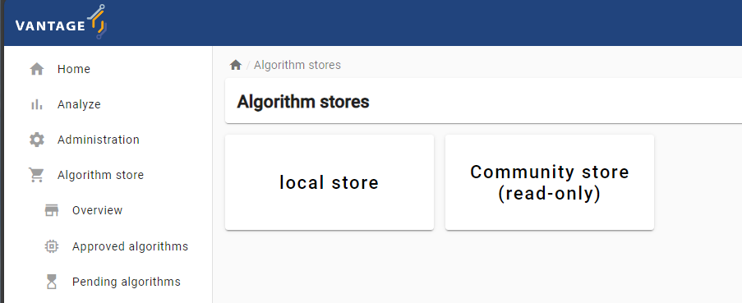
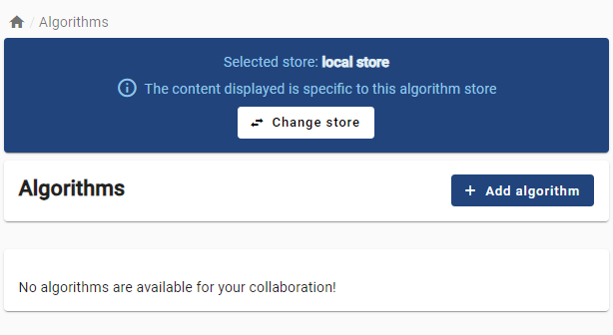
Uploading algorithm to the store
SOLUTION
1. Select local store
2. Select ‘Add algorithm’
Notes:
Create beautiful images of your code (ray.so)

Slide 27
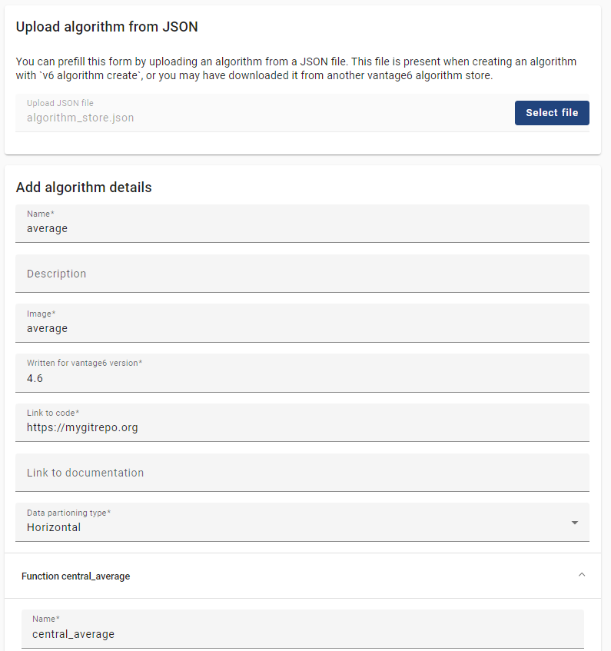
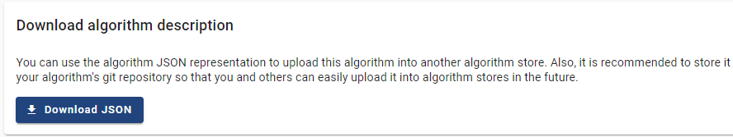
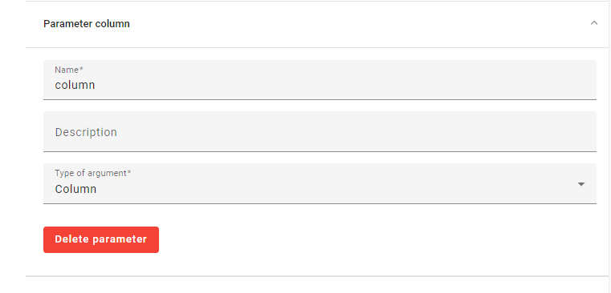
Uploading algorithm to the store
SOLUTION
3. Fill out the form
4. Download new JSON file
Notes:
Create beautiful images of your code (ray.so)

Slide 28
Run your algorithm in the UI
CHALLENGE
Now you can run your algorithm in the UI! Verify that the average age is the same as when running it via the Python client.
Can you also get the average of other columns?

Slide 29
Run your algorithm in the UI
SOLUTION
Average age – surprisingly – should still be 27.61
Average height is 178.5 (cm)
Average weight is 74.3 (kg)

Slide 30
Compute the average per group
ADVANCED CHALLENGE
Who are the eldest on average: gold, silver, or bronze medal winners? Adjust/extend your algorithm to find out!
You can answer this question using the Python client, or you can re-upload your algorithm to the algorithm store and use the UI again.

Slide 31
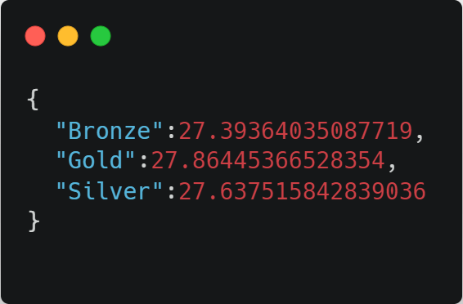
Compute the average per group
SOLUTION
You should get something like:
So gold medal winners are older than silver and bronze. Practice makes perfect!
Full code for the solution is here:
https://github.com/vantage6/workshop-average-boilerplate/tree/advanced-challenge
Notes:
Create beautiful images of your code (ray.so)

Slide 32
Production-ready algorithms
CHALLENGE
You now know how to create a simple vantage6 algorithm.
What would you like to improve in this algorithm before applying it to sensitive data in your institute?

Slide 33
Production-ready algorithms
SOLUTION
There is no single correct answer here. Several areas that are typically necessary are:
Privacy guards: make sure that the functions do not share sensitive data if there are few data points, if certain combinations of arguments are provided, etc.
Error handling: raise an error that is understandable by a researcher running the algorithm for common cases where e.g. input is wrong
Documentation: Fewer errors will occur when people know how to run an algorithm, so document it!
Notes:
Create beautiful images of your code (ray.so)

Slide 34
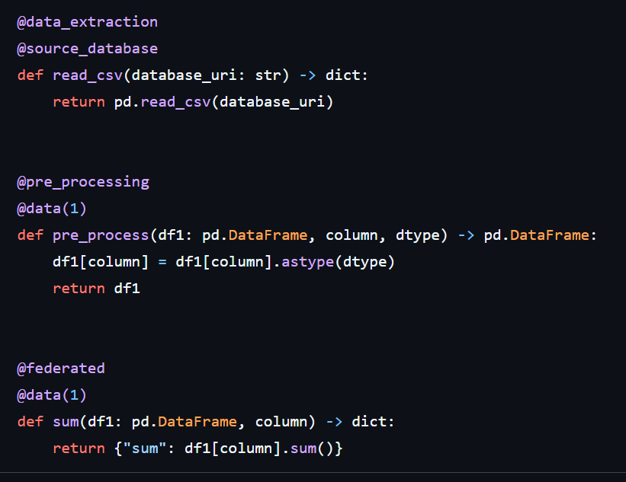
Future changes: sessions
Different parts of the algorithm will be split in different parts to improve reusability
UI/UX experience will improve because we know more about the dataset
Re-using previous data extraction step is quicker and less error-prone

Slide 35

Future changes: algorithm build service
Algorithm developer submits code to algorithm store
Build service builds image
Build service makes image available
Part of the algorithm store
Improve trust
Decrease developer burden

