Slide 1
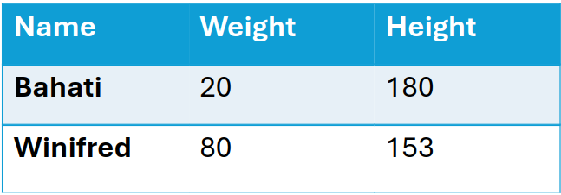


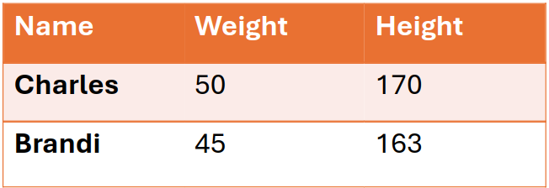

Slide 4



Slide 5






Slide 6





Slide 7
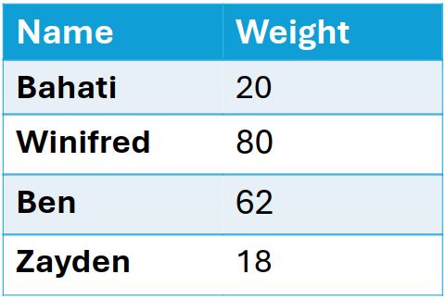
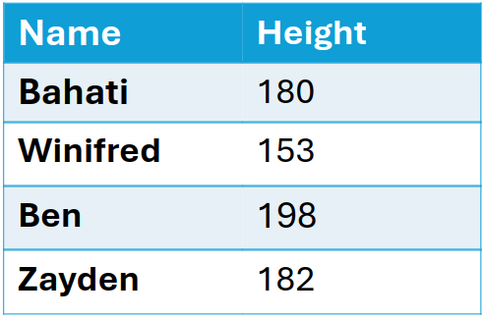

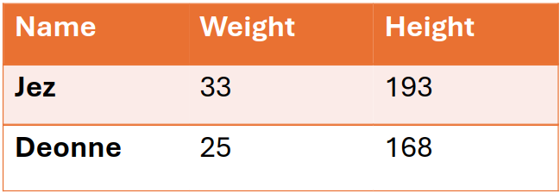
Horizontal partitioning
Vertical partitioning

Slide 8
Node 1
Node 3
Node 2
vantage6 server
Notes:
Chapter 2

Slide 9
-11
4
64
Mees
43 kg
19
-12
50
-38
Noor
45 kg
34
Sara
39 kg
17

Slide 10
Mees
-11 –12 + 19 = -4
Noor
4 + 34 + 64 = 102
Sara
50 + 17 –38 = 29

Slide 11
Mees
-4 + 29 + 102 = 127
Noor
Sara

Slide 12
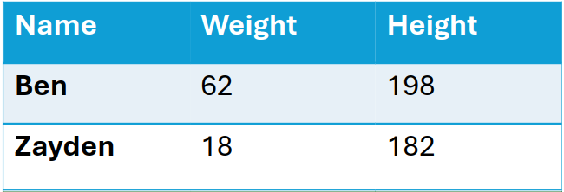
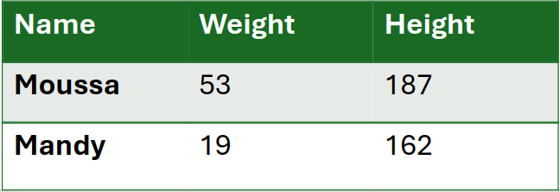
Name | Weight | Height
Charles | 50 | 170
Brandi | 45 | 163
Name | Weight | Height
Jez | 33 | 193
Deonne | 25 | 168
Name | Weight | Height
Bahati | 20 | 180
Winifred | 80 | 153
Name | Weight | Height
Ben | 62 | 198
Zayden | 18 | 182
Name | Weight | Height
Moussa | 53 | 187
Mandy | 19 | 162

Slide 13
Name | Weight
Bahati | 20
Winifred | 80
Ben | 62
Zayden | 18
Name | Height
Bahati | 180
Winifred | 153
Ben | 198
Zayden | 182

