Slide 1
Introduction to Privacy Enhancing Technology

Slide 2
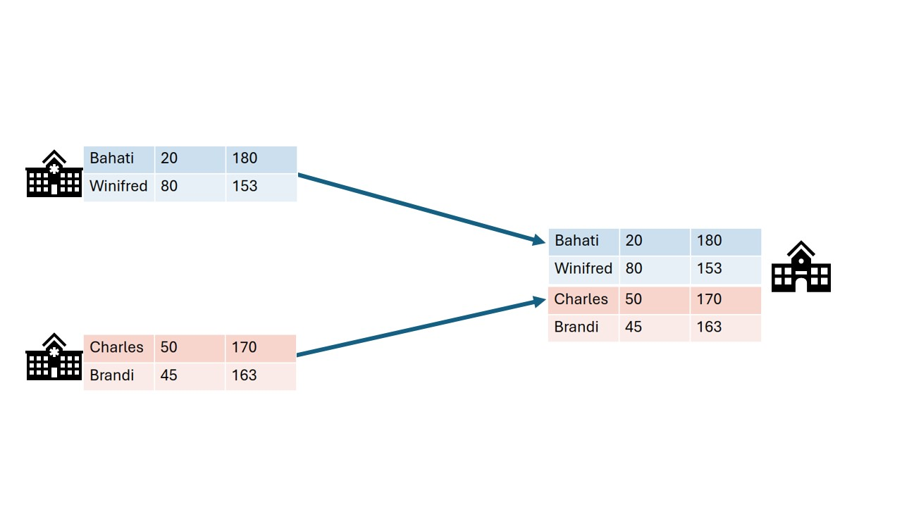
Classic analysis: Collect the data in one place
Notes:
Open source
Container orchestration for privacy enhancing techniques
Easily extensible to different types of data sources
Algorithms can be developed in any language
Other applications can connect using the API

Slide 3
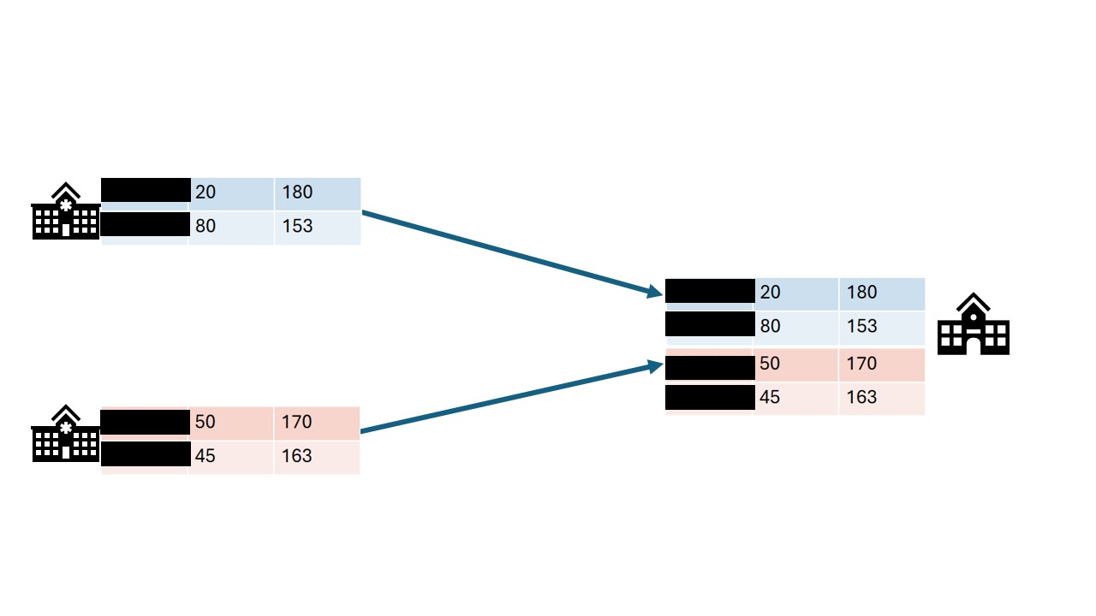
Data anonymization: Remove sensitive fields
Notes:
Open source
Container orchestration for privacy enhancing techniques
Easily extensible to different types of data sources
Algorithms can be developed in any language
Other applications can connect using the API

Slide 4
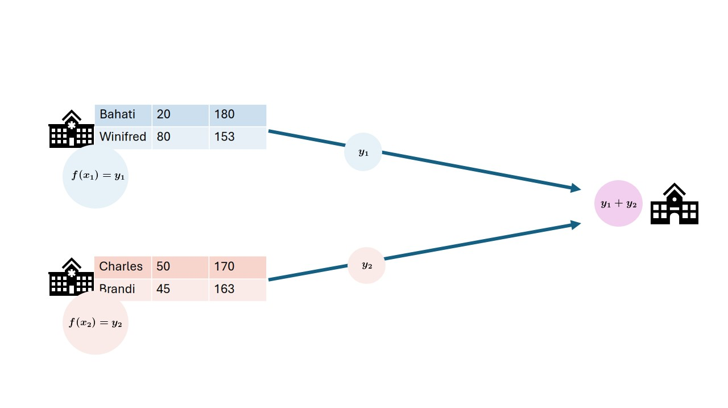
Federated data analysis: Send analysis to the source, then aggregate
Notes:
Open source
Container orchestration for privacy enhancing techniques
Easily extensible to different types of data sources
Algorithms can be developed in any language
Other applications can connect using the API

Slide 5
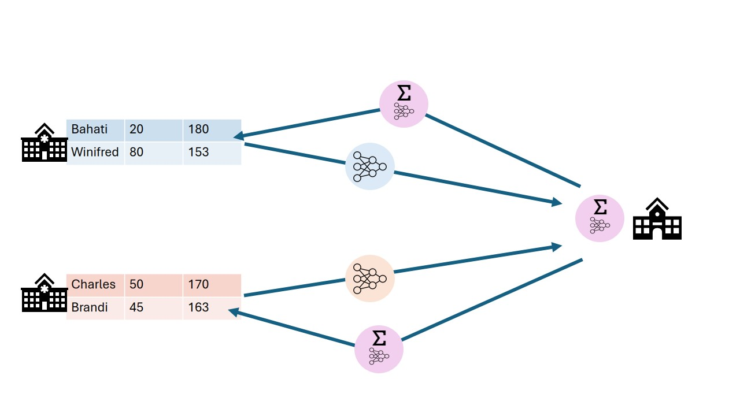
Federated learning: Train models locally, then aggregate
Notes:
Open source
Container orchestration for privacy enhancing techniques
Easily extensible to different types of data sources
Algorithms can be developed in any language
Other applications can connect using the API

Slide 6
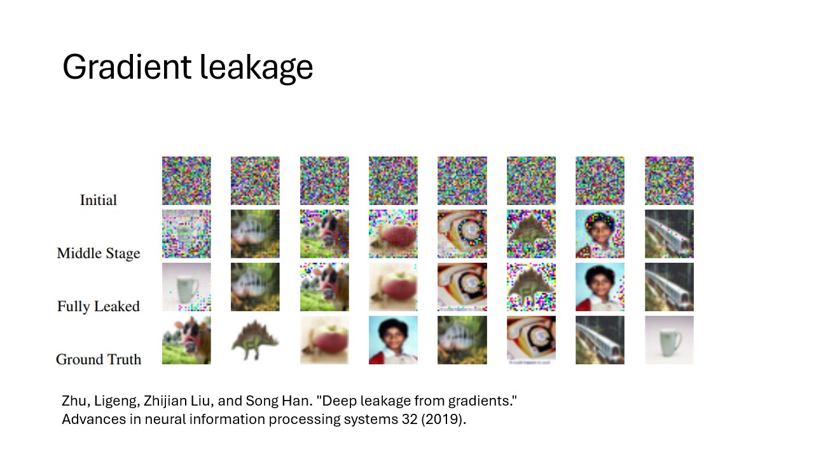
Federated learning and analysis can still leak data!
Notes:
Open source
Container orchestration for privacy enhancing techniques
Easily extensible to different types of data sources
Algorithms can be developed in any language
Other applications can connect using the API

Slide 7
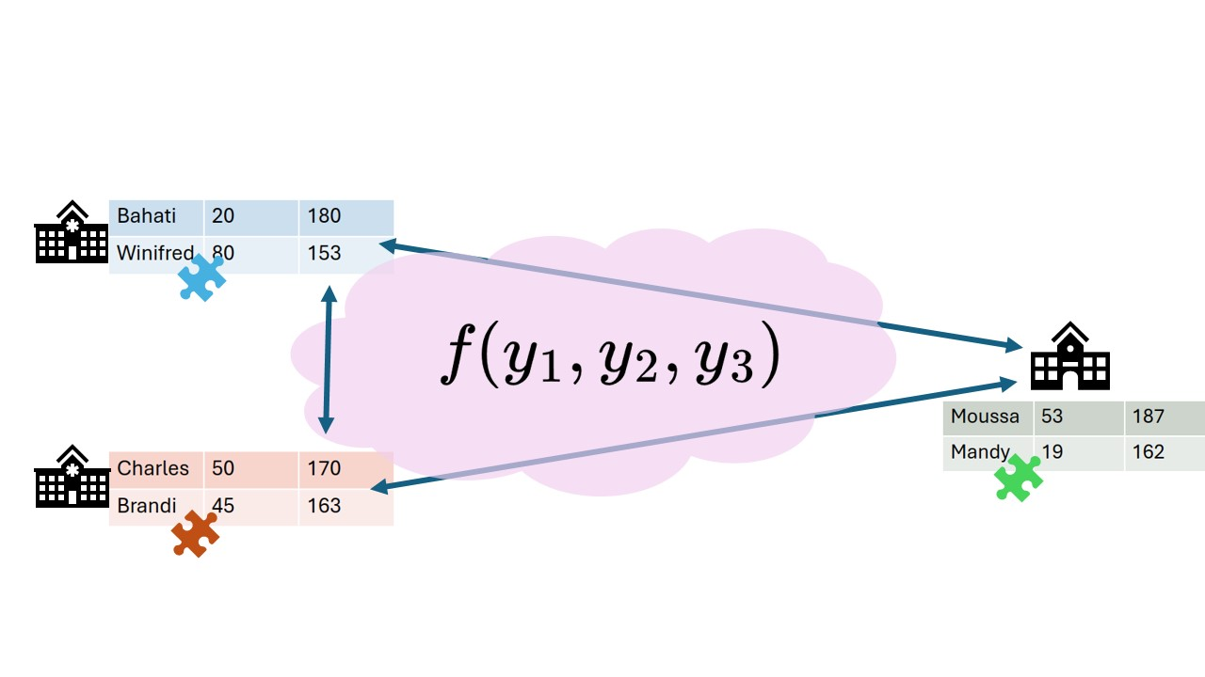
Secure multiparty computation: Send around encrypted puzzle pieces
Notes:
Open source
Container orchestration for privacy enhancing techniques
Easily extensible to different types of data sources
Algorithms can be developed in any language
Other applications can connect using the API

Slide 8
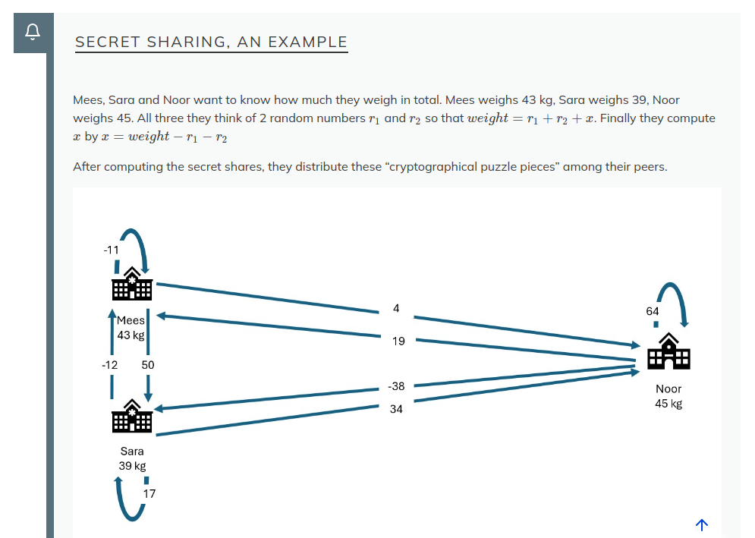
Secret sharing: an example
Notes:
Open source
Container orchestration for privacy enhancing techniques
Easily extensible to different types of data sources
Algorithms can be developed in any language
Other applications can connect using the API

Slide 9
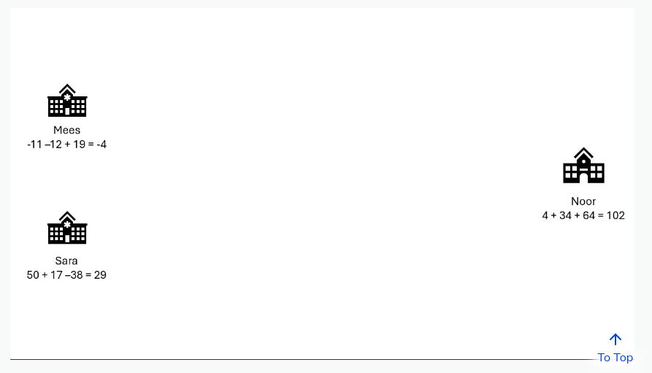
Secret sharing: an example
Notes:
Open source
Container orchestration for privacy enhancing techniques
Easily extensible to different types of data sources
Algorithms can be developed in any language
Other applications can connect using the API

Slide 10
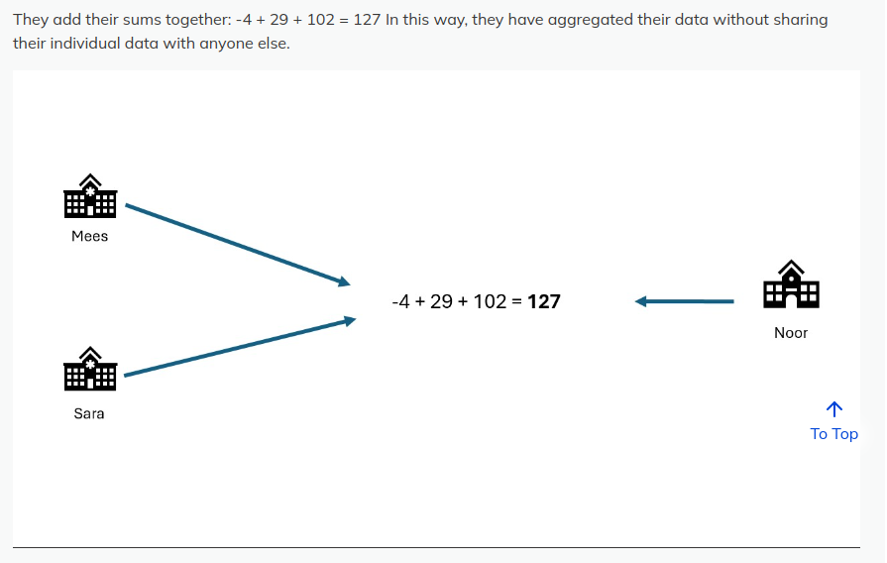
Secret sharing: an example
Notes:
Open source
Container orchestration for privacy enhancing techniques
Easily extensible to different types of data sources
Algorithms can be developed in any language
Other applications can connect using the API

Slide 11
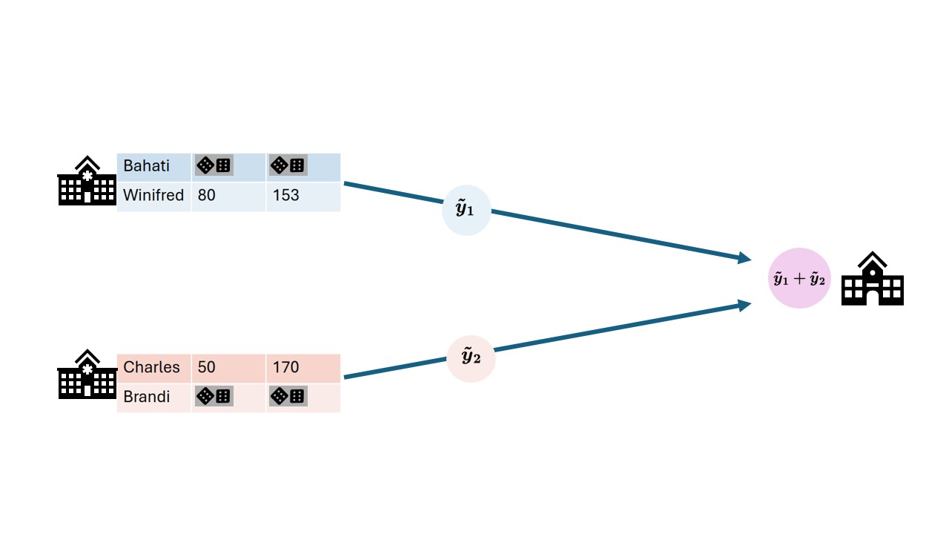
Differential privacy: Add noise
Notes:
Open source
Container orchestration for privacy enhancing techniques
Easily extensible to different types of data sources
Algorithms can be developed in any language
Other applications can connect using the API

Slide 12
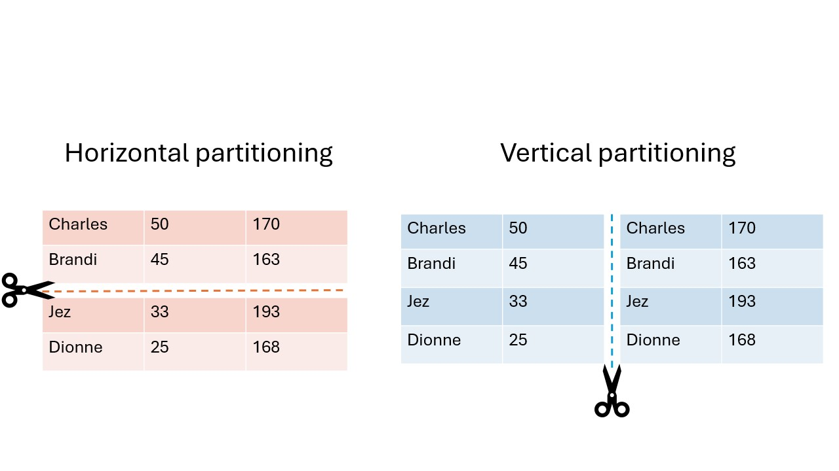
Data partitioning
Notes:
Open source
Container orchestration for privacy enhancing techniques
Easily extensible to different types of data sources
Algorithms can be developed in any language
Other applications can connect using the API

Slide 13
Technology doesn't solve everything!
Privacy enhancing technology is only a small part of the data sharing puzzle
Some other factors
Trust
Regulations (either general or specific to the location)
Data harmonization

Slide 14
Summary
With PETs you can derive insights from data without seeing individual records.
PET analysis usually starts with the anonymization or pseudonymization of the data.
In federated data analysis the analysis moves to the data, while in classic analysis the data moves around.
In secure multiparty computation, computations are performed collaboratively without any one party being able to see all the raw data.
Techniques from differential privacy add noise to the data to make it harder to reconstruct the original records from an aggregation.
Privacy enhancing analyses usually stack multiple techniques on top of each other to provide multiple layers of protection.
Horizontal partitioning means the records are split, while in vertical partitioning the features are split.
In research on privacy sensitive data, technology is only one part of the story

