Slide 1
Graph Learning Lab
Group 6 - Sheet 5

Slide 2
Exercise 1 - HOLU
Idea: Use the GCN from Sheet 3, but do vast amounts of feature engineering to inform it of chemical properties
The xyz data was translated into a z-matrix (chemical way of representation)
From the node labels (atom-number, we inferred electronic properties)
We computed some node feature kernels
Edge data was enhanced with length of the edge
Group 6 - Sheet 5

Slide 3
Exercise 1 - HOLU
Node Features
Electronic features (based on atom): (dimensions in brackets)
Atomic weight = atomic number (1)
Number of valence electrons in each shell (3)
Number of bonds = number of edges (1)
Electronegativity of the atom type (1)
Electron affinity (zero energy) & ionization energies up to the 4th one (4)
Group 6 - Sheet 5

Slide 4
Exercise 1 - HOLU
Node Features
Kernels:
Closed walk, but as node contributions, up to length 10: (10)
each node gets the number of cycles it contributes to
via eigenvalues and vectors
Hosoya index kernel: Hosoya index is the number of edge matchings. (6)
For each node 5 Hosoya indices on bfs sampled subgraphs (5)
Each node gets the graph’s Hosoya index as well (1)
Group 6 - Sheet 5

Slide 5
Exercise 1 - HOLU
Edge Features (5)
One-hot encoded edge labels (4)
Distance via the xyz data (1)
Z-Matrix (7-dim)
A tree through the graph, that holds all necessary 3d information.
No absolute positional data
Only based on distances, angles and dihedral angles between atoms
Feature consists of:
atom number, parent, distance, parent^2, angle, parent^3, dihedral angle
Group 6 - Sheet 5

Slide 6
Exercise 2 - CITE
Idea: Combine approaches from all previous exercises with some twists:
Train node2vec embeddings using random “p-trees” beforehand, Analogous to pq-walks but p ∈ (0,1] controls density & breadth of trees
Compute node-level closed-walk-kernel embedding via adjacency matrix, Stores number of closed walks of lengths 2,...,L for each node, Originally built “spectral” solution using eigenvalues & -vectors, Settled on direct matrix multiplication afterall due to computational issues
node_attributes are fed into a stack of GNN layers (1st stage) equiv. to GCN but using scatter operations & (optionally) multiple message passes per layer
Outputs from GNN layers are concatenated w/ both (norm.ed) embeddings & fed into MLP (2nd stage), which then predicts one-hot encoded node_labels
Group 6 - Sheet 5

Slide 7
Exercise 2 - CITE
Setup & Main Parameters:
12-fold cross-validation on train/test subgraphs of known graph by uniformly sampling associated node splits, compute (mean & std of) accuracies
Use cross-entropy loss w/ Adam optimizer, run over 25 epochs (per split)
Predict unknown node_labels after training model on whole known graph
Node2vec: p=0.5, m=10, m_ns=19, batch size=100, #batches=10, dim=180
Closed Walks: L = 21
GNN: dim_GNN = dim_MLP = 200, #GNN_layers = #MLP_layers = 5, 2 U-layers & 1 message pass per GNN layer w/ scatter_sum → GCN
Group 6 - Sheet 5

Slide 8
Exercise 2 - CITE
Mean ± StD over Accuracies on test splits (rounded in %): 68.62 ± 1.77
Discussion:
Decent result considering that we only tried hand-picked parameters intuited from previous tasks, better results may well be achieved via HPO
Improbable make-up of predictions though: mostly 0 & 1, few 3, no 2…
Test accuracies peeked at around 25 epochs, slightly overfit beyond that
Sampling p-trees was much slower than pq-walks for some reason (even w/ the latter in single-process), have not implemented multi-processing yet
Overall the concept of our approach at least seems promising
Group 6 - Sheet 5

Slide 9
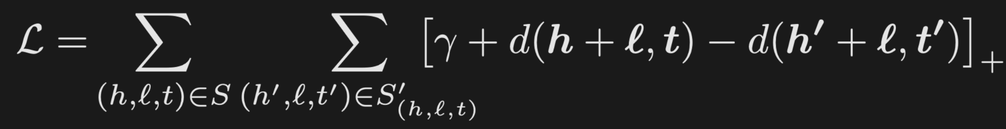
Exercise 3 - LINK
Idea:
[A. Bordes et al.] The TransE method: an energy-based model
Hierarchical relationships are extremely common and translations are the natural transformations for representing them
Relationships are represented as translations in the embedding space: if (h, ℓ, t) holds, then the embedding of the tail entity t should be close to the embedding of the head entity h plus some vector that depends on the relationship ℓ.
Energy function:
Group 6 - Sheet 5

Slide 10
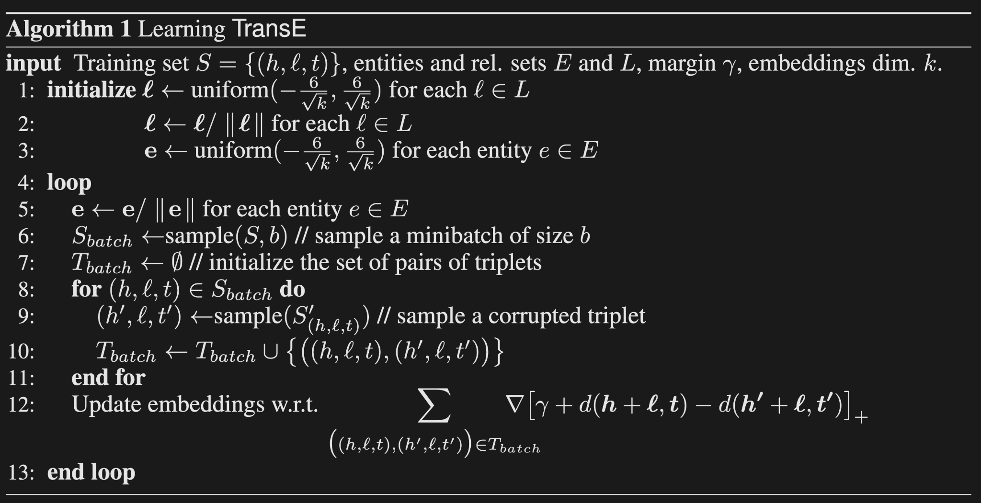
Exercise 3 - LINK
Group 6 - Sheet 5

Slide 11
Exercise 3 - LINK
Parameters:
dim = 50, lr = 0.01, margin = 1.0, n_epochs = 100, batch size = 128
Discussion:
Very efficient
Group 6 - Sheet 5

