Slide 1

IoT-Based Pet Health Monitoring and GPS Tracking System
REAL-TIME LOCATION AND ACTIVITY ANALYSIS
Intelligent continuous monitoring of pet health, location, and activity through wearable IoT devices and cloud connectivity.
VANTAKU RAMAKRISHNA
323129520129

Slide 2

Problem Statement
Monitoring Gap
No Continuous Health Data
Difficulty monitoring pet health and activity continuously throughout the day.
Lack of continuous health and activity monitoring leaves owners uninformed.
Tracking Challenges
Difficulty tracking pets when outdoors or left unattended in open environments.
Real-Time Need
Growing need for real-time location tracking and health monitoring solutions.
Limited Information
Traditional tracking methods provide limited health and behavioral information.
Safety & Well-Being
Ensuring pet safety and well-being requires proactive, data-driven approaches.

Slide 3
Proposed Solution
Wearable IoT Device
Real-Time GPS Tracking
Integrated with multiple sensors in a compact, pet-worn form factor for seamless continuous monitoring.
Continuous geographical location tracking providing accurate, up-to-the-minute pet location data.
Health & Activity Monitoring
Cloud-Based Platform
Continuous monitoring of movement, activity levels, and key health parameters around the clock.
Centralized cloud platform with a secure, user-friendly interface for remote pet monitoring.

Slide 4
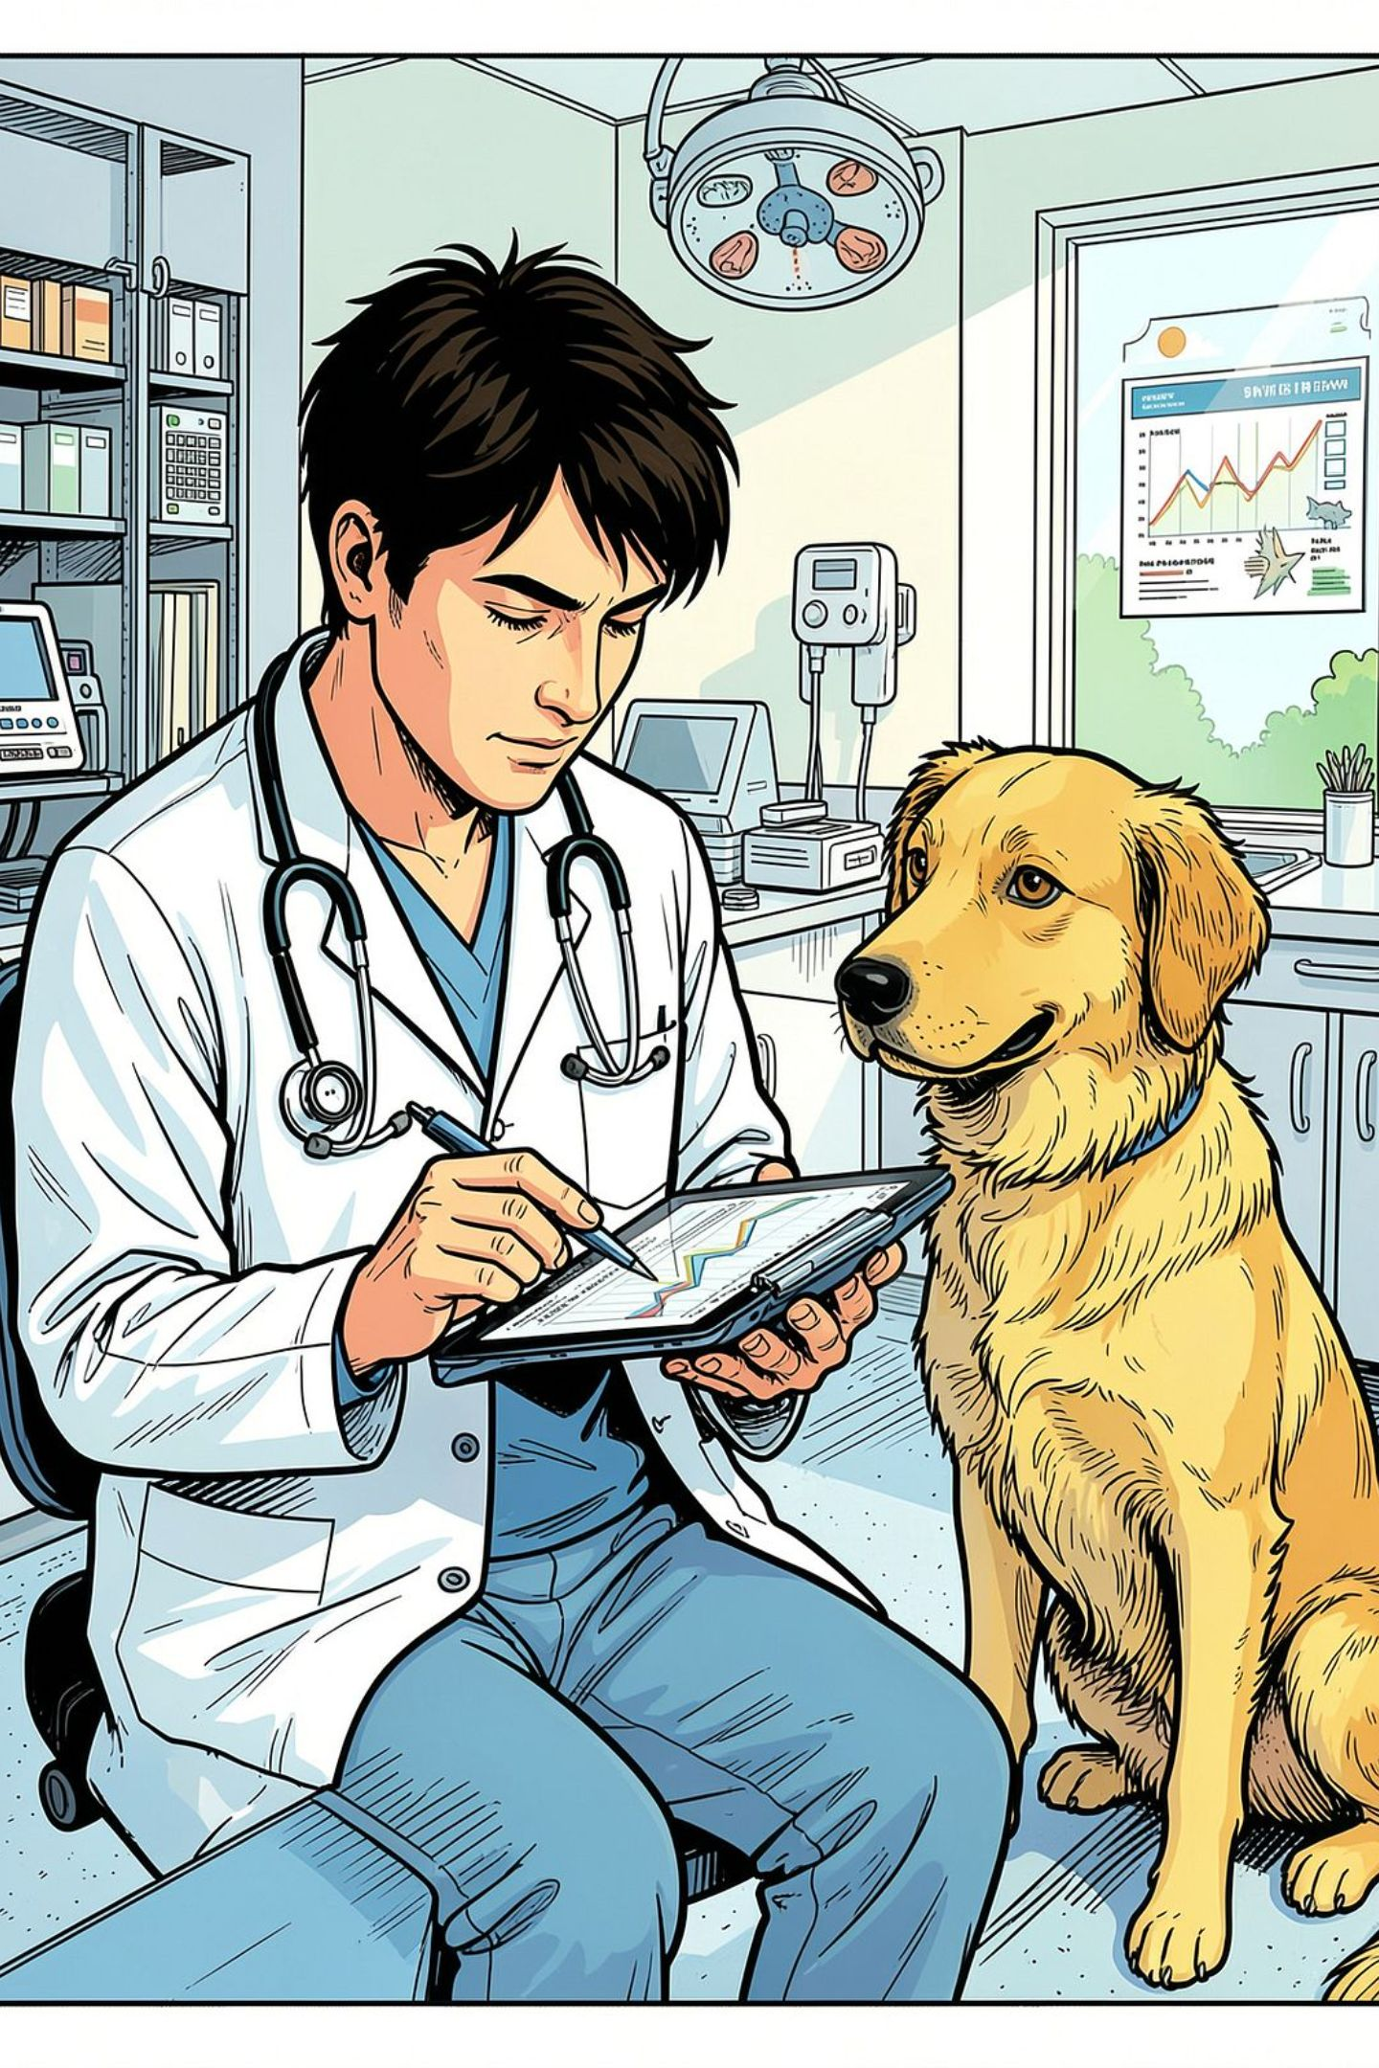
Objectives
Track pet location in real time
Monitor pet activity and movement patterns
Monitor important health parameters continuously
Provide remote monitoring capabilities for pet owners
Detect unusual situations and anomalies
Generate alerts and notifications automatically
Improve animal safety and well-being
Support smart pet care management

Slide 5
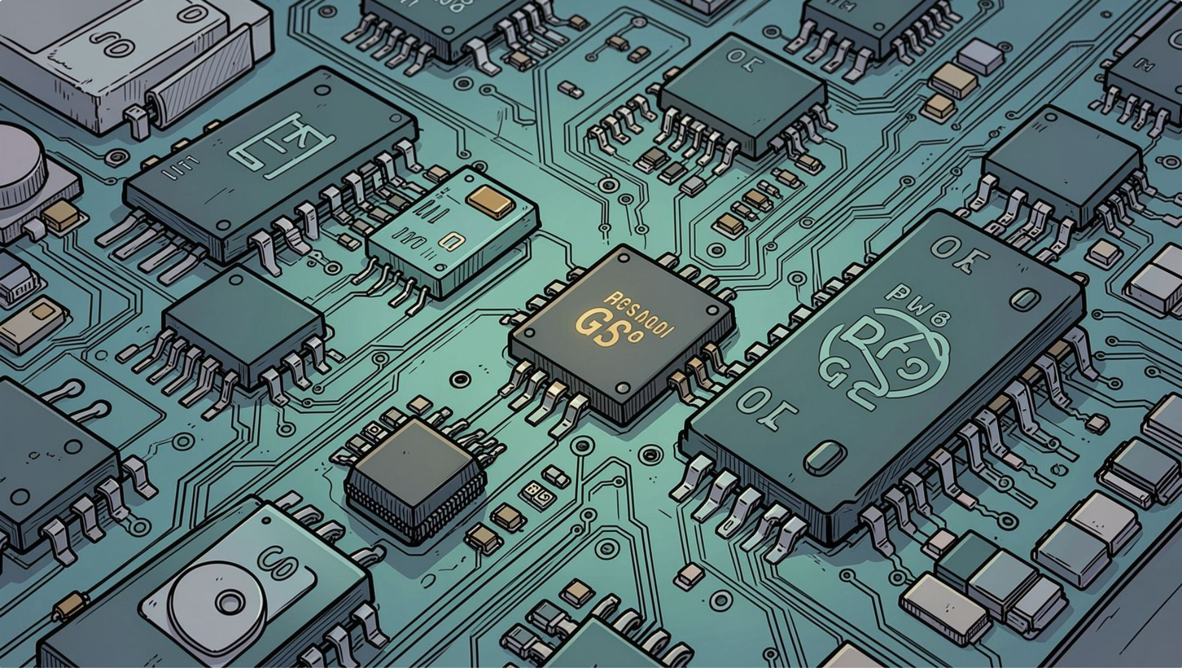
System Components
GPS Module
Tracks geographical location of the pet in real time.
Activity Sensors
Monitor movement and activity levels continuously.
Heart Rate Sensor
Monitors cardiac health and heart rate.
Temperature Sensor
Monitors body temperature in real time.
IoT Communication
Transmits collected sensor data wirelessly.
Cloud Connectivity
Enables centralized data access and monitoring.

Slide 6
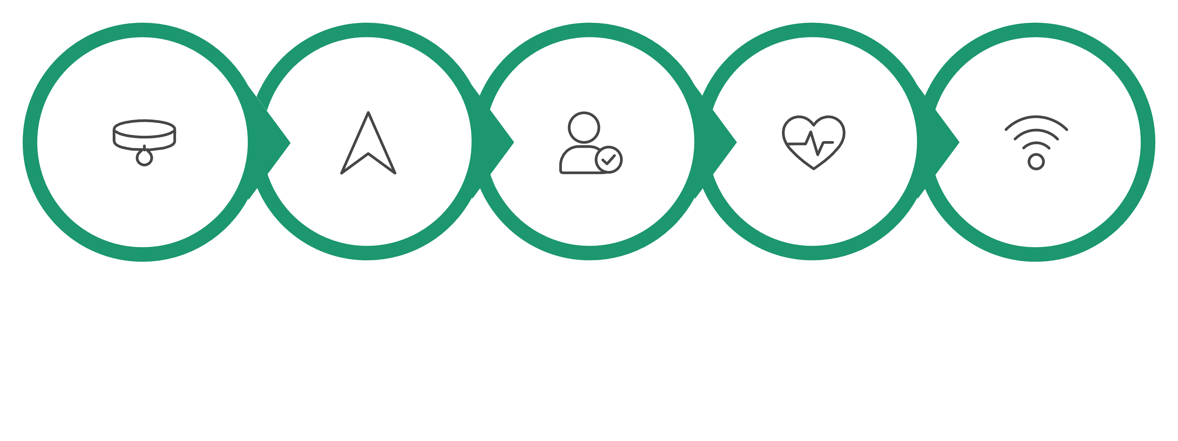
Working Principle
Wearable On Pet
Activity Sensing
Health Sensors
IoT Transmission
GPS Location
The system operates as a continuous closed loop — from data collection at the wearable device through cloud processing to real-time alerts — ensuring pet owners are always informed and ready to respond.

Slide 7
Monitoring Dashboard
1
2
Live Location Map
Activity Metrics
Pet location displayed on an interactive, real-time map interface.
Current activity levels and movement metrics updated continuously.
3
4
Health Statistics
Movement History
Vital signs and health statistics presented in a clear visual format.
Historical activity trends and movement playback for behavioral analysis.
5
6
Geofencing Alerts
Emergency Notifications
Instant alerts when the pet leaves designated safe zones.
Critical health event notifications sent immediately to the owner.
The dashboard enables pet owners to remotely monitor their pets and respond quickly to unusual situations.

Slide 8
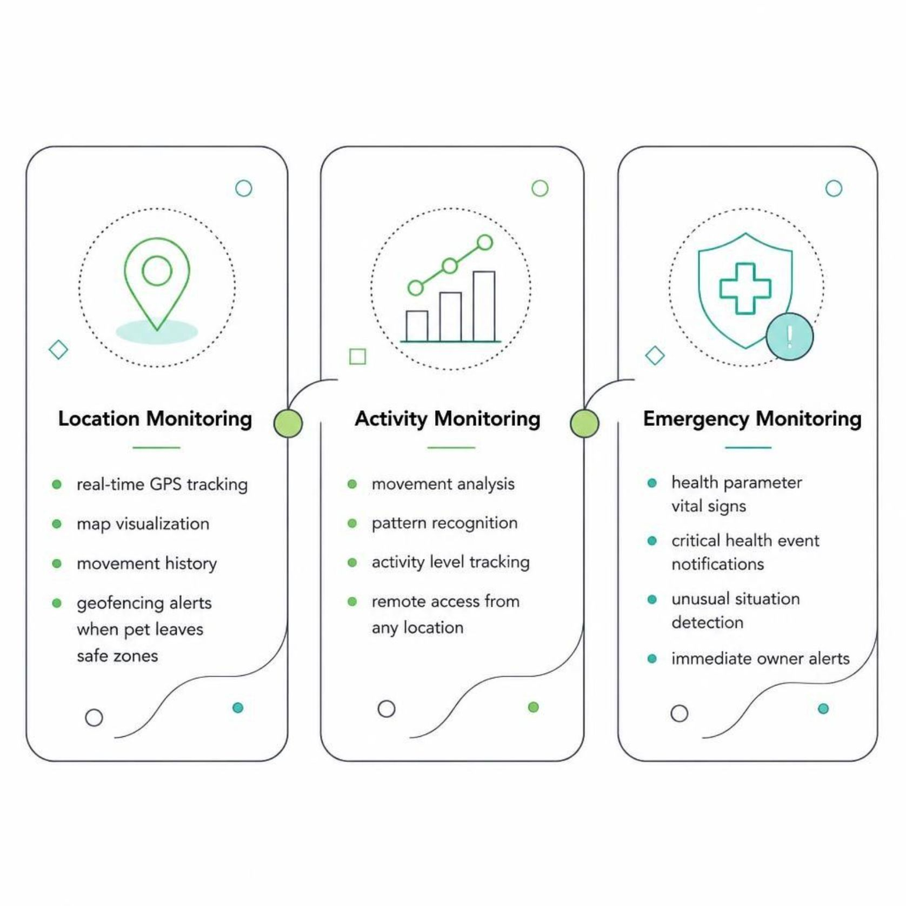

Location, Activity and Emergency Monitoring
These three integrated monitoring functions work together to provide comprehensive pet oversight:
Real-time GPS location tracking with map visualization
Activity and movement analysis with pattern recognition
Health parameter monitoring for vital signs
Movement history tracking and playback
Geofencing alerts when pet leaves safe zones
Emergency notifications for critical health events
Remote monitoring by pet owners from any location
These functions help identify unusual situations and improve pet safety and well-being.

Slide 9
Benefits and Applications
Key Benefits
Target Applications
Improved Safety: Continuous location and health tracking for enhanced animal security.
🏠 Pet Owners & Households
🏥 Veterinary Hospitals & Clinics
Remote Monitoring: Monitor pets from anywhere with real-time geofencing and alerts.
🐾 Animal Shelters & Rescue Orgs
🌾 Livestock Farms & Agriculture
Faster Response: Automatic notifications enable quicker reaction to unusual situations.
Smart Pet Care: Better understanding of activity patterns for enhanced care management.
🤝 Pet Care Organizations

Slide 10

Conclusion
Integrated Technology Stack
Combines wearable IoT technology, GPS, activity sensors, health sensors, IoT communication, and cloud connectivity into a unified system.
Comprehensive Monitoring
Enables continuous monitoring of pet location, activity, and health status with a centralized dashboard for live data, history, geofencing, and emergency alerts.
Enhanced Safety & Well-Being
Empowers pet owners to monitor remotely and respond quickly — improving animal safety, health tracking, and smart pet care management.
Using IoT technology to provide intelligent, continuous, and remote pet monitoring for enhanced safety and well-being.

