Slide 1
Elastic Stack — Beats Training
Notes:
Welcome! This session introduces the Elastic Beats family and how developers use them.

Slide 2
Table of Contents
1. Why Beats?
2. Ecosystem Flow
3. Beats Family Overview
4. Filebeat (Overview, Features, Use Cases, How It Works, Parsing Options ×4)
5. Winlogbeat
6. Metricbeat
7. Heartbeat
8. Packetbeat
9. Auditbeat
10. Cross-Cutting Features
11. Synergy & Scenarios
12. Key Takeaways
Notes:
Agenda overview

Slide 3
Why Beats?
Lightweight data shippers for logs, metrics, uptime, network, and audit
Plug & Play with Elasticsearch + Kibana (ECS-compatible data)
Developer-friendly: no app code changes needed
Scales from a single VM to thousands of endpoints
Notes:
Beats reduce friction.

Slide 4
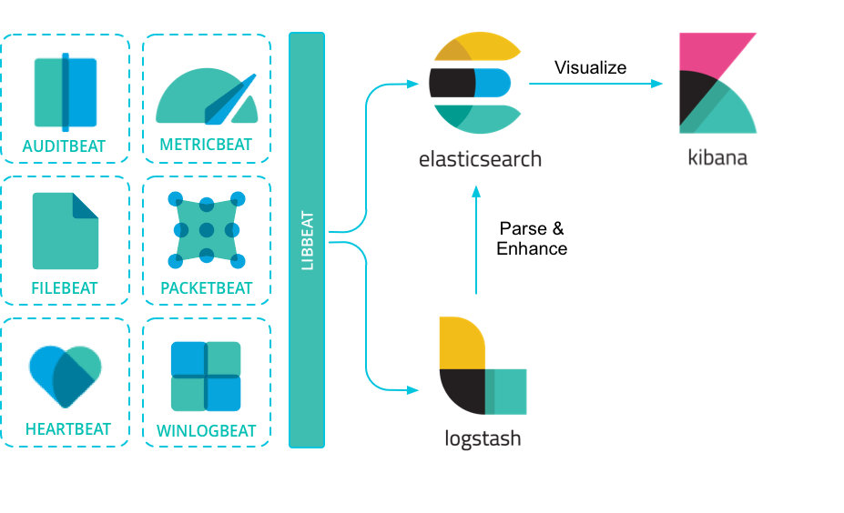
ElasticStack

Slide 5
Ecosystem Flow: Client Machines → Beats → Elasticsearch → Kibana
Beats
Filebeat
Winlogbeat
Metricbeat
Heartbeat
Packetbeat
Auditbeat
Client Machines
(Apps, DBs, OS)
Elasticsearch Cluster
(Ingest Pipelines, Indices)
Kibana
(Discover, Dashboards, Alerts)
Notes:
Data flows from client machines through Beats to Elasticsearch; Kibana provides UI.

Slide 6
Beats Family — Overview
Filebeat → Application & service logs
Winlogbeat → Windows Event Logs
Metricbeat → OS & service metrics
Heartbeat → Uptime & SLA checks
Packetbeat → Network & protocol metadata
Auditbeat → Security & file integrity
Notes:
Each Beat focuses on a telemetry type.

Slide 7
Filebeat

Slide 8
Filebeat — Overview
Collects log data from files, services, and containers
Works on Linux, Windows, macOS
Unifies distributed app logs in Elastic
Ideal for microservices & hybrid environments
Notes:
Centralizes logs and accelerates troubleshooting.

Slide 9
Filebeat — Features
50+ modules (Apache, Nginx, IIS, Kafka, MySQL, etc.)
Multiline handling for stack traces
JSON/NDJSON parsing support
Autodiscover for Docker/Kubernetes
Backpressure handling for reliable delivery
Notes:
Modules ship pipelines and dashboards; autodiscover simplifies containers.

Slide 10
Filebeat — Developer Use Cases
Debug exceptions across many servers
Compliance: immutable centralized logs
Business analytics from log data
Release validation: compare errors across versions
Faster troubleshooting without SSH/RDP
Notes:
ECS-structured logs power alerts and dashboards.

Slide 11
Filebeat — How Data Flows to Kibana
1) Reading: tails any text file (JSON/NDJSON supported); multiline groups stack traces
2) Parsing: default goes to `message`; modules/pipelines map to ECS fields
3) Shipping: events sent to Elasticsearch ingest pipelines for enrichment
4) Kibana: Discover shows raw `message` or structured fields; dashboards visualize parsed data
Notes:
Parsing unlocks rich insights.

Slide 12
Filebeat Parsing — JSON / NDJSON
• No separate schema file required
• If app logs JSON/NDJSON, Filebeat can auto-parse (decode_json_fields / ndjson)
• Fields unfold into structured fields immediately
• Kibana: structured fields ready for search/filters/charts
Notes:
Best when app outputs JSON lines.

Slide 13
Filebeat Parsing — Prebuilt Modules
• Technologies like IIS, Nginx, Apache, Kafka, MySQL supported
• Modules include ingest pipelines, ECS mappings, and prebuilt dashboards
• Minimal effort: enable module and start shipping
• Kibana: ready-made dashboards (e.g., status codes, URLs)
Notes:
Turnkey parsing + dashboards.

Slide 14
Filebeat Parsing — Custom Logs
• For plain-text logs without structure
• Provide grok/dissect patterns via Elasticsearch ingest pipelines
• Filebeat processors available: dissect, decode_json_fields, multiline
• Without parsing → `message` only; with parsing → rich ECS fields for dashboards/alerts
Notes:
Write small grok/dissect once; reuse.

Slide 15
Winlogbeat

Slide 16
Winlogbeat — Overview
Streams Windows Event Logs from Application, System, Security, and custom channels
Critical for Windows-based dev/test and production observability
Notes:
Windows Event Logs reveal app, system, and security signals.

Slide 17
Winlogbeat — Features
Filter by EventID/channel/time
ECS mappings for common Windows events
Runs as a lightweight Windows service
Notes:
Filtering reduces noise; ECS fields simplify analysis.

Slide 18
Winlogbeat — Developer Use Cases
Detect repeated service crashes (Event 7036)
Monitor failed logons (Event 4625)
Capture .NET/IIS app errors written to Event Log
Audit trail for software installs and updates
Notes:
Correlate with logs/metrics for faster RCA.

Slide 19
Winlogbeat — How It Works & What You See in Kibana
Reads from configured channels (Application/System/Security/custom)
Ships to Elasticsearch; pipelines can normalize fields to ECS
Kibana Discover: event.code, winlog.channel, user.name, host.name
Dashboards: security signals, service stability, app errors
Notes:
Start with key EventIDs for your use case.

Slide 20
Metricbeat

Slide 21
Metricbeat — Overview
Collects OS and service metrics (CPU, memory, disk, processes)
50+ modules: DBs (MSSQL, PostgreSQL, MySQL), Kafka, Nginx, etc.
Notes:
Metrics provide early indicators of stress and help validate releases.

Slide 22
Metricbeat — Features
Modular metricsets for databases, middleware, web servers
Exposes KPIs: cache hits, query latency, thread pools
ECS-aligned metrics for correlation with logs
Notes:
Use percentiles and moving averages for meaningful thresholds.

Slide 23
Metricbeat — Developer Use Cases
Capacity planning (CPU/memory/disk growth)
Detect memory leaks and resource hotspots
Correlate DB performance with app error rates
Baseline before/after deployment
Notes:
Combine with Packetbeat for latency and query insight.

Slide 24
Metricbeat — How It Works & What You See in Kibana
Collects metrics on a schedule; ships to Elasticsearch as time series
Kibana Discover: host.cpu.*, system.memory.*, db-specific fields
Dashboards: CPU/memory trends, DB query timings, service availability
Notes:
Use TSVB/Lens to build SLO/SLA panels and capacity forecasts.

Slide 25
Heartbeat

Slide 26
Heartbeat — Overview
Active monitoring of uptime & availability via ICMP, TCP, HTTP
Supports scripted browser checks (synthetic journeys)
Notes:
Heartbeat validates external reachability and basic functionality.

Slide 27
Heartbeat — Features
Validates status codes, response body, and latency
TLS certificate expiry monitoring
Scales to hundreds of endpoints
Notes:
Use multiple locations to detect regional issues.

Slide 28
Heartbeat — Developer Use Cases
Verify critical endpoints (/login, /checkout) meet performance goals
Monitor uptime of microservices after deploys
Alert on downtime/latency spikes; enforce SLAs
Notes:
Pair with Filebeat for rapid root-cause analysis.

Slide 29
Heartbeat — How It Works & What You See in Kibana
Sends probes on a schedule; records status, latency, and optional content checks
Kibana Uptime app: availability %, status history, TLS status
Dashboards: response time percentiles, failed checks per service
Notes:
Start with a small set of critical endpoints.

Slide 30
Packetbeat

Slide 31
Packetbeat — Overview
Passive network sniffer for protocol metadata (HTTP, DNS, TLS, SQL, Redis, etc.)
No code instrumentation required
Notes:
Great for API/DB insight when you can't modify applications.

Slide 32
Packetbeat — Features
Captures request/response metadata
Measures latency, errors, and query/URL attributes
Maps flows into ECS fields for correlation
Notes:
Combine with Heartbeat and Metricbeat for a complete picture of performance.

Slide 33
Packetbeat — Developer Use Cases
Analyze API latency distribution and error ratios
Identify slow SQL queries and chatty endpoints
Debug DNS/TLS handshake failures
Notes:
Packetbeat is especially useful in legacy or third-party systems.

Slide 34
Packetbeat — How It Works & What You See in Kibana
Sniffs traffic on interfaces; parses supported protocols
Kibana Discover: http.*, url.*, tls.*, dns.*, db.* fields
Dashboards: top endpoints by latency/errors, slow queries
Notes:
Ensure proper capture on Windows (Npcap) and appropriate privileges on Linux.

Slide 35
Auditbeat

Slide 36
Auditbeat — Overview
Security & compliance Beat for audit events and file integrity
Monitors file hashes, Linux auditd syscalls, user/process activity
Notes:
Ideal for tracking changes and enforcing security baselines.

Slide 37
Auditbeat — Features
File integrity hashing (e.g., SHA1, SHA256)
Detects user/process/privilege changes
ECS-ready for SIEM and compliance reporting
Notes:
Use to guard critical configs and binaries on servers.

Slide 38
Auditbeat — Developer Use Cases
Detect unauthorized config edits (.env, appsettings.json)
Confirm deployment pipelines only touch expected files
Spot privilege escalations and unusual processes
Notes:
Pair with Winlogbeat for comprehensive Windows/Linux security visibility.

Slide 39
Auditbeat — How It Works & What You See in Kibana
Watches configured paths and audit frameworks for changes/events
Kibana Discover: file.path, event.action, user.name, process.*
Dashboards: file change timelines, privileged action trends
Notes:
Define clear scopes and maintenance windows to reduce false positives.

Slide 40
Cross-Cutting Features

Slide 41
Cross-Cutting — Data & Schema
Elastic Common Schema (ECS): unified field naming
Ingest pipelines: grok, dissect, date, geoip, user_agent, masking
Index templates: consistent mappings; avoid conflicts
Notes:
ECS enables correlation across datasets.

Slide 42
Cross-Cutting — Operations
ILM for retention and rollover (hot/warm/delete)
Prebuilt dashboards accelerate adoption
Fleet for centralized policy management and monitoring
Notes:
Right-size retention per dataset.

Slide 43
Cross-Cutting — Security & Scalability
Authentication with API keys or TLS certs
Role-based access control in Elasticsearch
Lightweight agents suitable for thousands of nodes
Notes:
Harden transport with TLS; least-privilege keys.

Slide 44
Synergy & Scenarios

Slide 45
Beats Synergy
Filebeat + Metricbeat → correlate error spikes with CPU/memory
Heartbeat + Packetbeat → uptime + latency breakdown
Winlogbeat + Auditbeat → security + compliance visibility
Notes:
Combinations accelerate RCA.

Slide 46
Developer Scenarios
New feature rollout: Filebeat + Heartbeat
Performance regression: Packetbeat + Metricbeat
Security incident: Auditbeat + Winlogbeat
Notes:
Pick the combo that matches the problem domain.

Slide 47
Key Takeaways
Beats deliver immediate observability with minimal friction
ECS + Kibana enable powerful dashboards and alerts
Start with Filebeat/Metricbeat, add others as needs grow
Notes:
Thanks! Q&A.

Slide 48
Envisaged Tasks

