Slide 2
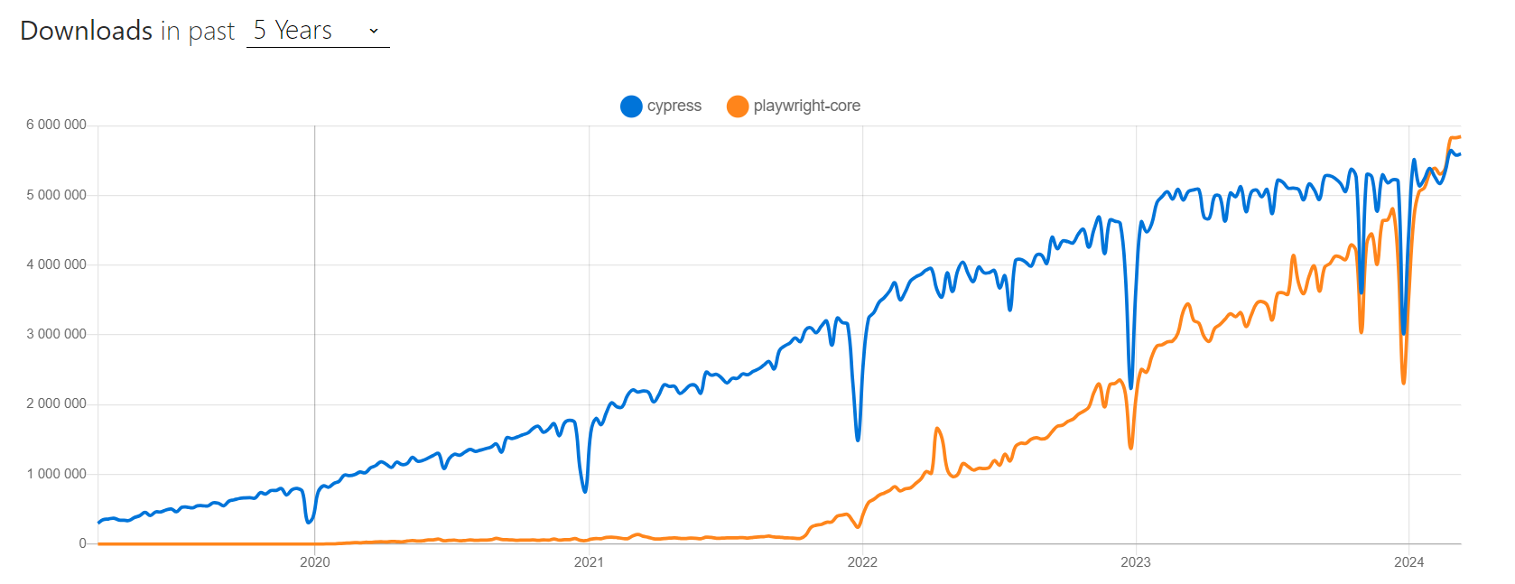
Popularity

Slide 3
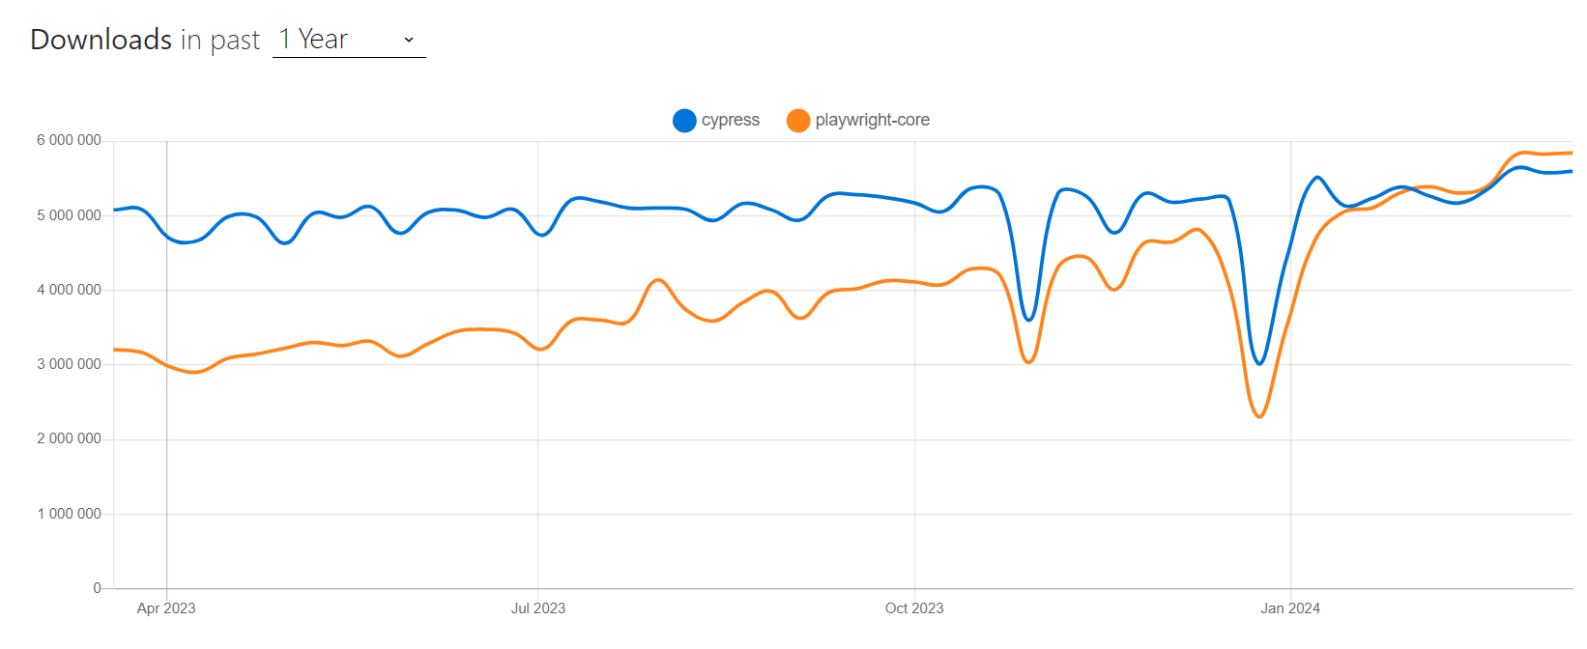
Popularity

Slide 4
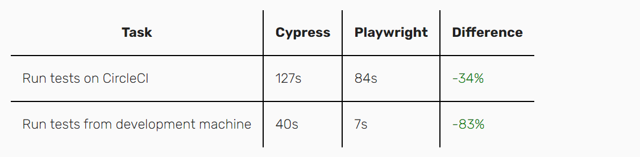
Speed

Slide 5
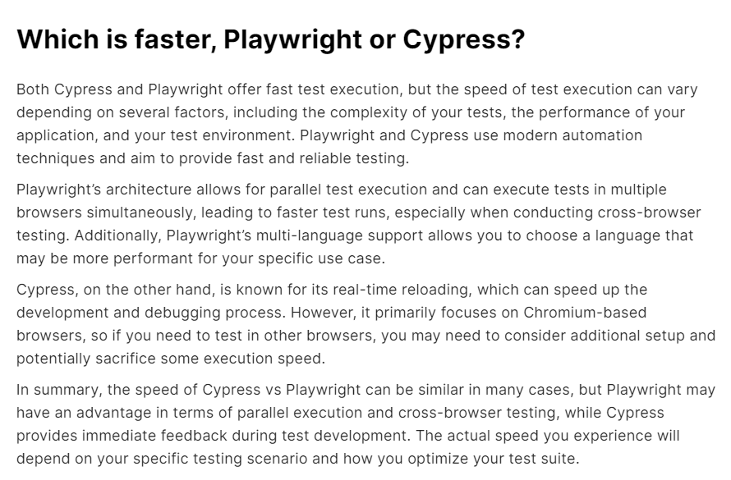
Speed

Slide 6
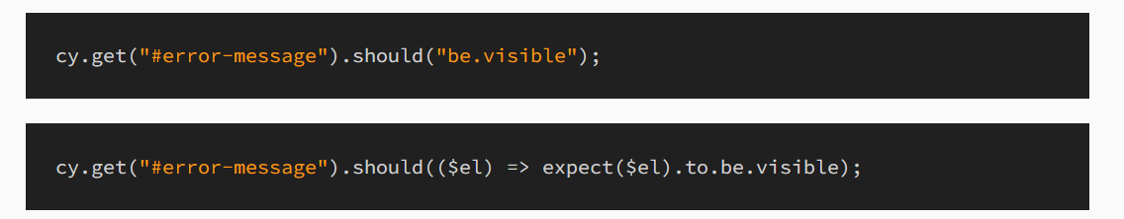
Playwright exposes a consistent set of assertions
For example, the following two code snippets perform identical assertions:
With Playwright, there’s a single, consistent API.

Slide 7
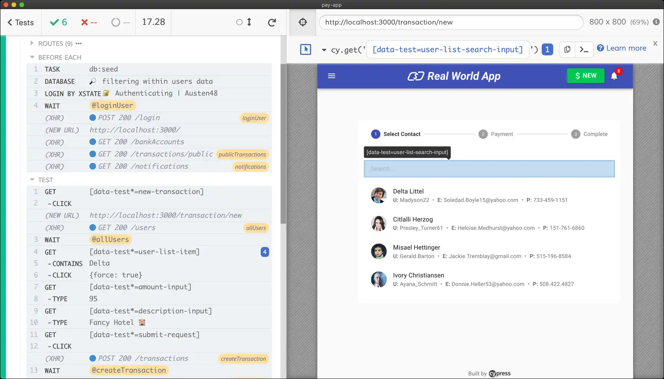
Playwright does not depend on a GUI environment
One of Cypress’ most touted features is their desktop GUI app:
The GUI problem crops up again when you try to run your Cypress tests in a CI environment. There’s generally not a desktop GUI there, either. Cypress’ answer is to use their paid CI service, which is the primary way they fund the company.

Slide 8
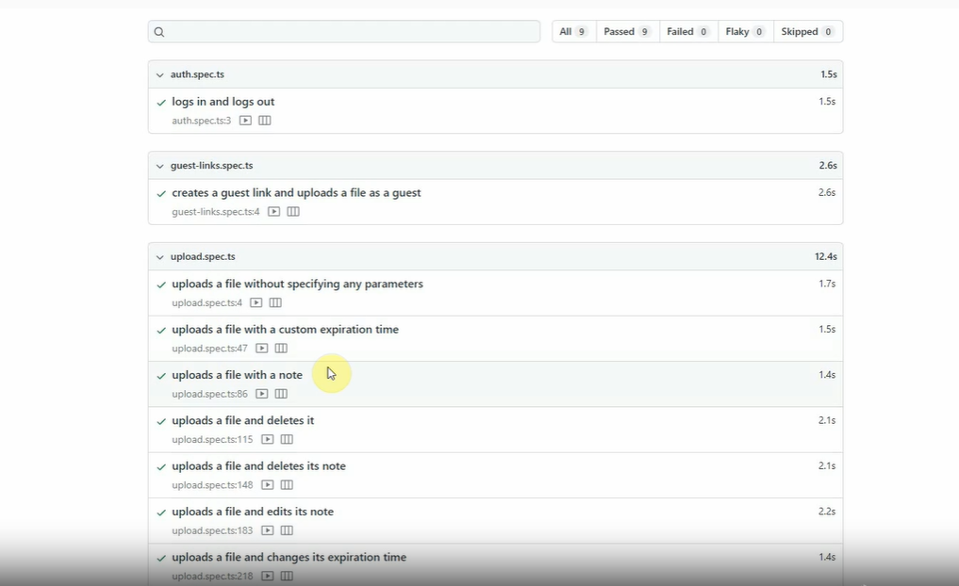
Playwright does not depend on a GUI environment
Playwright has the same time-travel feature as Cypress, but they implement it in a web UI instead of a desktop GUI, so it works in more environments.

Slide 9
Architecture
Playwright leverages direct WebSocket integration, enabling seamless transmission of test code in JSON format to the server through the WebSocket protocol.
Upon establishing the connection or handshake, a continuous command exchange occurs between your test and the Playwright server.
The client and server connections persist until either party decides to terminate them. Once the connection is closed, it is terminated from both ends.
One of the key factors contributing to Playwright’s exceptional speed is the uninterrupted nature of the connection, ensuring optimal performance as long as the connection remains active and uninterrupted by either party.

Slide 10
Record & Playback
Playwright has a powerful code generation that assists in automating user interactions within the browser.
With Playwright’s CodeGen functionality, you can effortlessly generate code corresponding to the actions performed during your browsing session.

Slide 11
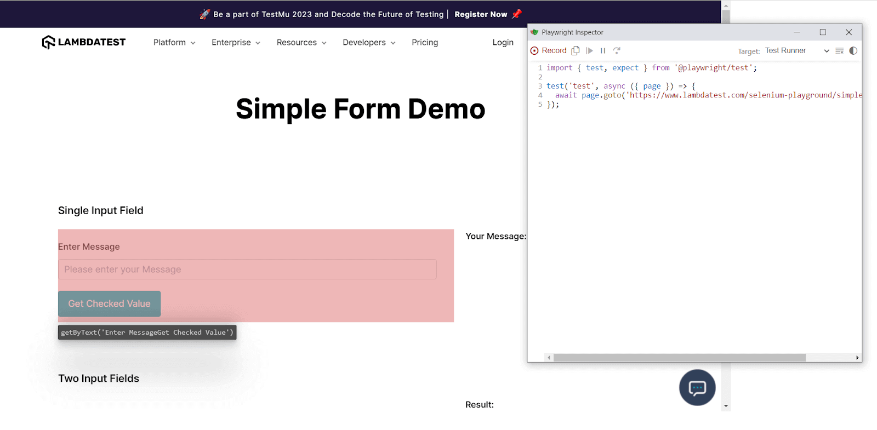
Record & Playback

Slide 12
Test Flakiness
Test flakiness, or the inconsistency of test results, can be a significant challenge in automated testing. It can lead to unreliable test outcomes and hinder the effectiveness of the testing process.

Slide 13
Test Flakiness
Async-Await and Promises
Playwright leverages modern JavaScript syntax, including async-await and promises, to handle asynchronous operations effectively. This ensures proper synchronization between test steps, reducing the likelihood of test flakiness caused by timing issues.

Slide 14
Test Flakiness
Built-in Waits
Playwright provides built-in wait mechanisms, such as waitForSelector and waitForNavigation, that allow tests to wait for specific conditions before proceeding. These waits help handle asynchronous behavior and eliminate the need for explicit manual waits.

Slide 15
Test Flakiness
Network and Request Interception
Playwright enables granular control over network requests, allowing developers to intercept, modify, or stub network responses. This control helps eliminate test flakiness caused by external dependencies or network variations.

Slide 16
Mobile Support
Developed by Microsoft, Playwright supports mobile automation tests on Android and iOS platforms, making it a robust choice for mobile testing.

Slide 17
Parallel Test Execution
Playwright supports parallel test execution by utilizing test runners and infrastructure tools.
Playwright can be integrated with popular test runners like Jest or Mocha, and parallelization can be achieved by leveraging the test runner’s built-in parallel execution capabilities.

Slide 18
Parallel Test Execution
Playwright will distribute the tests across multiple threads, enabling faster test execution.
Both Playwright and Cypress offer solutions for parallel test execution, allowing tests to run concurrently and reducing overall execution time.
Cypress provides built-in support for parallel execution using its Cypress Dashboard, while Playwright integrates seamlessly with popular test runners like Jest or Mocha, which offer parallelization features.

Slide 19
API Testing
API testing is a vital aspect of ensuring the quality and reliability of web applications
Intercepting and Modifying Network Requests
Playwright allows developers to intercept and modify network requests, enabling them to simulate different scenarios and validate API responses effectively. The Playwright’s route() function intercepts specific URLs or patterns and modifies the response. This capability is crucial for testing API behavior under various conditions.

Slide 20
API Testing
Authentication and Security
Playwright supports handling authentication and security during API testing. Developers can set custom headers, cookies, and request methods using the fetch() function or modify the page context. This flexibility enables accurate simulation of authenticated requests and testing of various security scenarios.

Slide 21
API Testing
Response Validation and Custom Assertions
Playwright provides a rich set of API testing functionalities for response validation and custom assertions. Developers can extract data from the response and assert the API returns the expected results. This allows for comprehensive validation and verification of the API behavior.

Slide 22
CI/CD Integration
Playwright can be integrated with tools like Jenkins, CircleCI, Azure Pipelines, and GitHub Actions

Slide 23
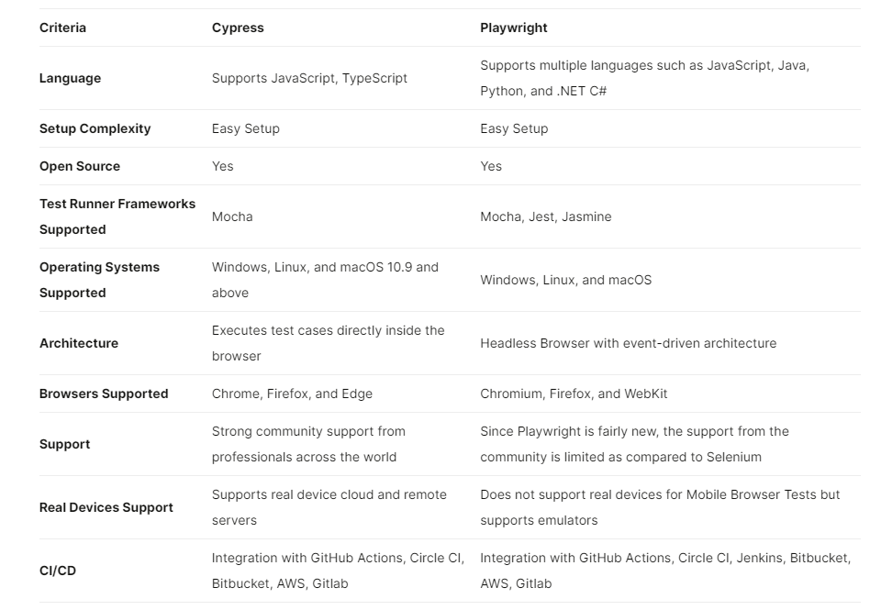
Comparison

Slide 24
What Are the Advantages of Playwright?
It supports all modern rendering engines, including Chromium, WebKit, and Firefox.
Playwright can be used on Windows, Linux, macOS, or CI.
It supports TypeScript, JavaScript (Node.js), Python, .NET, and Java.
Playwright's execution speed is faster than Selenium's.
The framework also supports auto-wait and performs relevant checks for elements.
You can generate selectors inspecting web pages and a scenario by recording your actions.
Playwright supports simultaneous execution and can also block unnecessary resource requests.

Slide 25
What Are the Disadvantages of Playwright?
It can handle only emulators and not real devices.
Compared to Selenium, Playwright doesn't have a big community.
It doesn't work on legacy browsers and devices.

Slide 26
Test Runner
Playwright comes with its own powerful playwright runner. You can also use third-party test runners such as Jest-playwright (playwright jest), AVA, Mocha, etc.

Slide 27
Element Locators

Slide 28
Visual Testing
Playwright Test includes producing and visually comparing screenshots using await expect(page).toHaveScreenshot().
Apart from screenshots, you can use expect(value).toMatchSnapshot(snapshotName) to compare text or arbitrary binary data. Playwright Test auto-detects the content type and uses the appropriate comparison algorithm.

Slide 29
Test Reporting
Playwright Test comes with a few built-in reporters for different needs, and it also has the ability to provide custom reporters.
All built-in reporters show detailed information about failures and mostly differ in verbosity for successful runs.

