Slide 2
Definition
Zapewnić, że klasa ma tylko jedną instancję
Zapewnić globalny punkt dostępu do tej instancji

Slide 3
Design
A private static geld that holds its unique instance.
• A public static Create() / GetInstance() method that creates or returns the unique instance.
• A private constructor, so external code cannot instantiate it without passing by the Create method

Slide 4
Concept / Goal
A singleton encapsulates both the object logic itself and its creational logic.
For example, the Singleton pattern could lower the cost of instantiating an object with a large memory footprint since it's instantiated only once.

Slide 5
Przykład z prawdziwego życia
Drużyna bierze udział w grze na turnieju.
Zasady gry:
Kapitan drużyny rzuca kostką, aby ustalić kolejność zawodników na boisku
Istnieje tylko jeden kapitan w drużynie
Kapitan nie zmienia się podczas turnieju

Slide 6
Przykład ze świata informatyki
Utrzymywanie jednego systemu zasobów

Slide 7
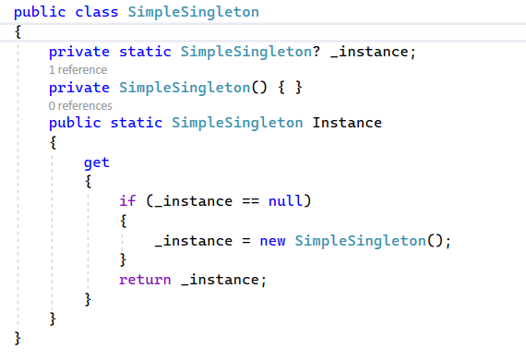

Slide 8
This approach can work in a single-threaded environment, but consider a multithreaded environment where two (or more) threads may try to evaluate the following code at the same time.
If the instance has not been created yet, each thread will try to create a new instance. As a result, you may end up with multiple instances of the class.
This approach can help you create instances when they are needed. But you must remember that, in general, the locking mechanism is expensive.

Slide 9
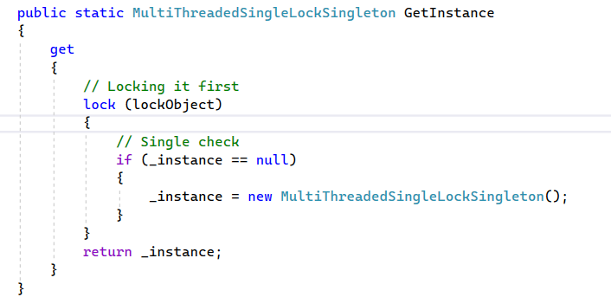
Although this approach may look simpler, it is not considered a better approach
because you’re acquiring the lock each time an instance of the Singleton instance is
requested, which degrades the performance of your application.

Slide 10
Volatile Keyword
“The volatile keyword indicates that a field might be modified by multiple threads that are executing at the same time. The compiler, the runtime system, and even the hardware may rearrange reads and writes to a memory location for performance reasons. Fields that are declared volatile are not subject to these optimizations. Adding the volatile modifier ensures that all threads will observe volatile writes performed by any other thread in the order in which they were performed.”

Slide 11
Why are you marking the instance as volatile in the double-checked locking example?

Slide 12
This simply means that the volatile keyword helps provide a serialize access mechanism, so all threads observe the changes by any other thread as per their execution order. It ensures that the most current value is always present in the field. Thus, using the volatile modifier makes your code safer

Slide 13
This simply means that the volatile keyword helps provide a serialize access mechanism, so all threads observe the changes by any other thread as per their execution order. It ensures that the most current value is always present in the field. Thus, using the volatile modifier makes your code safer.
Volatile keyword cannot be applied to all types, and there are certain restrictions. For example, you can apply it to class or struct fields, but not to local variables.

Slide 14
Why are multiple object creations a big concern?
Object creations can be costly if you are working with resource intensive objects.
• In some applications, you may need to pass a common object to multiple places.

Slide 15
When should I use the Singleton pattern?
When working with a centralized system (for example a database)
• When maintaining a common log file
• When maintaining a thread pool in a multithreaded environment
• When implementing a caching mechanism or device drivers, and so forth
If cannot rely on Dependency Injection.

Slide 16
Why learn Singleton?
It translates into a singleton scope
• Without knowing about it, you cannot locate it, nor try to remove it – or avoid its usage.
• It is a simple pattern to explore, and it leads to other patterns, such as the Ambient Context pattern

Slide 17
Why are you using the sealed keyword? The Singleton class has a private constructor that is sufficient for stopping the derivation process.

Slide 18
It is not mandatory, but it is always best to clearly show your intentions.
One special case: when you are tempted to use a derived nested class, and you prefer to initialize inside the private constructor itself.

Slide 19
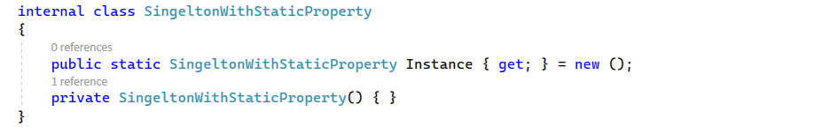
SingeltonWithStaticProperty
By doing this, our singleton becomes thread-safe as the property initializer creates
the singleton instance instead of nesting it inside an if statement. It is usually best to
delegate responsibilities to the language or the framework whenever possible.

Slide 20
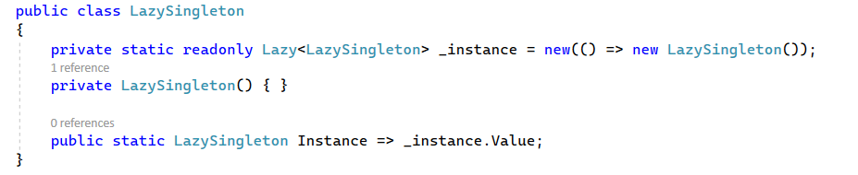
Lazy Singleton

Slide 21
Lazy loading
A great real-world example of where lazy loading comes in handy is with ORM's (Object Relation Mappers) such as Entity Framework and NHibernate.
Say you have an entity Customer which has properties for Name, PhoneNumber, and Orders. Name and PhoneNumber are regular strings but Orders is a navigation property that returns a list of every order the customer ever made.
You often might want to go through all your customer's and get their name and phone number to call them. This is a very quick and simple task, but imagine if each time you created a customer it automatically went and did a complex join to return thousands of orders. The worst part is that you aren't even going to use the orders so it is a complete waste of resources!
This is the perfect place for lazy loading because if the Order property is lazy it will not go fetch all the customer's order unless you actually need them. You can enumerate the Customer objects getting only their Name and Phone Number while the Order property is patiently sleeping, ready for when you need it.
https://stackoverflow.com/questions/6847721/when-should-i-use-lazyt

Slide 22
What is Lazy<T>?
The Lazy<T> class is a generic wrapper that provides a simple and convenient way to implement lazy initialization in C#. It encapsulates a value of type T and a factory method that creates the value when it is first requested. The Lazy<T> class also supports various modes of thread safety, which determine how the value is initialized and cached in a multithreaded environment.

Slide 23
How to use Lazy<T>?
To use Lazy<T>, you need to create an instance of the class and pass a delegate that defines how to create the value of type T. The delegate can be a lambda expression, an anonymous method, or a named method. You can also optionally specify a LazyThreadSafetyMode enum value that indicates the desired level of thread safety. The default mode is LazyThreadSafetyMode.ExecutionAndPublication, which ensures that only one thread can initialize the value and that all threads see the same cached value.

Slide 24
How to handle exceptions with Lazy<T>?
As mentioned above, if the factory method of Lazy<T> throws an exception, the Lazy<T> instance caches the exception and rethrows it on every access to the Value property. This means that you need to handle the exception either in the factory method or in the code that accesses the Value property. You can also use the IsValueCreated property of Lazy<T> to check whether the value has been successfully initialized or not.

Slide 25
How to change the value of Lazy<T>?
The Lazy<T> class does not provide a way to change the value of the instance once it has been initialized. However, you can create a new Lazy<T> instance with a different factory method and assign it to the same variable. This effectively resets the lazy initialization and allows you to create a new value when you access the Value property. Note that this approach is not thread-safe and may cause inconsistent results if multiple threads access the same variable.

Slide 26
How to compare Lazy<T> instances?
The Lazy<T> class implements the IEquatable<Lazy<T>> interface, which means that you can use the Equals method or the == operator to compare two Lazy<T> instances for equality. However, this comparison only checks whether the two instances have the same factory method and thread safety mode, not whether they have the same value. To compare the values of two Lazy<T> instances, you need to access their Value properties and compare them using the Equals method or the == operator of type T.

Slide 27
Beware of the Arrow operator
It may be tempting to use the arrow operator => to initialize the Instance property like this:
public static MySimpleSingleton Instance => new MySimpleSingleton();
but doing so would return a new instance every time. eis would defeat the purpose of what we want to achieve.
On the other hand, the property initializer is run only once. ee use of a static constructor would also be a valid, thread-safe alternative, once again delegating the job to the language.

Slide 28
Globals
Last Implementation is Ambient Context
Globals can be very convenient at grst because they are easy to use. eey are always there and accessible whenever needed: easy.
However, they can bring many drawbacks in terms of flexibility and testability.

Slide 29
ee system will most likely become less flexible. A global object is harder to replace
and cannot easily be swapped for another object. And the implementation cannot be different based on its consumer.
• Global objects are harder to mock, which can lead to a system that is harder to test.
• The system can become more brittle; for example, if some part of your system
messes up your global object, that may have unexpected consequences on other
parts of your system, and you may have a hard time finding out the root cause of
those errors.
• Another thing that does not help is the lack of isolation since consumers are usually directly coupled with the ambient context. Not being able to isolate components from those global objects can be a hassle, as stated in the previous points.

Slide 30
an ambient context is a global instance, usually available through a static property. ee Ambient Context pattern is not purely evil, but it is a code smell that smells bad.

Slide 31
There are a few examples in .NET Framework, such as System.Threading.Thread.CurrentPrincipal and System.Threading. Thread.CurrentThread. In this last case, CurrentThread is scoped instead of being purely global like CurrentPrincipal. An ambient context does not have to be a singleton, but that is what they are most of the time.

Slide 32
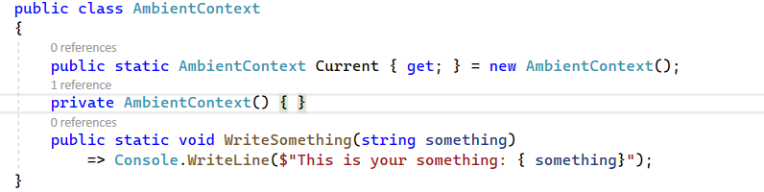
Instance is named Current.
• The WriteSomething method is new but has nothing to do with the Ambient
Context pattern itself; it is just to make the class do something.

Slide 33
SOLID
• S: The singleton violates this principle because it has two clear responsibilities:
- It has the responsibility for which it has been created (not illustrated here), like
any other class.
- It has the responsibility of creating and managing itself (lifetime management)
• O: TheSingleton pattern also violates this principle. It enforces a single static
instance, locked in place by itself, which limits extensibility. The class must be
modified to be updated, impossible to extend without changing the code.
• L: There is no inheritance directly involved, which is the only good point.
• I: There is no interface involved, which is a violation of this principle.
• D: The singleton class has a rock-solid hold on itself. It also suggests using its static
property (or method) directly without using an abstraction, breaking the DIP
with a sledgehammer

Slide 34
Having only a single instance of a class and always using that same instance is a legitimate concept. However, we'll see how to properly do this in the next chapter, leading me to the following advice: do not use the Singleton pattern, and if you see it used somewhere, try refactoring it out.
Another good idea is to avoid the use of static members as much as possible as they create global elements that can make your system less flexible and more brittle. There are occasions where static members are worth using, but try keeping their number as low as possible. Ask yourself if that static member or class could be replaced with something else before coding one.

Slide 35
In defence
Shared resources used by your application, whether they be databases, files, remote services, or robotic arms, are granted and guaranteed a single point of access.
The global state of the program is protected because there is only one point of access
Singletons are only initialized once, so any performance hit is taken only when the singleton is initialized.

Slide 36
In offense
According to the widely accepted tenet, every class should have one responsibility; it should
only solve one problem. Ironically, a singleton solves two. It ensures only one single instance of
the class exists and it provides a single point of access to some shared or constrained resource.
The Singleton pattern smells a lot like a global variable. Instead of just a variable, it’s a whole
class. Globals are universally vilified throughout coder-land because they are considered unsafe.
Any method on any given object within your running program can modify the global state,
which typically leads to unstable software. his has compounded ramiification for software
designed for threading or concurrency.

Slide 37
In offense
Singletons are cited as promoting tight coupling between classes. You really can’t get around this since there is no such thing as an abstract singleton.
Implementations of singletons are impossible to unit - test electively. Besides our earlier stated problem of tight coupling, which is itself anathema to testing, you can’t mock the singleton class. It’s sealed and has no parent class, so using Liskov substitution is impossible as a tool for testing. Unit tests should be isolable and the elects of one test shouldn’t affect other tests. With a singleton in the mix, they probably will

