Slide 1
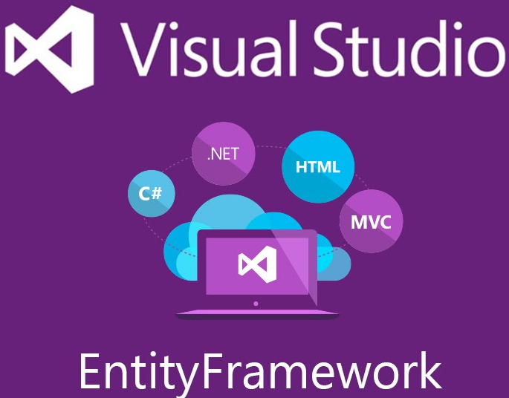
Entity Framework
khanhdsp@gmail.com

Slide 2
Objectives
Data access history
Entity Framework
Type of EF
Practice with EF
Database first
Code first
Model first

Slide 3
Data access history
ADO
RDO
DAO
ADO.NET
Linq
EF

Slide 4
What is Entity Framework?
Writing and managing ADO.Net code for data access is a tedious and monotonous job.
MS has provided an O/RM framework called "Entity Framework"
Entity framework is an Object/Relational Mapping (O/RM) framework to automate database related activities for your application

Slide 5
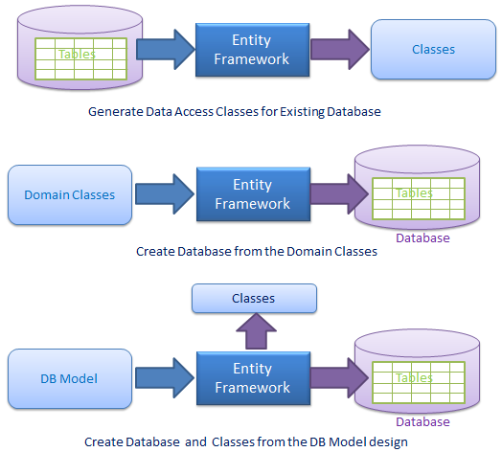
Types of EF

Slide 6
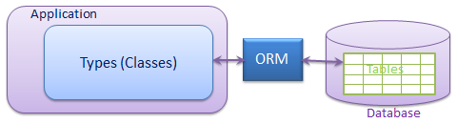
What is O/RM?
ORM is a tool for storing data from domain objects to RDB like MS SQL Server, in an automated way, without much programming.
O/RM includes three main parts: Domain class objects, RDB objects and Mapping information on how domain objects map to RDB objects
It also automates standard CRUD operation (Create, Read, Update & Delete)

Slide 7
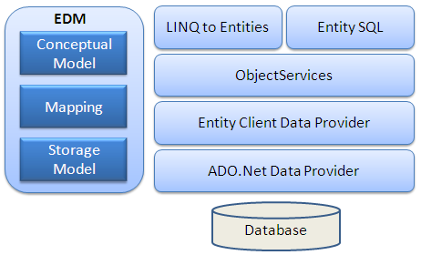
Entity Framework Architecture

Slide 8
Entity Framework Architecture (3)
EDM (Entity Data Model): consists of three main parts - Conceptual model, Mapping and Storage model.
Conceptual Model: The conceptual model contains the model classes and their relationships. This will be independent from your database table design.
Storage Model: Storage model is the database design model which includes tables, views, stored procedures, and their relationships and keys.
Mapping: Mapping consists of information about how the conceptual model is mapped to the storage model.

Slide 9
Mô hình lược đồ lưu trữ
Mô hình lưu trữ (Storage Schema Model) còn được gọi là lớp định nghĩa lược đồ lưu trữ (SSDL) đại diện cho lược đồ miêu tả của kho lưu trữ dữ liệu phụ trợ.
Mô hình khái niệm
Mô hình khái niệm (Conceptual Model) còn được gọi là lớp định nghĩa lược đồ khái niệm (CSDL) là mô hình thực thể thực, dựa vào đó chúng tôi viết các truy vấn của mình.
Mô hình ánh xạ
Lớp ánh xạ chỉ là ánh xạ giữa mô hình khái niệm và mô hình lưu trữ.
Lược đồ logic và ánh xạ của nó với lược đồ vật lý được biểu diễn dưới dạng EDM.
Visual Studio cung cấp Entity Designer để tạo EDM trực quan và đặc tả ánh xạ.
Đầu ra của công cụ này là file XML (*.edmx) định nghĩa lược đồ và ánh xạ.
File Edmx chứa các siêu dữ liệu của Entity Framework.
Ngôn ngữ định nghĩa lược đồ
Entity Framework ADO.NET sử dụng ngôn ngữ định nghĩa dữ liệu dựa trên XML được gọi là ngôn ngữ định nghĩa lược đồ (SDL) để định nghĩa lược đồ EDM.
SDL định nghĩa các kiểu dữ liệu đơn giản tương tự như các kiểu dữ liệu nguyên thủy khác, bao gồm String, Int32, Double, Decimal, và DateTime, và các kiểu khác.
Một enum định nghĩa ánh xạ của các giá trị và tên nguyên thủy, cũng được coi là một kiểu dữ liệu đơn giản.
Enum chỉ được hỗ trợ từ phiên bản Entity Framework 5.0 trở đi.
Các kiểu dữ liệu phức tạp được tạo ra từ một tập hợp của các kiểu dữ liệu khác. Một tập hợp các thuộc tính của các kiểu dữ liệu này định nghĩa kiểu thực thể.
Mô hình dữ liệu chủ yếu có ba khái niệm chính để mô tả cấu trúc dữ liệu:
-Kiểu thực thể.
-Loại liên kết.
-Thuộc tính.
https://comdy.vn/entity-framework/mo-hinh-du-lieu-trong-entity-framework/

Slide 10
Entity Framework Architecture (2)
LINQ to Entities: LINQ to Entities is a query language used to write queries against the object model.
Entity SQL: Entity SQL is another query language just like LINQ to Entities. However, it is a little more difficult than L2E and the developer will have to learn it separately.
Object Service: Object service is a main entry point for accessing data from the database and to return it back.
Entity Client Data Provider: The main responsibility of this layer is to convert L2E or Entity SQL queries into a SQL query which is understood by the underlying database. It communicates with the ADO.Net data provider which in turn sends or retrieves data from the database.
ADO.Net Data Provider:This layer communicates with the database using standard ADO.Net.

Slide 11
Setup Entity Framework Environment
Entity Framework 5.0 API was distributed in two places, in NuGet package and in .NET framework.
The .NET framework 4.0/4.5 included EF core API, whereas EntityFramework.dll via NuGet package included EF 5.0 specific features.

Slide 12
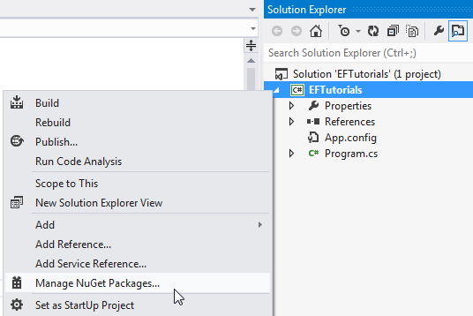
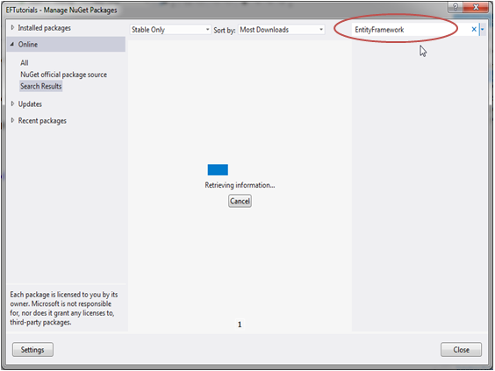
Install EF via Nuget

Slide 13
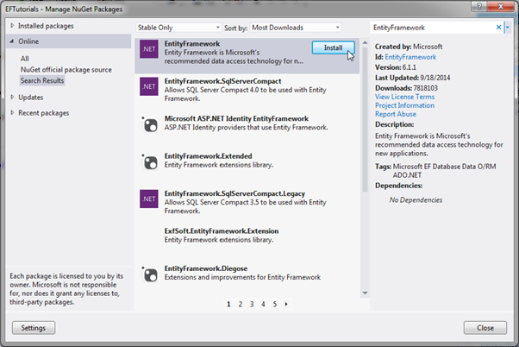
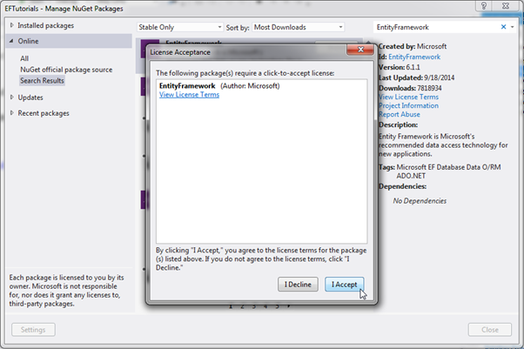
Install …

Slide 14
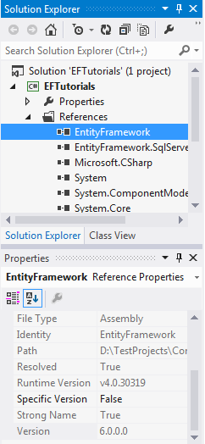
Install …

Slide 15
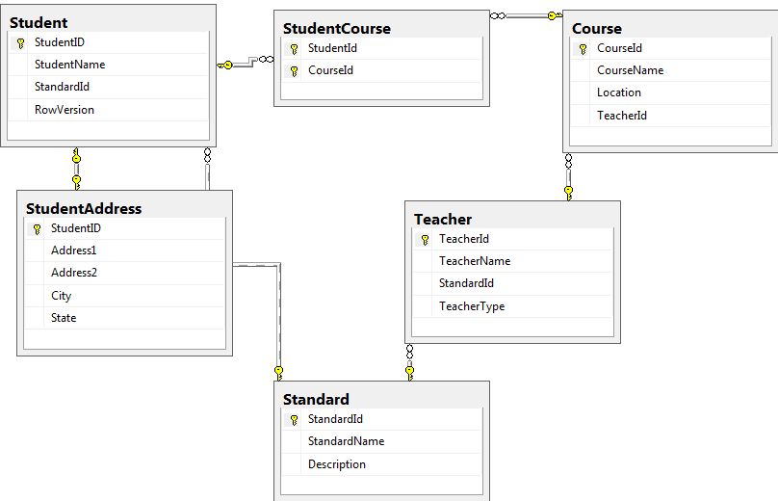
Database

Slide 16
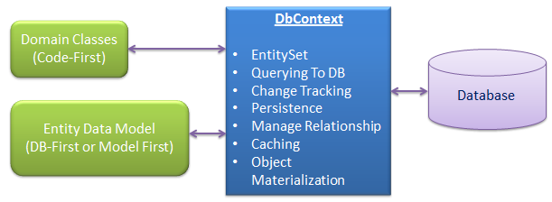
Context class
Class was derived from the System.Data.Entity.DbContext class
DbContext is an important part of Entity Framework. It is a bridge between your domain or entity classes and the database.

Slide 17
DbContext
DbContext is the primary class that is responsible for interacting with data as object. DbContext is responsible for the following activities:
EntitySet: DbContext contains entity set (DbSet<TEntity>) for all the entities which is mapped to DB tables.
Querying: DbContext converts LINQ-to-Entities queries to SQL query and send it to the database.
Change Tracking: It keeps track of changes that occurred in the entities after it has been querying from the database.
Persisting Data: It also performs the Insert, Update and Delete operations to the database, based on what the entity states.

Slide 18
DbContext
Caching: DbContext does first level caching by default. It stores the entities which have been retrieved during the life time of a context class.
Manage Relationship: DbContext also manages relationship using CSDL, MSL and SSDL in DB-First or Model-First approach or using fluent API in Code-First approach.
Object Materialization: DbContext converts raw table data into entity objects.

Slide 19
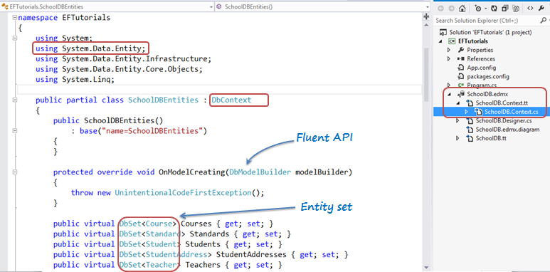
Context sample

Slide 20
CRUD operations
Create
Read
Update
Delete

Slide 21
Create
SchoolDbContext ctx = new SchoolDbContext();
var developmentTool = new DevelopmentTool() { Name = "Visual Studio 2012", Language = "C#“ };
ctx.Tools.Add(developmentTool);
var affectedRecords = ctx.SaveChanges();

Slide 22
Updating Entities
SchoolDbContext ctx = new SchoolDbContext();
var tool = ctx.Tools.FirstOrDefault();
//change something
t.Name += "_changed";
var affectedRecords = ctx.SaveChanges();

Slide 23
Upserting Entities
Sometimes you may want to either insert a record or to update it, depending on whether it already exists or not
ctx.Customers.AddOrUpdate(x => x.Name, new Customer { Name = "Big Customer" });

Slide 24
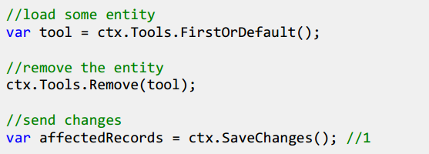
Delete

Slide 25
Read
PortalEntities context = new PortalEntities();
var users = context.Users;
Find by Primary key
using (var context = new BloggingContext()) {
// Will hit the database
var blog = context.Blogs.Find(3);
}
Finding an entity by composite primary key
using (var context = new BloggingContext()) {
var settings = context.BlogSettings.Find(3, "johndoe1987");
}

Slide 26
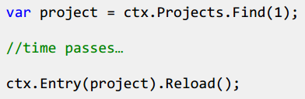
Refreshing Entities
We want to make sure we have the latest data, we need to force an explicit refresh

Slide 27
Types of Entity in Entity Framework
There are two types of Entities in Entity Framework 5.0/6.0:
POCO entity and
Dynamic proxy entity

Slide 28
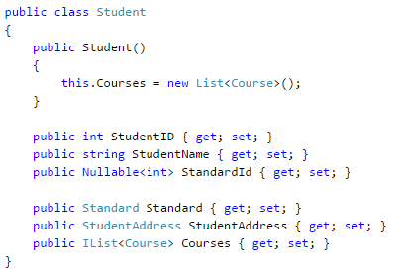
POCO
POCO Entity (Plain Old CLR Object)
It is like any other normal .net class which is why it is called "Plain Old CLR Objects".

Slide 29
Dynamic Proxy (POCO Proxy)
Dynamic Proxy is a runtime proxy class of POCO entity.
It is like a wrapper class of POCO entity.
Dynamic proxy entities allow lazy loading and automatic change tracking. POCO entity should meet the following requirements to become a POCO proxy:
A POCO class must be declared with public access.
A POCO class must not be sealed
A POCO class must not be abstract
Each navigation property must be declared as public, virtual
Each collection property must be ICollection<T>
ProxyCreationEnabled option must NOT be false (default is true) in context class

Slide 30
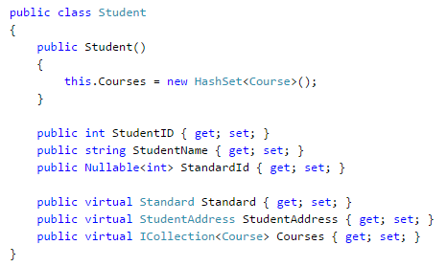
Dynamic Proxy

Slide 31
Entity states
The Context holds the reference to all the objects retrieved from the database, entity states and maintains modifications made to the properties of the entity.
This feature is known as Change Tracking
Added
Deleted
Modified
Unchanged
Detached

Slide 32
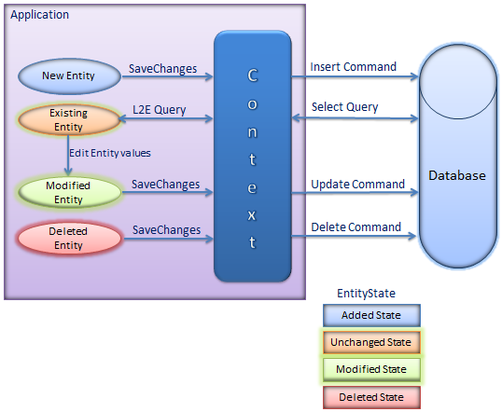
Entity lifecircle

Slide 33
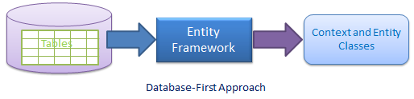
Database first model
We have seen this approach in Create Entity Data Model where we created the EDM, context and entity classes from an existing database

Slide 34
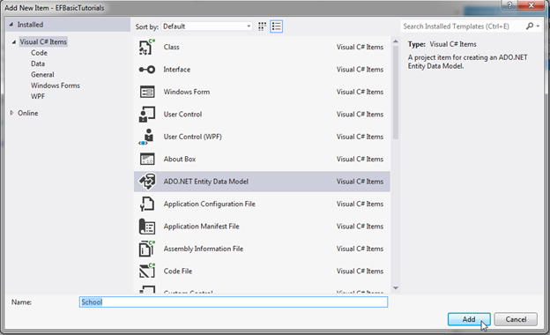
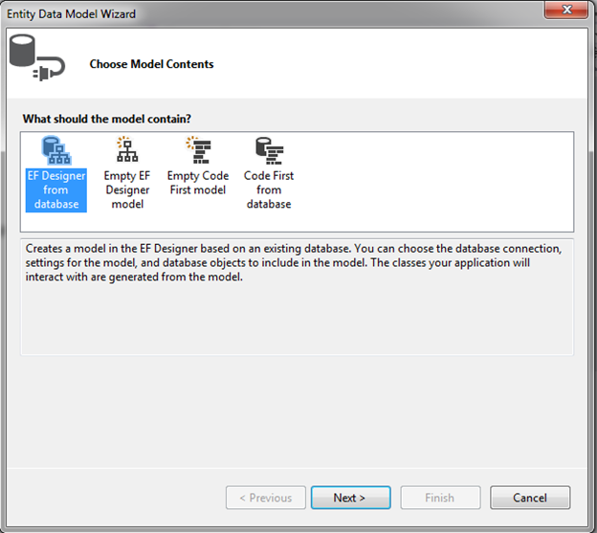
EF Database first
Create database
Create a blank Project
Choose .NET Framework 4.5
Add new ADO.NET Entity Data Model
(1)
(2)

Slide 35
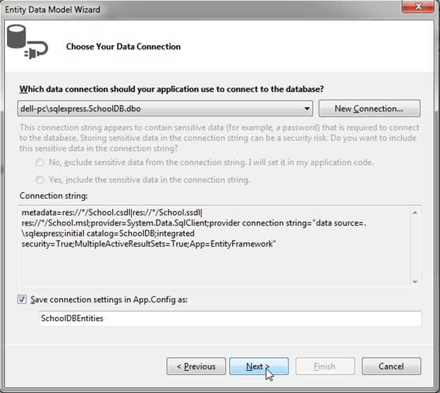
ConnectionString

Slide 36
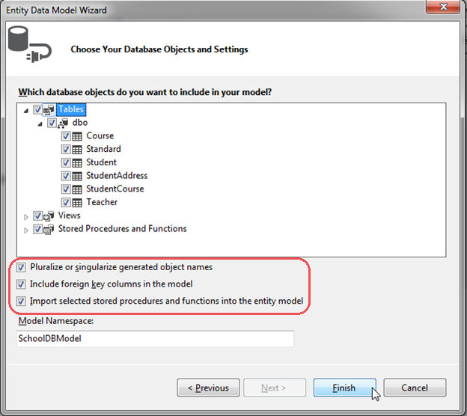
Select database Objects

Slide 37
Notes
Pluralize or singularize generated object names checkbox singularizes an entityset name, if the table name in the database is plural
The second checkbox, Include foreign key columns in the model, includes foreign key property explicitly to represent the foreign key
Import selected stored procedures and functions into entity model, automatically creates Function Imports for the stored procedures and functions

Slide 38
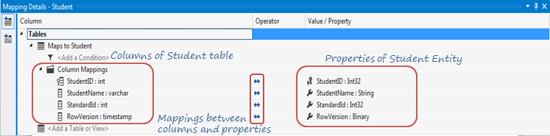
Entity-Table Mapping:
Each entity in EDM is mapped with the database table.
Right clicking on any entity in the EDM designer -> select Table Mapping

Slide 39
Model First

Slide 40
Model first
You create Entities, relationships, and inheritance hierarchies directly on the design surface of EDMX and then generate database from your model

Slide 41
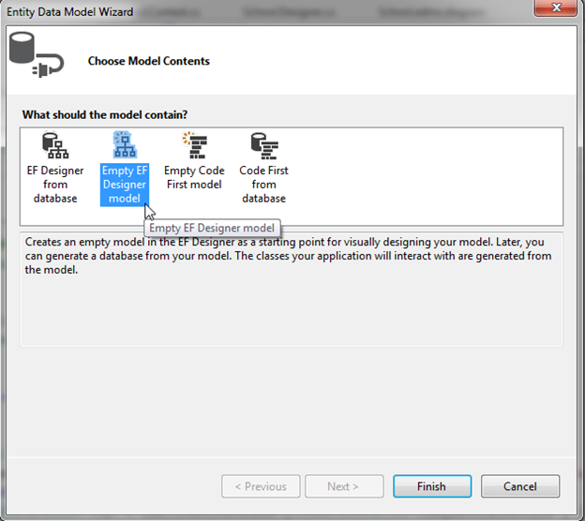
Model first

Slide 42
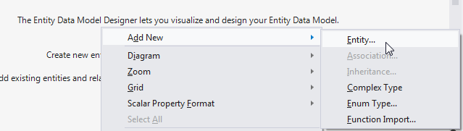
Add Entity

Slide 43
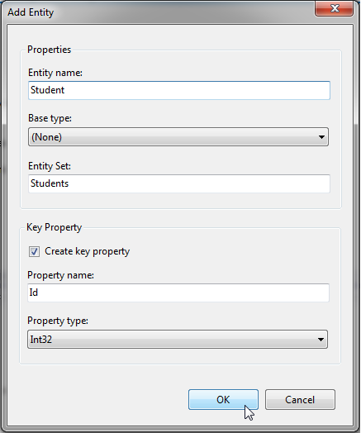
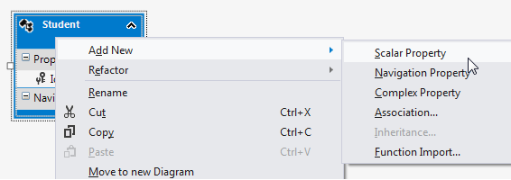
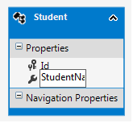
Add property

Slide 44
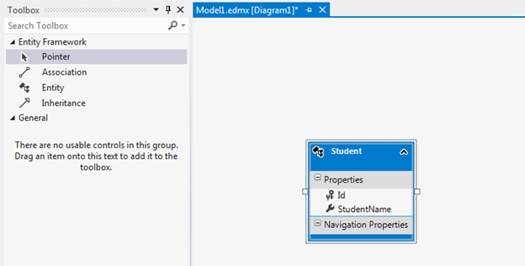
Add Association

Slide 45
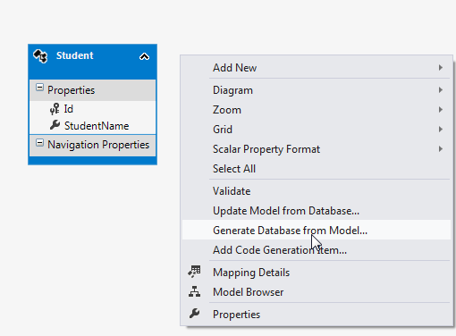
Generate database
This will add ModelName.edmx.sql file in the project. You can execute DDL scripts in Visual Studio by opening .sql file -> right click -> Execute.
Now, you can generate context class and entities by right clicking on the designer and selecting Add Code Generation Item..

Slide 46
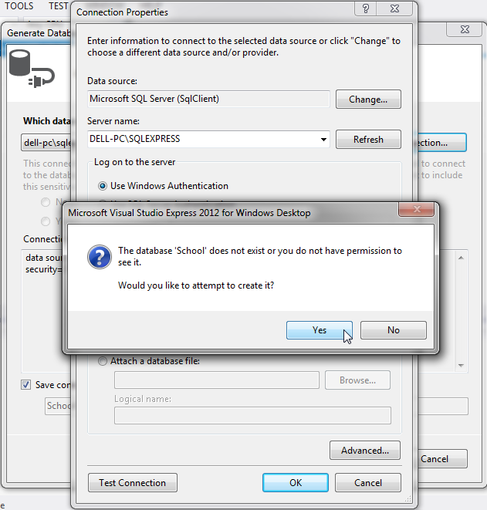

Slide 47
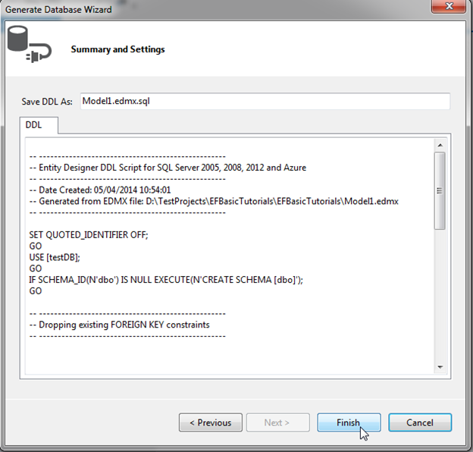
Generate database

Slide 48
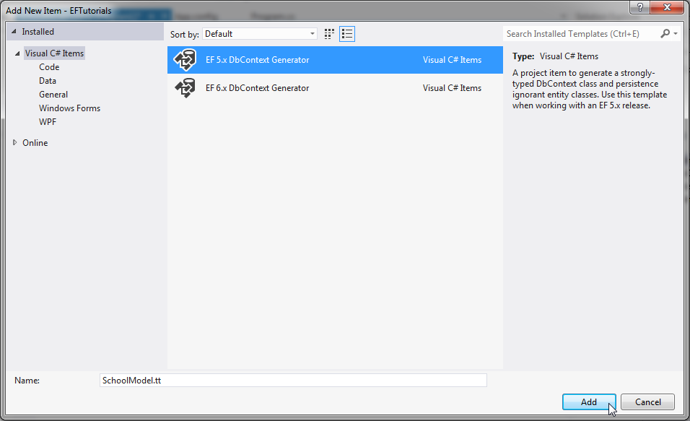
Add Code Generation Item..

Slide 49
Code First

Slide 50
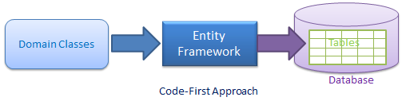
Code first
Write your POCO classes first and then create database from these POCO classes.
Developers who follow the path of Domain-Driven Design (DDD) principles, prefer to begin by coding their domain classes first and then generating the database required to persist their data.

Slide 51

What is Code-First?
Entity Framework introduced Code-First approach from Entity Framework 4.1. Code-First is mainly useful in Domain Driven Design
You can focus on the domain design and start creating classes as per your domain requirement rather than design your database first and then create the classes which match your database design

Slide 52
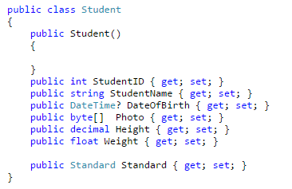
Simple Code First Example
Create student class
Notes:
public class Student { public Student() { } public int StudentID { get; set; } public string StudentName { get; set; } public DateTime? DateOfBirth { get; set; } public byte[] Photo { get; set; } public decimal Height { get; set; } public float Weight { get; set; } public Standard Standard { get; set; } }

Slide 53
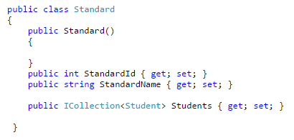
Standard

Slide 54
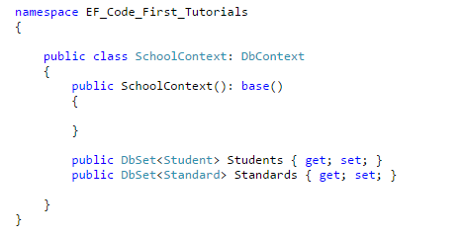
Context class

Slide 55
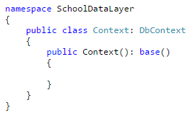
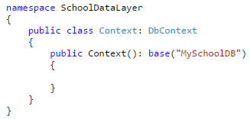
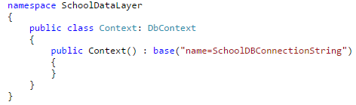
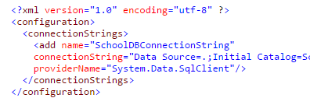
Base constructor of DbContext
No Parameter, EF creates db name as syntax namespace.ConextClass
Database name
Connection String

Slide 56
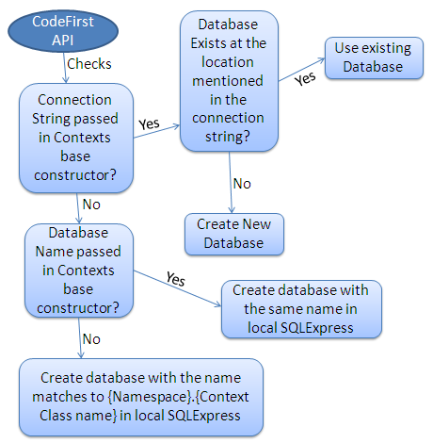
Database Initialization

Slide 57
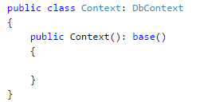
No Parameter
If you do not specify the parameter in the base constructor of the context class then it creates a database in your local SQLEXPRESS server with a name that matches your {Namespace}.{Context class name}

Slide 58
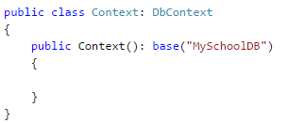
Database Name
If you specify a database name parameter, then Code First creates a database with the name you specified in the base constructor in the local SQLEXPRESS database server

Slide 59
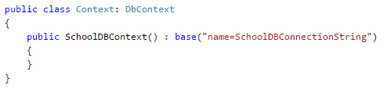
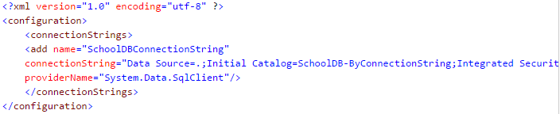
ConnectionString Name
You can also define connection string in app.config or web.config and specify connection string name starting with "name=" in the base constructor of the context class

Slide 60
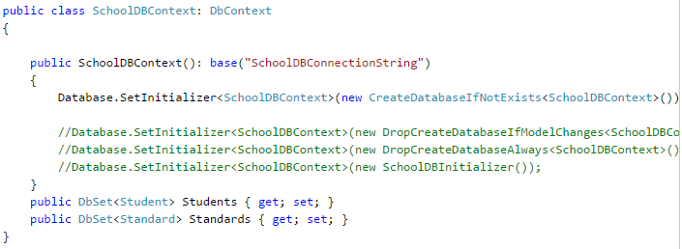
Database Initialization Strategies
There are four different database initialization strategies
CreateDatabaseIfNotExists: This is default initializer
DropCreateDatabaseIfModelChanges
DropCreateDatabaseAlways
Custom DB Initializer

Slide 61
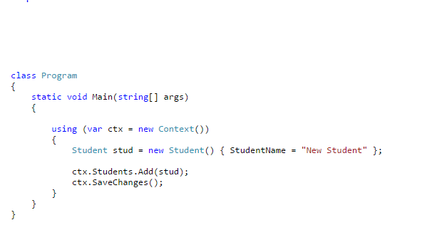
Test Code first

Slide 62
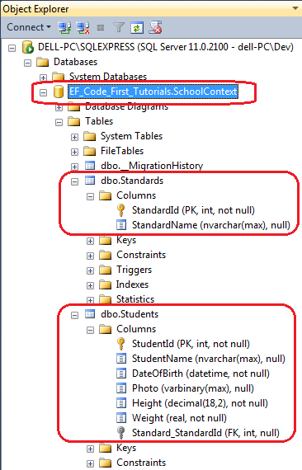

Slide 63
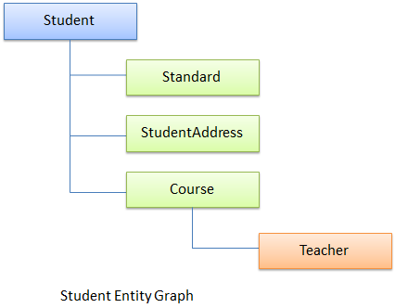

Entity Relationship

Slide 64

One-to-One Relationship

Slide 65

One-to-Many

Slide 66
EF Migration
Update lại cấu trúc database
Enable-Migrations -ContextTypeName EFMigration.Models.MGContext
EFMigration.Models.MGContext: Fullpath of class
Add-Migration ’anyname’
Update-Database

Slide 67

Many – to - Many

Slide 68

Thiết lập tên bảng, cột

Slide 69
Code First Conventions
Type Discovery
Code First includes types defined as a DbSet property in context class.
Code First includes reference types included in entity types even if they are defined in different assembly.
Code First includes derived classes even if only base class is defined as DbSet property.

Slide 70
Code First Conventions (cont..)
Primary Key
Code First would create a primary key for a property if the property name is Id or <class name>Id (NOT case sensitive).
The data type of a primary key property can be anything, but if the type of the primary key property is numeric or GUID it will be configured as an identity column
If you have defined key property other than Id or <ClassName>Id then ModelValidationException will be thrown

Slide 71
Code First Conventions (cont..)
Relationship convention
Code First infer relationship between the two entities using navigation property.
This navigation property can be simple reference type or collection type
Code First automatically inserts foreign key when it encounter navigation property
It is recommended to include a foreign key property on the dependent end of a relationship

Slide 72

Code First Conventions (cont..)

Slide 73

Key
public class Student {
public Student() { }
[Key]
public int StudentKey { get; set; }
public string StudentName { get; set; }
}

Slide 74
Nullable field, Not null
public class Student {
public Student() { }
public int StudentID { get; set; }
[Required]
public string StudentName { get; set; }
public string? StudentAddress { get; set; }
}

Slide 75
Max, MinLength
public class Student {
public Student() { }
public int StudentID { get; set; }
[MaxLength(50)]
public string StudentName { get; set; }
}
public class Student {
public Student() { }
public int StudentID { get; set; }
[MaxLength(50),MinLength(2)]
public string StudentName { get; set; }
}

Slide 76
StringLength
public class Student {
public Student() { }
public int StudentID { get; set; }
[StringLength(50)]
public string StudentName { get; set; }
}

Slide 77
Table, Column name
public class Student {
public Student() { }
public int StudentID { get; set; }
[Column("Name")]
public string StudentName { get; set; }
}
[Table("StudentMaster")]
public class Student {
public Student() { }
public int StudentID { get; set; }
public string StudentName { get; set; }
}

Slide 78



Foreign Key

Slide 79
Querying with EDM

Slide 80
Reference to Querying with EDM slide

Slide 81
Code First Conventions
Type Discovery
Code First includes types defined as a DbSet property in context class.
Code First includes reference types included in entity types even if they are defined in different assembly.
Code First includes derived classes even if only base class is defined as DbSet property.

Slide 82
Code First Conventions (cont..)
Primary Key
Code First would create a primary key for a property if the property name is Id or <class name>Id (NOT case sensitive).
The data type of a primary key property can be anything, but if the type of the primary key property is numeric or GUID it will be configured as an identity column
If you have defined key property other than Id or <ClassName>Id then ModelValidationException will be thrown

Slide 83
Code First Conventions (cont..)
Relationship convention
Code First infer relationship between the two entities using navigation property.
This navigation property can be simple reference type or collection type
Code First automatically inserts foreign key when it encounter navigation property
It is recommended to include a foreign key property on the dependent end of a relationship

Slide 84
Code First Conventions (cont..)

Slide 85

DB Initialization
Parameter passed in the base constructor of context class, which is derived from DbContext
Base constructor of the context class can have following parameter.
No Parameter
Database Name
Connection String Name

Slide 86
Database Initialization Strategies
There are four different database initialization strategies
CreateDatabaseIfNotExists: This is default initializer
DropCreateDatabaseIfModelChanges
DropCreateDatabaseAlways
Custom DB Initializer

Slide 87


Seed Database in Code-First

Slide 88
Inheritance Strategy in Code-First
SQL database management systems don't support type inheritance. So, you map object-oriented domain classes with the relational database
There are three different approaches to represent an inheritance hierarchy:
Table per Hierarchy (TPH)
Table per Type (TPT)
Table per Concrete class (TPC)

Slide 89


Table per Hierarchy (TPH)

Slide 90


Table per Type (TPT)

Slide 91

TPT

Slide 92


Table per Concrete type(TPC)

Slide 93


Code

Slide 94

Data Annotation

Slide 95
EF Stored Procedures

Slide 96
SP with EF
Entity Framework automatically build native commands for the database CRUD operation
You can override these steps and use your own predefined stored procedures.
You can use stored procedures either to get the data or to add/update/delete the records to one or multiple database tables
Stored procedures and functions (UDFs) in the database are represented as functions in entity framework.

Slide 97

SP
Notes:
CREATE PROCEDURE [dbo].[GetCoursesByStudentId] -- Add the parameters for the stored procedure here @StudentId int = null AS BEGIN -- SET NOCOUNT ON added to prevent extra result sets from -- interfering with SELECT statements. SET NOCOUNT ON; -- Insert statements for procedure here select c.courseid, c.coursename,c.Location, c.TeacherId from student s left outer join studentcourse sc on sc.studentid = s.studentid left outer join course c on c.courseid = sc.courseid where s.studentid = @StudentId END

Slide 98

Add SP to EDM

Slide 99


The result after import SP

Slide 100

Code in Context class

Slide 101

Call SP

