Slide 1
SMGAN
Anthony J Vasquez

Slide 2
Outline
Acronyms
Definitions
Background
Related Work
VAE
MolGAN
Data
Preprocessing
Tokenization
Architecture
Training
Hyperparameter Tuning
Results
Questions

Slide 3
Acronyms
BCEL – Binary Cross Entropy Loss
GAN – Generative Adversarial Network
Graph – Convolutional Network
GRU – Gated Recurrent Unit
MHA – Multi-head attention
QED - Quantitative Estimate of Druglikeness
RMSProp - Root Mean Squared Propagation
SMILES – Simplified Molecular Input Line Entry System

Slide 4
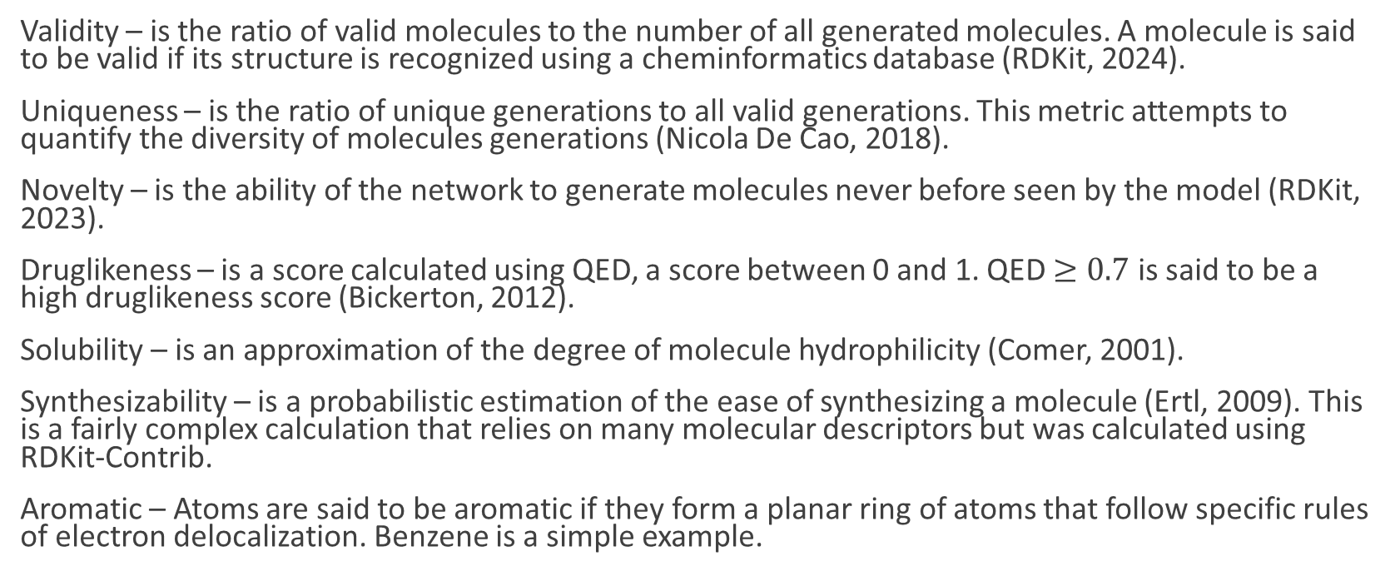
Definitions
Validity – is the ratio of valid molecules to the number of all generated molecules. A molecule is said to be valid if its structure is recognized using a cheminformatics database (RDKit, 2024).
Uniqueness – is the ratio of unique generations to all valid generations. This metric attempts to quantify the diversity of molecules generations (Nicola De Cao, 2018).
Novelty – is the ability of the network to generate molecules never before seen by the model (RDKit, 2023).
Druglikeness – is a score calculated using QED, a score between 0 and 1. QED $≥0.7$ is said to be a high druglikeness score (Bickerton, 2012).
Solubility – is an approximation of the degree of molecule hydrophilicity (Comer, 2001).
Synthesizability – is a probabilistic estimation of the ease of synthesizing a molecule (Ertl, 2009). This is a fairly complex calculation that relies on many molecular descriptors but was calculated using RDKit-Contrib.
Aromatic – Atoms are said to be aromatic if they form a planar ring of atoms that follow specific rules of electron delocalization. Benzene is a simple example.

Slide 5
References
Bickerton, G. R. (2012). Quantifying the chemical beauty of drugs.
Bidisha, S. (2019). NeVAE: A Deep Generative Model for Molecular Graphs.
Comer, J. a. (2001). Lipophiicity profiles: theory and measurement. Zurich, Switzerland.
Ertl, P. a. (2009). Estimation of synthetic accessibility score of drug-like molecules based on molecular complexity and fragment contributions. Journal of Cheminformatics, 1-8.
Phrma. (22 de July de 2024). Research & Development Policy Framework. Obtenido de phrma.org: https://phrma.org/policy-issues/Research-and-Development-Policy-Framework
RDKit. (2023). rdkit.Chem.rdMolTransforms module. Obtenido de rdkit.org: https://www.rdkit.org/docs/source/rdkit.Chem.rdMolTransforms.html
RDKit. (20 de August de 2024). RDKit: Open-Source Cheminformatics Software. Obtenido de rdkit.org: 2024.
Nicola De Cao, T. K. (2018). MolGAN: An Implicit Generative Model for Small Molecular Graphs. Stockholm, Sweden.

Slide 6
Background
Designing new drugs is laborious, costly, and yields few new drugs (Badisha, 2019).
It can take 10-15 years to develop a single new medicine (Phrma, 2024).
It costs an estimated $2.6 billion to create a single new medicine (Phrma, 2024).
For the above reasons, synthesizing molecules is a hot topic.
What makes it challenging machine learning?
- Ordering: Molecular graph syntax
- Meaning: Molecular graph semantics

Slide 7
SMILES and a Few Examples
C – Single carbon atom
CC - molecule with a single bond (also be written C-C – not usually)
C(C)C – a central carbon is bonded to two other carbons (isopropane)
c1ccccc1 – a ring of six carbons (ring and ring closure denoted by 1), lowercase represents aromatic carbons with a ring closure (Benzene)
CC(=O)O – A two carbon chain with one carbon double-bonded to a single oxygen atom which is bonded by an OH pair
TBD Some example pictures

Slide 8
Related Work
NeVAE – this work combines GCNs to capture local molecular graph structures. It uses the latent space representation to create a Gaussian distribution from which samples are drawn. This representation captures the underlying structure of a molecule. In addition, hierarchical decoding is used for scaffold generation (backbone) followed by fine decoding (domain expertise) to ensure a finer more detailed and valid molecule generation. The training uses reconstruction loss paired with KL divergence to regularize for latent space distribution (Badisha, 2019) .
MolGAN -

Slide 9
Related Work Continued
MolGAN

Slide 10
Data

Slide 11
Preprocessing

Slide 12
Architecture

Slide 13
Training

Slide 14
Hyperparameter Tuning

Slide 15
Results

Slide 16
Questions

