Slide 1
SMGAN
Anthony J Vasquez, TBD

Slide 2
Outline
Acronyms
Definitions
Background
Related Work
VAE
MolGAN
Hardware Considerations
Data
Preprocessing
Tokenization
Architecture
Hyperparameter Tuning
Inference Tuning
Inference
Quantitative Results
Qualitative Results
Questions

Slide 3
Acronyms
ASHA – Asynchronous Successive Halving Algorithm
BCEL – Binary Cross Entropy Loss
GAN – Generative Adversarial Network
Graph – Convolutional Network
GRU – Gated Recurrent Unit
MHA – Multi-head attention
QED - Quantitative Estimate of Druglikeness
RMSProp - Root Mean Squared Propagation
SMILES – Simplified Molecular Input Line Entry System

Slide 4
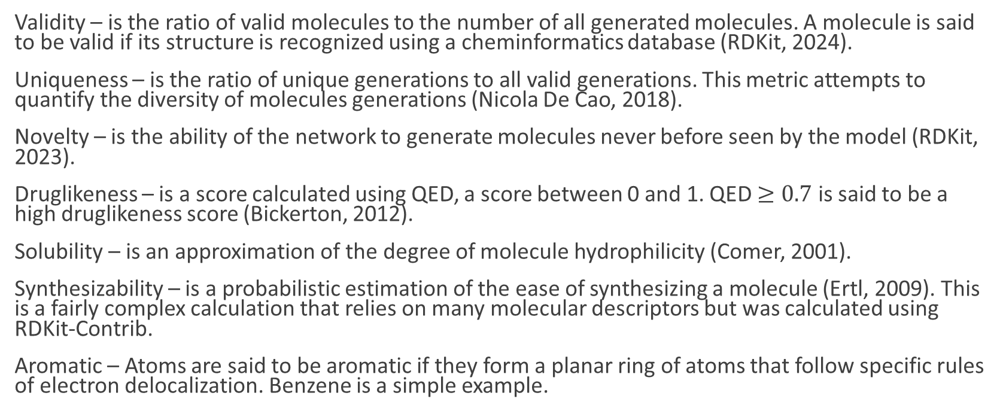
Definitions
Validity – is the ratio of valid molecules to the number of all generated molecules. A molecule is said to be valid if its structure is recognized using a cheminformatics database (RDKit, 2024).
Uniqueness – is the ratio of unique generations to all valid generations. This metric attempts to quantify the diversity of molecules generations (Nicola De Cao, 2018).
Novelty – is the ability of the network to generate molecules never before seen by the model (RDKit, 2023).
Druglikeness – is a score calculated using QED, a score between 0 and 1. QED $≥0.7$ is said to be a high druglikeness score (Bickerton, 2012).
Solubility – is an approximation of the degree of molecule hydrophilicity (Comer, 2001).
Synthesizability – is a probabilistic estimation of the ease of synthesizing a molecule (Ertl, 2009). This is a fairly complex calculation that relies on many molecular descriptors but was calculated using RDKit-Contrib.
Aromatic – Atoms are said to be aromatic if they form a planar ring of atoms that follow specific rules of electron delocalization. Benzene is a simple example.

Slide 5
Background
Designing new drugs is laborious, costly, and yields few new drugs (Badisha, 2019).
It can take 10-15 years to develop a single new medicine (Phrma, 2024).
It costs an estimated $2.6 billion to create a single new medicine (Phrma, 2024).
For the above reasons, synthesizing molecules is a hot topic.
What makes it challenging machine learning?
- Ordering: Molecular graph syntax
- Meaning: Molecular graph semantics

Slide 6

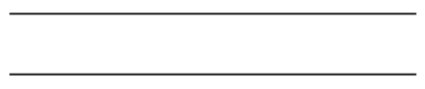
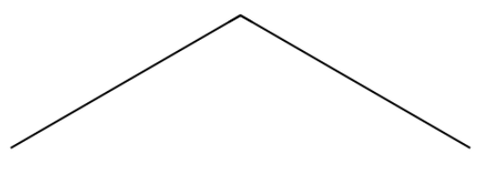
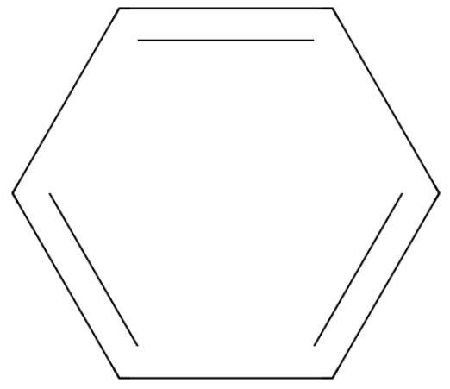
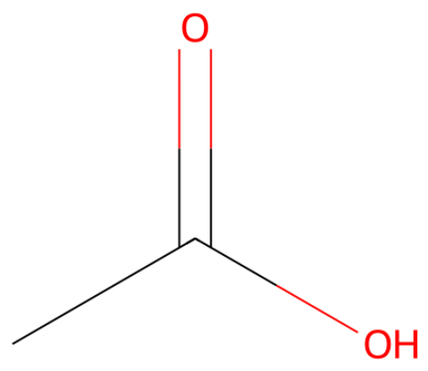
SMILES and a Few Examples
CC – carbon molecule with single bond
C=C - molecule with a double bond
C(C)C – a central carbon is bonded to two other carbons (isopropane)
c1ccccc1 – a ring of six carbons (ring and ring closure denoted by 1), lowercase represents aromatic carbons with a ring closure (Benzene)
CC(=O)O – A two carbon chain with one carbon double-bonded to a single oxygen atom which is bonded by an OH pair

Slide 7
Related Work
NeVAE – this work combines GCNs to capture local molecular graph structures. It uses the latent space representation to create a Gaussian distribution from which samples are drawn. This representation captures the underlying structure of a molecule. In addition, hierarchical decoding is used for scaffold generation (backbone) followed by fine decoding (domain expertise) to ensure a finer more detailed and valid molecule generation. The training uses reconstruction loss paired with KL divergence to regularize for latent space distribution (Badisha, 2019).
MolGAN – is a generative adversarial approach that does not explicitly define a probability distribution of molecular graphs but instead directly generates a graphs using the a neural network (Nicola De Cao, 2018). The generator takes a noise vector, and outputs a molecular graph as an adjacency matrix along with a feature matrix. The network is trained adversarial, with a generator generating molecules, and a discriminator classifying molecules. An additional deep reinforcement mechanism is used to explicitly reinforce positive properties, such as, solubility, druglikeness, and synthesizability (Nicola De Cao, 2018).
Summary: Overall, these networks performed well, but there are many problems that still need attention. One problem for both methods are how to effectively synthesize larger more complex molecules. For MolGAN, mode collapse is a challenge, where the network can only generate a small set of molecules that are not diverse. Furthermore, reinforcement learning optimization adds another layer of complexity, since reinforcement algorithms can also be unstable.

Slide 8
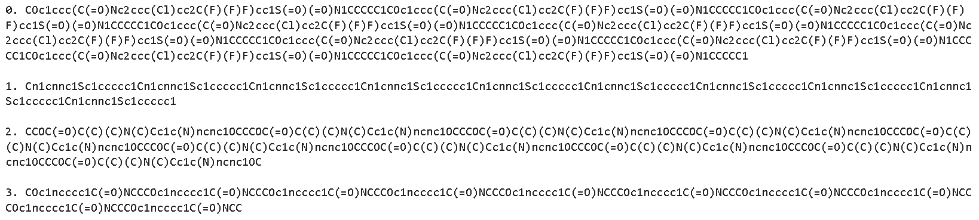
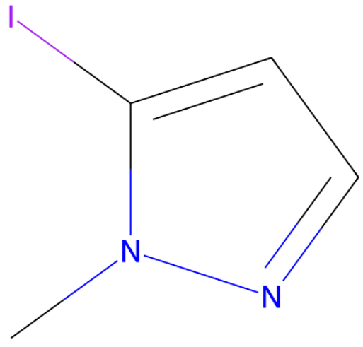
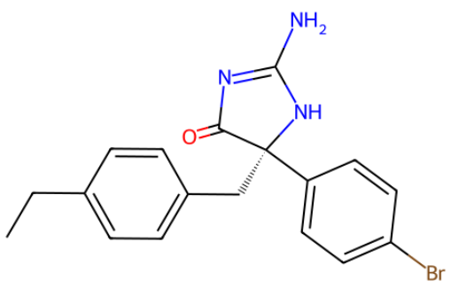
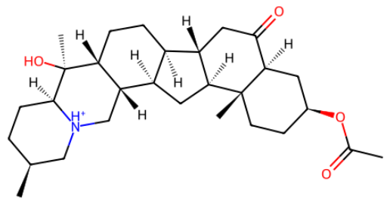
Data
Full Dataset: 250K SMILES strings from RDKit API/Database
Train Dataset: 25K randomly sampled from Full Dataset
Each sample is represented as a string.
Single Bond | -
Double Bond | =
Triple Bond | #
Arom. Bond | :
Pos. Charge | [C+]
Neg. Charge | [C-]
Arom. Carb. | c (lowercase)
Table of Common
Symbol and Meaning
(Not Exhaustive)
Example of Strings From Dataset
Least Complex Example
Moderately Complex Example
Most Complex Example

Slide 9
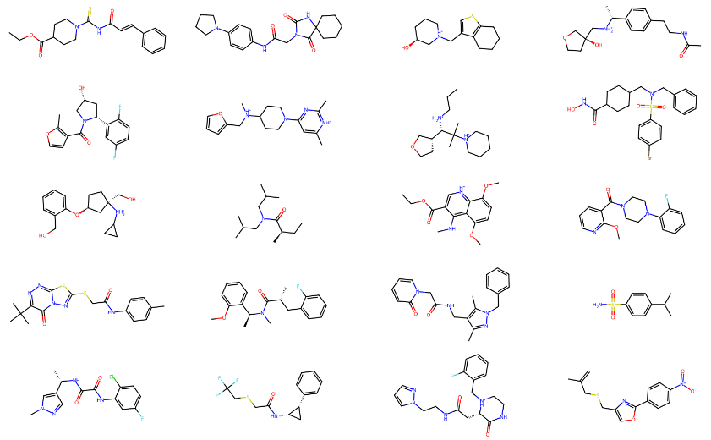
Data Randomly Selected from Dataset:

Slide 10
Preprocessing
Tokenize using regular expressions
Atoms requiring explicit definition, such as:
- Atoms with explicit isotopes,
- Aromatic Rings,
- Organic Elements, etc.
For example:
- Carbon-13 is [13C]. Explicit representation of carbon-13 isotope.
- Cannot be written as 13C, as this is invalid SMILES string, as it does not convey relationships to other molecules.
- Therefore backets are retained for semantic reasons
Chiral Centers
'C[C@@H]1CC(Nc2cncc(-c3nncn3C)c2)C[C@@H](C)C1’
'C', '[C@@H]', '1CC(Nc2cncc(-c3nncn3C)c2)C', '[C@@H]', '(C)C1'

Slide 11
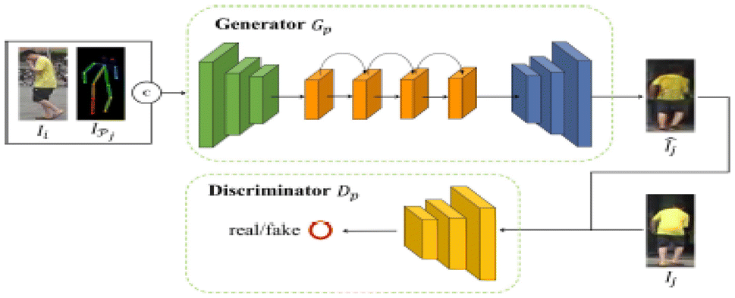
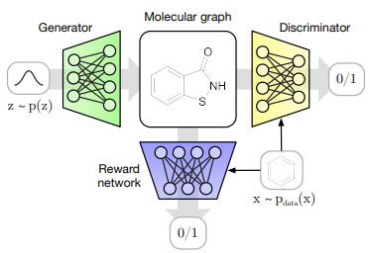
SMGAN Architecture
Traditional GAN (Alqahtani, 2019)
MolGAN (Nicola De Cao, 2018)

Slide 12
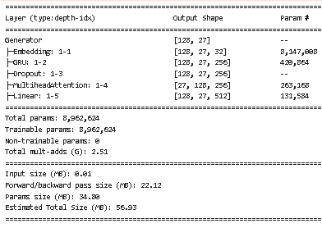
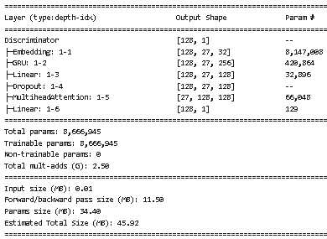
Architecture
Generator
Discriminator

Slide 13
Training (Pseudo Code)
Initialize discriminator network
Iterate over epochs
Iterate over batches of data
For each Discriminator update, do
Zero grad
Get real sample
Generate noise sample
Generate fake sample (generator)
Forward pass fake samples to discriminator
Compute discriminator fake sample loss using BCEL
Forward pass real samples to discriminator
Compute discriminator real sample loss
Sum losses for discriminator loss
Backward pass
Discriminator optimizer step
Clip weights
Discriminator scheduler step
Initialize generator network
Iterate over epochs
Iterate over batches of data
Zero grad
Generate noise sample
Generate fake sample (generator)
Forward pass fake samples to discriminator
Compute loss between fake samples and real samples
Backward pass
Generator optimizer step
Generator scheduler step

Slide 14
Hyperparameter Tuning
RayTune ASHA Scheduler Used:
- Large Search space
- 1 GPU and 4 Logical Cores per run
- Concurrent Runs: 4
- Max time to train: 2500s
- Early stopping: 5 epochs
- Reduction Factor: 2
- Number of Experiments: 300
Search Space
Findings
Hyperparameter | Search Space | Selection
Optimizer | Adam, Nadam, RMSProp | Choice
Learning Rate | 0.00002 - 0.002 | Loguniform
Batch Size | 32, 64, 128, 256, 384 | Choice
Hidden Layer Dim | 16, 32, 64, 128 | Choice
Embedding Dim | 16, 32, 64 | Choice
Num GRU Layers | 2, 3 | Choice
Dropout Prob | 0.25, 0.5 | Choice
Num Attn. Heads | 2, 4, 8 | Choice
Bidirectional | True, False | Choice
Num Discr. Updates | 1, 2, 3, 4, 5 | Choice
Weight Clip Value | 0.01 - 0.001 | Loguniform
Hyperparameter | Value
Optimizer | RMSProp
Gen. LR | 0.00408680002539221
Disc. LR | 0.0134480709026601
Batch Size | 128
Hidden Layer Dim | 128
Embedding Dim | 32
Num GRU Layers | 2
Dropout Prob | 0.5
Num Attn. Heads | 4
Bidirectional | TRUE
Num Discr. Updates | 3
Weight Clip Value | 0.00810198750825

Slide 15
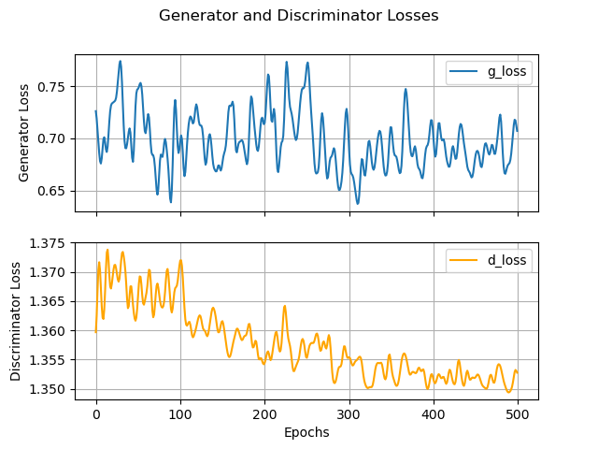
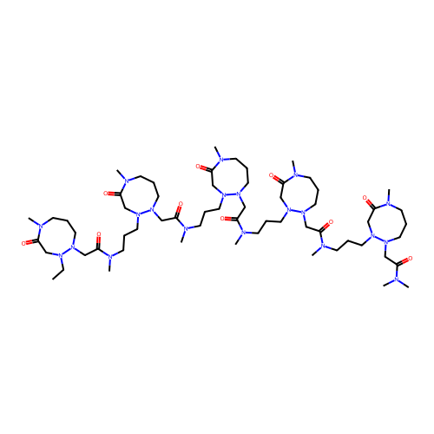
Tuned Training
Generator and Discriminator Loss During Training (Vasquez, 2024)
SMGAN Generated Molecule (Vasquez, 2024)

Slide 16
Results
Metric | SMGAN BASELINE | SMGAN Tuned | MolGAN
Valid (%) | 17.5 | 31.20 | 100.00
Unique (%) | 0.02 | 0.05 | 0.03
Novel (%) | 100 | 100.00 | 100.00
Solubility | 0.58 | 0.60 | 0.89
Druglikeness | 0.03 | 0.02 | 0.62
Synthesizeability | 0.42 | 0.46 | 0.95

Slide 17
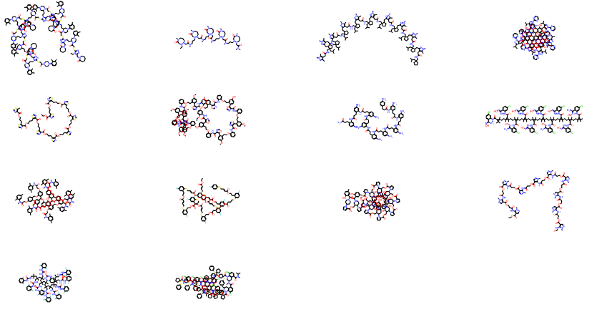
Generated Examples
Real Samples
Generated Samples

Slide 18
Future Work

Slide 19
Conclusion

Slide 20
References
Alqahtani, H. E. (19 Dec. 2019). Applications of Generative Adversarial Networks (GANS): An Updated Review.
Bickerton, G. R. (2012). Quantifying the chemical beauty of drugs.
Bidisha, S. (2019). NeVAE: A Deep Generative Model for Molecular Graphs.
Comer, J. a. (2001). Lipophiicity profiles: theory and measurement. Zurich, Switzerland.
Ertl, P. a. (2009). Estimation of synthetic accessibility score of drug-like molecules based on molecular complexity and fragment contributions. Journal of Cheminformatics, 1-8.
Phrma. (22 de July de 2024). Research & Development Policy Framework. Obtenido de phrma.org: https://phrma.org/policy-issues/Research-and-Development-Policy-Framework
RayTune. (20 de 8 de 2024). Tune Trial Schedulers. Obtained: https://docs.ray.io/en/latest/tune/api/schedulers.html
RDKit. (2023). rdkit.Chem.rdMolTransforms module. Obtenido de rdkit.org: https://www.rdkit.org/docs/source/rdkit.Chem.rdMolTransforms.html
RDKit. (20 de August de 2024). RDKit: Open-Source Cheminformatics Software. Obtenido de rdkit.org: 2024.
Nicola De Cao, T. K. (2018). MolGAN: An Implicit Generative Model for Small Molecular Graphs. Stockholm, Sweden.
Vasquez J, V. (22 de August de 2024). SMGAN. Obtenido de github: https://github.com/vanthony715/SMGAN

Slide 21
Questions

