Slide 1
UMAP
Uniform Manifold Approximation and Projection:
Topology Based Dimensionality Reduction

Slide 2
Usage
Dimension reduction of high dimension non-linear data
Parallel process clustering
Metric Learning
Connection visualization
Feature Extraction via separation analysis

Slide 3
Algorithm: High-Level
Step 1: Graph Construction: Calculate Fuzzy Simplicial Set and Weighted graph
Step 2: Lower dimension calculation using eigenvectors of normalized graph of the fuzzy simplicial complex affinity matrix (Spectral Vectors)
Step 3: Optimize Spectral Embedding by finding k-Nearest Neighbors

Slide 4
Local Fuzzy Simplicial Set
High dimensional graph construction (3D Space)
Shape approximation in real space (topology)
Each point has a variable radius – low density (large radius), high density (small radius)
0 Simplex
1 Simplex
2 Simplex
…
Topology

Slide 5
Create Weighted Graph
Density determined by distance between nearest neighbors
If k is large, global structure is more preserved (point radius is large)
If k is small, local structure is preserved (point radius is small)
Connection probability calculated
Weights calculated per point – far away points have lower weights
Points connected by high weighted regions are grouped in lower dimension space.

Slide 6
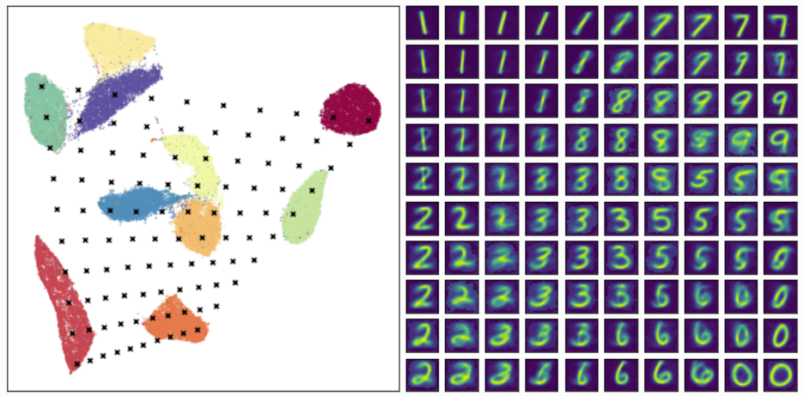
Plot in Lower Dimension Space

Slide 7
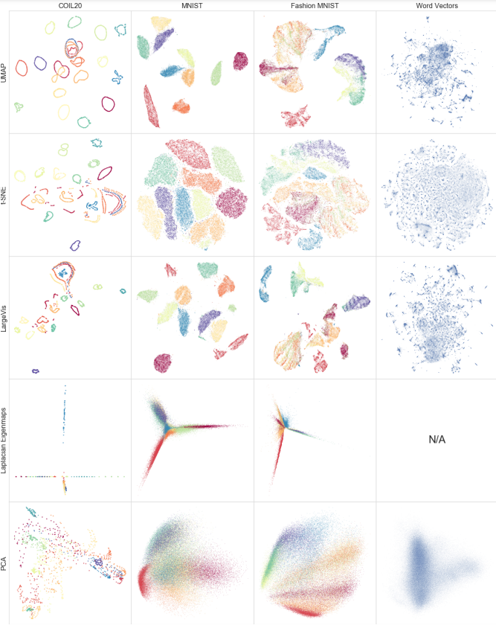
Qualitative Results

Slide 8
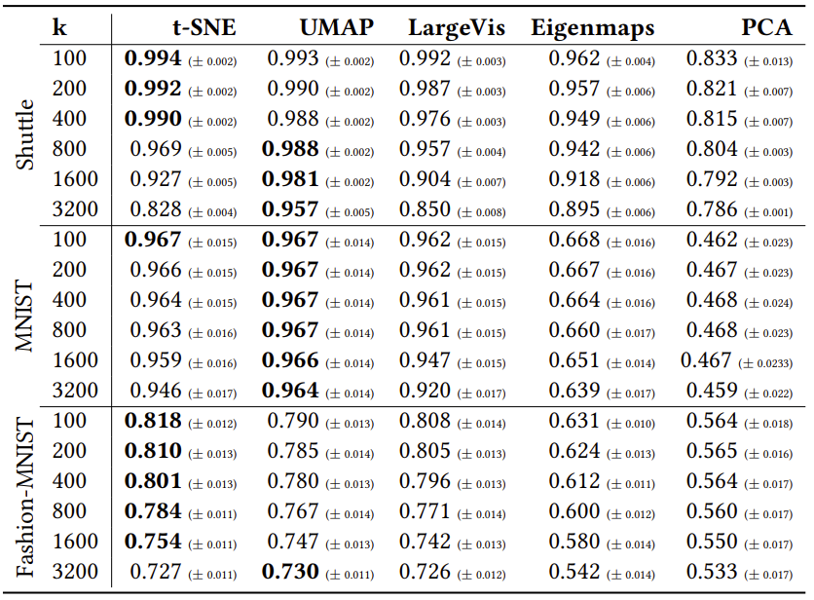
Cluster Accuracy

Slide 9
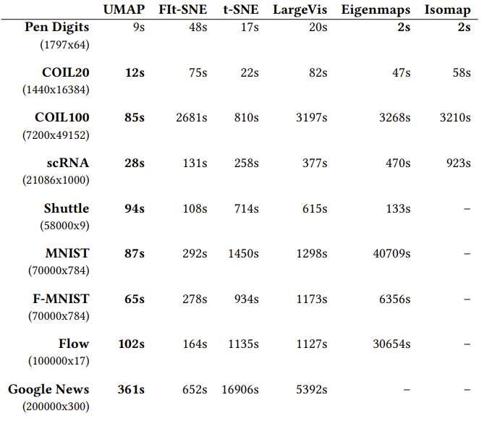
Computation Performance

Slide 10
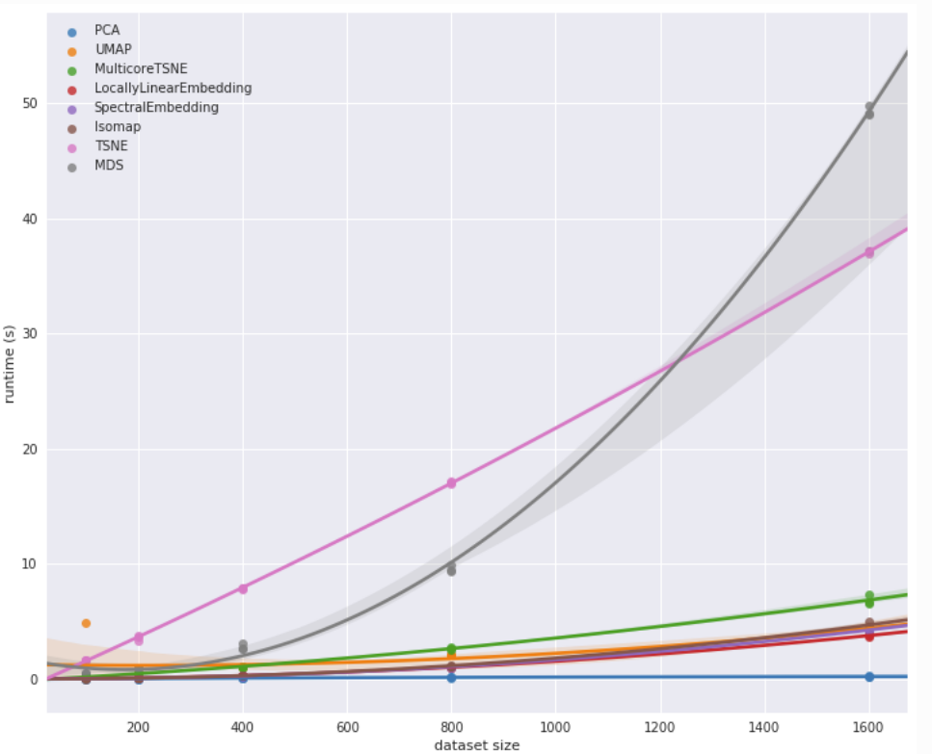
Computation Performance

Slide 11
References
McInnes, L., Healy, J., Melville, J., UMAP: Uniform Manifold Approximation and Projection. https://arxiv.org/pdf/1802.03426.pdf
Dalmia, A., Sia, S., Clustering with UMAP: Why and How Connectivity Matters. CoRR, 2021. https://arxiv.org/abs/2108.05525

