Slide 1
Reducing boilerplate code with Project Lombok
Presenter: Thuong Van Nguyen
Email: thuongvnguyen@kms-technology.com

Slide 2
What is boilerplate code?
public class Pet {
private String name;
private Person owner;
public Pet(String name, Person owner) {
this.name = name;
this.owner = owner;
}
public String getName() {
return name;
}
public void setName(String name) {
this.name = name;
}
public Person getOwner() {
return owner;
}
public void setOwner(Person owner) {
this.owner = owner;
}
}
class Pet(var name: PetName, var owner: Person)
Java
Scala
“In computer programming, Boilerplate code refers to sections of code that have to be included in many places with little or no alteration.”
(Source: Wikipedia)
public class Pet
{
public String Name { get; set; }
public Person Owner { get; set; }
}
C#
Notes:
In OOP, classes are often provided with methods for getting and setting instance variables. The definitions of these methods can frequently be regarded as boilerplate. Although the code will vary from one class to another, it is sufficiently stereotypical in structure that it would be better generated automatically than written by hand.

Slide 3

Scenarios
I want to code faster.
Is there any way to reduce boilerplate code?
OMG! I got this error caused by forgot to put new added field in equals() & hashCode() methods.
Take time to often write significantly more code for the same tasks.
Notes:
Java is quite verbose and will require a developer to often write significantly more code for the same task than other languages
- Java Developers want to code faster
- Avoid stupid errors like forgetting the getter and setter for a new added field
➔ Reduce boilerplate code ➔ Easy to control class, code is readable,…

Slide 4
What is Project Lombok?
@Setter
Product.java
Reduce lines of code
@Getter
Category.java
Code faster
@Data
User.java
Apply
Earn
@EqualsAndHashCode
Cart.java
Readable code
@ToString
Order.java
Easy to use
@Builder
OrderDetail.java
….and more
Etc…
Etc…
Project Lombok
Your Application
Benefits
Notes:
In short, Project Lombok a code generation library that provides a set of annotations you can use to drastically (đáng kể) reduce boilerplate code in your applications.

Slide 5
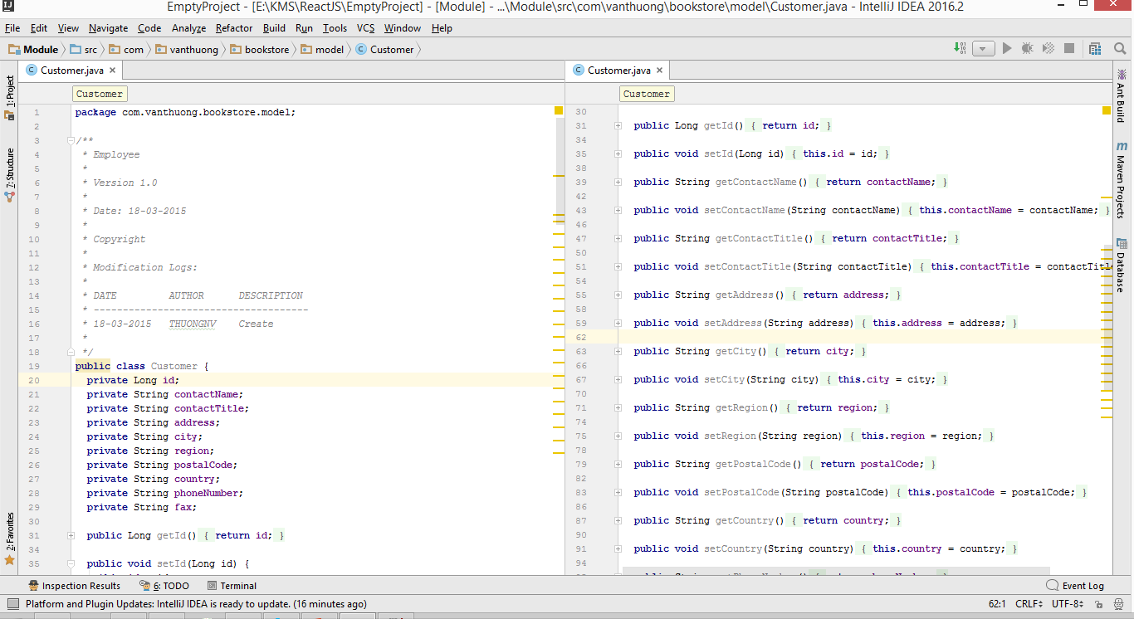
Vanilla Java

Slide 6
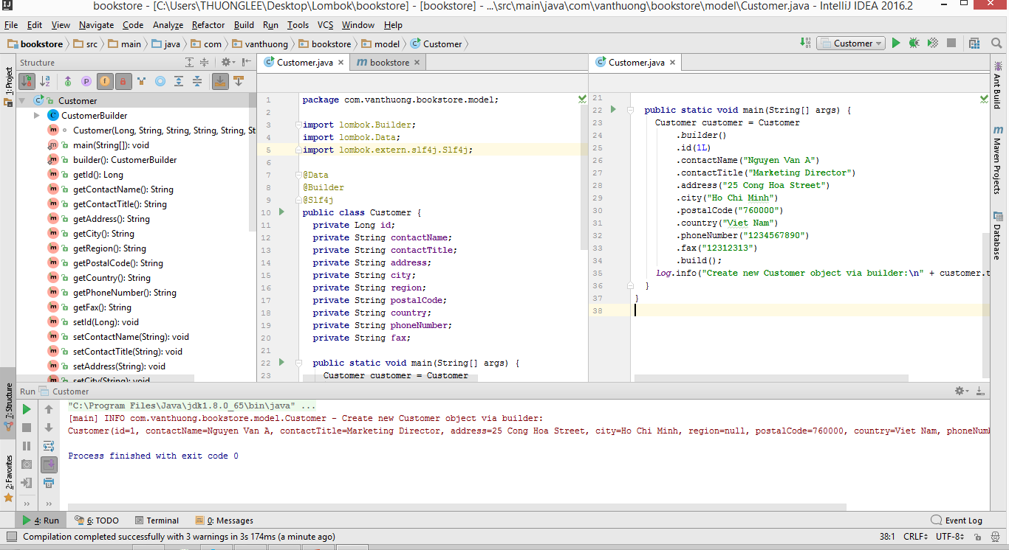
Is it cool?

Slide 7
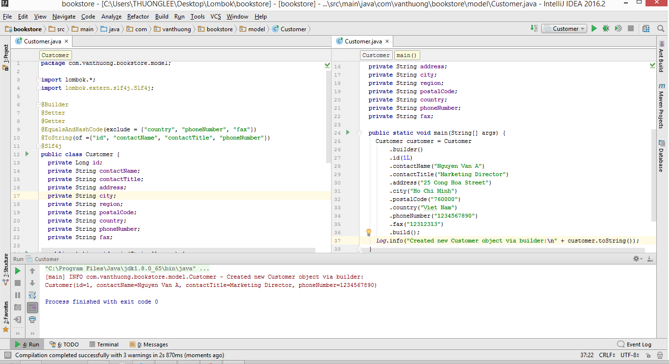
Specific Lombok Annotations

Slide 8
How does it works?
Java compile phases
Java source files
Parse and Enter
AST
Annotation Processing
Byte code
Analyze and Generate
Notes:
In the Parse and Enter phase, the compiler parses source files into an Abstract Syntax Tree (AST). Think of the AST as the DOM-equivalent for Java code. Parsing will only throw errors if the syntax is invalid. Compilation errors such as invalid class or method usage are checked in phase 3.
In the Annotation Processing phase, custom annotation processors are invoked. This is considered a pre-compilation phase. Annotation processors can do things like validate classes or generate new resources, including source files. Annotation processors can generate errors that will cause the compilation process to fail. If new source files are generated as a result of annotation processing, then compilation loops back to the Parse and Enter phase and the process is repeated until no new source files are generated.
In the last phase, Analyse and Generate, the compiler generates class files (byte code) from the Abstract Syntax Trees generated in phase 1. As part of this process, the AST is analyzed for broken references (e.g. class not found, method not found), valid flow is checked (e.g. no unreachable statements), type erasure is performed, syntactic sugar is desugared (e.g. enhanced for loops become iterator loops) and finally, if everything is successful, class files are written out.

Slide 9
How does it work?
When Lombok fit in
Annotation Processing
Java source files
Parse and Enter
Lombok Processor
AST
AST
Lombok Annotation Handler
Byte code
Analyze and Generate
Modified AST
Notes:
Project Lombok hooks itself into the compilation process as an annotation processor. But Lombok is not your normal annotation processor. Normally, annotation processors only generate new source files whereas Lombok modifies existing classes.
The trick is that Lombok modifies the AST. It turns out that changes made to the AST in the Annotation Processing phase will be visible to the Analyse and Generate phase. Thus, changing the AST will change the generated class file. For example, if a method node is added to the AST, then the class file will contain that new method. By modifying the AST, Lombok can do things like generate new methods (getter, setter, equals, etc) or inject code into an existing method (e.g. cleaning up resources).

Slide 10
How to integrate Lombok?
Step 1: Add lombok.jar to the project Libraries.
Step 2: Enable Annotation Processing in Editor.
Supported popular IDEs such as: Eclipse, NetBeans, IntelliJ
Lombok works well on Maven Project
<dependency>
<groupId>org.projectlombok</groupId>
<artifactId>lombok</artifactId>
<version>1.16.10</version>
<scope>provided</scope>
</dependency>

Slide 11
Lombok Annotations
@Getter / @Setter: generate the default getter/setter automatically for all non-final fields. (AccessLevel.PUBLIC/PROTECTED/PACKAGE/PRIVATE/NONE)
@EqualsAndHashCode: Generates hashCode and equals implementations from the fields of object.
@NoArgsConstructor, @RequiredArgsConstructor and @AllArgsConstructor : Generates constructors that take no arguments, one argument per final / non-null field, or one argument for every field.
@ToString: Generates toString() method from the fields of object.
@Data: A shortcut for @ToString, @EqualsAndHashCode, @Getter on all fields, and @Setter on all non-final fields, and @RequiredArgsConstructor
@Builder: lets you automatically produce the code required to have your class be instantiable like:
@NonNull: Use it on the parameter of a method or constructor to have lombok generate a null-check statement for you.
@Log: You can annotate any class with a log annotation to let lombok generate a logger field. For example: @Log, @Log4j, @Log4j2, @Slf4j, @XSlf4j
Etc…

Slide 12
References links
https://projectlombok.org/index.html
https://projectlombok.org/download.html
https://gualtierotesta.wordpress.com/2014/03/03/tutorial-using-lombok-to-reduce-boilerplate-code-in-java/

Slide 13
Thanks for you attention!

