Slide 1
UPDATE plugin kzvideoplayer
to 3.9.X

Slide 2
original version
- KzVideoPlayer.7z (download)
- uses lib VLC to play video / audio
- works well on 3.6.x version but doesn’t work on 3.9.x
→ Porting to 3.9.x

Slide 3
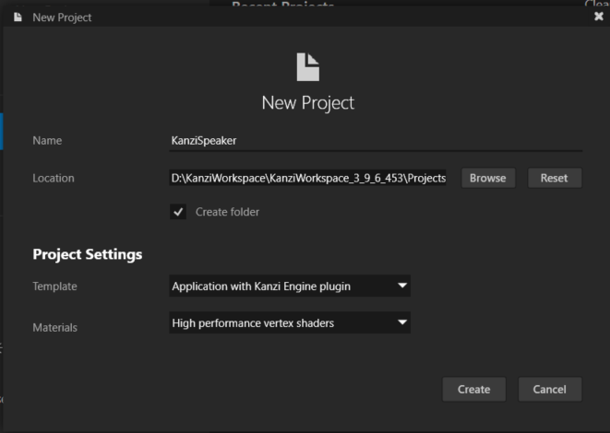
Update to 3.9.x version
Step 0: Create a new Kanzi project 3.9.6
- with template Application with Kanzi Engine plugin
- (Name KanziSpeaker for example)

Slide 4



Update to 3.9.x version
Step 1: Get lib VLC 3.0.9.2
- Copy include and lib folder from KzVideoPlayer\Application\lib\Win32\vlc
to
KanziSpeaker\Application\lib\VLC\sdk
- Copy libvlc.dll and libvlccore.dll from
KzVideoPlayer\Application\lib\Win32\vlc
to
KanziSpeaker\Application\bin
- Copy plugin folder from
KzVideoPlayer\Application\lib\Win32\vlc
to
KanziSpeaker\Application\bin
Those files can be downloaded here:
https://download.videolan.org/pub/videolan/vlc/3.0.9.2/win64/

Slide 5
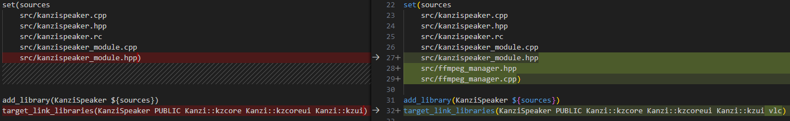
Update to 3.9.x version
Step 2: Define paths in CMakelists.txt
- Add following lines to KanziSpeaker\Application\src\plugin\CMakeLists.txt
include_directories(${PROJECT_SOURCE_DIR}/../../lib/VLC/sdk/include)
add_library(vlc SHARED IMPORTED)
set_target_properties(vlc PROPERTIES
IMPORTED_LOCATION ${PROJECT_SOURCE_DIR}/../../lib/VLC/libvlc.dll
IMPORTED_IMPLIB ${PROJECT_SOURCE_DIR}/../../lib/VLC/sdk/lib/libvlc.lib)
target_compile_definitions(KanziSpeaker PRIVATE -Dssize_t=intptr_t)
- And modify like below:

Slide 6
Update to 3.9.x version
Step 3: Copy and modify source code of plugin
- copy KzVideoPlayer\Application\src\plugin\src\ffmpeg_manager.cpp and .hpp
to
KanziSpeaker\Application\src\plugin\src
- And modify it:
Use std::mutex instead of KzsThreadLock
Ignore using suspension_manager.hpp header
- And modify kanzispeaker.cpp and hpp similar to kzvideoplayer.cpp and kzvideoplayer.hpp
→ In conclusion, APIs that cannot be used in version 3.9 need to be replaced with other APIs with similar functionality.

Slide 7
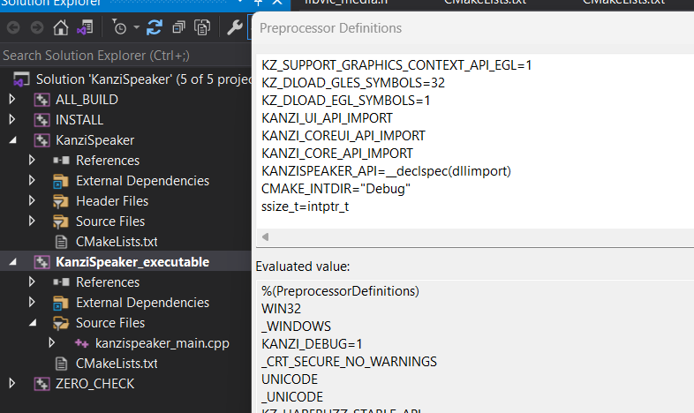
Update to 3.9.x version
Step 4: Define Proprocessor & Build source
- Add this to preprocessor definitions: ssize_t=intptr_t
- Build

Slide 8
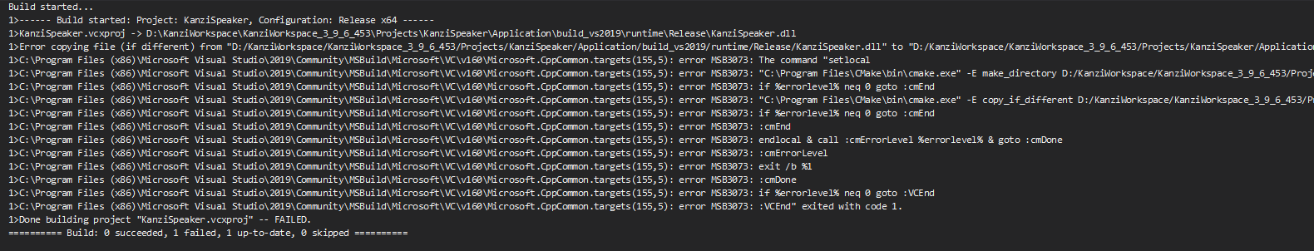
Update to 3.9.x version
Note
- If these errors are showed after building, close Kanzi Studio and re-build

Slide 9
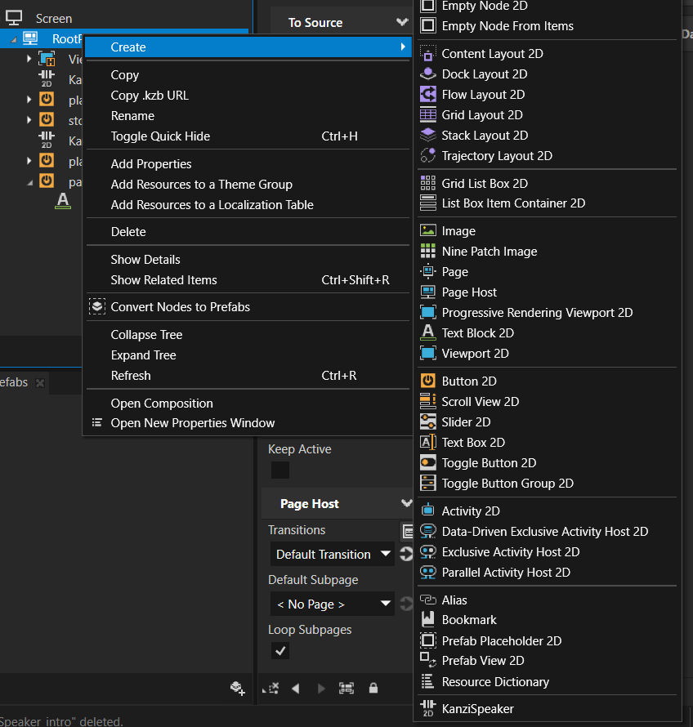
UsE Plugin in kanzi 3.9.x
1. Load plugin to the project
2. Create a new KanziSpeaker node
(example name KanziSpeaker_intro

Slide 10
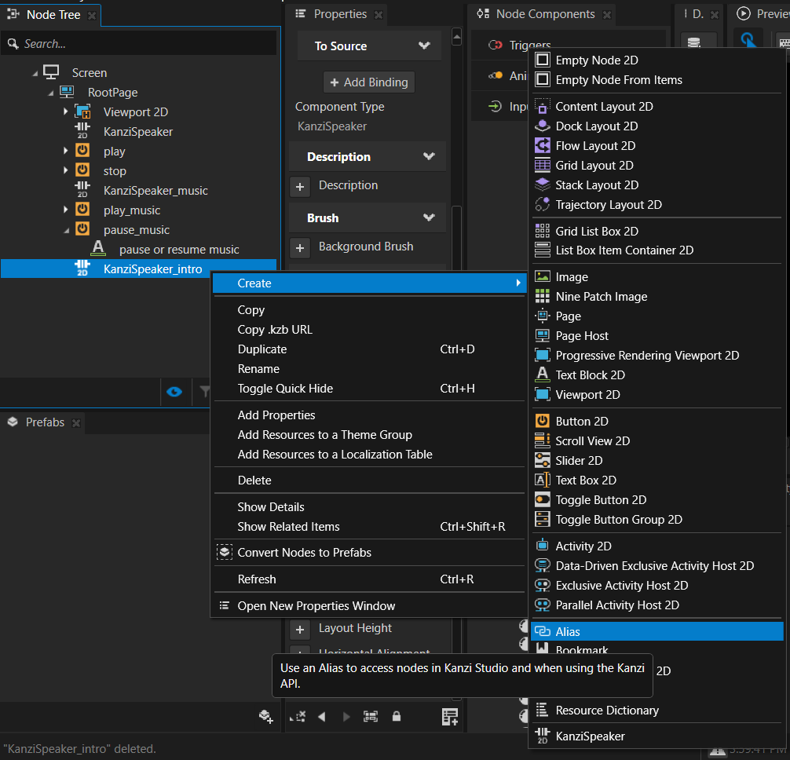
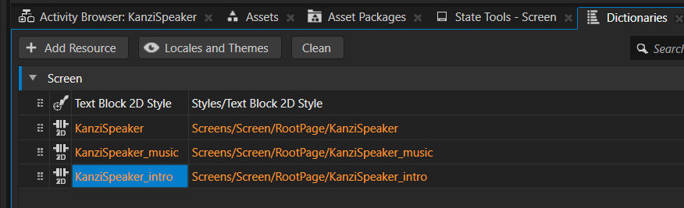
UsE Plugin in kanzi 3.9.x
3. Create an allias for the node
(example name KanziSpeaker_intro

Slide 11
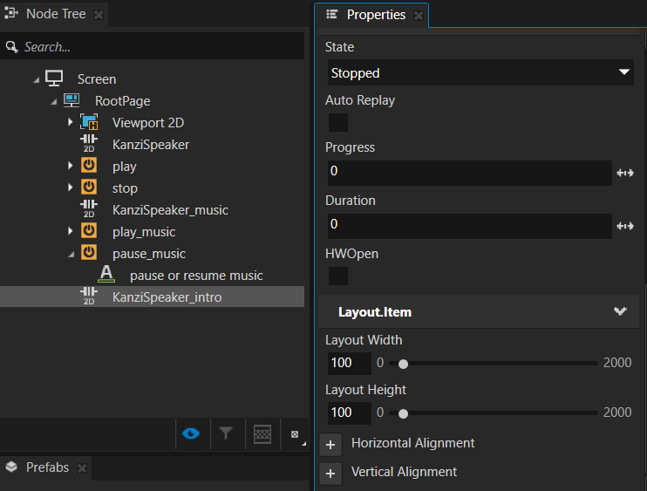
UsE Plugin in kanzi 3.9.x
4. Set size of the node
- Set width and high for that node, it is also the size of the video screen

Slide 12
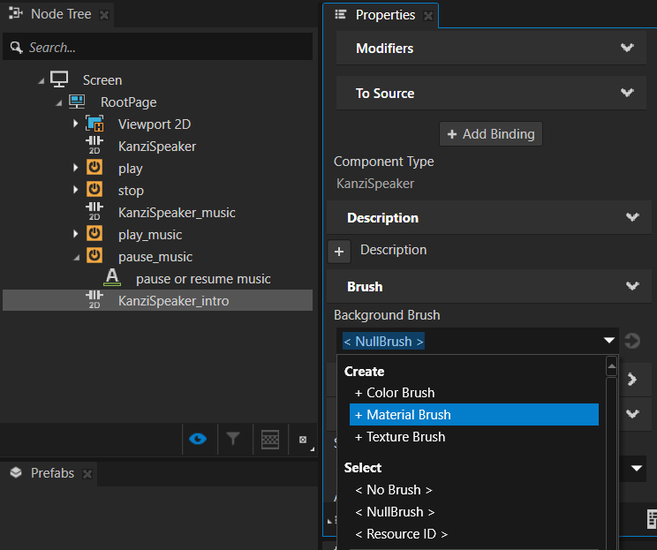
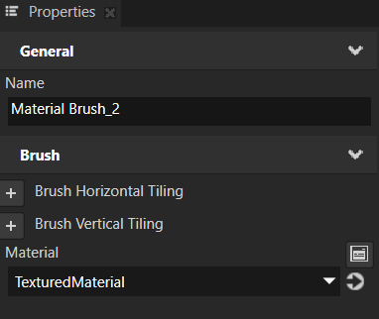
UsE Plugin in kanzi 3.9.x
4. Set background brush of the node
- Set Background Brush to a new Material Brush (eg. name Material Brush_2)
- Use TexturedMaterial as Material for Material Brush_2

Slide 13
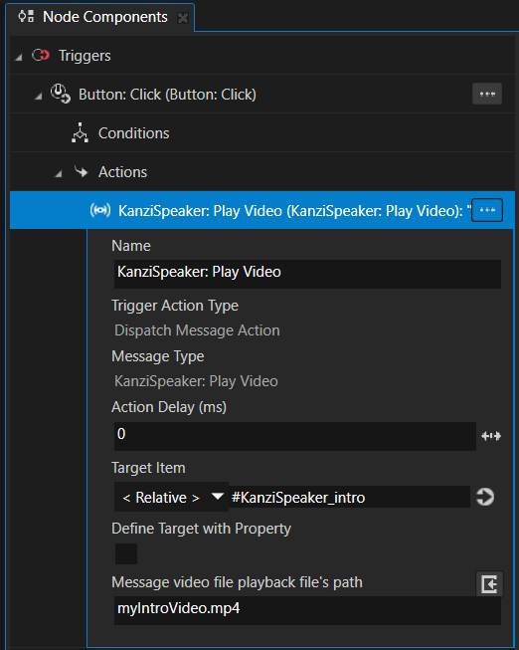
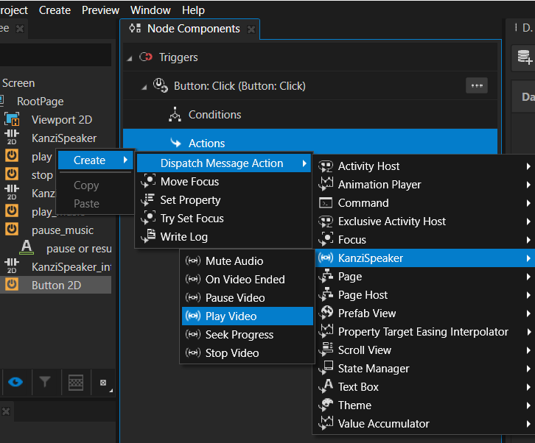
UsE Plugin in kanzi 3.9.x
5. Create a Button 2D for testing
- Create a button to Start and another to Stop
- Add trigger “Click”
- Add action “Play Video”
Target Item: to alias of the node KanziSpeaker
Message video file playback file’s path: to video path

Slide 14
UsE Plugin in kanzi 3.9.x
NOTE
- If video is not played after click Start button, click Stop button and try again
- the preview seems like below:

Slide 15
Thanks

