Slide 1

Generate reflection for C++
Head diploma: Hayk Shahparonyan
Implemented by: Vladimir Antonyan

Slide 2
INTRODUCTION
In computer science, reflection is the ability of a computer program to examine, introspect, and modify its own structure and behavior at runtime.
Some object-oriented programming languages contain built-in reflection mechanism
  Java։ java.lang.reflect – special package
  C# (.NET)։ System.Reflection - namespace
  . . .
C++: As reflection example we can consider MOC tool in Qt lib.
MOC (meta object compiler) is required
      Qt liberary
      inheritance from the class QՕbject
      Write Q_OBJECT macro in private section of classes, which is an activation of meta-object mechanism
National Polytechnic University of Armenia
1

Slide 3
OUR GOAL
Create an application, which will satisfy requirements below
  For C ++ program code reflection generation
  The code of the desired point for reflection
  Simple software interface
  Keep the performance
  Usage of output file should be provided opportunities below
    Class type information at run time
    Class method research
    Object’s methods call by string
    Binding with scrips languages
National Polytechnic University of Armenia
2

Slide 4

ALGORITHM DESCRIPTION
The input file should be describe correctly by C++ programing language
greflect
Input file
C++code
libClang
preprocessor
Lexical analyze
Abstract syntax tree
The output file also will be describe by C++ programing language
C++ code
Output file
Note that this solution differs from solution in Qt the fact that in this case, the output file is independent for a library.
National Polytechnic University of Armenia
3

Slide 5
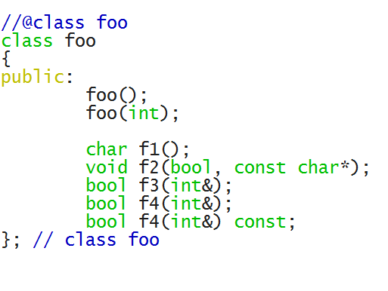
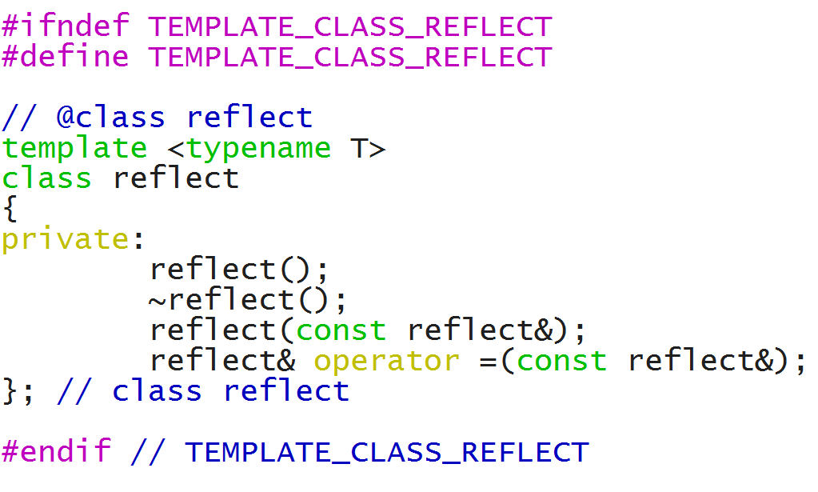
EXAMPLE
foo.hpp
foo_reflect.hpp
  . . .
National Polytechnic University of Armenia
4

Slide 6
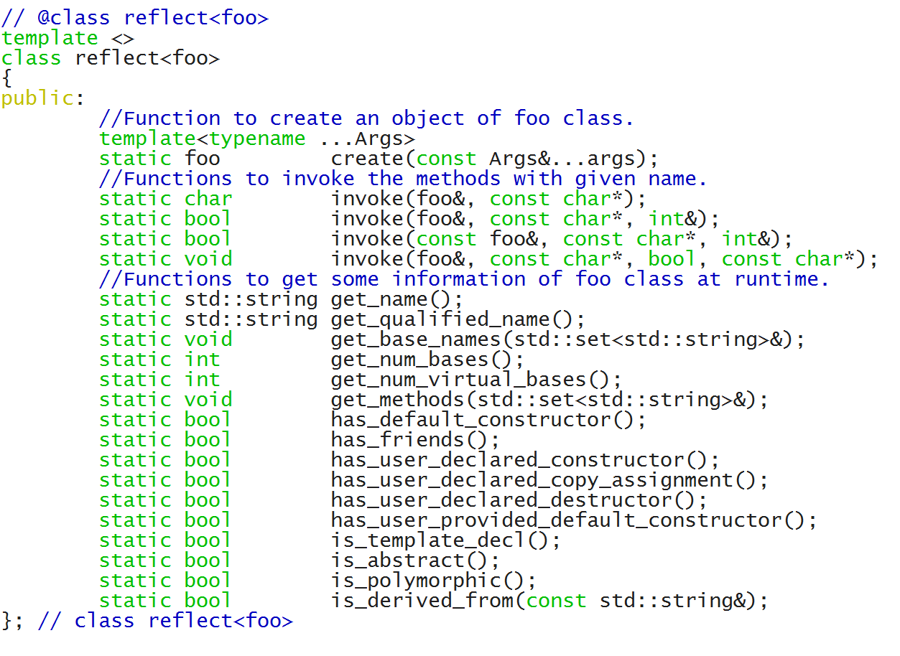
EXAMPLE
Described reflect for specialization of foo class
foo_reflect.hpp
National Polytechnic University of Armenia
5

Slide 7
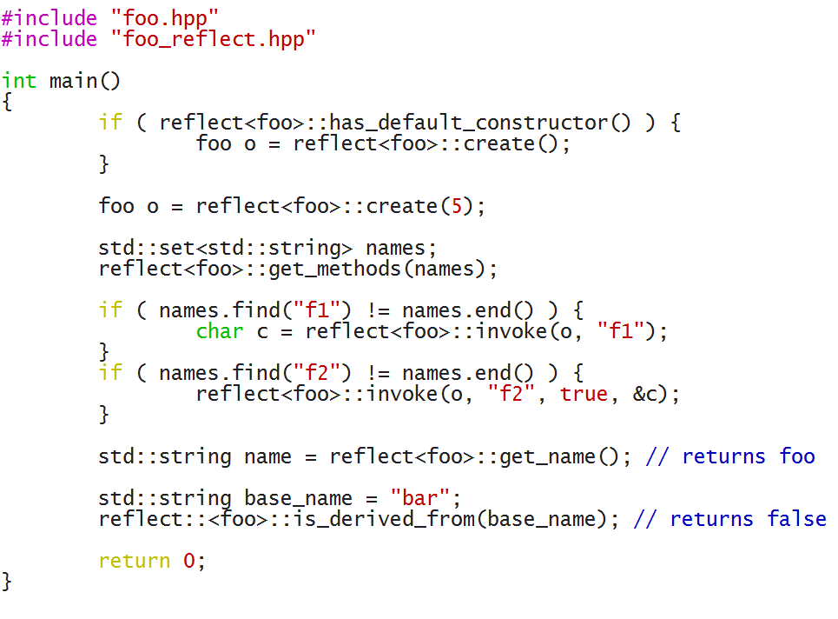
EXAMPLE
The generated file foo_reflect.hpp we can include in our basic code and use the interface of reflect class
National Polytechnic University of Armenia
6

Slide 8
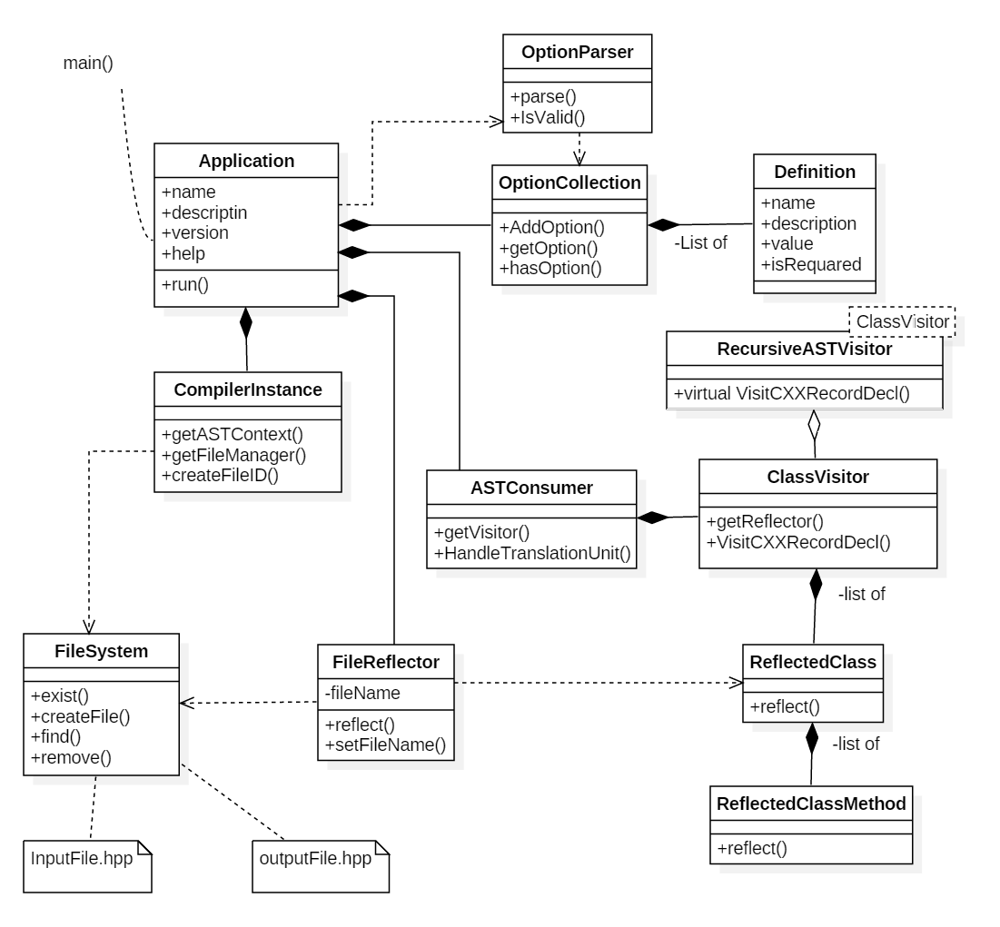
UML – CLASS DIAGRAM
Application
Definition
OptionParser
Clang::CompilerInstance
Clang::ASTConsumer
ClassVisitor
ReflectedClass
ReflectedClassMethod
FileReflector
Clang::FileSystem
National Polytechnic University of Armenia
7

Slide 9
FETCHER ENHANCEMENTS
Users will be able to reflect the class members.
Serialization -process, which translates the data structure of the bit sequence
National Polytechnic University of Armenia
8

Slide 10
SUMMARY
Created software, which enables to expand the capabilities of the C ++ programming language.
Application is implemented by C++ programing languages based on libClang for Windows, Linux environments
Software is open source. Link: https://github.com/vantonyy/SSreflect
National Polytechnic University of Armenia
9

Slide 11
THANK YOU

