Slide 1
The Future of AI in Healthcare

Slide 2
Agenda
Introduction to AI in Healthcare
Current Applications of AI in Healthcare
Future Trends and Potential Impact
Challenges and Ethical Considerations
Q&A

Slide 3
Introduction to AI in Healthcare
03

Slide 4
What is Artificial Intelligence?
AI is the theory and development of computer systems able to perform tasks that normally require human intelligence.
These tasks include:
* Visual perception
* Speech recognition
* Decision-making
* Translation between languages
In healthcare, AI aims to improve efficiency, accuracy, and patient outcomes.

Slide 5
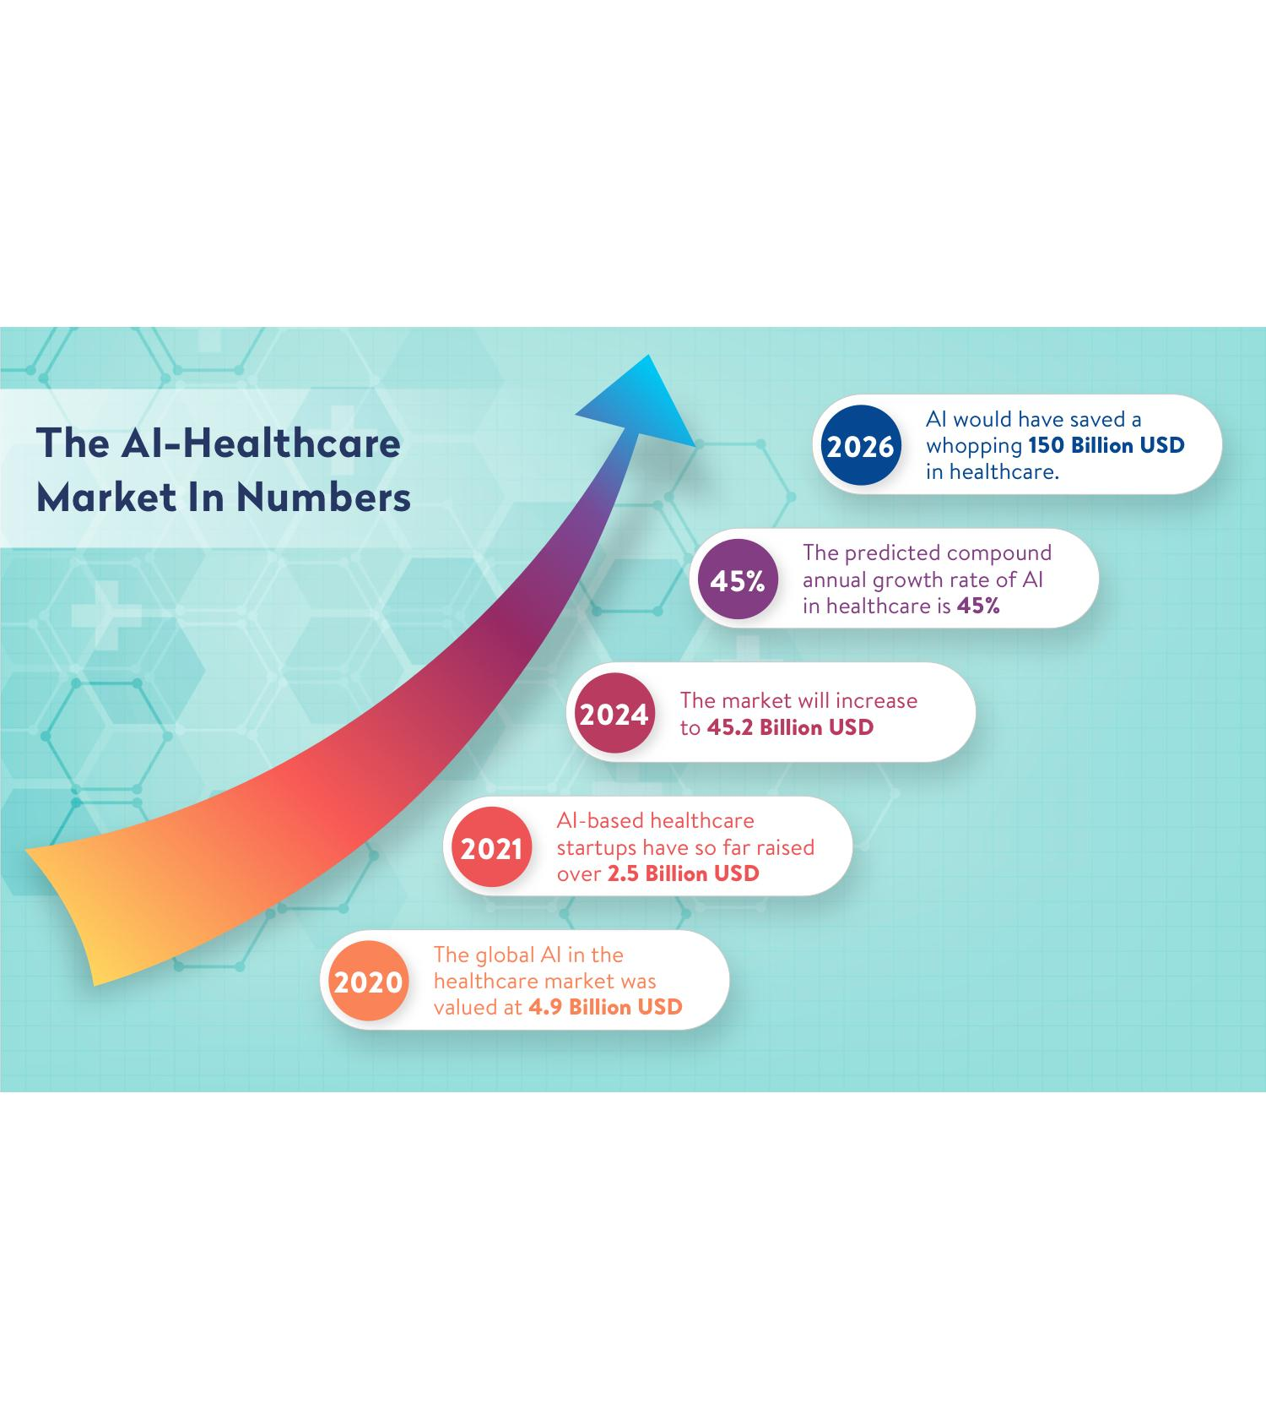
A Brief History & Why Now?
Early AI: Rule-based systems (1960s-80s)
AI Winter: Funding waned.
AI Resurgence (2010s-Present):
* Big Data, GPUs, Deep Learning
Why AI in healthcare *now*?
* Aging populations, healthcare demands
* Personalized medicine
* Reduce costs, improve access

Slide 6
Current Applications of AI in Healthcare

Slide 7
AI in Diagnostics

Slide 8
AI in Drug Discovery & Personalized Medicine

Slide 9
AI in Administrative Tasks & Robotic Surgery

Slide 10
Future Trends and Potential Impact
05

Slide 11
AI-Powered Virtual Assistants and Chatbots
24/7 Patient Support
Appointment Scheduling and Reminders
Medication Reminders and Information
Initial Symptom Assessment and Triage
Mental Health Support and Counseling
Personalized Health Recommendations

Slide 12
Predictive Analytics for Disease Outbreaks and Resource Allocation
Early Detection of Disease Outbreaks
Predicting Patient Volume and Demand
Optimizing Resource Allocation (staff, beds, equipment)
Improving Emergency Response Times
Personalized Risk Assessments
Data-Driven Public Health Interventions

Slide 13
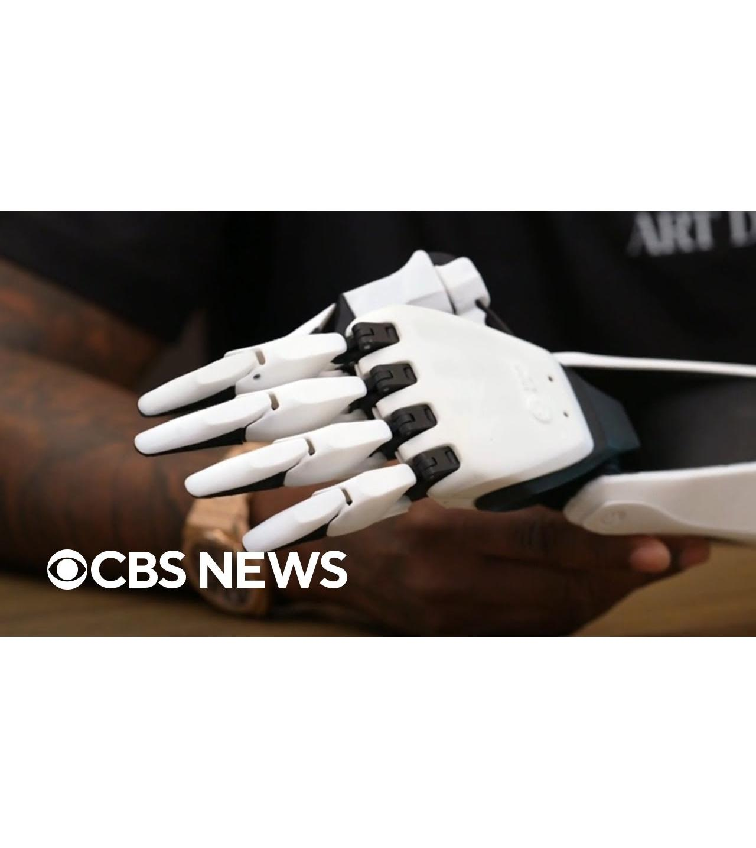
AI-Driven Prosthetics, Assistive Devices & Wearable Integration
Advanced Prosthetics with Enhanced Dexterity and Control
Smart Wheelchairs and Mobility Aids
Wearable Sensors for Continuous Health Monitoring
Personalized Rehabilitation Programs
Remote Patient Monitoring
Integration with Electronic Health Records

Slide 14
AI in Preventative Medicine and Wellness Programs

Slide 15
Challenges and Ethical Considerations

Slide 16
Data Privacy and Security
Stringent data protection is crucial (HIPAA compliance).
AI systems require vast amounts of patient data, raising privacy risks.
Data breaches and unauthorized access are major concerns.
Need for robust anonymization and de-identification techniques.

Slide 17
Algorithmic Bias and Fairness
AI algorithms amplify existing biases.
Biased algorithms lead to unfair outcomes.
Need diverse data to train AI models.
Audit AI systems for bias detection.
Focus on fairness metrics and strategies.

Slide 18
Transparency and Explainability
AI decision-making can be opaque.
Lack of transparency hinders AI trust.
Need explainable AI (XAI) techniques.
Clinicians need to understand AI logic.
Regulatory needs for transparency.

Slide 19
Key Takeaways: The Future is Collaborative
AI: A powerful tool for improved diagnostics, treatment, and patient care.
Implementation: Requires careful planning, data management, and ethical considerations.
Continuous Learning: Essential for healthcare professionals in the age of AI.
Collaboration: The future of healthcare is a collaborative effort between humans and AI.

Slide 20
Q & A

Slide 21
Thank You!
Thank you for your time and attention!
Contact Information: [Your Email/Website]
Further Resources: [Links to relevant articles/organizations]

