Slide 1
Decision Trees: A Simple Guide for Smarter Business Decisions

Slide 2
Agenda
What are Decision Trees?
Why Use Decision Trees for Your Business?
How Decision Trees Work: A Step-by-Step Guide
Benefits and Limitations
Q&A

Slide 3
What are Decision Trees?

Slide 4
Decision Trees: A Visual Guide to Choices
A decision tree is a visual representation of possible decisions and their potential outcomes.
It helps you analyze different courses of action and make informed choices.
Think of it as a flowchart that maps out the consequences of various decisions.

Slide 5
Understanding the Components
<b>Nodes:</b> Represent decisions or chance events.
<b>Branches:</b> Show the possible outcomes of each decision.
<b>Leaves:</b> Indicate the final result or payoff of a particular path.

Slide 6
Why Use Decision Trees for Your Business?

Slide 7
Improved Decision-Making & Transparency
**Structured Approach:** Decision trees
provide a clear, step-by-step method.
**Visual Representation:** Complex
decisions are broken down into components.
**Easy to Understand:** Branching makes
reasoning transparent to stakeholders.
**Improved Communication:** Facilitates
better team communication and collaboration.

Slide 8
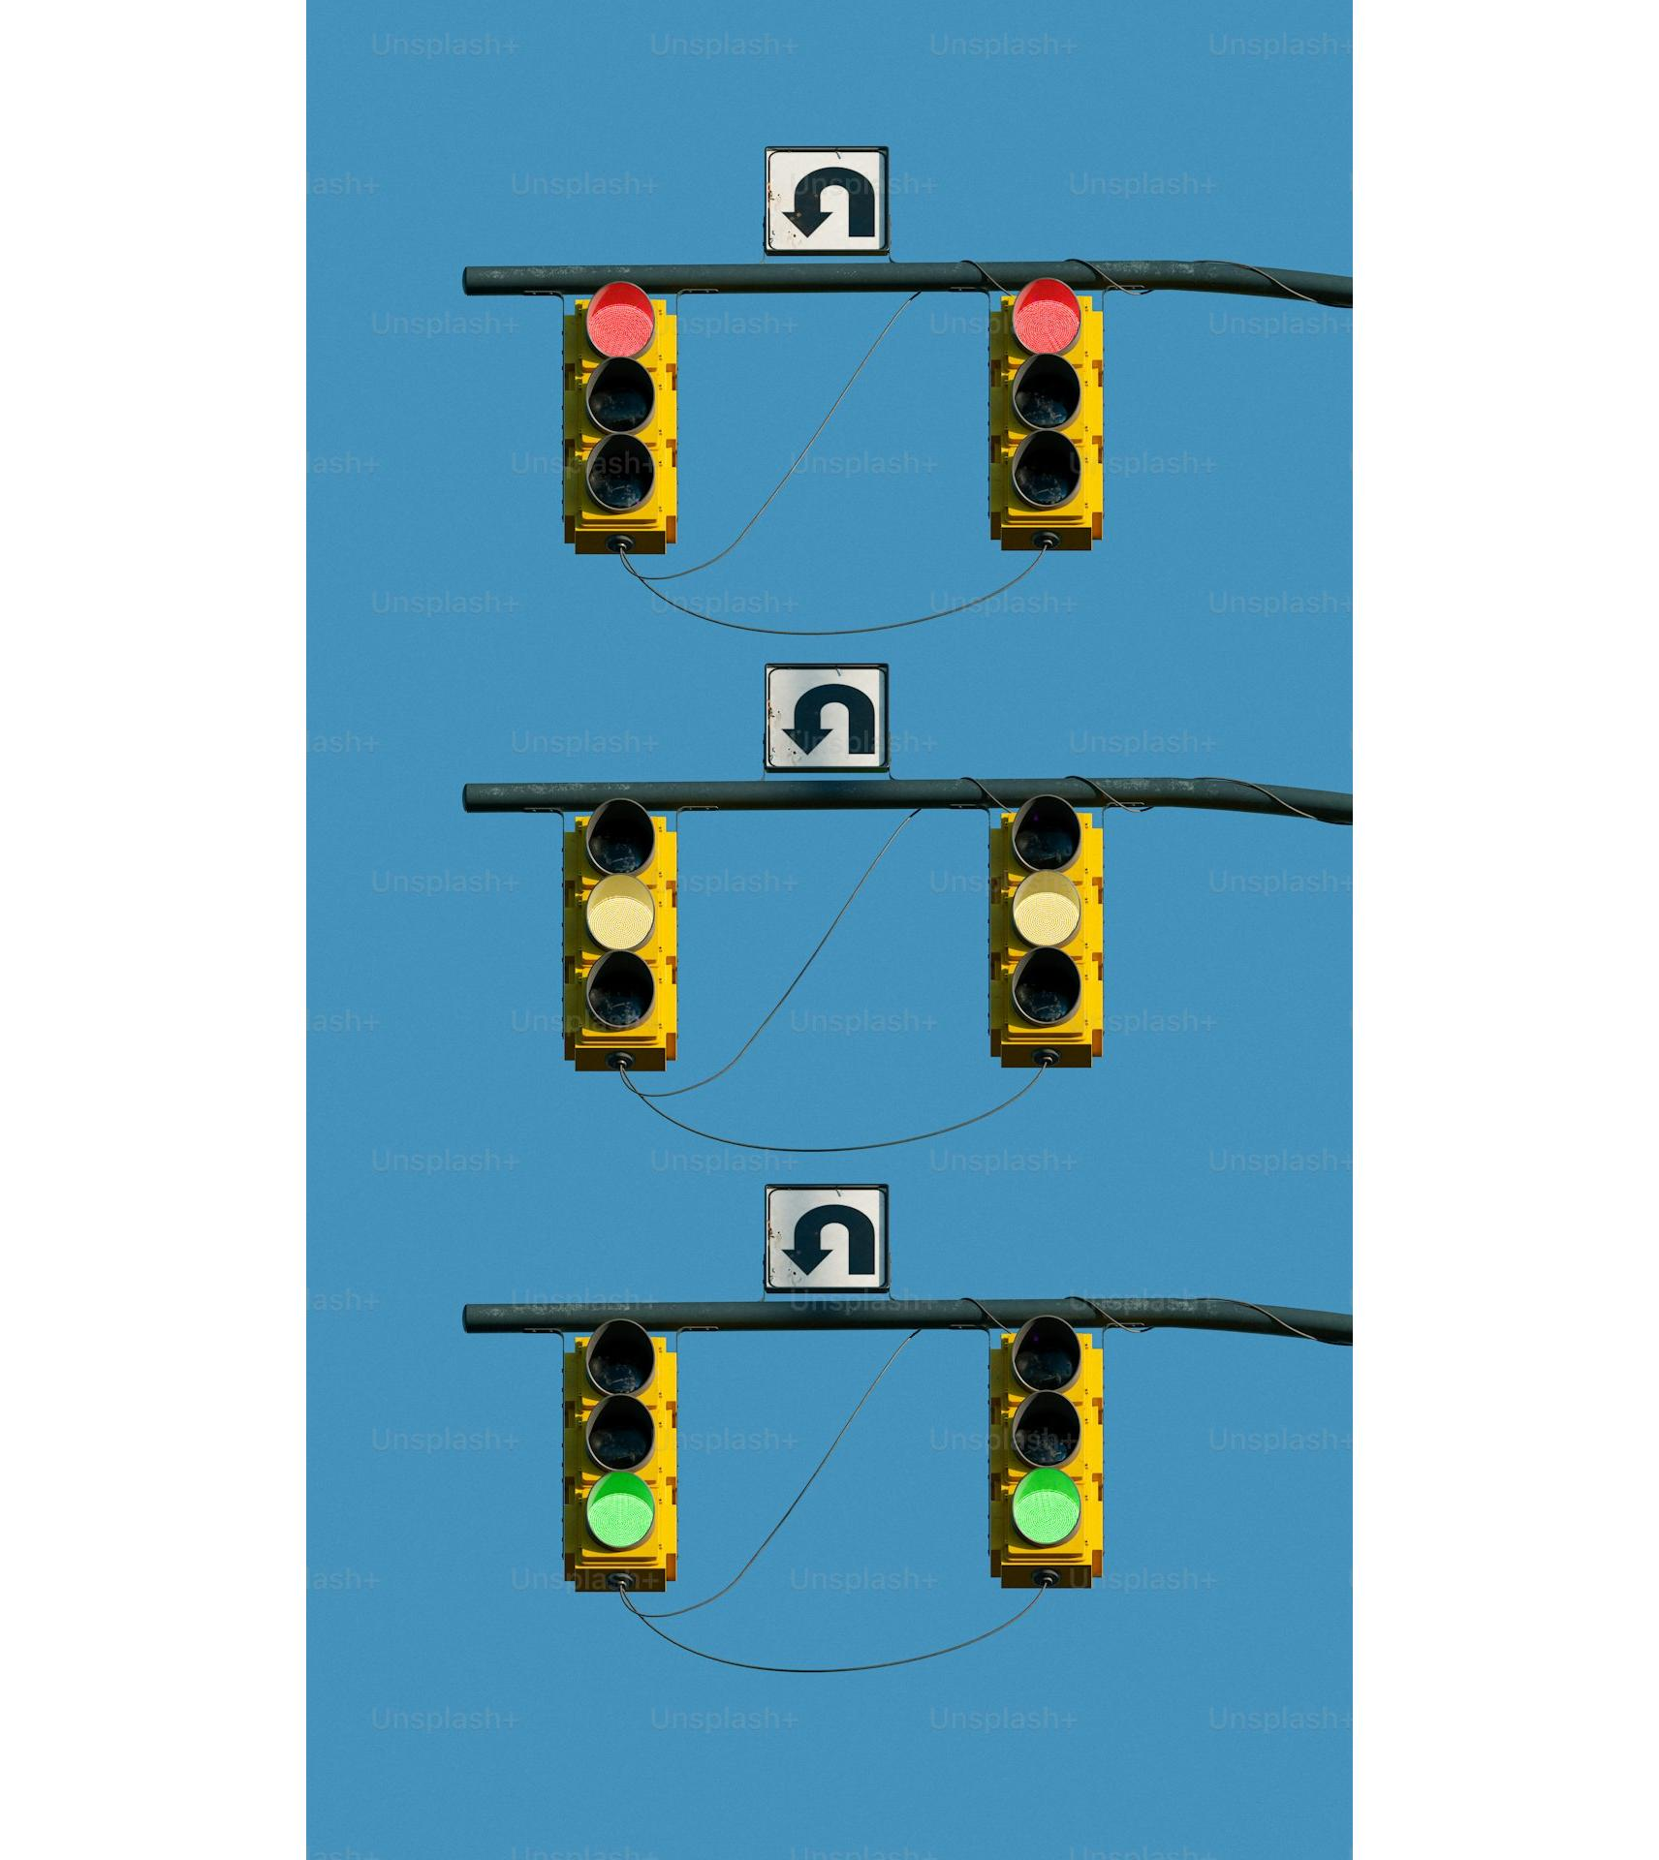
Risk Assessment & Data-Driven Decisions
**Identify Potential Risks:** Visualize
potential risks and rewards of choices.
**Quantify Outcomes:** Assign probabilities
and values for risk assessment.
**Data Integration:** Combine trees with
data analysis for informed choices.
**Evidence-Based Decisions:** Leverage
data to support the decision process.

Slide 9
How Decision Trees Work: A Step-by-Step Guide

Slide 10
Step 1 & 2: Define and Identify
**Step 1: Define the Problem or Decision**
* State the question you're answering.
* What decision needs to be made?
**Step 2: Identify Possible Options**
* Brainstorm all possible choices.
* These are the initial tree branches.

Slide 11
Step 3 & 4: Map Outcomes and Evaluate
**Step 3: Map Potential Outcomes**
* Consider what could happen for each option.
* Include probabilities (e.g., 70% success).
**Step 4: Evaluate Value/Cost of Outcome**
* Assign a numerical value to each outcome.
* Consider positive and negative outcomes.

Slide 12
Conclusion: Key Takeaways
Decision trees: Simple, powerful tools for better business decisions.
Structured, transparent approach to evaluating options.
Informed choices, risk assessment, and improved outcomes.
Embrace decision trees for smarter, more effective strategies.

Slide 13
Next Steps: Continue Your Decision Tree Journey
Explore online resources and tutorials (e.g., YouTube, Coursera, blog posts).
Identify a specific business decision suitable for a decision tree.
Start creating simple decision trees using pen and paper or spreadsheet software.
Consider consulting with a business advisor or data analyst for complex applications.
Remember: Practice makes perfect! The more you use decision trees, the more intuitive they become.

Slide 14
Q & A
Your questions are welcome!
Let's discuss how decision trees can benefit your business.
We're here to provide clear and concise answers.
For further learning, check out the resources mentioned earlier.

Slide 15
Thank You!
Thank you for your time and attention!
We hope you found this presentation helpful.
For further questions or support, please reach out:
temp/slides/image_8_0.png
temp/slides/image_8_0.png

