Slide 1
Reinforcement Learning for Healthcare Professionals
Presenter: [Your Name/Organization]
Date: [Date]

Slide 2
Presentation Agenda: Reinforcement Learning in Healthcare
Reinforcement Learning (RL) Introduction
Key Concepts and Healthcare Applications
Benefits, Challenges, and Conclusion

Slide 3
03
Introduction to Reinforcement Learning (RL)

Slide 4
Agent learns decisions via interaction, feedback to maximize reward.
What is Reinforcement Learning?
Reinforcement Learning
Agent
Environment
Reward

Slide 5
RL vs. Other Learning Paradigms
Supervised Learning
Unsupervised Learning

Slide 6
04
Key Concepts in Reinforcement Learning

Slide 7
States, Actions, and Rewards
State: Environment's current situation, the agent's 'observation'.
**Action:** Choices the agent can make in each state. These actions change the environment.

Slide 8
Policy: The Agent's Strategy
**Policy:** A strategy for selecting actions in different states.
It's a mapping from state to action: π(a|s)

Slide 9
Value Function: Long-Term Reward
Value Function: Estimates long-term reward from a state or state-action pair.
V(s): Value of a state - expected return starting from that state.
Q(s, a): Value of a state-action pair - expected return starting from that state, taking that action.

Slide 10
RL Applications in Healthcare
05

Slide 11
Personalized Treatment Plans with RL
personalized medicine
treatment optimization
drug dosage
therapy schedules

Slide 12
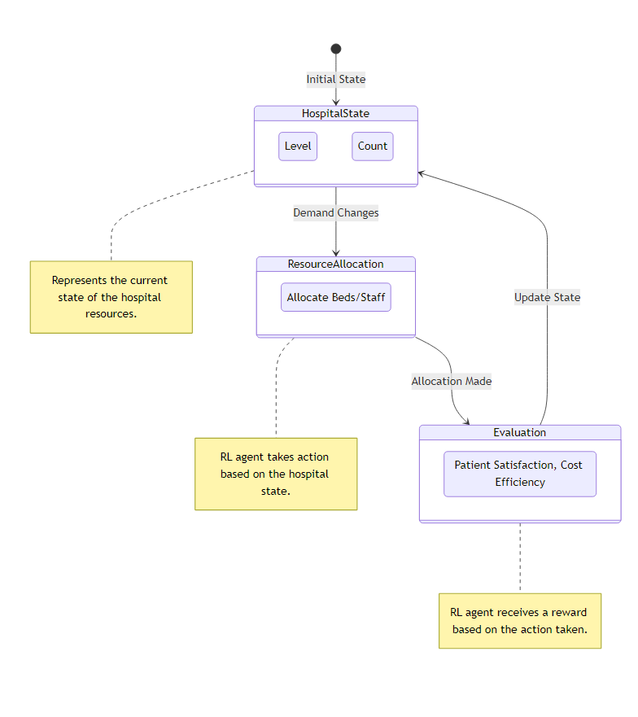
Efficiently managing hospital beds based on demand.
Optimizing staff allocation to reduce wait times.
Predicting resource needs and proactively adjusting allocation.
Example: Dynamically allocating nurses to different units based on patient acuity and staffing levels.

Slide 13
RL for Medical Diagnosis & Robotics
medical diagnosis
image analysis

Slide 14
06
Benefits and Challenges

Slide 15
Reinforcement Learning: Key Benefits
Improved Patient Outcomes: Optimize treatment plans for better results.
Personalized Treatments: Tailor interventions based on individual patient characteristics.
Increased Efficiency: Automate tasks and streamline workflows.
Reduced Costs: Optimize resource allocation and minimize waste.

Slide 16

Data Scarcity: Limited availability of high-quality, labeled data.
Ethical Considerations: Ensuring patient safety and avoiding bias.
Interpretability: Understanding the reasoning behind RL's decisions.
Computational Complexity: High computational demands for training and deployment.
Reward Function Design: Carefully crafting reward functions to align with desired outcomes.

Slide 17
Key Takeaways: RL in Healthcare
RL offers a novel approach to complex healthcare.
Personalized treatment plans are within reach.
Adaptive interventions improve patient outcomes.

Slide 18
Future Directions and Conclusion
Further research is crucial to address limitations.
Focus on safe and ethical implementation strategies.
RL can revolutionize healthcare. Let's unlock its potential!

Slide 19
Open Forum: Your Questions Answered
We're now happy to address any questions you may have.
No question is too basic or too complex!
Let's explore the possibilities of RL in healthcare together.

Slide 20
Further Clarification and Examples
Need more details on a specific RL concept?
Want to see more examples of RL applications?
We're here to provide further clarification and insights.

Slide 21
Thank you for your attention!
Open for questions
Contact Information: [Your Email/Website]

