Slide 1
Intership final presetation
Do Van Tu
MS/EMC-TM-XC
15/05/2024

Slide 2
Agenda
Flicker Detection
AI Slidegen
HR Interview

Slide 3
01
Flicker detection: Detecting screen flicker issues in automation testing.

Slide 4
1.1 Introduction
1.Flicker detection
Flicker is the unintended screen blinking or instability during UI rendering.
In automation testing, flicker affects test reliability and user experience.
This project aims to automatically detect flicker from test videos to reduce manual inspection effort.

Slide 5
1.2 Use Cases & Pain Points
1.Flicker detection

Slide 6
1.3 System Architecture / Workflow
1.Flicker detection

Slide 7
1.4 Impact & Result
1.Flicker detection

Slide 8
02
AI Slidegen

Slide 9
2.1 Introduction
2. AI Slidegen
1. A tool for generating presentation slides with a predefined template
Users can upload a custom PowerPoint template (master slide)
The system generates slides with essential layout and structure for basic presentations
2. Enhanced with AI-powered editing and flexibility
Allows users to modify slides using natural language commands
Supports content generation, formatting, and layout improvements automatically

Slide 10
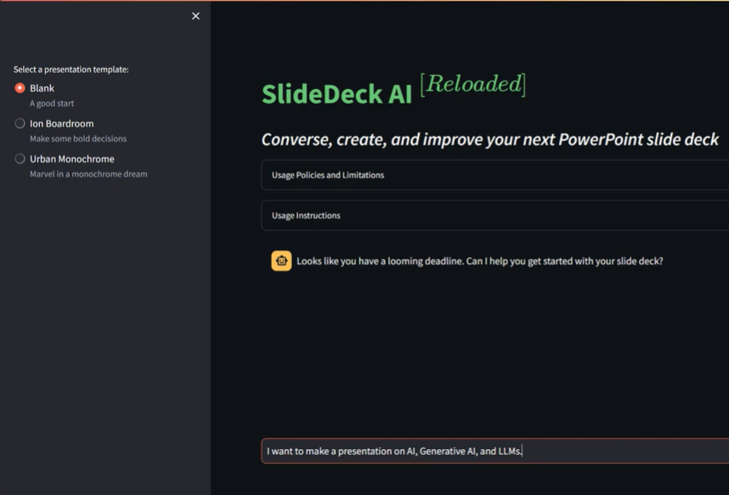
2.2 Use cases
2. AI Slidegen
Users upload a PowerPoint template (master slide)
Provide a topic and specific requirements for the desired slides
System returns downloadable and editable slide decks

Slide 11
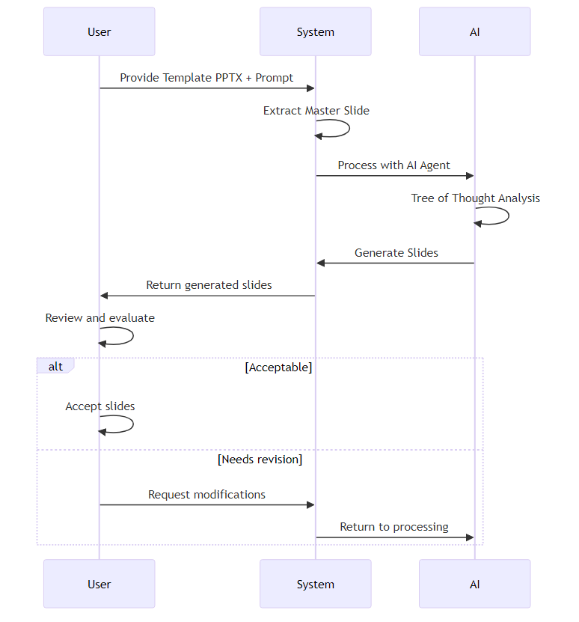
2.3 Architecture / Workflow
2. AI Slidegen
Input: User uploads PPTX template and content prompt.
Processing: AI analyzes requirements using Tree of Thought method.
Output: System delivers generated slides matching template format.
Feedback: User either accepts slides or requests revisions.

Slide 12
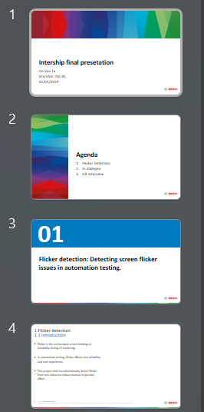
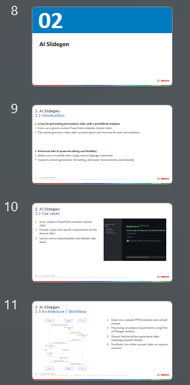
2.4 Impact & Result
2. AI Slidegen
Speeds up basic slide creation by over 70%
Generates diverse slides based on the uploaded master template
Creates clear and intuitive charts automatically
Reduces reliance on manual design tools like PowerPoint or Google Slides
Improves content consistency across different presentations and teams
Makes presentation creation accessible for non-designers and technical users

Slide 13
03
HR Interview
(AI Interview Assistant)

Slide 14
3.1 Introdution
3. HR Interview
Employee Insight
Analyzes employee behavior and performance data to predict attrition risk
Recommends personalized retention actions or engagement plans for at-risk employees
Interview Assistant AI
Supports online interview assessments, including quizzes and behavioral questions
Uses video analysis to evaluate facial expressions, tone, and response quality

Slide 15
3.2 Use cases
3. HR Interview

Slide 16
3.3 Architech
3. HR Interview

Slide 17
Link demo:

Slide 18
Conclusion
Throughout this internship, I had the opportunity to work on three impactful projects:
Flicker Detection: Improved the reliability of UI automation by detecting screen flickers automatically.
HN Slidegen: Accelerated content creation by generating professional slides from user input with AI.
HR Interview Assistant: Enhanced the recruitment process through AI-driven interviews and employee insight analysis.
Each project helped solve real-world problems by combining automation, AI, and practical system design.

Slide 19
Q & A
Thank you for listening! If you have any questions, I’d be happy to answer.

