Slide 1
Business Data Analysis Capstone
Sales • Customer Churn • House Prices

Slide 2
Project Overview
• End-to-end analytics across three business domains
• EDA, statistics, and regression for insights
• Actionable recommendations for decisions

Slide 3
Datasets Used
• Sales: revenue & performance drivers
• Customer Churn: retention and risk factors
• House Prices: real-estate price determinants

Slide 4
Sales Data Analysis

Slide 5
Sales — Business Problem
• Understand sales performance
• Identify revenue drivers
• Improve pricing & marketing

Slide 6
Sales — Data Preparation
• Handled missing & duplicate values
• Corrected data types
• Standardized numerical features

Slide 7
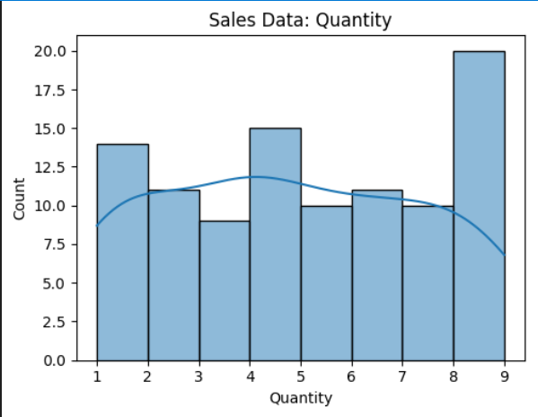
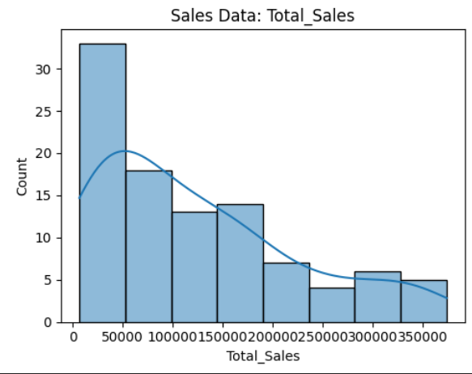
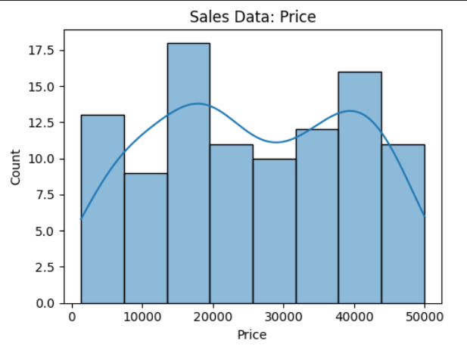
Sales — EDA (placeholders)

Slide 8
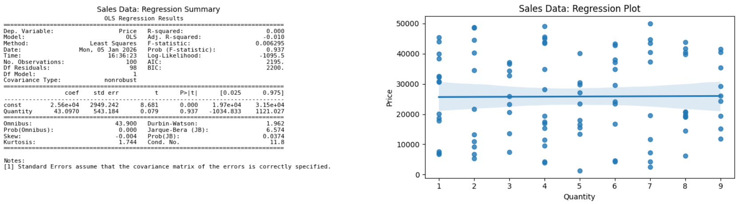
Sales — Regression (placeholders)

Slide 9
Sales — Key Insights
• Few products drive most revenue
• Strong variable relationships
• Supports targeted strategies

Slide 10
Customer Churn Analysis

Slide 11
Churn — Business Problem
• Identify customers likely to churn
• Reduce attrition
• Improve retention

Slide 12
Churn — Data Preparation
• Encoded categorical variables
• Scaled numerical features
• Handled missing values

Slide 13
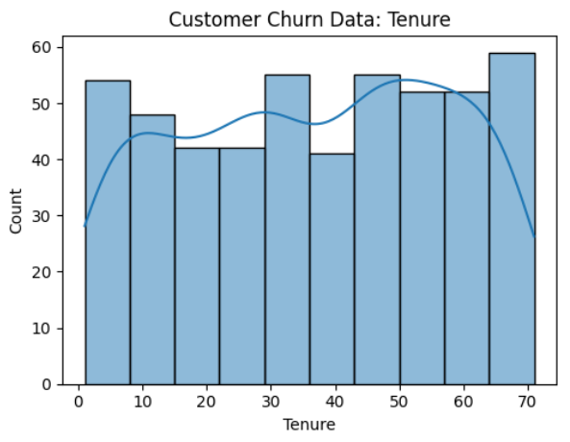
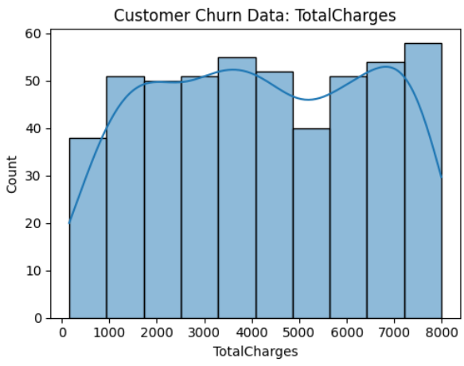
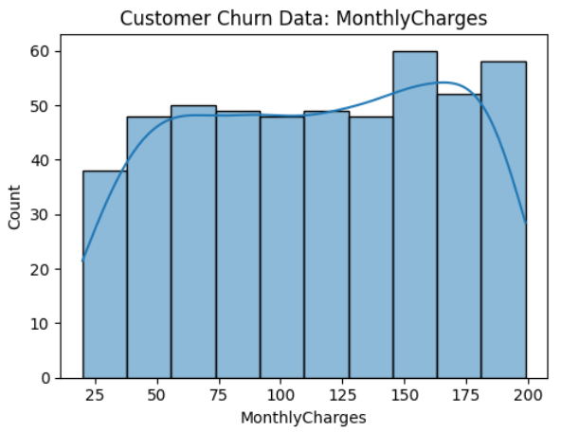
Churn — EDA (placeholders)

Slide 14
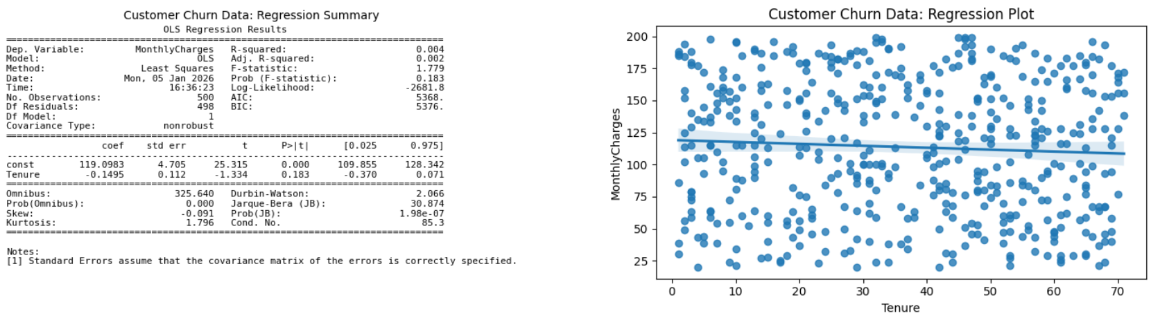
Churn — Regression (placeholders)

Slide 15
Churn — Key Insights
• Clear churn drivers identified
• Early risk detection possible
• Enables proactive retention

Slide 16
House Prices Analysis

Slide 17
House Prices — Business Problem
• Understand price determinants
• Predict prices
• Support real-estate decisions

Slide 18
House Prices — Data Preparation
• Removed outliers
• Handled missing values
• Normalized features

Slide 19
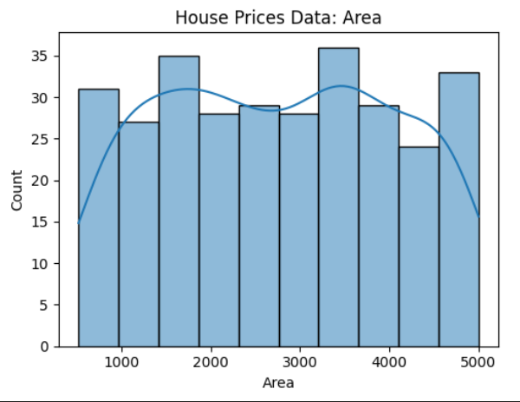
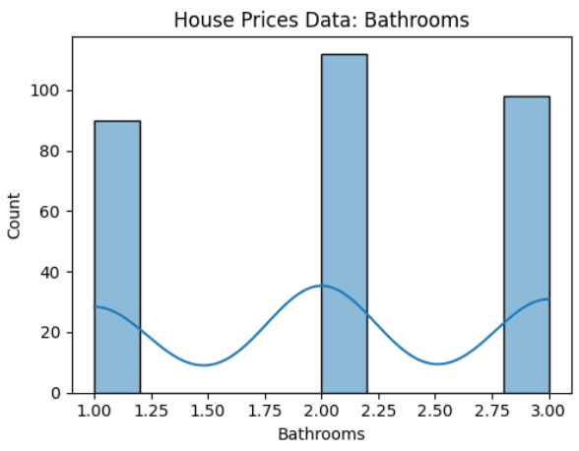
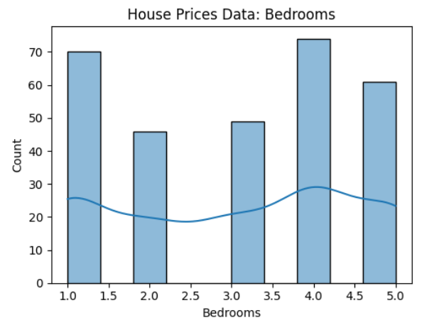
House Prices — EDA (placeholders)

Slide 20
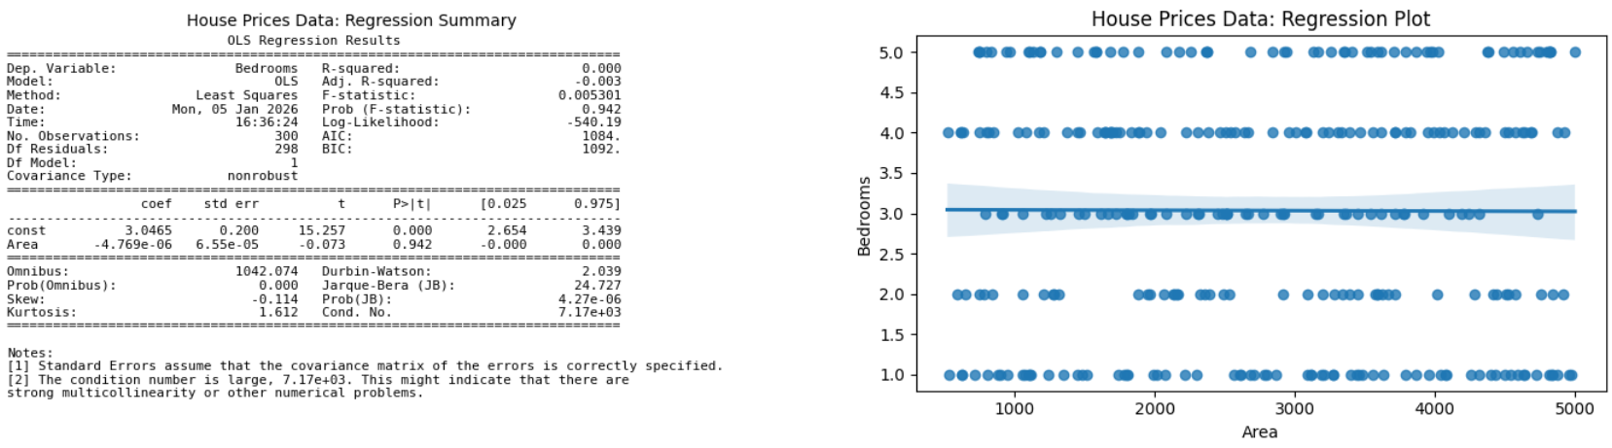
House Prices — Regression (placeholders)

Slide 21
House Prices — Key Insights
• Key features dominate pricing
• Linear relationships observed
• Supports valuation decisions

Slide 22
Combined Insights & Recommendations
• Data-driven decisions outperform intuition
• Statistical validation builds confidence
• Use models for forecasting & planning

Slide 23
Conclusion
• End-to-end analytics demonstrated
• Business insights delivered
• Ready for real-world deployment

