Slide 1
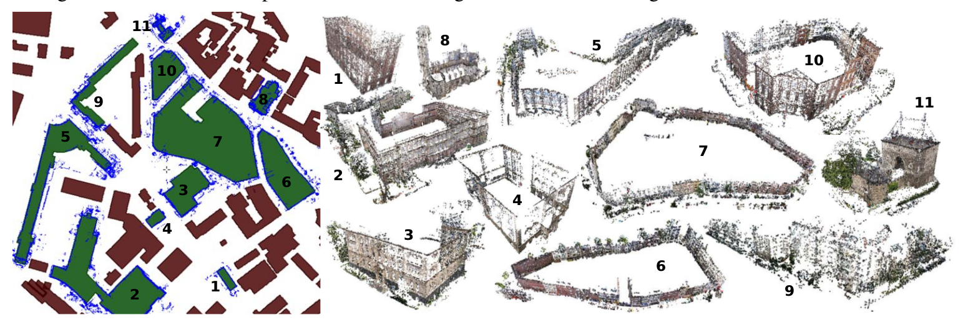
WP1: Segmenting the point cloud
Sparse point clouds of buildings and their registration to 2D outlines
2D “footprint” of the point clouds to enable registration onto OSM building outlines
Estimation of up-vector for detecting the ground plane
Segmenting the part of point cloud that forms the building's facades using point normals
Extracting building footprints by projecting the points onto ground plane
O. Untzelmann, T. Sattler, S. Middelberg, and L. Kobbelt. A scalable collaborative online system for city reconstruction. In Computer Vision Workshops (ICCVW), 2013 IEEE International Conference on, pages 644–651, Dec 2013.

