Slide 1
Registering Point Clouds to OSM Building Outlines
Anurag Sai Vempati
Wolf Vollprecht
Supervisor: Torsten Sattler

Slide 2
Introduction
Goal: Implement a method to reliably fit a SfM point cloud to 2D building shapes
Shapes are provided by OSM (manually generated by users)
Point cloud data acquired by SfM (from photographs)
Will help generate informative 3D landscapes of cities
Needs fewer resources and relies on user generated accurate OSM maps and any collection of images like Flickr.

Slide 3
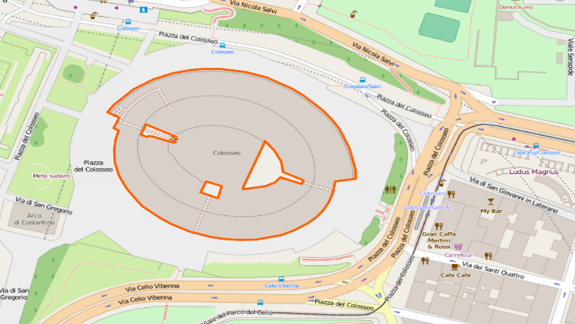
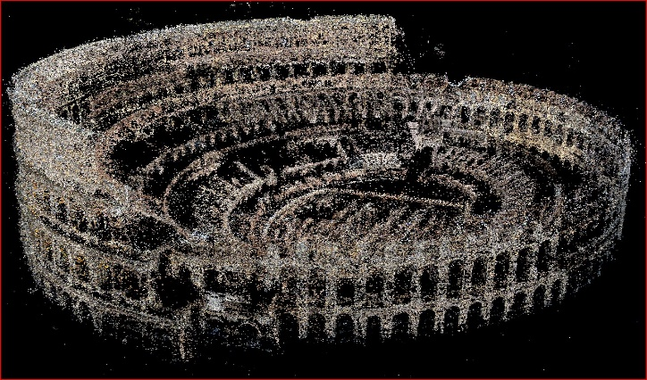
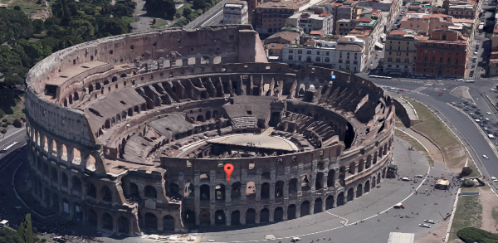

Motivation
Bridge the gap between different representations of the same entity
Build large-scale informative cityscapes
Accurate
Extensive
User generated
…
Easy to generate
Online photo collection
Quick and less demanding
…
COLOSSEUM

Slide 4
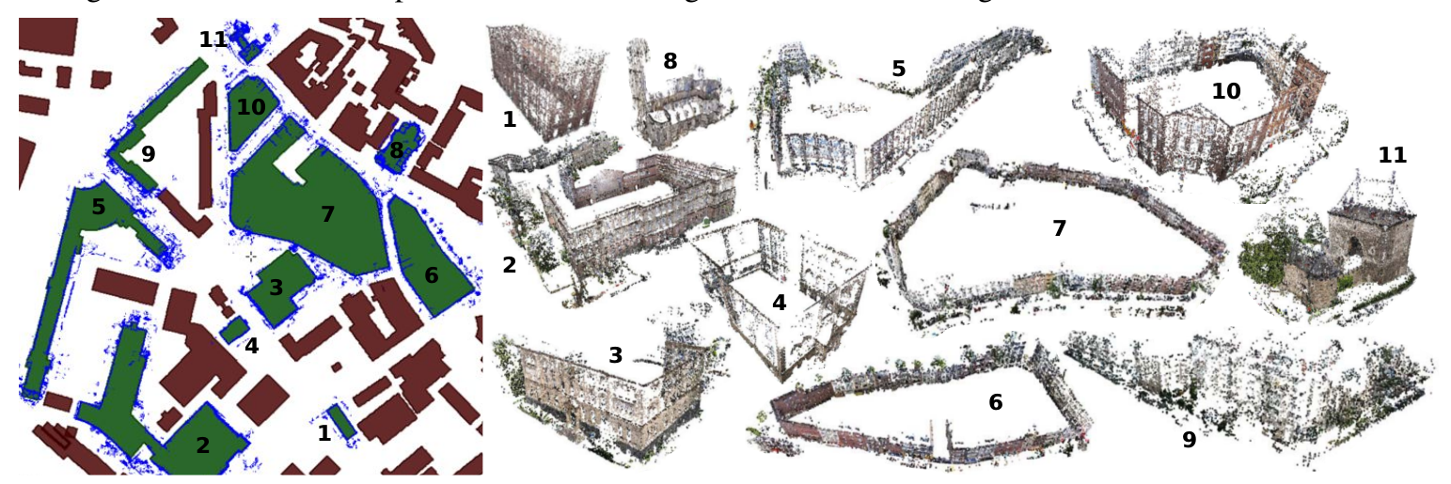
WP1: Segmenting the point cloud
SfM point clouds of buildings and their registration onto building outlines [1]
2D “footprint” of the point clouds to enable registration onto OSM building outlines
Estimation of up-vector for detecting the ground plane
Segmenting the part of point cloud that forms the building's facades using point normals
Extracting building footprints by projecting the points onto ground plane
[1] O. Untzelmann, T. Sattler, S. Middelberg, and L. Kobbelt. A scalable collaborative online system for city reconstruction. In Computer Vision Workshops (ICCVW), 2013 IEEE International Conference on, pages 644–651, Dec 2013.

Slide 5
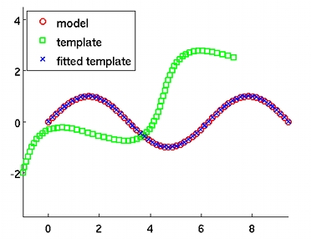
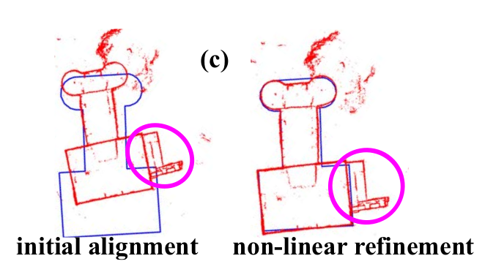
WP2: Aligning Point Cloud footprint with OSM data
Using “Iterative Closest Point” (ICP) algorithm for fitting building shapes
2D project building outlines into ground plane
If GPS available, use for initial fit
Evaluate removing undetectable things from OSM (holes, inside walls)

Slide 6
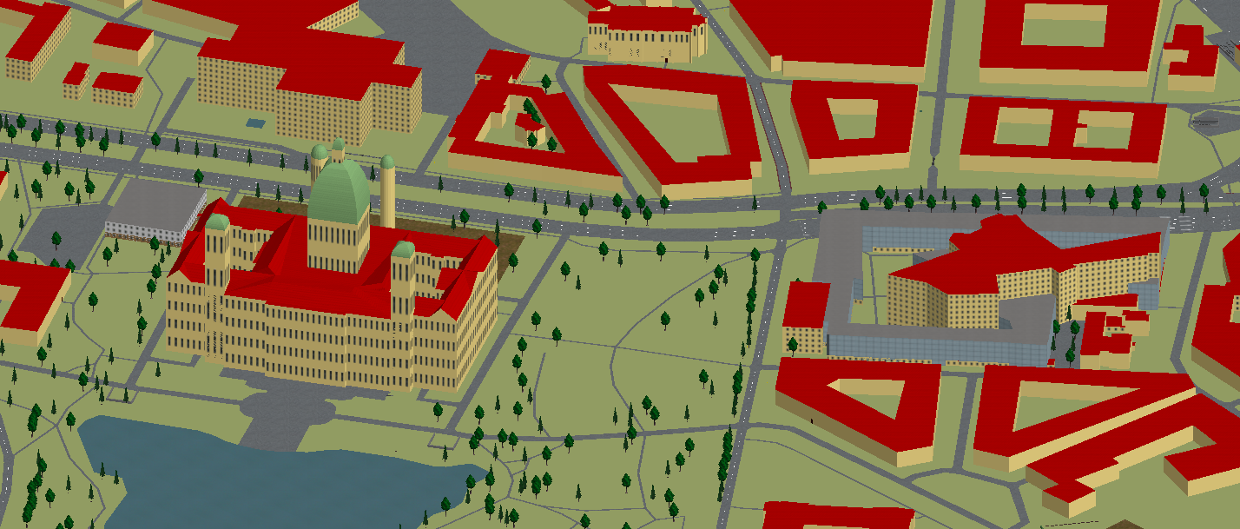
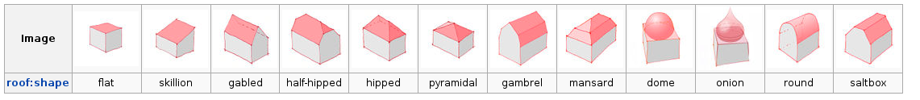
Further: Building Height + Roof Shape Estimation
Building height estimation from lowest and highest plane along upvector (can be contributed back to OSM)
Absolute value known because of merging with OSM data
Roof Shape estimation: Harder problem (point cloud on top sparse, because images taken from groundlevel)
Take images from above, or use symmetry, and maybe human input to estimate roof shapes

Slide 7

Thank You!!
Questions??

