Slide 1


Implementing Multi-Party Computation from Quantum Oblivious Transfers
Dave van Wijk
Supervised by: Dr. Garazi Muguruza Lasa, Prof. dr. Paola Grosso

Slide 2
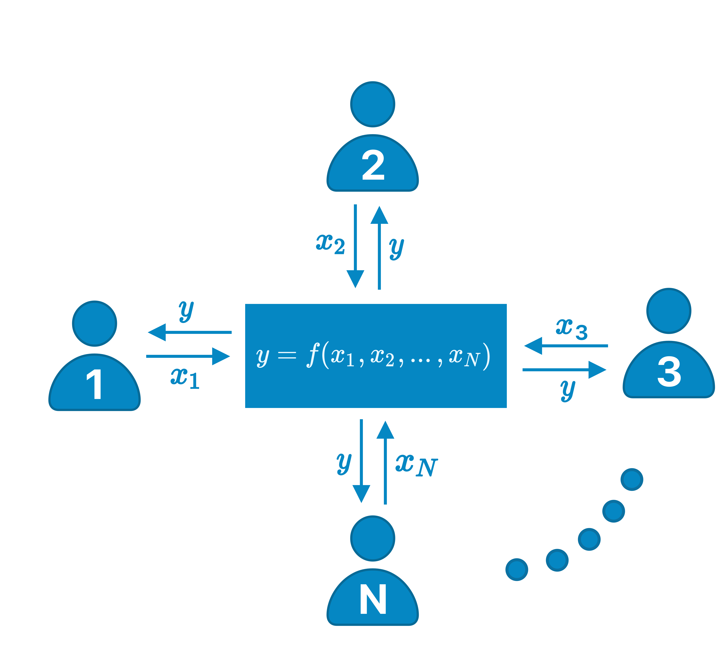
Multiparty Computation (MPC)
Carrying out a joint computation of a function among multiple parties in a secure manner.
No additional data known beyond what can be derived from the result
Notes:
Ç√

Slide 3
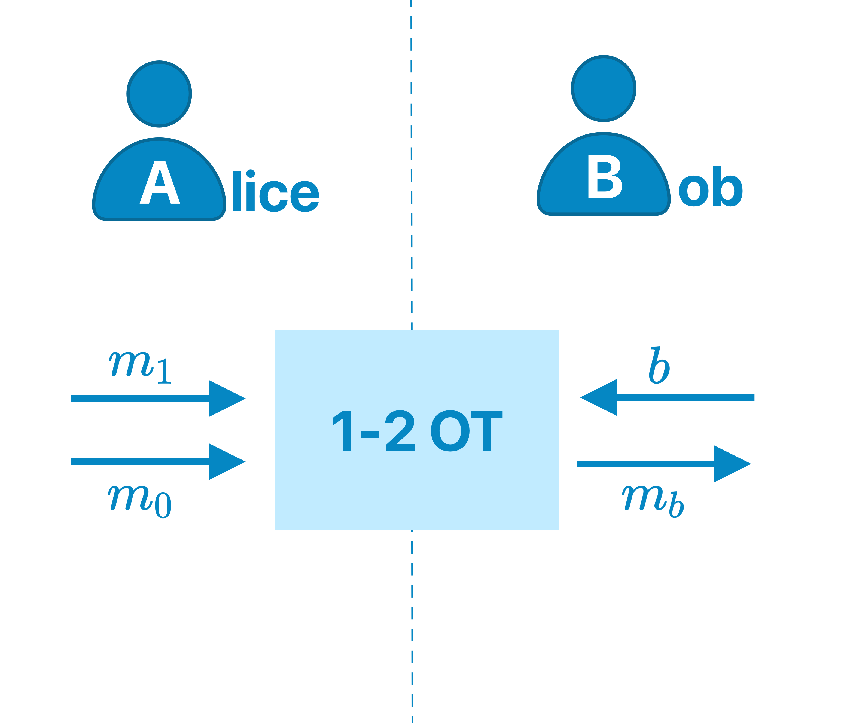
Oblivious Transfer (OT)
A sender transfers multiple pieces of information, but remains oblivious as to what has been transferred
Key building block for MPC protocols
Requires PKI
Relies on computational hardness of Asymmetric encryption
Different variants:
Bit, 1-2, 1-N
Rabin
Notes:
Ç√

Slide 4
Oblivious Transfer (OT)
Are you Shor about that?
A sender transfers multiple pieces of information, but remains oblivious as to what has been transferred
Several computational hard problems can be broken by Quantum computation.
Breaking assymetric encryption -> PKI -> OT -> MPC
Key building block for MPC protocols
Requires PKI
Relies on computational hardness of Asymmetric encryption
Different variants:
Bit, 1-2, 1-N
Rabin
Notes:
Ç√

Slide 5
Oblivious Transfer (OT)
Are you Shor about that?
A sender transfers multiple pieces of information, but remains oblivious as to what has been transferred
Several computational hard problems can be broken by Quantum computation.
Breaking assymetric encryption -> PKI -> OT -> MPC
Key building block for MPC protocols
Requires PKI
Relies on computational hardness of Asymmetric encryption
Different variants:
Bit, 1-2, 1-N
Rabin
Notes:
Ç√

Slide 6
Quantum Cryptography
Quantum mechanics makes it is impossible to measure an arbitrary quantum system's state without disturbing it, making eavesdropping detectable.
Quantum Key Distribution
Two communication techniques:
Prepare-and-measure
Transmission of individual quantum states from the sender to the receiver
Entanglement-based
Measurement outcomes are correlated, even when spatially separated
Notes:
Ç√

Slide 7
Quantum Cryptography
Quantum mechanics makes it is impossible to measure an arbitrary quantum system's state without disturbing it, making eavesdropping detectable.
Quantum Key Distribution
Two communication techniques:
Prepare-and-measure
Transmission of individual quantum states from the sender to the receiver
Entanglement-based
Measurement outcomes are correlated, even when spatially separated
Hanouz et al.
Notes:
Ç√

Slide 8
Quantum Cryptography
Quantum mechanics makes it is impossible to measure an arbitrary quantum system's state without disturbing it, making eavesdropping detectable.
Quantum Key Distribution
Two communication techniques:
Prepare-and-measure
Transmission of individual quantum states from the sender to the receiver
Entanglement-based
Measurement outcomes are correlated, even when spatially separated
Hanouz et al.
Us!
Notes:
Ç√

Slide 9
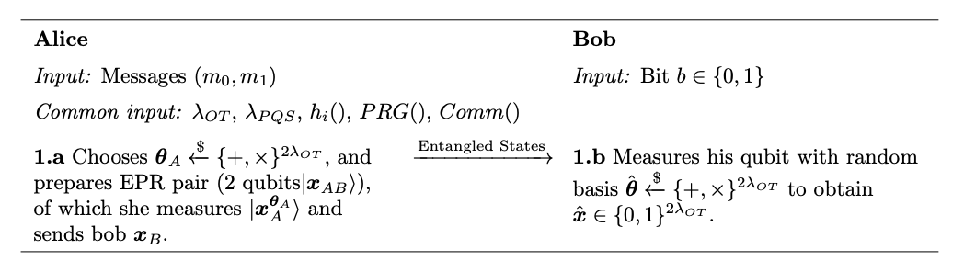
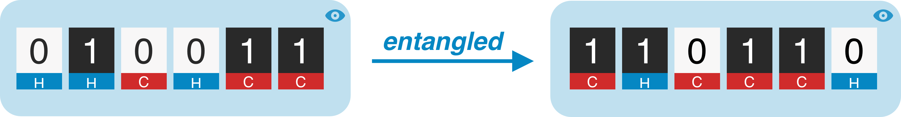
Quantum Oblivious Transfer (QOT)
Step 1: State Distrubution
Notes:
Ç√

Slide 10
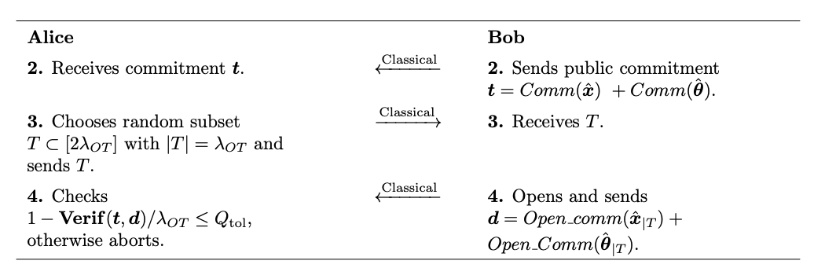
Quantum Oblivious Transfer (QOT)
Step 2: Bit commitment
r = Random nonce
t = SHA-256(b||r)
Notes:
Ç√

Slide 11
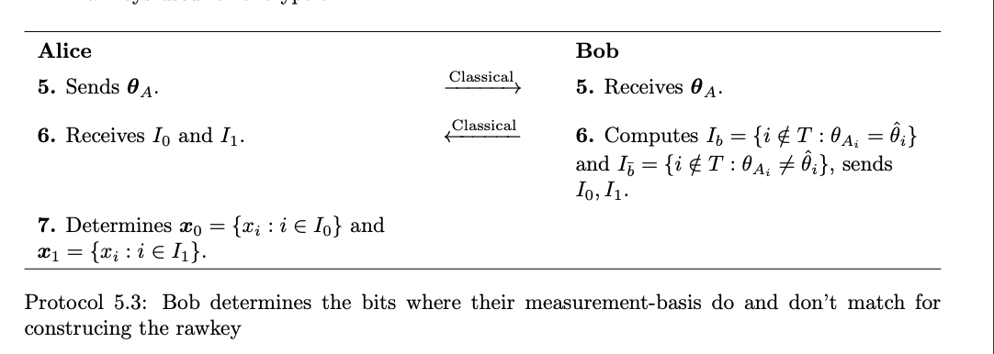
Quantum Oblivious Transfer (QOT)
Step 3: Basis Reconciliation
Notes:
Ç√

Slide 12
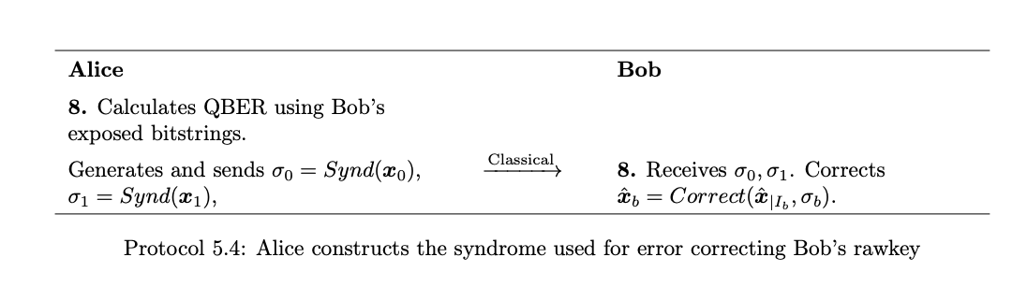
Quantum Oblivious Transfer (QOT)
Step 4: Error Correction
Reed–Solomon vs low-density parity-check (LDPC) codes
Notes:
Ç√

Slide 13
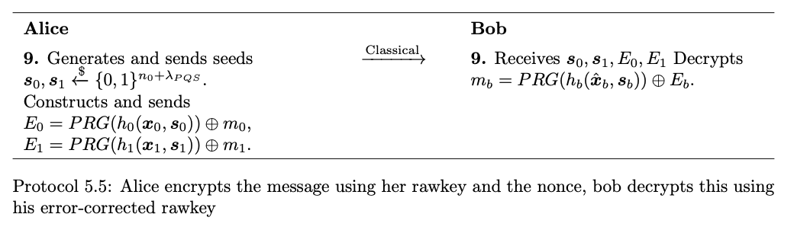
Quantum Oblivious Transfer (QOT)
Step 5: Encryption
Carter–Wegman vs Toeplitz hash
Notes:
Ç√

Slide 14
QOT Optimal Configuration – Error correction
LDPC Error correction outperforming RS
Clear turning point at 0.3-0.4 ->
From literature known that higher scores are posible
Figure 5.2: Comparison between success rates for the current and optimistic scenarios as a function of the leakage rate.
For each data point the parameter. Showing RS (left) with λ_{OT} = 256, and LDPC error correction (right) with λ_{OT} = 7680
Notes:
Ç√

Slide 15
QOT – Performance
Carter-Wegman hashing scales better than Toeplitz
Post processing remains insignificant compared to QCommunication
Figure 5.4: Measured time taken to hash a random bitstring with a given length for the two different hashes.
Figure 5.5: Time taken from the start of the protocol until the attempt at decoding the chosen message.
Notes:
Ç√

Slide 16
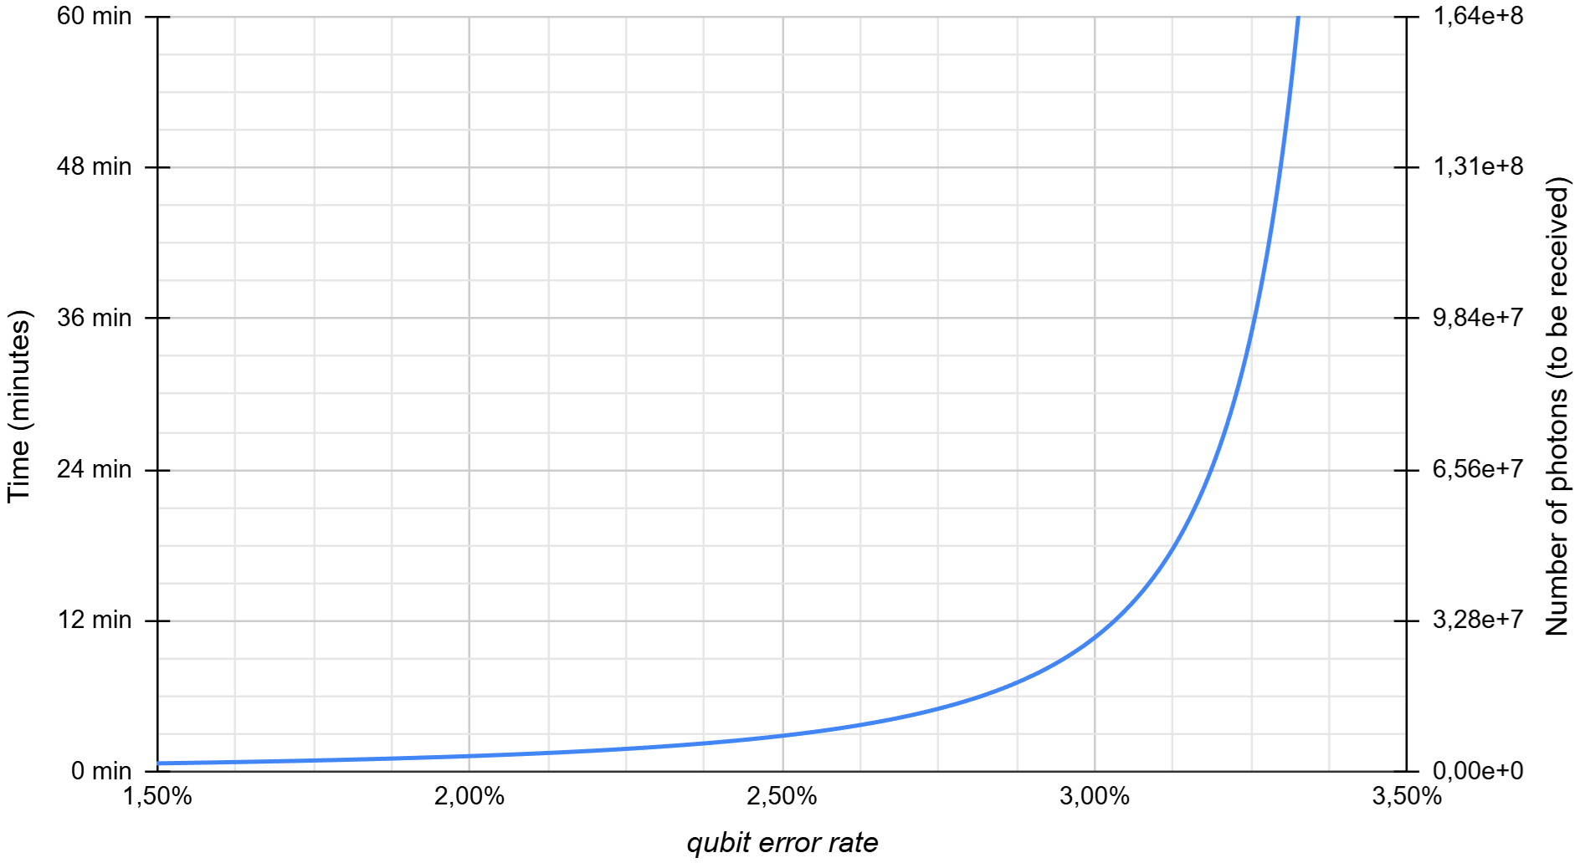
QOT – Performance
Scales linearly for sufficient Leakage Rate,
λ_{OT} = 6000 per hour, so 200 EPR pairs per minute
Obliterated by Qline, which performs 1.4 × 10⁴ times better.
Figure 5.6: Our average time needed to obtain a successful 1-2 QOT execution.
Figure 5.7: Estimation of the number of qubits and corresponding time to perform one OT on Qline
Notes:
Ç√

Slide 17
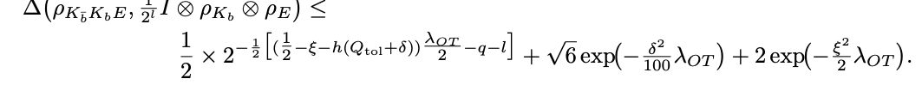
QOT – Error Bound
Difference between real and ideal state of security
Calculate minimum λ_{OT} for a set security parameter (ϵ_{sec} = 2⁻²²) and 3 leakage rates
Minimum λ_{OT} of 4 × 10⁶
Comes down to weeks of runtime for one OT
Figure 5.8: Minimal λ_{OT} as a function of the QBER for different leakage rates λ_{ℓ}.
Notes:
Ç√

Slide 18
QOT – Variants Performance
Bit/Base OT 1 QOT
1-2 String OT 1 QOT
1-N String OT Log₂(N) calls to QOT, potential for Log(N)
Rabin OT Set N based on erasure probability
Notes:
Ç√

Slide 19
Main Findings
Succesfully implemented 1-out-of-2 quantum oblivious transfer protocol in an entanglement-based quantum-network simulator
To conclude, getting rid of PKI does not justify the time requirements associated with QOT. Outperformed by cOT and Prepare and measure.
LDPC codes outperform RS and Carter–Wegman outperforms Toeplitz hashing.
Still, for optimistic scenario and ϵ_{sec} = 2⁻²² , transfer would take over a month.
Variants of OT for MPC don’t add much overhead
Notes:
Ç√

