Slide 1
Embedded System Design lecture 12_13
--Processor(2)_hazard
Jun WANG

Slide 2
Contents
Learnt from last test example
Hazard
  Structure
  Data
    Arithmetic
      Software solution
        NOP
      Hardware solution
        Data forwarding
    LOAD
      Software solution
        NOP
      Hardware solution
        Stall
  Control

Slide 3
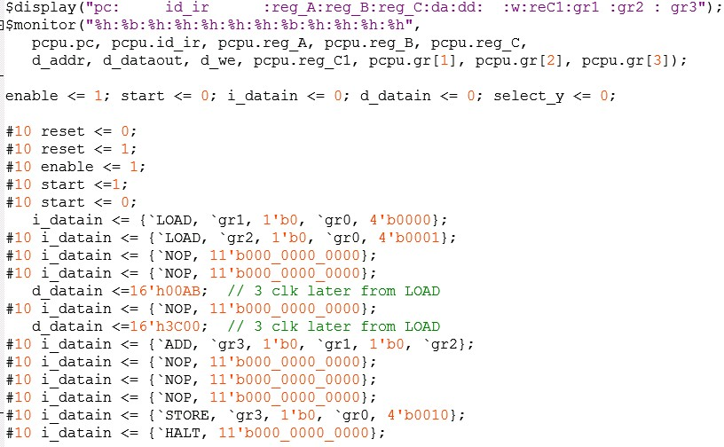
Example of test pattern (texture simulation)
LOAD gr1, gr0, 0
LOAD gr2, gr0, 1
NOP
NOP
NOP
ADD gr3, gr1, gr2
NOP
NOP
NOP
STORE gr3, gr0, 2
HALT

Slide 4
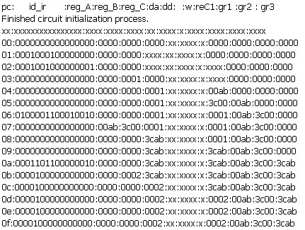
Simulation results (texture)
Please test by yourself, and analyse it
LOAD gr1, gr0, 0
LOAD gr2, gr0, 1
NOP
NOP
NOP
ADD gr3, gr1, gr2
NOP
NOP
NOP
STORE gr3, gr0, 2
HALT

Slide 5
Hazards
Situations that prevent starting the next instruction in the next cycle
Structure hazards
  A required resource is busy
Data hazard
  Need to wait for previous instruction to complete its data read/write
Control hazard
  Deciding on control action depends on previous instruction

Slide 6
Structure Hazards
Conflict for use of a resource
In X86（by intel） pipeline with a single memory
  Load/store requires data access
  Instruction fetch would have to stall for that cycle
    Would cause a pipeline “bubble”
  So called von Neumann structure
In ARM/MIPS pipeline
  separate instruction/data caches
  So called Harvard structure

Slide 7
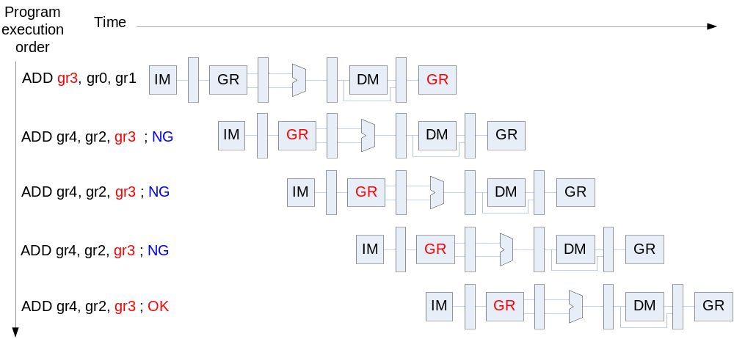
Data Hazards
An instruction depends on completion of data access by a previous instruction

Slide 8
Solution
Software
  Insert 3 NOPs
Hardware
  Data forward
    For arithmetic op
  Data forward & Stall
    For LOAD

Slide 9
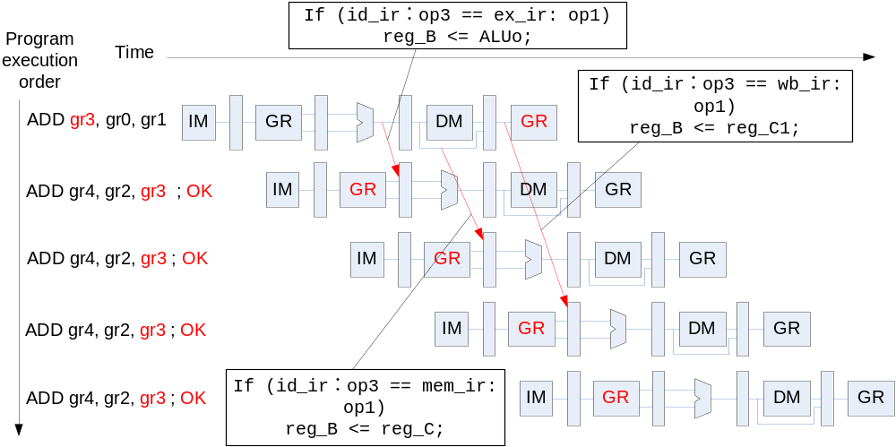
Data forwarding
Data forwarding happens in ID stage, always check id_ir to decide reg_A/B

Slide 10
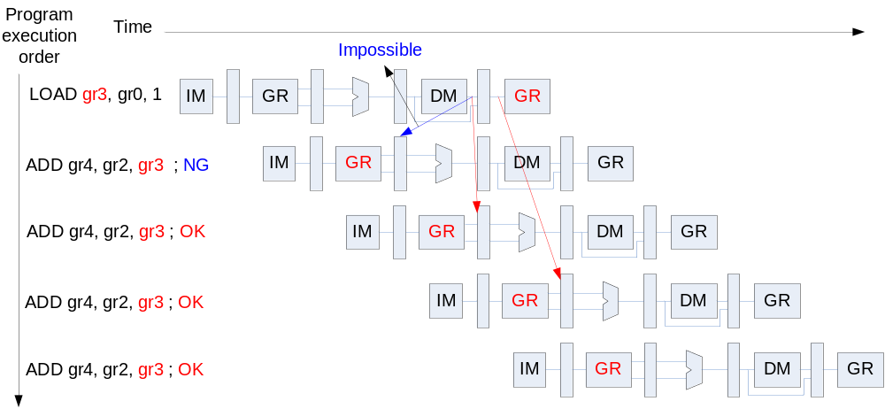
Can’t always forwarding
“LOAD” can still cause hazard
  since data was accessed from data memory
    after reg_C

Slide 11
Solution
Software
  Insert 3 NOPs
Hardware
  Joint usage of Data forwarding & Stall
    Data forwarding to solve 2nd and 3rd NOPs
    Stall to sove 1st NOP

Slide 12
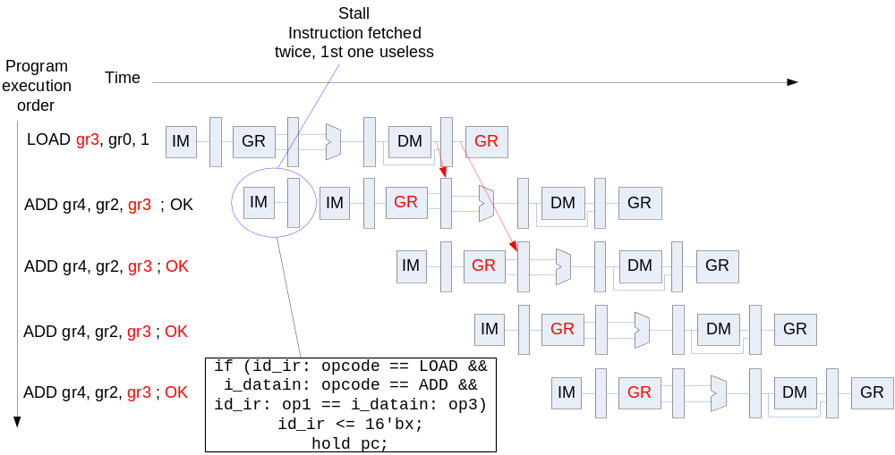
Stall
Stall the pipeline by keeping an instruction in the same stage
Stall happens in IF stage, always compare id_ir with i_datain to decide pc and id_ir

Slide 13
Control Hazard
When CPU decide to branch, other instructions are still in pipeline!!
  During the time from branch instruction fetch to branch address generate (from IF to ID to EX to IF, 3 stages),
  the 3 instructions followed by branch are in pipeline.
    The computing results by them are useless
    Should be flushed
      or will impact the following instructions computing

Slide 14
Solution
Software
  Insert 3 NOPs
  Insert independent operations
Hardware
  Flushing
I am not going to more detail…

Slide 15
Summary
Hazard
  Structure
  Data
    Arithmetic
      Software solution
        NOP
      Hardware solution
        Data forwarding
    LOAD
      Software solution
        NOP
      Hardware solution
        Stall
  Control
      Software solution
        NOP
        Independent operation
      Hardware solution
        Flushing

Slide 16
Use hazard to understand test pattern
Control Hazard is an optional topic, you do not need to implement hazard by verilog
  but your implementation is highly recommended and scored
  Submit by the final examination day
Data hazard (including forwarding and stall) you MUST finish by the final examination day, and submit
  Both design and test
Understand how to write test pattern for your verilog
  Always insert 3 NOPs
  But please be more smart…

Slide 17
Next
Board evaluation

