Slide 1
Embedded System Architecture lecture 10_11
--Processor(1)_stages
Jun WANG

Slide 2
Contents
Operation field
Storage and access
Operations
Top-view and block diagram
Verilog for stages

Slide 3
Design target
RISC CPU
Data path 16b
Data memory
  2⁸ X 16b
Operation memory:
  2⁸ X 16b
  Size of operation set: 2⁵
General register
  8 X 16b
Flags
  NF, ZF, CF
Control
  Clock, reset, enable, start
Testing
  4 bit selection for 16 bit output

Slide 4
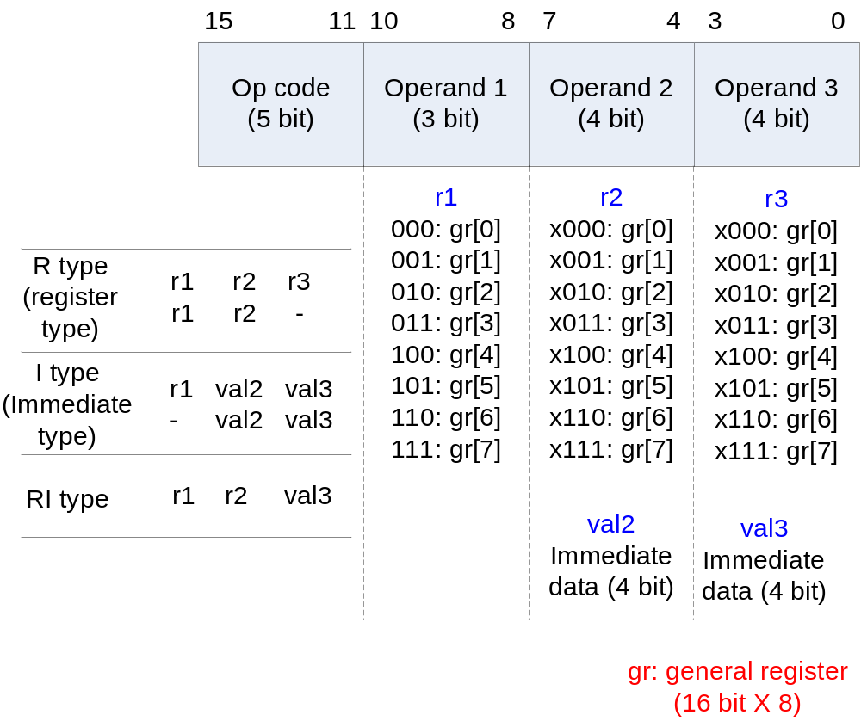
Operation field

Slide 5
Access memory and register
Access register:
  Ex. gr[r1],
  r1 for simplification
  [r1]/r1gets register number
Access memory:
  Ex. m[r2+val3],
  [r2+val3]/[gr(r2)+val3] gets address of memory
Access immediate data:
  Ex. {val2, val3},
  MSB: val2, LSB:val3

Slide 6
An example of operation codes (assemble language)
LOAD gr1, gr0, 0
LOAD gr2, gr0, 1
NOP
NOP
NOP
ADD gr3, gr1, gr2
NOP
NOP
NOP
STORE gr3, gr0, 2
HALT
In C code:
Y = A + B
M[gr0+2] =M[gr0+1]+M[gr0+0]

Slide 7
Operation
Data transfer & Arithmetic
mnemonic | operand1 | operand2 | operand3 | op code | operation
NOP * |  |  |  | 00000 | no operation
HALT * |  |  |  | 00001 | halt
LOAD * | r1 | r2 | val3 | 00010 | gr[r1]<-m[r2+val3]
STORE * | r1 | r2 | val3 | 00011 | m[r2+val3]<-r1
LDIH | r1 | val2 | val3 | 10000 | r1<-r1+{val2, val3, 0000_0000} (lower 8’b0 can be given with ADDI)
ADD * | r1 | r2 | r3 | 01000 | r1<-r2+r3
ADDI | r1 | val2 | val3 | 01001 | r1<-r1+{val2, val3}
ADDC | r1 | r2 | r3 | 10001 | r1<-r2+r3+CF
SUB | …
SUBI | …
SUBC | …
CMP * |  | r2 | r3 | 01100 | r2-r3; set CF,ZF and NF
*: operations have been implemented in the following verilog

Slide 8
Operation
Logical / shift
mnemonic | operand 1 | operand2 | operand3 | op code | operation
AND | r1 | r2 | r3 | 01101 | r1<-r2 and r3
OR | …
XOR | …
SLL | r1 | r2 | val3 | 00100 | r1<-r2 shift left logical (val3 bit shift)
SRL | …
SLA | r1 | r2 | val3 | 00101 | r1<-r2 shift left arithmetical (val3 bit shift)
SRA | …
Logical shift: 1001 SRL 2b → 0010 (append 0)
Arithmetical shift: 1001 SRA 2b → 1110 (keep the sign)

Slide 9
Operation
  Flag registers:
    -Used for control operations (conditional branch)
    -ZF (zero flag), NF (negative flag), CF (carry flag)
Control
mnemonic | operand 1 | operand2 | operand3 | op code | operation
JUMP |  | val2 | val3 | 11000 | jump to {val2, val3}
JMPR | r1 | val2 | val3 | 11001 | jump to r1+{val2, val3}
BZ * | r1 | val2 | val3 | 11010 | if ZF=1 branch to r1+{val2, val3}
BNZ | r1 | val2 | val3 | 11011 | if ZF=0 branch to r1+{val2, val3}
BN * | r1 | val2 | val3 | 11100 | if NF=1 branch to r1+{val2, val3}
BNN | …
BC | r1 | val2 | val3 | 11110 | if CF=1 branch to r1+{val2, val3}
BNC | …

Slide 10
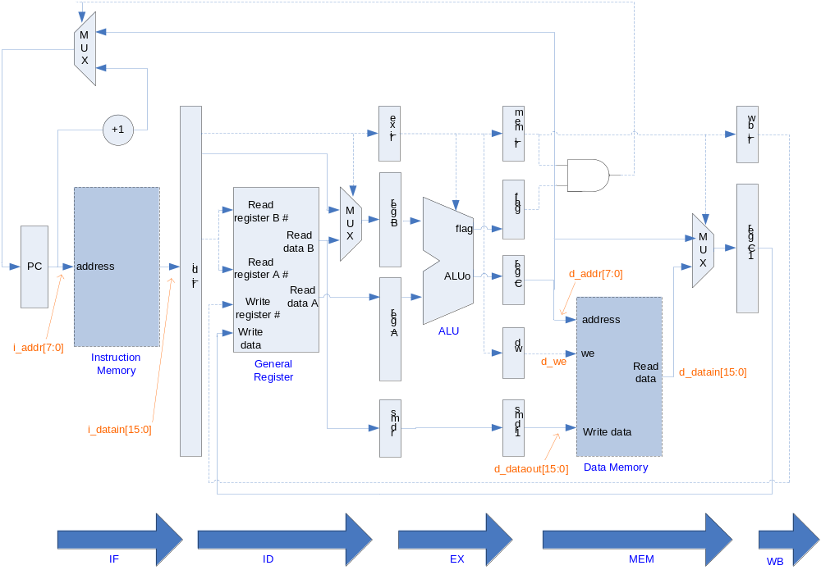
Block diagram
smdr: data for save memory directly
Use LOAD, STORE, ADD, BZ to help you understand this graph

Slide 11
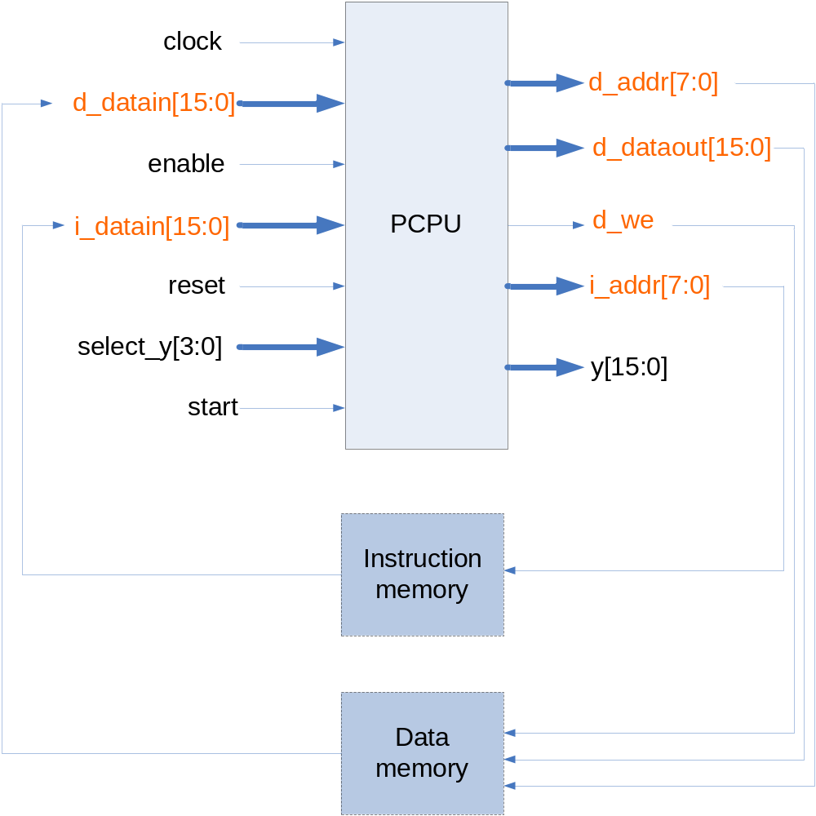
Top view

Slide 12
Storage
Outside CPU
  Instruction storage
    Instruction memory (2⁵ X 16b)
  Data storage
    Data memory (2⁸ X 16b)
Inside CPU
  Instruction storage
    Stage instruction registers
      id_ir(16b x1), ex_ir (16b x 1), mem_ir (16b x 1), wb_ir (16b x 1)
  Data storage
    General registers
      Storage for operand data (2³ X 16b)
    Stage data registers
      @ID: reg_A (16b x 1), reg_B (16b x 1), smdr (16b x 1),
      @EX : reg_C (16b x 1), flag (1b x3), dw (1b x1), smdr1 (16b x 1),
      @WB: reg_C1 (16b x 1)

Slide 13
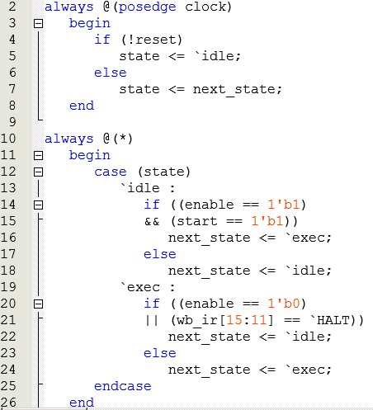
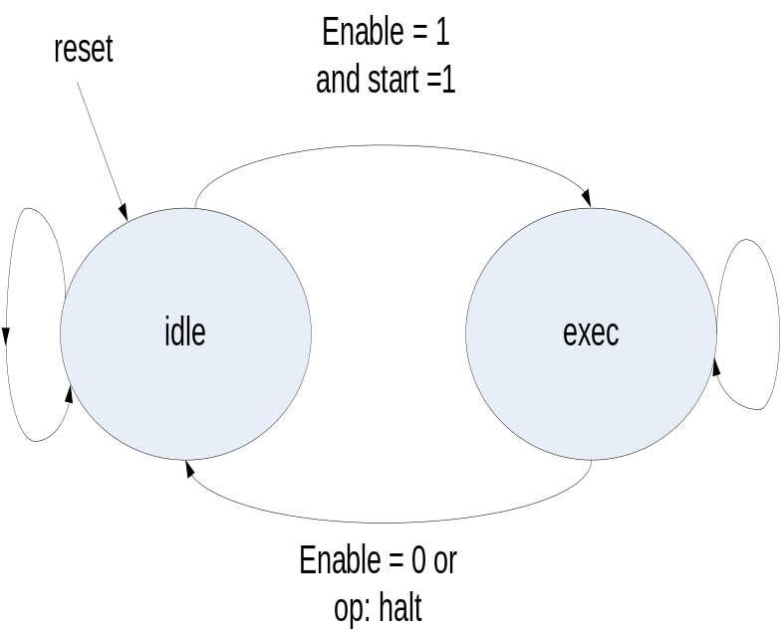
CPU control

Slide 14
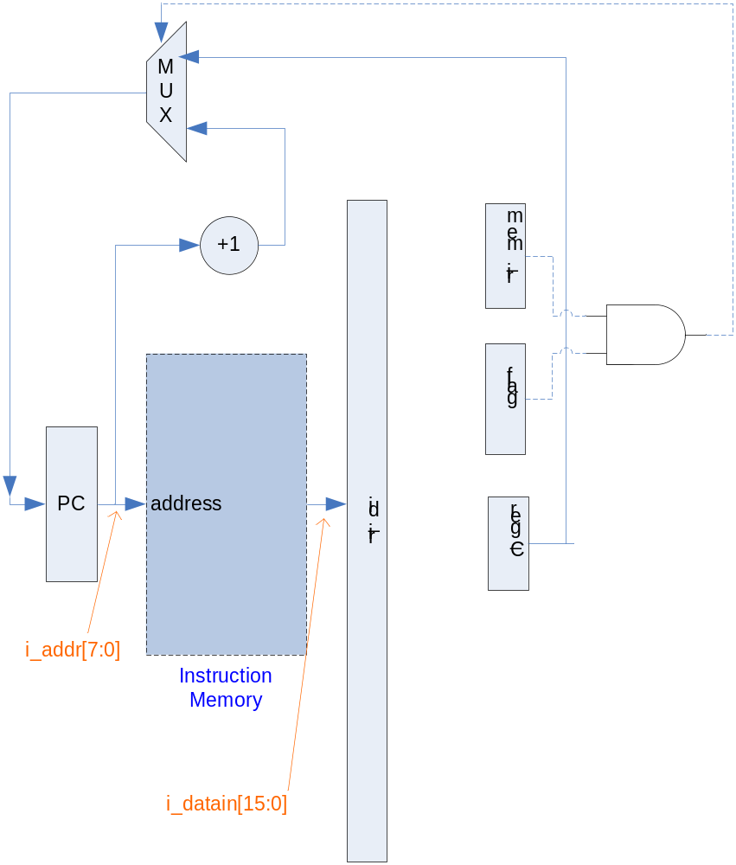
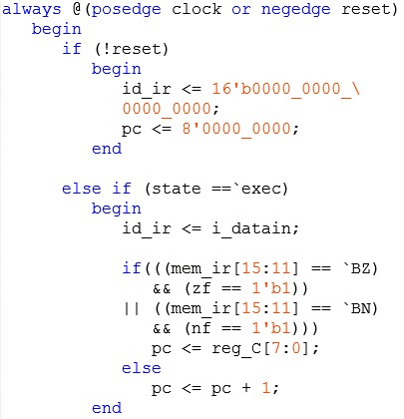
IF

Slide 15
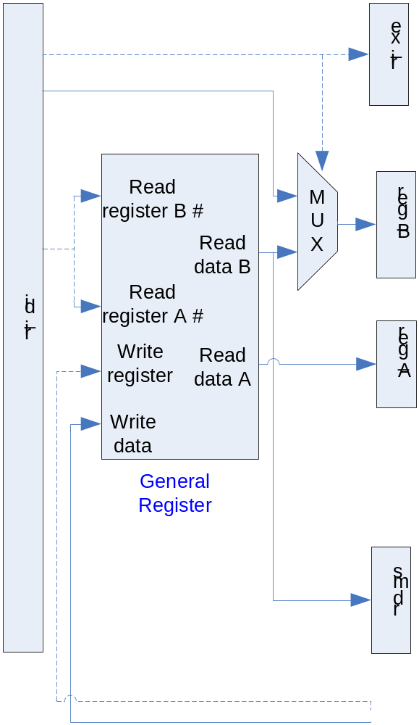
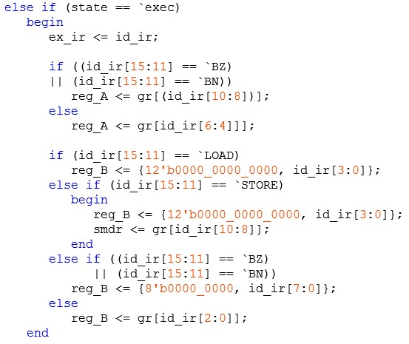
ID
reg_A: 1st input operand of ALU, always gr[]
reg_B: 2nd input operand of ALU, gr[] or val
smdr: used only for STORE
operand1: r1
operand2: r2
operand3: val3
Note latch!!
operand2,3: val2+val3
operand3: r3

Slide 16
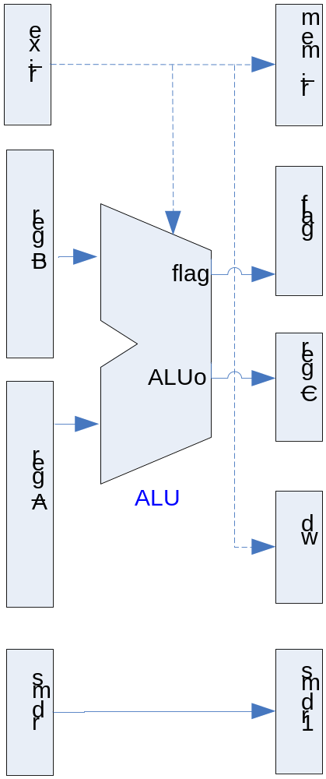
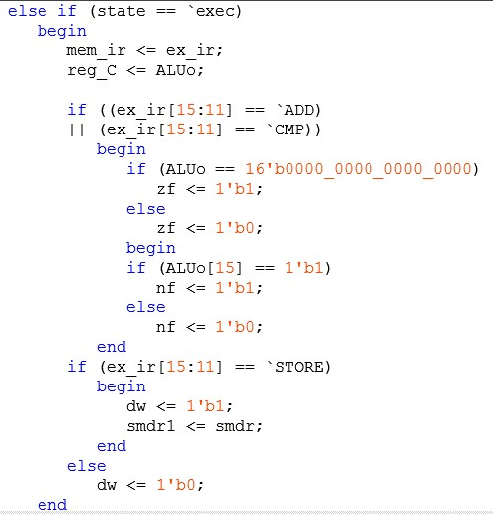
EX
Note latch !

Slide 17
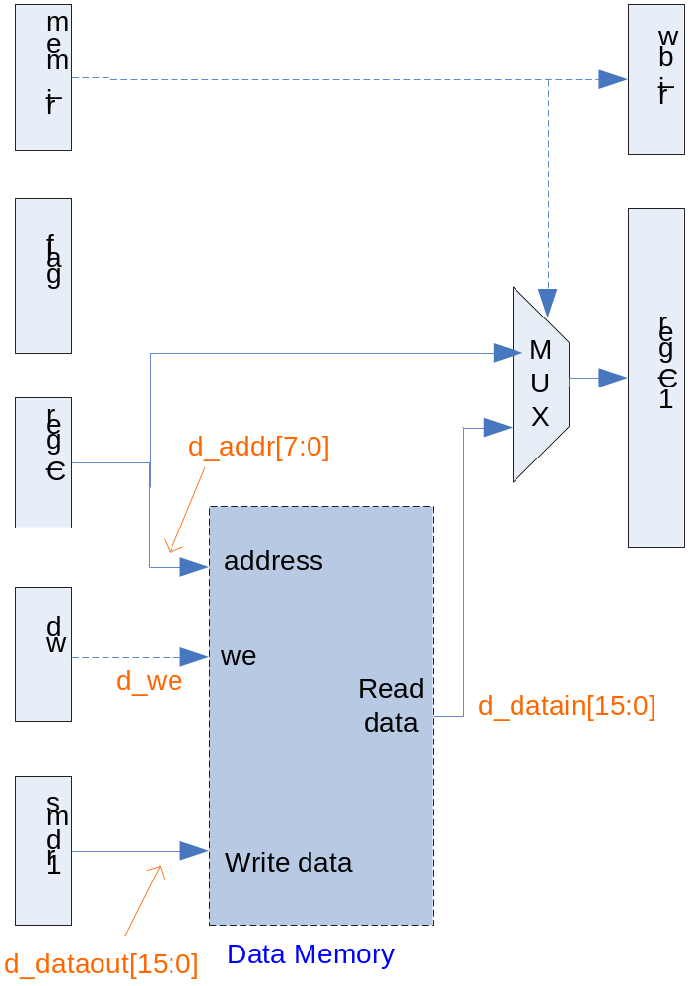
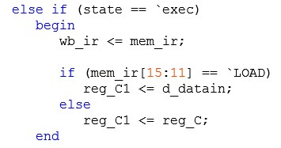
MEM

Slide 18
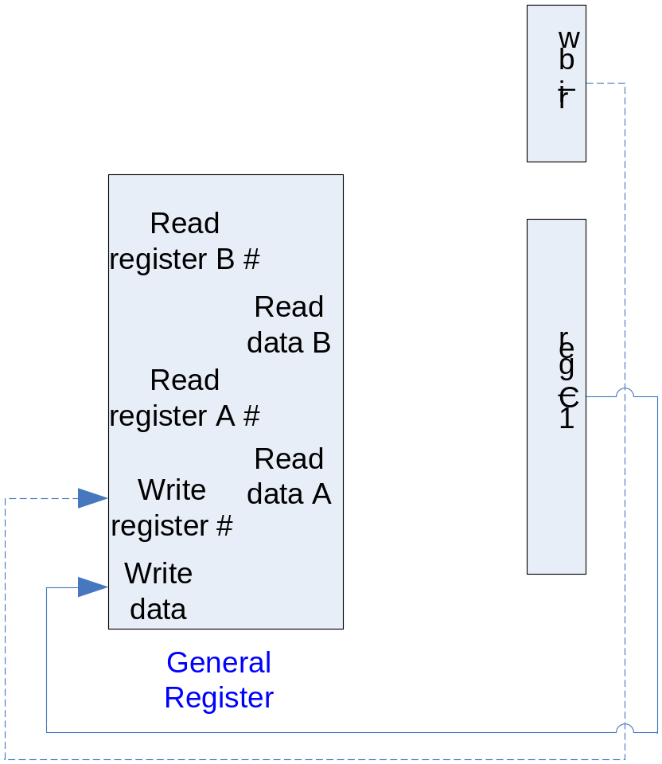
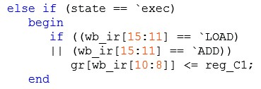
WB
Note latch !

Slide 19
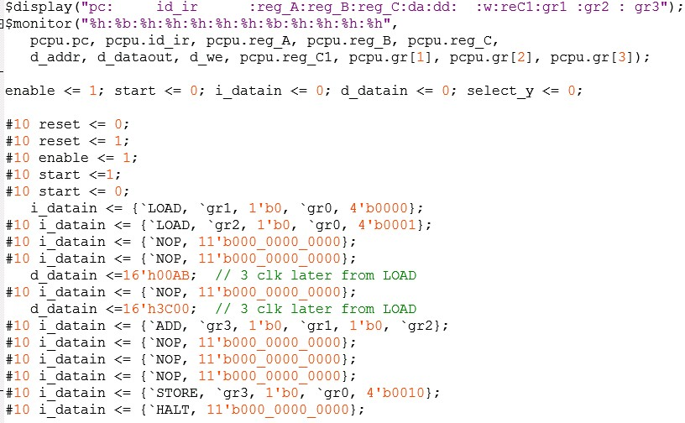
Example of test pattern (texture simulation)
LOAD gr1, gr0, 0
LOAD gr2, gr0, 1
NOP
NOP
NOP
ADD gr3, gr1, gr2
NOP
NOP
NOP
STORE gr3, gr0, 2
HALT

Slide 20
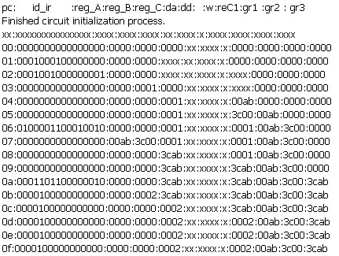
Simulation results (texture)
Please test by yourself, and analyse it
reset
LOAD gr1, gr0, 0
LOAD gr2, gr0, 1
NOP
NOP
NOP
ADD gr3, gr1, gr2
NOP
NOP
NOP
STORE gr3, gr0, 2
HALT

Slide 21
Labs
1, Complete the designs above
  Complete the verilog with variable declarations
  Simulate by the test pattern (texture simulation)
2, Add more to your verilog
  Complete the left operations other than * ones
    LDIH, ADDI,ADDC, …
  Add flag register
    CF
  Add your original operations
    You can add up to 5 ops with unused codes: 10011, 10100, 10101, 10110, 10111.
  Design you own test patterns
Submit your report due to Dec 19th
  Your own operation set description (like the table in slide#7/8/9), verilog, testbench
  snapshot of simulation (texture only), RTL snapshots, design report (timing/area/power). Note: no board verification
  Impression (感想) on this project

Slide 22
Hazards
Situations that prevent starting the next instruction in the next cycle
Structure hazards
  A required resource is busy
Data hazard
  Need to wait for previous instruction to complete its data read/write
Control hazard
  Deciding on control action depends on previous instruction

Slide 23
Structure Hazards
Conflict for use of a resource
In X86（by intel） pipeline with a single memory
  Load/store requires data access
  Instruction fetch would have to stall for that cycle
    Would cause a pipeline “bubble”
  So called von Neumann structure
In ARM/MIPS pipeline
  separate instruction/data caches
  So called von Harvard structure

Slide 24
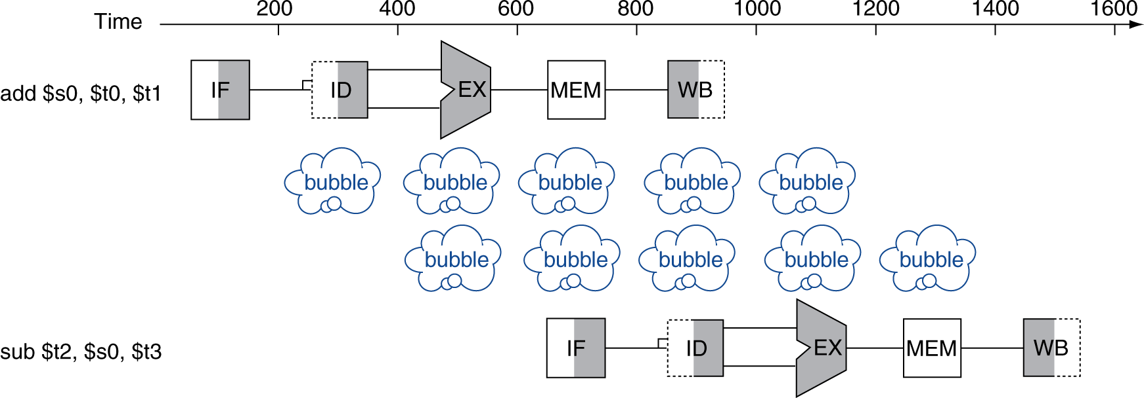
Data Hazards
An instruction depends on completion of data access by a previous instruction
  add $s0, $t0, $t1
  sub $t2, $s0, $t3

Slide 25
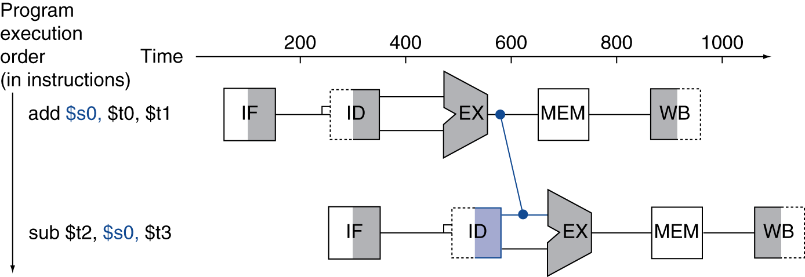
Forwarding (aka Bypassing)
Use result when it is computed
  Don’t wait for it to be stored in a register
  Requires extra connections in the datapath

Slide 26
Next
Pipeline Hazard

