Slide 1



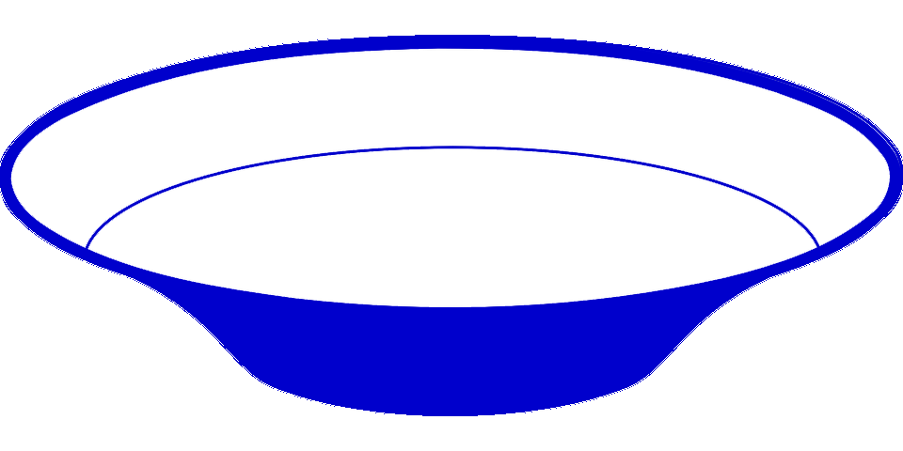

Stage | Example Species (phila) | Synthesis of the Medium and Small proteins | Function of the Medium and Small proteins | B12 pathway (anaerobic) | Large subunit (chlH/cobN) | CHL pathway | B12 pathway (aerobic)
1 | Methanobacterium paludis (Archaea) Thermoplasma acidophilum (Archaea) |  | Unknown | Yes | - | - | -
2 | Spirochaeta thermophila (Spirochaetes) Brevefilum fermentans (Chloroflexi) |  | Unknown | - | - | - | -
3 | Thermodesulfobacterium commune (Thermodesulfobacteria) Thermodesulfovibrio yellowstonii (Nitrospirae) |  | Unknown | - | - | - | -
4 | Polynucleobacter duraquae (Proteobacteria) |  | Mg-chelatase (small and medium subunits) | - | chlH | Yes | -
5 | Halorhodospira halophila (Proteobacteria) Thiocystis violascens (Proteobacteria) |  | Mg-/Co-chelatase (small and medium subunits) | Yes | chlH | Yes | Yes
6 | Synechococcus elongatus (Cyanobacteria) Prochlorococcus marinus (Cyanobacteria) |  | Mg- and Co- chelatases (small and medium subunits) | Yes | chlH + cobN | Yes | Yes
7 | Rhodospirillum rubrum (Proteobacteria) Dinoroseobacter shibae (Proteobacteria) Rhodovulum sulfidophilum (Proteobacteria) |  | Mg- and Co- chelatases (small and medium subunits)* | Yes | chlH + cobN | Yes | Yes
8 | Mycobacterium tuberculosis (Actinobacteria) Prauserella marina (Actinobacteria) |  | Small and medium subunits of Co- chelatases | Yes | cobN | - | Yes
9 | Pseudomonas aeruginosa (Proteobacteria) Methanocaldococcus fervens (Archaea) |  | Small and medium subunits of Co- chelatases | Yes | cobN | - | Yes
chlD
Frameshifting
fs-chlD
Yes
No
chlD
chlI
chlD
chlI
chlD
chlI
chlD
chlI
chlD
chlI
cobT
cobS
chlD
chlI
Frameshifting
fs-chlD
Yes
No

