Slide 1

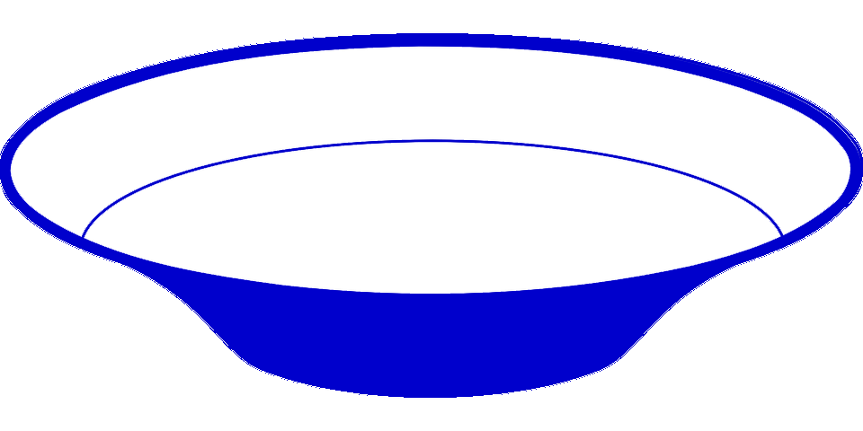

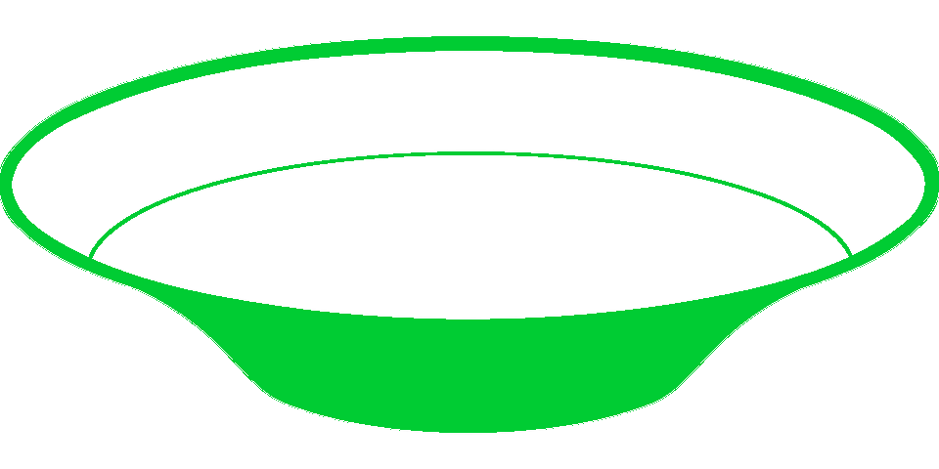

A
B
C
D
chlH
chlD
chlI
cobN
cobT
cobS
cobN
chlD
chlI
fs-chlD
cobN
Frameshifting
Yes
No
Mg-chelatase chlIDH
(Gibson et al. 1995)
Co-chelatase cobNST
(Debussche et al. 1992)
Co-chelatase cobNST
(Rodionov et al. 2003)
Co-chelatase cobNST
(Antonov 2020)

