Slide 1


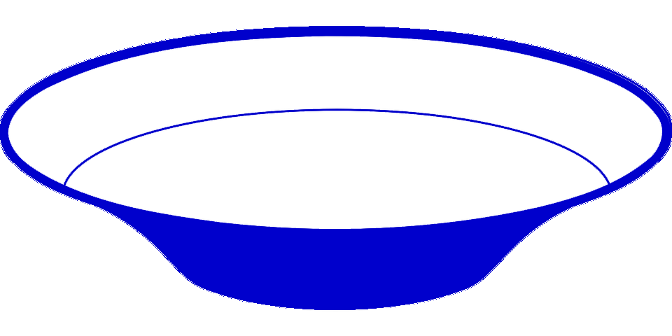
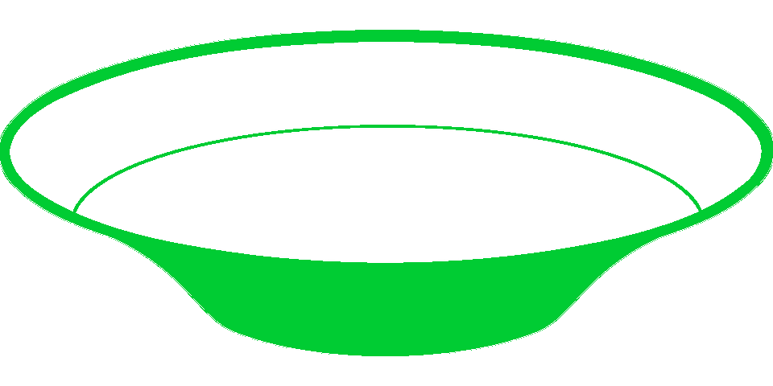

chlD
chlI
cobT
cobS
chlH
cobN
Mg-chelatase chlIDH
Co-chelatase cobNST
Production of Mg-/Co-chelatases from different gene sets | Main taxa
 | Proteobacteria
 | Proteobacteria
 | Cyanobacteria
 | Actinobacteria
 | Proteobacteria Actinobacteria Archaea
 | Proteobacteria Actinobacteria Archaea
chlH
chlD
chlI
Mg-chelatase
chlH
chlD
chlI
cobN
cobT
cobS
Mg-chelatase
Co-chelatase
chlH
chlD
chlI
cobN
Mg-chelatase
Co-chelatase
chlD
chlI
cobN
Co-chelatase
fs-chlD
Frameshifting
cobN
Yes
No
Co-chelatase
chlD
Frameshifting
cobN
No
Yes
Co-chelatase
- chlD gene with a frameshifting signal
- fs-chlD gene with a frameshifting signal and a frameshift mutation

